Slide 1
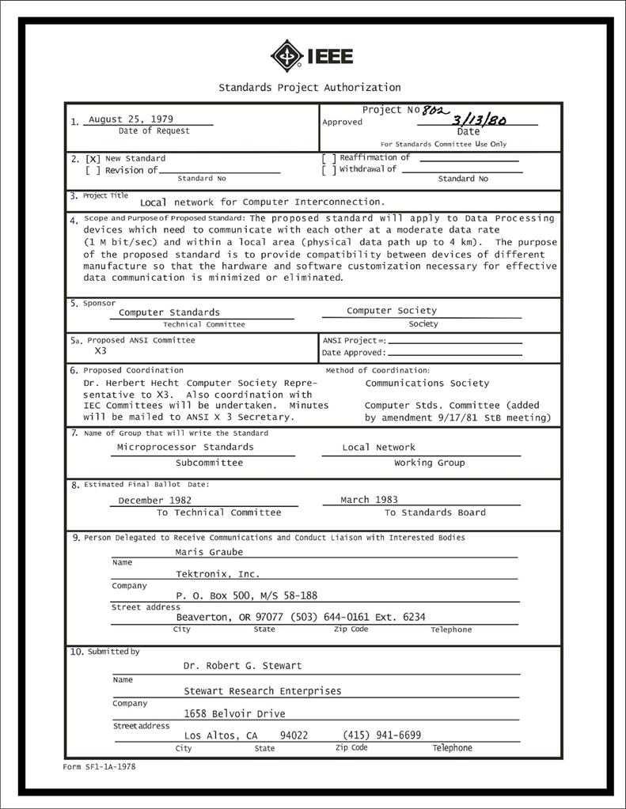
IEEE 802 LMSC Executive Committee 05 APR 2022 Electronic Meeting 19:00-21:00 UTC 15:00-17:00 ET
DCN ec-22-077-02-00EC

Slide 2
1.00 Meeting called to order/role call
2.00 Review/modify/approve agenda
2.01 Participation Slide Set URLs:
https://ieee802.org/sapolicies.shtml
https://standards.ieee.org/content/dam/ieee-standards/standards/web/documents/other/Participant-Behavior-Individual-Method.pdf
Participant behavior is guided by IEEE Code of Ethics & Conduct
Participants shall act independently of others, including employers
Standards activities shall allow the fair & equitable consideration of all viewpoints

Slide 3
3.00 Chair’s Announcements
Proforma:
Use IMAT to log your attendance
Please enable mute when you are not speaking
Please use the Chat function to request being put in the queue
Ongoing preparations for Mixed Mode July Plenary Session
George Zimmerman will be leading the Mixed Mode ad hoc meeting next week 1-2pm pacific time, Tuesday 12 April 2022
802 LMSC Chair on vacation 09 through 17 April 2022
802 LMSC 1st Vice Chair, James Gilb, will be acting 802 LMSC Chair during Nikolich’s absence

Slide 4
3.07 802 Leadership Workshop
Index | Date | Location | Co-lead | Co-lead
8 | 2022 July 16 | Montreal Sheraton | George Zimmerman | Ben Rolfe
7 | 2018 July | San Diego Hyatt | John D’Ambrosia | Glenn Parsons James Gilb
6 | 2016 January | Atlanta Hyatt | David Law
5 | 2014 November | San Antonio Hyatt | Subir Das | Apurva Mody
4 | 2013 November | Dallas Hyatt | Adrian Stephens
3 | 2012 November | San Antonio Hyatt | Roger Marks | Steve Shellhammer
2 | 2011 November | Atlanta Hyatt | Bruce Kraemer | Jon Rosdahl
1 | 2009 July | San Francisco Hyatt | James Gilb | Geoff Thompson

Slide 5
3.07 802 Leadership Workshop
We are overdue for an IEEE 802 LMSC Leadership Workshop. The last one we held was in July 2018 in San Diego. Nikolich suggests we hold a 1 day Leadership Workshop adjacent to the July 2022 plenary session.
George Zimmerman has offered to be co-lead, we need one more volunteer to help organize and lead it.
Potential topics:
a) 802 Overview and Architecture revision
b) impact of emerging technologies, market trends and regulations on evolving 802 standards
c) mixed mode meetings: requirements, best practices, implementation, costs, P&P impact, etc.
d) long term meeting strategy -- remote only, mixed-mode, in-person only
e) tools: stability and evolution to improved platforms
f) assess relationships with regulators, external SDOs and alliances
Please recommend additional topics and to share your thoughts regarding holding a workshop.
July 2018 workshop minutes: https://mentor.ieee.org/802-ec/dcn/18/ec-18-0071-03-00EC-2018-leadership-conference-agenda.xlsx

Slide 6
9.0 EC Action Item Status Review
Action item review
3.02 WG/TAG chairs to send March 2022 WG/TAG webex attendance report to GeorgeZ/JonR
by 12 April 2022
3.07 JonR to issue email requesting potential 802 Leadership Workshop attendees to confirm attendance
by 15 April 2022
3.07 GeorgeZ/BenR to convene 802 Leadership Workshop preparatory meeting
not later than 29 April 2022

Slide 7
Adjourn EC Meeting

