Slide 1
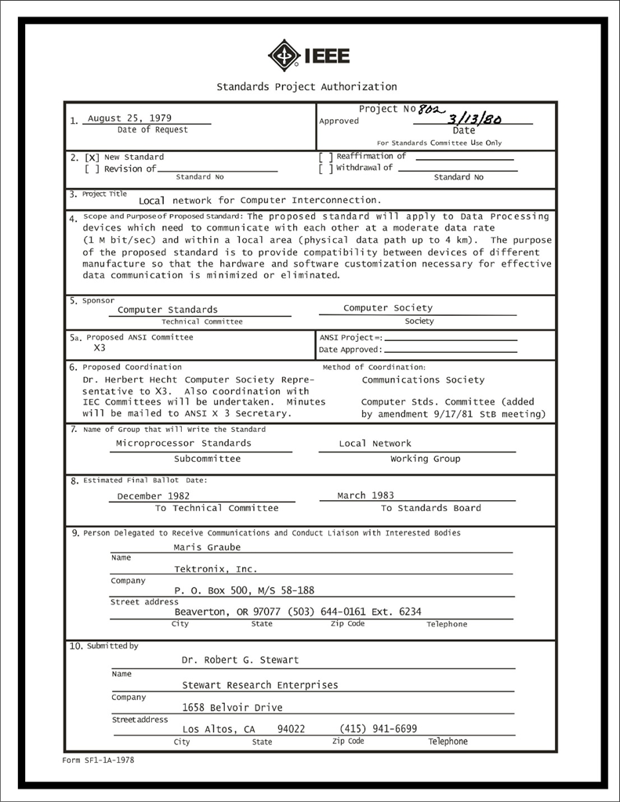
IEEE 802 LMSC
Executive Committee
05 FEB 2022
Electronic Meeting
19:00-21:00 UTC
14:00-16:00 ET
DCN ec-22-077-00-00EC

Slide 2
1.00 Meeting called to order/role call
2.00 Review/modify/approve agenda
2.01 Participation Slide Set URLs:
https://ieee802.org/sapolicies.shtml
https://standards.ieee.org/content/dam/ieee-standards/standards/web/documents/other/Participant-Behavior-Individual-Method.pdf
Participant behavior is guided by IEEE Code of Ethics & Conduct
Participants shall act independently of others, including employers
Standards activities shall allow the fair & equitable consideration of all viewpoints

Slide 3
3.00 Chair’s Announcements
  Proforma:
    Use IMAT to log your attendance
    Please enable mute when you are not speaking
    Please use the Chat function to request being put in the queue
  Ongoing preparations for Mixed Mode July Plenary Session
    George Zimmerman will be leading the Mixed Mode ad hoc meeting next week
    1-2pm pacific time, Tuesday 12 April
  802 LMSC Chair on vacation 09 through 17 April 2022
    802 LMSC 1st Vice Chair, James Gilb, will be acting 802 LMSC Chair during Nikolich’s absence

Slide 4
3.04 802 Leadership Workshop
We are overdue for an IEEE 802 LMSC Leadership Workshop. The last one we held was in July 2018 in San Diego. Nikolich suggests we hold a 1 day Leadership Workshop adjacent to the July 2022 plenary session
Potential topics:
a) 802 Overview and Architecture revision
b) impact of emerging technologies, market trends and regulations on evolving 802 standards
c) mixed mode meetings: requirements, best practices, implementation, costs, P&P impact, etc.
d) long term meeting strategy -- remote only, mixed-mode, in-person only
e) tools: stability and evolution to improved platforms
f) assess relationships with regulators, external SDOs and alliances
Please recommend additional topics and to share your thoughts regarding holding a workshop.
James Gilb and John D'Ambrosia led the July 2018 workshop (see https://mentor.ieee.org/802-ec/dcn/18/ec-18-0071-03-00EC-2018-leadership-conference-agenda.xlsx).
George Zimmerman has offered to be co-lead, we need one more volunteer to help organize and lead it.

Slide 5
9.0 EC Action Item Status Review
Action item review
tbd

Slide 6
Adjourn EC Meeting

