Slide 1

IEEE 802 LMSC
129th Plenary Session
(6th electronic Plenary Session)
04 March 2022 to
18 March 2022
DCN ec-22-0055-01-00EC

Slide 2
3.0 Participant behavior in IEEE-SA activities is guided by the IEEE Codes of Ethics & Conduct
All participants in IEEE-SA activities are expected to adhere to the core principles underlying the:
  IEEE Code of Ethics
  IEEE Code of Conduct
The core principles of the IEEE Codes of Ethics & Conduct are to:
  Uphold the highest standards of integrity, responsible behavior, and ethical and professional conduct
  Treat people fairly and with respect, to not engage in harassment, discrimination, or retaliation, and to protect people's privacy.
  Avoid injuring others, their property, reputation, or employment by false or malicious action
The most recent versions of these Codes are available at
  http://www.ieee.org/about/corporate/governance

Slide 3
3.0 Participants in the IEEE-SA “individual process” shall act independently of others, including employers
The IEEE-SA Standards Board Bylaws require that “participants in the IEEE standards development individual process shall act based on their qualifications and experience”
This means participants:
  Shall act & vote based on their personal & independent opinions derived from their expertise, knowledge, and qualifications
  Shall not act or vote based on any obligation to or any direction from any other person or organization, including an employer or client, regardless of any external commitments, agreements, contracts, or orders
  Shall not direct the actions or votes of other participants or retaliate against other participants for fulfilling their responsibility to act & vote based on their personal & independently developed opinions
By participating in standards activities using the “individual process”, you are deemed to accept these requirements; if you are unable to satisfy these requirements then you shall immediately cease any participation

Slide 4
3.0 IEEE-SA standards activities shall allow the fair & equitable consideration of all viewpoints
The IEEE-SA Standards Board Bylaws (clause 5.2.1.3) specifies that “the standards development process shall not be dominated by any single interest category, individual, or organization”
  This means no participant may exercise “authority, leadership, or influence by reason of superior leverage, strength, or representation to the exclusion of fair and equitable consideration of other viewpoints” or “to hinder the progress of the standards development activity”
This rule applies equally to those participating in a standards development project and to that project’s leadership group
Any person who reasonably suspects that dominance is occurring in a standards development project is encouraged to bring the issue to the attention of the Standards Committee or the project’s IEEE-SA Program Manager

Slide 5
3.02 Fee Waivers
Motion: Approve waiving the plenary session registration fee for the following individuals:
Mover: Glenn Parsons Seconder: John D’Ambrosia
Participant | Affiliation | Rationale
Ms. Jia Xueqin | China Unicom | Attendance at one TSN TG meeting to present TSN demo project in Shenzhen CubeNet3.0
Ms. Zhu Jinyu | China Academy of Information and Communications Technology (CAICT) | Attendance at one TSN TG meeting to present of 5G + TSN Carrier Network Testbed
Mr. Genio Kronauer | L-Acoustics Board of Directors, AVNU Alliance | Attendance at one TSN TG meeting to present future ProAV requirements
Mr. Henning Kaltheuner | d&b audiotechnik Board of Directors, AVNU Alliance | Attendance at one TSN TG meeting to present future ProAV requirements
Mr. Lukas Osswald | University of Tübingen LNI 4.0 member | Attendance at one TSN TG meeting to present LNI 4.0 liaison
Mr. Rob Wilton | Cisco IETF Operations & Management Area Director | Attendance at YANGsters meeting to discuss 802.1 liaison on keystore
Mr. Kent Watsen | Watsen Networks IETF NETCONF & NETMOD co-chair | Attendance at YANGsters meeting to discuss 802.1 liaison on keystore
Mr. Milton Lie | Bell Textron SAE member | Attendance at joint meeting of SAE AS6675 / IEEE 802.1DP

Slide 6
4.00 IEEE Staff
Michelle Turner role: 802 lead editorial support
title: Managing Editor, Content Production Management
Catherine Berger role: 802 editorial support
title: Senior Program & Special Project Manager
Jodi Haasz role: 802 lead
supports: dot03 and dot18 groups
title: Operational Program Management Senior Manager
Christy Bahn role: supports dot11, dot15, dot19 and, dot24 groups
title: Operational Program Management Program Manager
Christian Orlando role: supports dot01
title: Operational Program Management Program Coordinator
NOTE additional staff support:
Erin Morales, Director, Operational Program Managerment (e.spiewak@ieee.org), Ashley Moran, Program Manager, Operational Program Management (a.f.moran@ieee.org), Patricia Roder, Senior Program Manager, Operational Program Management (p.roder@ieee.org), Malia Zaman, Senior Program Manager, Operational Program Management (m.zaman@ieee.org), Jennifer Santulli, Program Manager, Operational Program Management (j.santulli@ieee.org), Tom Thompson, Program Manager, Operational Program Management (thomas.thompson@ieee.org), Vanessa Lalitte (v.lalitte@ieee.org), Program Coordinator, Operational Program Management, Mike Kipness (m.kipness@ieee.org), Program Manager, Operational Program Management

Slide 7
5.01 Chair’s Announcements

Slide 8
5.01 Chair’s Announcements
In person interaction is vital to our productivity and creativity.
  I look forward to a safe and productive return to in person sessions by July 2022.
  Continuing the mixed mode meeting experiment started in July 2021,
  I will conduct the 14:00-18:00 ET 18 March 2022 plenary closing 802 EC meeting in a mixed-mode at the IEEE HQ in Piscataway NJ.
  Interested participants are invited to join us in person while we simultaneously connect to remote participants.

Slide 9
5.01 Chair’s Announcements
  Reminder #1: Please use IMAT to log your attendance
  Reminder #2: Interim EC meeting scheduled for 20:00-22:00 UTC 5 April (15:00-17:00 ET)
  Reminder #3:
  closing EC consent agenda items due 19:00 UTC Wednesday 16 March 2022 (14:00 ET)
  -- 48 hours prior to the start of the closing EC meeting.
  vote tallies in support of consent agenda items due 17:00 UTC Friday 19 March 2022 (12:00 ET)
  -- 2 hours prior to the start of the closing EC plenary meeting.
  Reminder #4:
  Congratulations to David Law for being appointed Standards Board Chair.
  Congratulations to Roger Marks for being appointed Registration Authority Committee Chair.

Slide 10
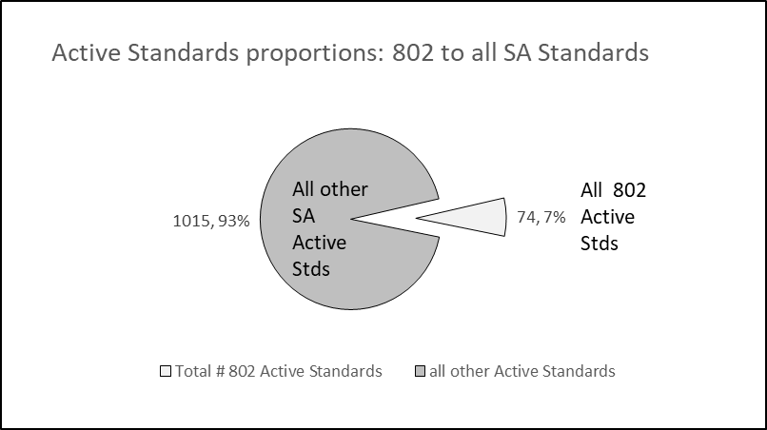
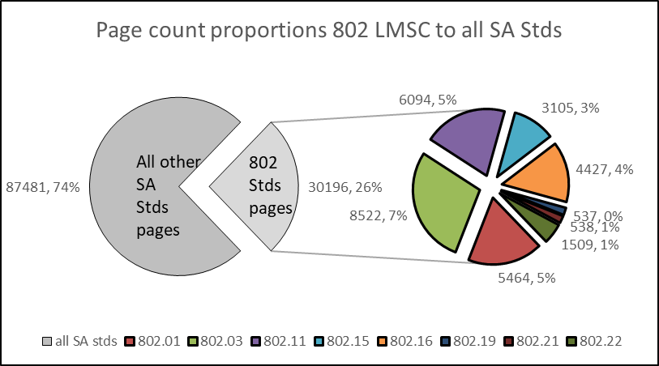
5.01 802 Analytics

Slide 11
5.02 March 2022 802 LMSC Elections
IEEE 802 LMSC Elections to be conducted at the March 2022 Plenary Session
802 Working Group and Technical Advisory Groups to hold elections for Chair and Vice Chair positions during the plenary session
  Reminder to Chairs, please record and report numerical results of all elections
802 Executive Committee Elections/Confirmations at the closing 802 EC meeting
  802 LMSC Chair to be elected by non-appointed EC voting members
  802 LMSC Appointed position candidates to be confirmed by EC voting members
  802 LMSC WG/TAG Chair and Vice Chair position candidates to be confirmed by EC voting members
  Non-voting 802 LMSC position candidates to be confirmed by EC voting members

Slide 12
5.02 802 Chair and Appointed Officer Candidates
Paul Nikolich is standing for re-election as Chair of 802 LMSC
If Nikolich is re-elected, he plans to fill the 802 Appointed Officer positions as follows:
- First Vice Chair - James Gilb, Second Vice-Chair - Roger Marks,
- Recording Secretary - John D’Ambrosia, Executive Secretary - Jon Rosdahl and
- Treasurer - George Zimmerman.
Nikolich also plans to appoint the following individuals to fill the non-voting positions of 802:
- Member Emeritus Treasurer Advisor - Clint Chaplin,
- 802 Member Emeritus-Advisor - Geoff Thompson and
- Hibernating Working Group Chairs:
802.16 - Roger Marks, 802.21 - Subir Das and 802.22 - Apurva Mody.
Details of the March 2022 IEEE 802 LMSC Executive Committee election process are defined in
https://mentor.ieee.org/802-ec/dcn/22/ec-22-0032-00-00EC-march-2022-ec-election-appointment-process.pdf

Slide 13
5.03 IEEE Boards updates
Standards Association Standards Board February 2022
  The SASB recognized the Vehicular Technology Society/Mobile Radio Standards Committee, to be abbreviated as (VT/MRSC), as an official Standards Committee, in accordance with IEEE SASB Bylaws 5.2.2.
  David Law appointed as 2022 SASB Chair
Computer Society BoG & SAB January 2022
  SAB/Roger Marks is working with SA staff to remove ambiguities regarding the definition of a “Standards Development Meeting”
SA BoG December 2021
  The BOG defined a potential AVL (from the IEEE SA perspective) as all BOG/SASB/CAG members and any others who have signed a staff-approved NDA.
IEEE Technical Activities and BoD meetings January/February 2022
  Technical Activities (TA) Committee on Standards continues to encourage initiation of standards activities across all TA Societies and Councils. The VP of Technical Activities has reserved $100k for ‘special projects’. Please contact Paul Nikolich for details.
  The BoD and TAB are planning to return to in person meetings in May/June 2022

Slide 14
5.04 SA Standards Board Actions
802 Project Authorization SASB Approvals December 2021 & February 2022
- New: P802.3df, P802.15.3revision, P802.1ASds, P802.11-2020/Cor1
- Extensions: P802.1ABcu, P802.1ACct
- PAR Modifications: P802.11bb
SASB 802 Standard Ratifications in December 2021 & February 2022
802.1: ABcu, ABdh, Acct, AS/Cor1, BA,CBcv, CBdb
802.15: 802.15.4aa

Slide 15
5.05
LMSC Email Ballot Recap
open date topic yes/no/abs/dnv* result
01DEC Approval of change to WG P&P 10/00/00/03 pass
22DEC Confirm Marc Holness as 802 RAC rep 07/00/00/06 pass
25JAN Liaison to JTC1/SC6 on Deterministic Wireless Industrial Network PWI
10/00/00/03 pass
* 802 chair is counted as DNV unless his vote is required

Slide 16
5.06 EC Affiliation Update
IEEE 802 Executive Committee Members
Position | Name | Affiliation
Chair | Paul Nikolich | Self, HPE, Huawei, YAS BBV Origin Wireless, Wyebot
First Vice Chair | James P. K. Gilb | General Atomics Aeronautical Systems, Inc., Univ of San Diego
Second Vice Chair | Roger Marks | EthAirNet Associates, Huawei
Treasurer | George Zimmerman | CME Consulting, Analog Devices, Marvell, Cisco Systems, CommScope, Sen Tekse LLC, APL Group
Recording Secretary | John D'Ambrosia | Futurewei, a U.S. subsidiary of Huawei
Executive Secretary | Jon Rosdahl | Qualcomm Technologies, Inc.
P802.1 High Level Interface (HILI) | Glenn Parsons | Ericsson
P802.3 Ethernet | David Law | Hewlett Packard Enterprise
P802.11 Wireless Local Area Network (WLAN) | Dorothy Stanley | Hewlett Packard Enterprise
P802.15 Wireless Specialty Networks | Pat Kinney | Kinney Consulting, LLC.
P802.18 Radio Regulatory TAG | Jay Holcomb | Itron Inc.
P802.19 Wireless Coexistence | Steve Shellhammer | Qualcomm Technologies, Inc.
P802.24 Vertical Network Applications TAG | Tim Godfrey | Electric Power Research Institute
Member Emeritus Member Emeritus | Geoff Thompson Clint Chaplin | Self, GraCaSI Standards Advisors Self, Samsung Research America
Hibernating Working Groups
P802.16 Broadband Wireless Access | Roger Marks | EthAirNet Associates
P802.21 Media-independent Handover | Subir Das | Peraton Labs
P802.22 Wireless Regional Area Networks | Apurva Mody | A5 Systems, AiRANACULUS, White Space Alliance

Slide 17
5.06 EC Affiliation Update
Changes in affiliation among EC members from previous slide?

Slide 18
5.07 Drafts to SA Ballot
802.01: none
802.03:
  P802.3cx Improved PTP timestamping accuracy (Conditional)
  P802.3db 100 Gb/s, 200 Gb/s, and 400 Gb/s Short Reach Fiber (Unconditional)
  P802.3de Time Synchronization for Point-to-Point Single Pair Ethernet (Conditional)
802.11: P802.11bd D4.0 Conditional
802.15: P802.15.4-2020/Cor 1
802.19: none

Slide 19
5.08 Drafts to RevCom
802.01: none
802.03: P802.3 (IEEE 802.3dc) Maintenance #16 (Revision) (Conditional)
802.11: none
802.15: none
802.19: none

Slide 20
5.09 Draft Documents or Actions for EC to consider
802.EC: tbd.
802.01: none
802.03: none
802.11: Liaison - P802.11az D4.0 to ISO/IEC JTC1 for information
802.15: none
802.18: none
802.19: none
802.24: none
802/JTC1 SC: report
802/ITU SC: report
802/IETF SC: report
802/Wireless Chairs SC: none
802 Public Visibility Standing Committee: none
20

Slide 21
5.10 Draft PARs to NesCom
P802-Rev Standard - Overview and Architecture
P802.1Qdt Amendment: Priority-based Flow Control Enhancements
P802.1DU Standard for Cut-Through Forwarding Bridges and Bridged Networks
P802.3dg 100Mb/s Operation and Associated Power Delivery over a Single Balanced Pair of Conductors
P802.15.6ma Wireless Body Area Networks revision
48 hour maintenance policy PARs
P802.3dh Multi-Gigabit Graded-index Plastic Optical Fiber Automotive Ethernet
PAR Modification Request P802.3cz Multi-Gigabit Graded-index Glass Optical Fiber Automotive Ethernet
PAR withdrawal requests:
P802.15.12 Enhanced Ultra Wide-Band (UWB)
P802.15.6a Dependable Human and Vehicle Body Area Networks w

Slide 22
5.11 Pre-PAR activity
Group | New | Existing
dot01 | none | IC: IEEE 802 Network Enhancements for the Next Decade IC Activity (Nendica)
dot03 | none | SG: Greater than 10 Mb/s long-reach point-to-point single pair Ethernet PHY Enhancements to Single Pair Ethernet (2nd recharter & extension) IC: New Ethernet Applications (NEA)
dot11 | none | Standing Committees Wireless Next Generation

Slide 23
5.11 Pre-PAR activity
Group | New | Existing
dot15 | none | Interest Groups: Link Dependability, UWB Standing Committees: TeraHertz
dot19 | none | none
dot24 | none | none
dot ECSG | none | none

Slide 24
5.12 802/SA Task Force Topics
802/SA Task Force Electronic Meeting held Monday 31 January 2022 16:00-17:00 ET
Meeting notes at ec-22-0028-00-00EC-31jan2022-802-sa-task-force-mtg-notes.docx
Agenda:
Action Items:
AI: Markus to share IEEE IT recommendations and rough schedule with 802 at the next 802/SA Task Force meeting 28 FEB 2022
AI: Markus to investigate SA’s ability to support mixed mode meetings and report back at the next 802/SA Task Force meeting 28 FEB 2022
AI: Nikolich to ask Zimmerman to supply 802’s mixed mode meeting requirements based on his ad-hoc Mixed Mode Meeting Best Practices draft 28 FEB 2022
AI: Markus to ask Adam Newman if he can put PLAN B into action and report back to the 802 EC as soon as possible. PLAN B consists of contacting the original Mentor SW developer, Biveo, or a SW contractor with the skills to refactor Mentor into a maintainable SW platform to eliminate the risk of Mentor failing.
Next 802/SA TF Meeting Tentatively Scheduled for 4-5pm ET Monday 21 March 2022

Slide 25
5.13 EC Action Item recap
Review Recording Secretary’s list of Open Action Items

Slide 26
5.14 802 Restructuring ad hoc Update
Status of remaining work items
  d. Hybrid Meeting Evaluation split into two sub-ad hocs
  d.1 Mixed Mode Best Practices (GeorgeZ) in process of drafting a document
  d.2 Future Meeting Vision (AndrewM) in process of establishing a long term vision for effective 802 sessions
Next meeting tentative scheduled for 13:00-14:00pm ET Tuesday15 March 2022
Potential follow on activity: Organizing an 802 LMSC Leadership Workshop
The last Workshop was held in July 2018.
Is there interest in conducting a 1 day Workshop in July 2022?

Slide 27
5.14 802 Next Gen Technologies Workshop
Goals:
Provide a platform for 802 groups to exchange information on their next-gen activities
Provide a platform for developers of early-stage technologies (e.g., academic and industrial researchers), to get familiar with early stage 802 activities and introduce their early-stage technologies to the 802 community.
Feedback from 02 March 2022 Workshop
mixed
seeking feedback on improving the format
possible topic for 802 LMSC Leadership Workshop

Slide 28
5.14 802 LMSC Leadership Workshop
Potential follow on activity to the Restructuring ad hoc:
Organizing an 802 LMSC Leadership Workshop. The last Workshop was held in July 2018.
Is there interest in conducting a 1 day Workshop in July 2022?
Potential topics:
a) 802 Overview and Architecture revision
b) impact of emerging technologies, market trends and regulations on evolving 802 standards
c) mixed mode meetings: requirements, best practices, implementation, costs, P&P impact, etc.
d) long term meeting strategy -- remote only, mixed-mode, in-person only
e) tools: stability and evolution to improved platforms
f) assess relationships with regulators, external SDOs and alliances
g) 802 Next Gen Technologies Workshop improvements

Slide 29
5.15 802 IEEE Milestone Project Status Update
Geoff Thompson and Stuart Kerry to report

Slide 30
11.0 Cross 802 Activities EC Meeting Schedule
(all times ET)
LMSC Rules 16:00-18:00 Tue 01 MAR
Next Gen Technology Workshop 16:00-17:00 Wed 02 MAR
Technical Plenary 9:00-11:00 Thu 03 MAR
Orientation 10:00-11:00 Fri 04 MAR
Opening EC Meeting 15:00-17:00 Fri 04 MAR
802/JTC1 Stdng Cmte 16:00-18:00 Tue 08 MAR
Public Visibility Stdng Cmte 15:00-16:00 Wed 09 MAR
Restructuring Ad Hoc 13:00-14:00 Tue 15 MAR
802/ITU Stdg Cmte 16:00-17:00 Wed 16 MAR
Closing EC Meeting 14:00-18:00 Fri 18 MAR

Slide 31
End of Opening EC Meeting

