Slide 1
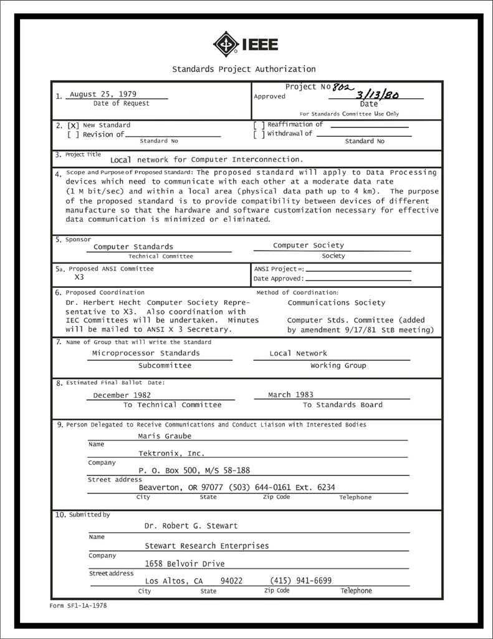
IEEE 802 LMSC Executive Committee 01 FEB 2022 Electronic Meeting 19:00-21:00 UTC 14:00-16:00 ET
DCN ec-22-030-00-00EC

Slide 2
1.00 Meeting called to order/role call
2.00 Review/modify/approve agenda
2.01 Participation Slide Set URLs:
https://ieee802.org/sapolicies.shtml
https://standards.ieee.org/content/dam/ieee-standards/standards/web/documents/other/Participant-Behavior-Individual-Method.pdf
Participant behavior is guided by IEEE Code of Ethics & Conduct
Participants shall act independently of others, including employers
Standards activities shall allow the fair & equitable consideration of all viewpoints

Slide 3
3.00 Chair’s Announcements
Proforma:
Use IMAT to log your attendance
Please enable mute when you are not speaking
Please use the Chat function to request being put in the queue
March Plenary Session will be 100% electronic
May Interim Sessions are still undecided and up to the Working Groups – I encourage WGs to seriously consider a mixed mode approach.
Preparations for Mixed Mode July Plenary Sessions are underway.

Slide 4
9.0 EC Action Item Status Review
Action item review
tbd

Slide 5
Adjourn EC Meeting

