Slide 1
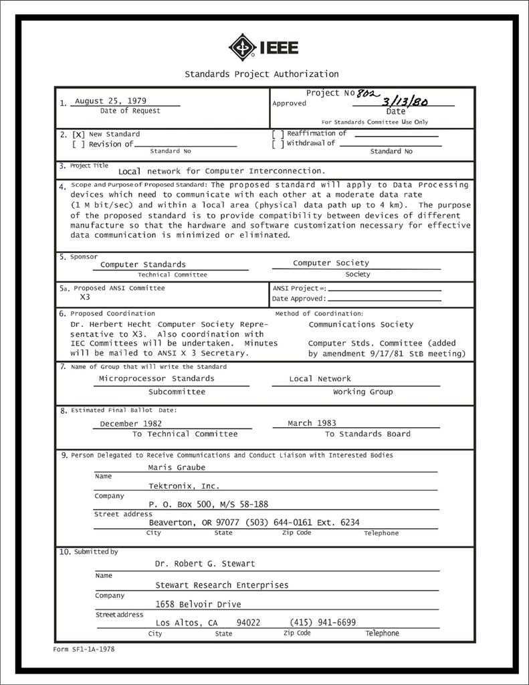
IEEE 802 LMSC Executive Committee 04 JAN 2022 Electronic Meeting 19:00-21:00 UTC 14:00-16:00 ET
DCN ec-22-008-01-00EC

Slide 2
1.00 Meeting called to order/role call
2.00 Review/modify/approve agenda
2.01 Participation Slide Set URLs:
https://ieee802.org/sapolicies.shtml
https://standards.ieee.org/content/dam/ieee-standards/standards/web/documents/other/Participant-Behavior-Individual-Method.pdf
Participant behavior is guided by IEEE Code of Ethics & Conduct
Participants shall act independently of others, including employers
Standards activities shall allow the fair & equitable consideration of all viewpoints

Slide 3
3.00 Chair’s Announcements
Proforma:
Use IMAT to log your attendance
Please enable mute when you are not speaking
Please use the Chat function to request being put in the queue
January Interim Sessions will be 100% electronic
March Plenary Session will be 100% electronic
May Interim Sessions are still undecided and up to the Working Groups – perhaps some WG will decide on a mixed mode approach.
We need begin preparations for Mixed Mode July Plenary Sessions now.

Slide 4
3.07 14/16 DEC 2021 Exec Session Report
• Contract Negotiations on the March 2022 cancellation will result in a significant penalty fee not anticipated on December 7th, 2021.
• Registration for the March 2022 Plenary will be suspended immediately until a new Fee Structure for the plenary is determined to address the penalty fee.
• The discussion of the new fee structure will occur on the STDS-802-SEC reflector and an email motion will be conducted.

Slide 5
9.0 EC Action Item Status Review
Action item review
tbd

Slide 6
Adjourn EC Meeting

