Slide 1
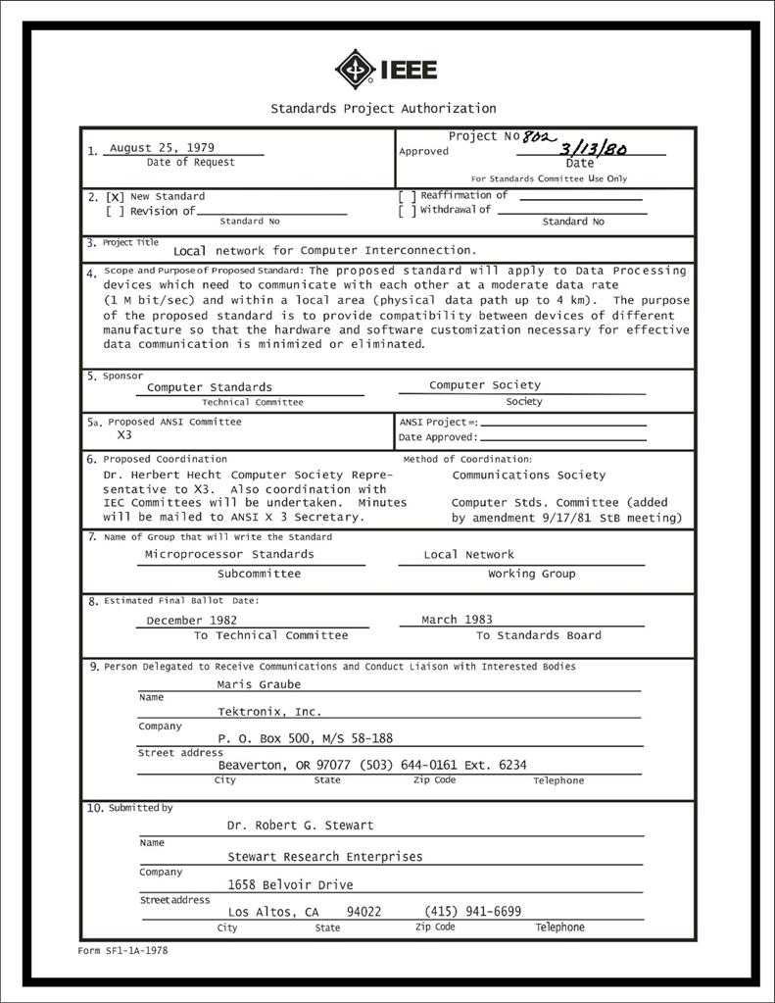
IEEE 802 LMSC Executive Committee 04 JAN 2022 Electronic Meeting 19:00-21:00 UTC 14:00-16:00 ET
DCN ec-22-0xxx-00-00EC

Slide 2
1.00 Meeting called to order/role call
2.00 Review/modify/approve agenda
2.01 Participation Slide Set URLs:
https://ieee802.org/sapolicies.shtml
https://standards.ieee.org/content/dam/ieee-standards/standards/web/documents/other/Participant-Behavior-Individual-Method.pdf
Participant behavior is guided by IEEE Code of Ethics & Conduct
Participants shall act independently of others, including employers
Standards activities shall allow the fair & equitable consideration of all viewpoints

Slide 3
3.00 Chair’s Announcements
Reminder #1: Use IMAT to log your attendance
Reminder #2: Please enable mute when you are not speaking
Reminder #3: Please use the Chat function to request being put in the queue
Reminder #4: January Interim Sessions will be 100% electronic
Reminder #5: March Plenary Session will be 100% electronic
Reminder #6: We need begin preparations for Mixed Mode July Plenary Sessions now.

Slide 4
9.0 EC Action Item Status Review
Action item review
tbd

Slide 5
Adjourn EC Meeting

