Slide 1
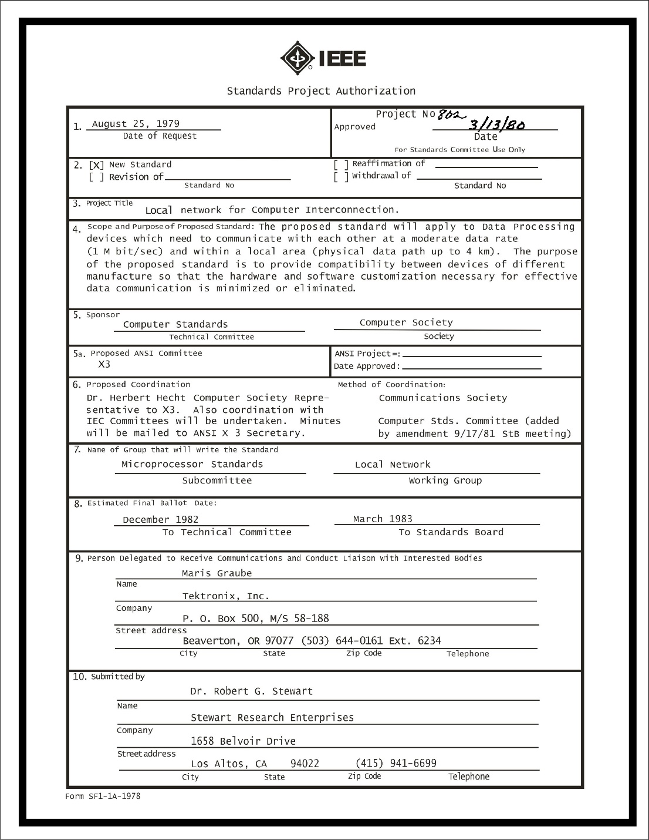

IEEE 802 LMSC
128th Plenary Session
(5th electronic Plenary Session)
05 November 2021 to
19 November 2021
Closing EC Meeting
DCN ec-21-0288-00-00EC

Slide 2
2.0 Participant behavior in IEEE-SA activities is guided by the IEEE Codes of Ethics & Conduct
All participants in IEEE-SA activities are expected to adhere to the core principles underlying the:
  IEEE Code of Ethics
  IEEE Code of Conduct
The core principles of the IEEE Codes of Ethics & Conduct are to:
  Uphold the highest standards of integrity, responsible behavior, and ethical and professional conduct
  Treat people fairly and with respect, to not engage in harassment, discrimination, or retaliation, and to protect people's privacy.
  Avoid injuring others, their property, reputation, or employment by false or malicious action
The most recent versions of these Codes are available at
  http://www.ieee.org/about/corporate/governance

Slide 3
2.0 Participants in the IEEE-SA “individual process” shall act independently of others, including employers
The IEEE-SA Standards Board Bylaws require that “participants in the IEEE standards development individual process shall act based on their qualifications and experience”
This means participants:
  Shall act & vote based on their personal & independent opinions derived from their expertise, knowledge, and qualifications
  Shall not act or vote based on any obligation to or any direction from any other person or organization, including an employer or client, regardless of any external commitments, agreements, contracts, or orders
  Shall not direct the actions or votes of other participants or retaliate against other participants for fulfilling their responsibility to act & vote based on their personal & independently developed opinions
By participating in standards activities using the “individual process”, you are deemed to accept these requirements; if you are unable to satisfy these requirements then you shall immediately cease any participation

Slide 4
2.0 IEEE-SA standards activities shall allow the fair & equitable consideration of all viewpoints
The IEEE-SA Standards Board Bylaws (clause 5.2.1.3) specifies that “the standards development process shall not be dominated by any single interest category, individual, or organization”
  This means no participant may exercise “authority, leadership, or influence by reason of superior leverage, strength, or representation to the exclusion of fair and equitable consideration of other viewpoints” or “to hinder the progress of the standards development activity”
This rule applies equally to those participating in a standards development project and to that project’s leadership group
Any person who reasonably suspects that dominance is occurring in a standards development project is encouraged to bring the issue to the attention of the Standards Committee or the project’s IEEE-SA Program Manager

Slide 5
3.00 Chair’s Announcements

Slide 6
3.00 Chair’s Announcements
  Reminder #1: Use IMAT to log your attendance
  Reminder #2: Interim EC meeting scheduled for 20:00-22:00 UTC 7 December (15:00-17:00 ET)
  Reminder #3: This closing 802 EC meeting is being held in a mixed-mode, with in person participants at the IEEE HQ in Piscataway NJ.
  Reminder #4: IEEE Fellow Nominations
  The SA Fellows Committee will help Senior Members with significant technical standards experience prepare a nomination for elevation to IEEE Fellow. Contact Paul Nikolich or Doug Zuckerman, FelCom Chair (d.zuckerman@ieee.org) for details.

Slide 7
3.00 EC/WG/TAG plenary meetings

Slide 8
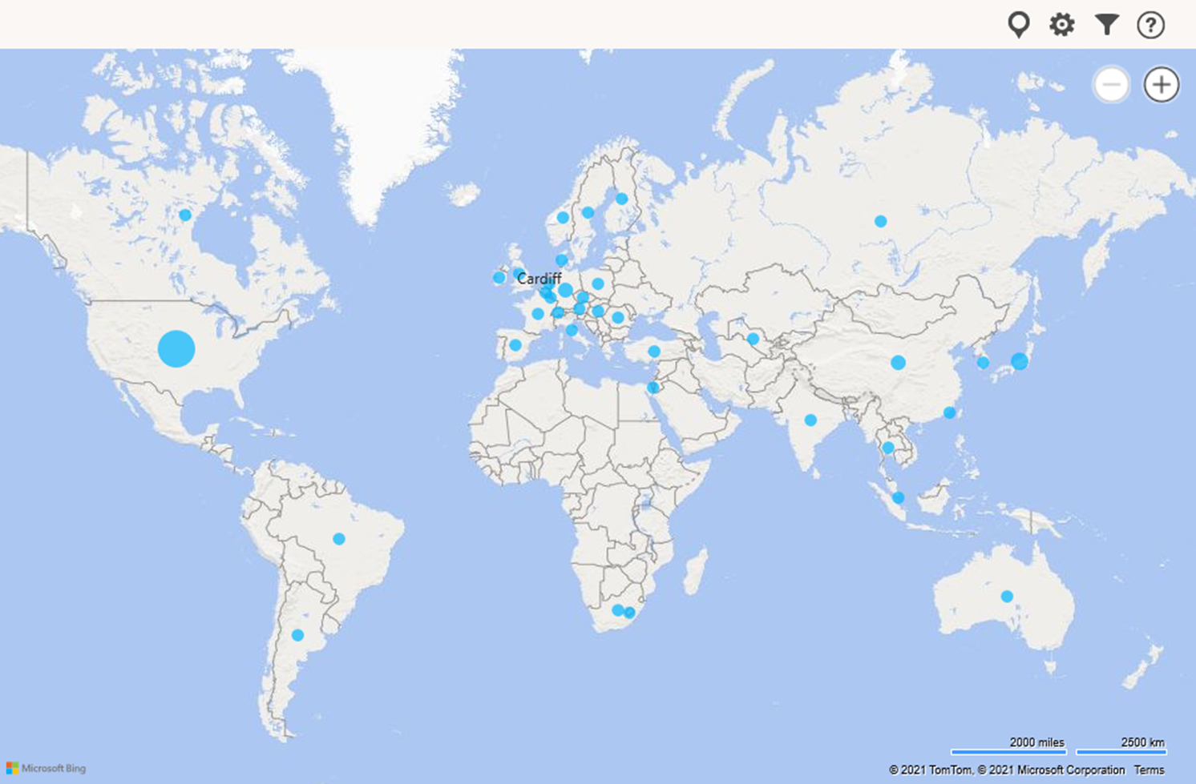
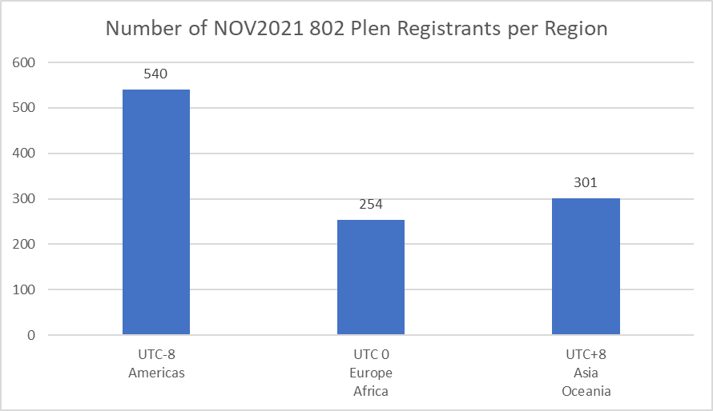
Geographic Distribution of Nov 2021 Registrants
mean time zone of all 802 registrants = UTC -0.4

Slide 9
4.0x Meeting Fee Waiver
Invited Guests
Motion: Fee waiver request: Monisha Ghosh
Grant a retrospective fee waiver to Monisha Ghosh (University of Chicago) for the November 2021 IEEE 802 plenary session.
Moved: Stanley
Second: Rosdahl
__Y/__N/__A

Slide 10
4.0x Meeting Fee Waiver
Invited Guests
Motion: Confirm meeting fee waivers for the November 2021 IEEE 802 Electronic Plenary for DAVID DAZET, COMPLEX SALES MANAGER, HILTON ORLANDO LAKE BUENA VISTA
Moved: Jon Rosdahl
Seconded: George Zimmer
__Y/__N/__A

Slide 11
4.0x 802 Restructuring ad hoc Status
Status
  1. 802 Mission/Purpose for Chair’s Guideline complete (RogerM).
  2. Sub Ad Hocs
  a. Operational Efficiency (BenR) submitted P&P changes to improve efficiency
  b. Strategic Planning (PaulN) schedule additional Next Gen Workshops
  c. Technical Coherence (RogerM) 802 O&A revision assigned to 802.1/NENDICA
  d. Hybrid Meeting Evaluation split into two sub-ad hocs
  d.1 Mixed Mode Best Practices (GeorgeZ) in process of drafting a document
  d.2 Future Meeting Vision (AndrewM) in process of establishing a long term vision for effective 802 sessions
Next meeting 13:00-14:00pm ET Tuesday 14 December 2021
  Summarize results, formulate a 2021 report, discuss 2022 plans

Slide 12
4.0x EC Action Item recap
Review Recording Secretary’s list of Open Action Items

Slide 13
x.xx 802/SA Task Force Meeting Reminder
802 Task Force Electronic Meeting held Monday 18 Oct 2021 16:00-17:00 ET
Meeting notes at ec-21-0241-00-00EC on Mentor
Agenda:
Action Items:
AI: Markus to bring rough schedule to next 802/SA Task Force meeting 13 DEC 2021
AI: Markus to seek feedback from 802 on Mentor & Equivalent Tools after a IEEE IT review

Slide 14
5.15 802 IEEE Milestone Project Status Update
Geoff Thompson to report

Slide 15
11.01 Any Other Business
tbd

Slide 16
End of Closing EC Meeting

