Slide 1
IEEE 802 Networking Standards
– Next Gen Technologies Workshop
03 November 2021 DCN ec-21-0257-01-00EC

Slide 2
Housekeeping
Moderator and Presenters, please turn on your video, if available. Everyone else, video off please.
Everyone please go on mute, except for the presenter and moderator.
When a participant wants to speak/comment, please use the Chat function to request to be put on the Queue. Paul Nikolich will monitor the Chat and let you know when to speak.
Paul Nikolich will take and publish notes. However, feel free to send Nikolich your observations and notes, I will incorporate them into the Workshop’s published notes.
In order to know who is participating in the workshop, please send an email with “802 Workshop” in the subject line to p.nikolich@ieee.org indicating your participation

Slide 3
Per IEEE Standards Association Standards Board Bylaws, Mar 2019
  “At lectures, symposia, seminars, or educational courses, an individual presenting information on IEEE standards shall make it clear that his or her views should be considered the personal views of that individual rather than the formal position of IEEE.”

Slide 4
Introductory Remarks, Nikolich, 5 minutes

Slide 5
IEEE Networking Standards: Next Gen Technology Workshop
Goals:
Provide a platform for 802 groups to exchange information on their next-gen activities
Provide a platform for developers of early-stage technologies (e.g., academic and industrial researchers), to get familiar with early stage 802 activities and introduce their early-stage technologies to the 802 community.
Outcomes:
Enable the wider 802 community to become familiar with all 802 next gen activities and identify opportunities for cross-802 collaboration and synergies
Familiarize researchers on the 802 process, introduce them to the 802 community and enable them to make their research more relevant to the interests of the 802 community. Ideally, some of these early-stage technologies could eventually be incorporated in to a relevant 802 standard project.

Slide 6
IEEE Networking Standards: Next Gen Technology Workshop
Agenda: Introduction, 5 minutes, Nikolich
a) leaders of 802 next gen activity present ~5 minutes on their activities: (30 minutes total):
- Roger Marks on 802.1 Nendica
- Jon Lewis on 802.3/New Ethernet Applications
- Jim Lansford on 802.11 Wireless LANs Next Generation
- Ben Rolfe on 802.15 Wireless Specialty Networks Next Generation
- Tim Godfrey on 802.24 Vertical Network Applications
b) open discussion exploring collaborative next-gen opportunities across 802 (15 minutes, Nikolich)
c) brainstorm with 802 participants and researchers on new next gen topics (30 minutes, Restuccia)
Two presenters from academia will share their thoughts and lead the discussion:
- Francesco Restuccia, Northeastern University, “Can AI-driven Technologies Revolutionize IEEE 802 Standards?”
- Josep Jornet, Northeastern University, "The Role of the Spectrum Above 100 GHz: Reality Check”
d) organize next steps to continue next gen 802 work (15 minutes, Nikolich)

Slide 7

Examples of current 802 market drivers
Source - Inphi blog post 'Bandwidth in the Age of COVID-19' posted 22nd April 2020 by Ford Tamer, President and CEO, Inphi Corporation <https://www.inphi.com/blog/>

Slide 8
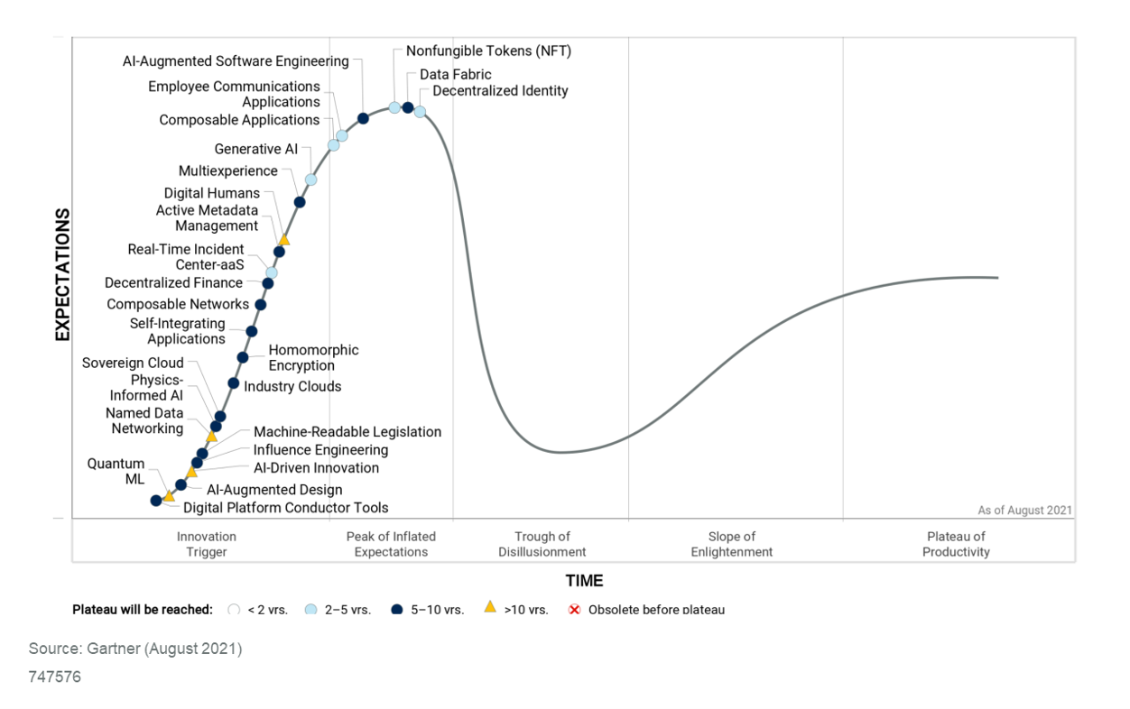
Early stage tech drivers -- Gartner Hype Cycle Model
potential 802 technologies?
Typical 802 activities

Slide 9
802 groups present their next gen activities
In order to know who is participating in the workshop, please send an email with “802 Workshop” in the subject line to p.nikolich@ieee.org indicating your participation

Slide 10
IEEE Networking Standards: Next Gen Technology Workshop
Agenda: Introduction, 5 minutes, Nikolich
a) leaders of 802 next gen activity present ~5 minutes on their activities: (30 minutes total):
- Roger Marks on 802.1 Nendica
- Jon Lewis on 802.3/New Ethernet Applications
- Jim Lansford on 802.11 Wireless LANs Next Generation
- Ben Rolfe on 802.15 Wireless Specialty Networks Next Generation
- Tim Godfrey on 802.24 Vertical Network Applications
b) open discussion exploring collaborative next-gen opportunities across 802 (15 minutes, Nikolich)

Slide 11
IEEE Networking Standards: Next Gen Technology Workshop
Agenda:
c) brainstorm with 802 participants and researchers on new next gen topics (30 minutes, Restuccia)
Two presenters from academia will share their thoughts and lead the discussion:
- Francesco Restuccia, Northeastern University, “Can AI-driven Technologies Revolutionize IEEE 802 Standards?”
- Josep Jornet, Northeastern University, "The Role of the Spectrum Above 100 GHz: Reality Check”
--Open Discussion

Slide 12
Brainstorm presentations and discussion, 30 minutes
In order to know who is participating in the workshop, please send an email with “802 Workshop” in the subject line to p.nikolich@ieee.org indicating your participation

Slide 13
Potential Brainstorm Topics
Francesco Restuccia/NEU: Can AI-driven Technologies Revolutionize IEEE 802 Standards?
Josep Jornet/NEU: The Role of the Spectrum Above 100 GHz: Reality Check
Paul: Convergence – wired/wireless/unlicensed/licensed packet data networks – when and how? Spectrum sharing, Machine Learning PHY enhancements, Network Infrastructure Energy Efficiency, Quantum Communication, Human/Machine Communication Interface
Dorothy: Full Duplex, AI, IoT, Terahertz, Machine Learning, WLAN evolution, mmWave Beamforming, private dedicated spectrum networks, coexistence techniques/evolution
Ben: Coexistence – leverage learning techniques, challenges of hybrid wless operation, intelligent channel access
Tim: High reliability wless, shortage of spectrum, dynamic spectrum, explore leveraging licensed spectrum, coordination of wired and wireless technology for integration
Roger: Cut Through Forwarding, TSN—coordinating links is a challenge for wless, e.g. 802.11 represents an opportunity for coordination/management/scheduled/facility control
Jim: Unlicensed QoS/QoE challenges
George: Return to half-duplex for CSMA/CD networks, automation applications for 802.3
Identify topics for a deeper dive during follow on meetings, possibly in December 2021

Slide 14
IEEE Networking Standards: Next Gen Technology Workshop
Agenda:
d) organize next steps to continue next gen 802 work (15 minutes, Nikolich)
In order to know who is participating in the workshop, please send an email with “802 Workshop” in the subject line to p.nikolich@ieee.org indicating your participation

Slide 15
Organize Next Steps
Identify topics for in depth follow up meeting(s), possibly in December 2021
  Choose a few topics from the brainstorm discussion for follow up
Should we hold similar workshops on a regular basis?
  Annually around the November plenary?
  More often?
  How can we improve the workshop structure and content?

Slide 16
IEEE Networking Standards: Next Gen Technology Workshop
Agenda:
e) Adjourn -- thank you for participating
In order to know who is participating in the workshop, please send an email with “802 Workshop” in the subject line to p.nikolich@ieee.org indicating your participation

