Slide 1
IEEE 802 July 2021 Public Visibility Standing Committee Report
IEEE 802 Jul 2021 Plenary
Opening Mtg – 09 July 2021

Slide 2
Agenda – Wed, July 21 Time: 3pm to 4:00pm ET, Meeting Info
Agenda
Review of Social Media Stats
Public Visibility Metrics
Future Tech Talks
Preparations - Ethernet 50th Anniversary in 2023
Other content

Slide 3
Social Media Related Tools
Twitter
Twitter (@IEEE802)
216 followers
Last 90 days (Apr 5 – Jul 6)
6k impressions
LinkedIn
229 followers (+21% since Mar 21)

Slide 4
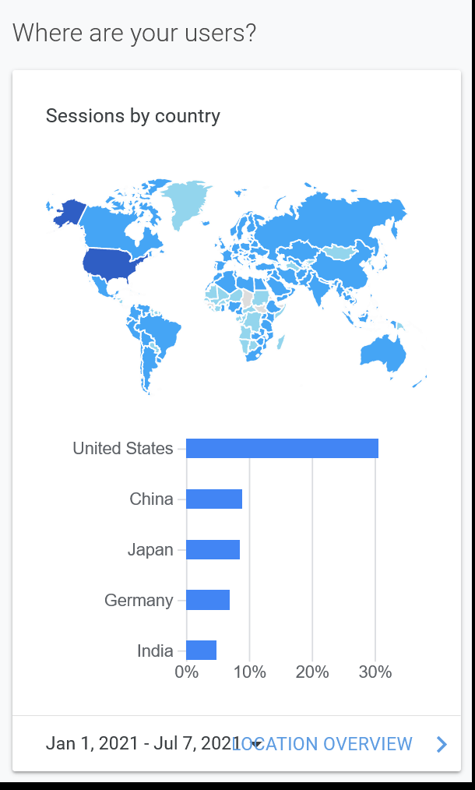
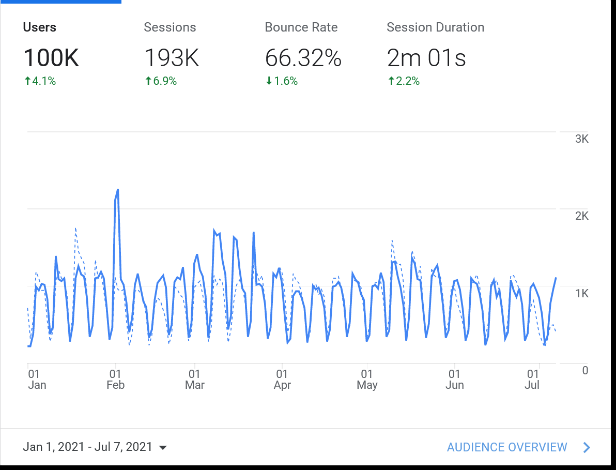
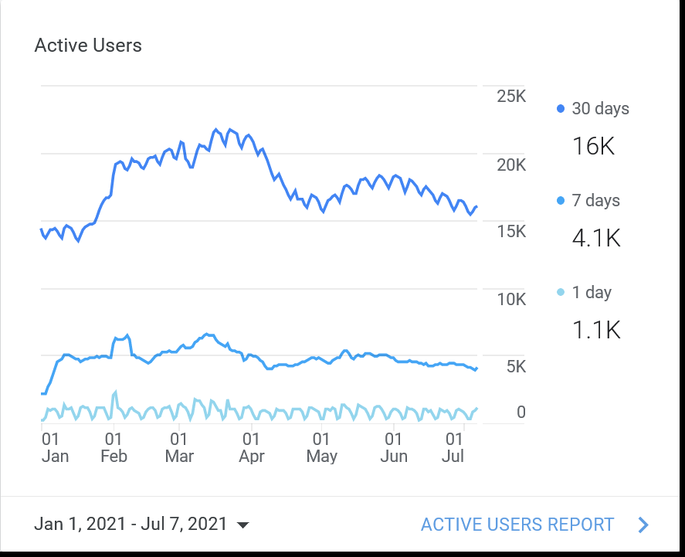
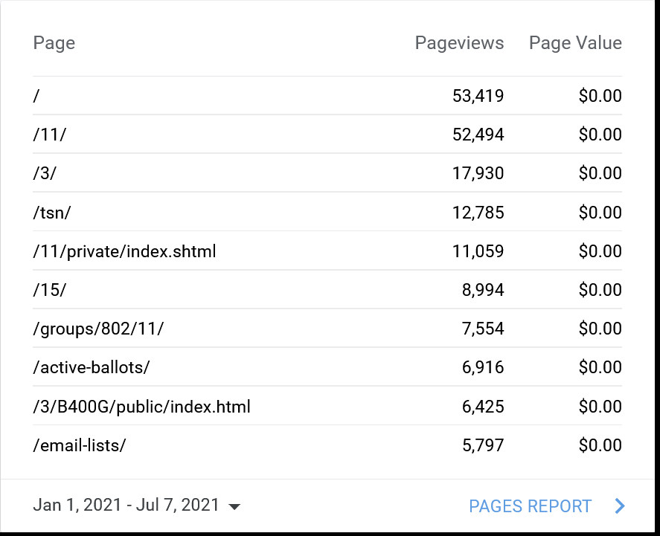
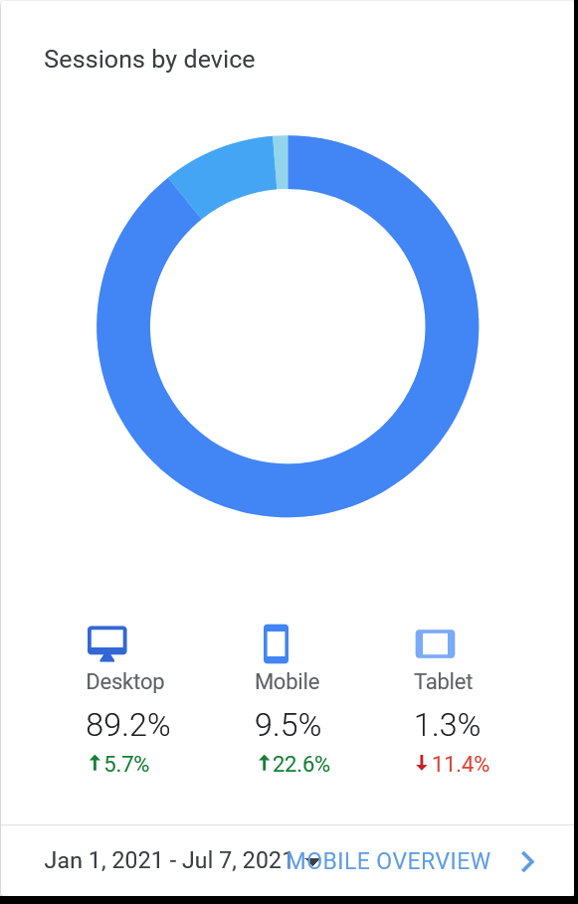
Google Analytics 802 (Jan 1 – Jul 7, 2021)

Slide 5
Content Efforts - IEEE EA Tech Talks
Reference - https://innovationatwork.ieee.org/events/techtalk-panel-802/
Recordings of Tech Talks available at above URL
Past Talks Views as of 7/7
IEEE 802: Connecting the World Views - 434
Ethernet Broadband Assessment Views - 154
Industrial Ethernet Views – 116
WLAN Sensing (Hanxiao, Da Silva) Views - 146
IEEE 802.22: TV White Space (Mody) Views - 98
IEEE 802.3: State of Ethernet (Law) Views - 181
IEEE 802.18: 802 and the Regulatory World (Holcomb) Views – 89
IEEE 802 & 802.24 (Godfrey) Views – 105
IEEE 802.11: State of Wireless (Stanley) Views – 120
Preparations for new 2021- 2022 series underway

Slide 6
Closing Report Update
To Be added

Slide 7
Backup

Slide 8
802 Public Visibility SC Scope, Duties, Membership
Scope and Duties
To raise industry awareness in timely fashion of IEEE 802 WG / TAG activities
Develop social media content based on IEEE 802 WG / TAG activities
Twitter - https://twitter.com/ieee802
LinkedIn – https://www.linkedin.com/company/ieee802
IEEE-SA 802 - https://standards.ieee.org/featured/802/index.html
Content
Review Pre 802 Plenary meetings for social media messaging: PARs to be considered, Tutorials, [802.3] Call-for-Interests, New Task Force formations
Review Post 802 Plenary meetings for social media messaging: Study Group formations, IEEE 802 Position Approvals
Other 802 related material for social media messaging: Press Releases, White Paper publications, Other 802 approved news, 802 WG / TAG Activities with IEEE-SA
IEEE-SA Standards Board Related - PAR Approvals, Standards Approval, Standards Publication,
Membership
Membership in the Standing Committee is open to anyone that wishes to participate (ideally at least one participant from each 802 WG and TAG)

