Slide 1
IEEE 802 LMSC Restructuring ad hoc
Operational Efficiency Sub-ad hoc
19 April 2021
DCN ec-21-0065-02-00EC

Slide 2
Goals
  PAR Process:
    Document a proposed review process to present to the EC
      Consider greater consistency across working groups?
    Identify other efficiency improvement in PAR/CSD
      Review CSD format for updates/improvement?
      Other steps we should add/delete/modify?
  Training:
    Better characterize the issues in the current process (define the problem)

Slide 3
Agenda
Proposed Agenda
Review
Discuss ideas for PAR process improvements
Plan for work on improving leadership training
AoB

Slide 4
Actions
Schedule virtual meeting to develop PAR process proposal
  Ben
Present to EC in April call
  Ben and everyone who joins the call

Slide 5
Operational Efficiency Ideas: PARs
Adopt handling PARs in between plenary sessions
  Allow consideration on monthly EC interim electronic meetings that precede a NesCom meeting
  Retain the same review process level of rigor
  > 30 day review period
  Can announce prior to EC call n, review by EC on call n+1
  Additional work for WGs:
    Need to review PARs on monthly (electronic or in person)
    Otherwise the same process
  Additional work for EC
    Need to review PARs more often
    May or may not see more PARs
    So workload likely distributed more evenly

Slide 6
Requirements for the PAR review process
Maintain or improve upon current level of review rigor
  Assure PARs and CSDs get the same or greater exposure
  Ensure enough time for review, comment, revision and response
  Posting and noticing at least 30 (45?) days ahead of EC meeting
Possible improvements:
  Improve the technical review of PARs
  More flexibility and time for groups to review and prepare comment
  More time for originating group to improve based in input
  Could increase review period and still improve response and efficiency
Align with NESCOM schedule
  More opportunities to move new projects forward
  NESCOM schedule varies year by year (??)

Slide 7
Par Review Considerations
Possibly 7 PAR review cycles per year
But fewer PARs per cycle
  Typically from 10 to 20 PARs per year
  Number of projects per year likely to stay the same
Spreads the work out over more time
Group review process may change
  Dot-3 and Dot-11 have a PAR review meeting
  Dot-11
    2 meetings during plenary
    WG Opening – identify PARs to review and PAR review meeting
    Initial comments brought to mid week
    Second meeting to go over replies to comments, result brought to closing
  Anytime after PAR+CSD is available comments can be collected to discuss at the meeting
  So prep time before review meeting is valuable
  Comments are usually sent informally to originating WG
  Could be done via virtual meeting

Slide 8
Technical Quality of PAR Review
Lack of consistency across (and even within) WGs
  Coherence of 802 “brand”
  Maintaining the high technical quality of 802 standards
Need to identify criteria for “technical quality”
  Need metrics
Action: Paul to call Geoff and define “technical quality”
  Work in progress
  Nontrivial effort (Geoff POV, not a checklist)
  Need clarity on the goals
  Overlap with the technical coherence ad hoc

Slide 9
Proposed Recommendation
Amend rules to allow consideration at any duly noticed EC meeting
  Identify the necessary rules that need to change
  Develop proposed text for rules committee
Develop annual calendar for 802 PAR review process
  Posting (submission) deadlines, comment deadline, Response / revision deadline
  Depends on IEEE-SA Standards Board (SASB) calendar

Slide 10
NesCom/RevCom schedule
Schedule is different every year
Depends on IEEE-SA Standards Board schedule
  No consistent release date for future schedule
  Not currently available past end of 2021
As shown on SASB Calendar:
  Four NesCom/RevCom meetings explicitly shown
  Three occur during "SASB Series" shown on calendar
Submission deadline:
  40 days prior for all but “last quarterly”
  50 days prior for last quarterly

Slide 11
Example, Current Schedule
NesCom/RevCom Meeting | NesCom/RevCom Submission | EC Approval | Comment Response | Comment Received | PAR & CSD Posted | Notes
26 January 2021 | 11 December 2020 | 13 Nov | -- | -- | -- | November Plenary EC Closing
24 March 2021* | 12 February 2021 | 13 Nov | -- | -- | --
28 April 2021 | 18 March 2021 | 18 Mar | 17 Mar | 10 Mar | 02 Feb | March Plenary EC Closing
15 June 2021 | 06 May 2021
22 September 2021* | 13 August 2021 | 16 Jul | 15 Jul | 08 Jul | 04 Jun | July Plenary EC Closing
22 October 2021 | 10 September 2021
07 December 2021* | 18 October 2021 | 19 Nov | 18 Nov | 11 Nov | 09 Oct | July Plenary EC Closing November Plenary with pre-submission
*During SASB series

Slide 12
Example Calendar Alignment (Take 1)
NesCom/RevCom Meeting | NesCom/RevCom Submission | EC Approval | Comment Response | Comment Received | PAR & CSD Posted | Notes
26 January 2021 | 11 December 2020 | 13 Nov | -- | -- | -- | --
24 March 2021* | 12 February 2021 | 13 Nov | -- | -- | -- | --
28 April 2021 | 18 March 2021 | 18 Mar | 17 Mar | 10 Mar | 02 Feb | March Plenary EC Closing
15 June 2021 | 06 May 2021 | 04 May | 03 May | 26 Apr | 27 Mar | May 4th interim call June 1st with pre-submission
22 September 2021* | 13 August 2021l | 03 Aug | 02 Aug | 26 Jul | 19 Jul | August 3rd interim call Sept 7th with pre-submission
22 October 2021 | 10 September 2021 | 07 Sep | 06 Sep | 30 Aug | 23 Aug | September 7th interim call October 5th with pre-submission
07 December 2021* | 18 October 2021 | 05 Oct | 04 Oct | 27 Sep | 20 Sep | October 5th interim call November plenary with pre-submission
*Not shown explicitly on SA calendar; Part of “SASB series” (see backup slide)

Slide 13
To do next
PAR statistics
  How many PARs per year and when reviewed
  How many PARs are delayed by the plenary only schedule
    Past experienced biased by the habits of aligning with the known schedule
    Having a sparse schedule may have advantages also
  Optimize – minimum change for maximum value
    Solve the “summer gap” (6 months between hitting NesCom meetings
    Balance the need for change with the benefit
    Will need to be done anually
Revise the sample schedule with optimization and more detail
  Show the review schedule dates

Slide 14
Example Calendar Alignment (Take 2)
NesCom/RevCom Meeting | NesCom/RevCom Submission | EC Approval | Comment Response | Comment Received | PAR & CSD Posted | Notes
28 April 2021 | 18 March 2021 | 18 Mar | 17 Mar | 10 Mar | 02 Feb | March Plenary EC Closing
15 June 2021 | 06 May 2021 | 04 May | 03 May | 26 Apr | 27 Mar | May 4th interim call June 1st with pre-submission
22 September 2021* | 13 August 2021l | 03 Aug | 02 Aug | 26 Jul | 19 Jul | August 3rd interim call Sept 7th with pre-submission
22 October 2021 | 10 September 2021 | 07 Sep | 06 Sep | 30 Aug | 23 Aug | September 7th interim call October 5th with pre-submission
07 December 2021* | 18 October 2021 | 05 Oct | 04 Oct | 27 Sep | 20 Sep | October 5th interim call November plenary with pre-submission
*Not shown explicitly on SA calendar; Part of “SASB series” (see backup slide)
Work in
Progress

Slide 15
Rule Changes
Based rules we suspend for virtual plenary
  Subclause 9.3 Plenary Review
Action: Need to review to ensure there are not others (Ben)

Slide 16
Training
Identified issues so far:
  Observed some participants don’t know the process and rules
    Frequent debates on calls that are clearly settled if the rules and guidance documents are brought into the discussion
  Hierarchy of rules not understood
Solutions not obvious
  Rules and guidance documents readily available now
    Links on 802 home page, WG home pages
  This is included in the newbie training now
  Informed leadership is readily available (and mostly consistent)
Objective: ensure better training of leadership
  Training and qualification of TG/TF leaders
  Mentorship of new leaders –
    Starting with pre-PAR activities, continue throughout
    Leverage experienced folks other than WG chairs

Slide 17
Suggested Approach
Leverage the SA training material
Augment with 802 specific training materials
Establish mentorship process
Action:
  Make a list of relevant SA materials
  Identify gaps where 802 specific material needed
  (Paul N.)

Slide 18
Mentorship Discussion
Different WGs have different needs
  Different culture and procedures
WG Chair can have a list of mentoring resources
  Will help new TG/TF chairs
  Can help new WG chairs
Cross-WG (all 802) mentors
  802-wide practices and procedures
Broaden concept to include operational aspects (not just process)
  E.g. editorial practices, support of meetings
  Within WG: prepare leadership to step up (future proofing)
  Across 802: prepare for when an individual moves on or needs more bandwidth
Action: Further develop the concept of mentorship across operational, technical, architectural and procedural skills (Roger).

Slide 19
Next Call
10th May same time half hour later, to fit virtual wireless interim schedule
1.5 hours
On 802 Meeting Calendar
  802 Restructuring sub-ad hoc on Operational Efficiency
  Mon, May 10, 13:30 – 15:00 ET
Same meeting info

Slide 20
Next Meeting Info
Benjamin Rolfe is inviting you to a scheduled Zoom meeting.
Topic: 802 Restructuring sub-ad hoc on Operational Efficiency
Time: May 10, 2021 10:30 AM Pacific Time (US and Canada)
May 10, 2021 10:30 AM
May 31, 2021 10:00 AM
Please download and import the following iCalendar (.ics) files to your calendar system.
Weekly: https://us02web.zoom.us/meeting/tZwoceCvqT4tEtVBHtoJXfLYSiBcubZNmcp2/ics?icsToken=98tyKuGgqz0jHdOQtxGGRpw-GY_oXe3wtiVaj7drvjfxDAprZC_PBetgMad9Kvbd
Join Zoom Meeting
https://us02web.zoom.us/j/88569775781?pwd=d0JoSGlBZHlXczJ1cmNEZzRFZ3FZUT09
Meeting ID: 885 6977 5781
Passcode: 241947
One tap mobile
+16699009128,,88569775781#,,,,*241947# US (San Jose)
+13462487799,,88569775781#,,,,*241947# US (Houston)
Dial by your location
+1 669 900 9128 US (San Jose)
+1 346 248 7799 US (Houston)
+1 253 215 8782 US (Tacoma)
+1 312 626 6799 US (Chicago)
+1 646 558 8656 US (New York)
+1 301 715 8592 US (Washington DC)
Meeting ID: 885 6977 5781
Passcode: 241947
Find your local number: https://us02web.zoom.us/u/kexZaQfoNi

Slide 21
Background Slides
NesCom Schedule

Slide 22
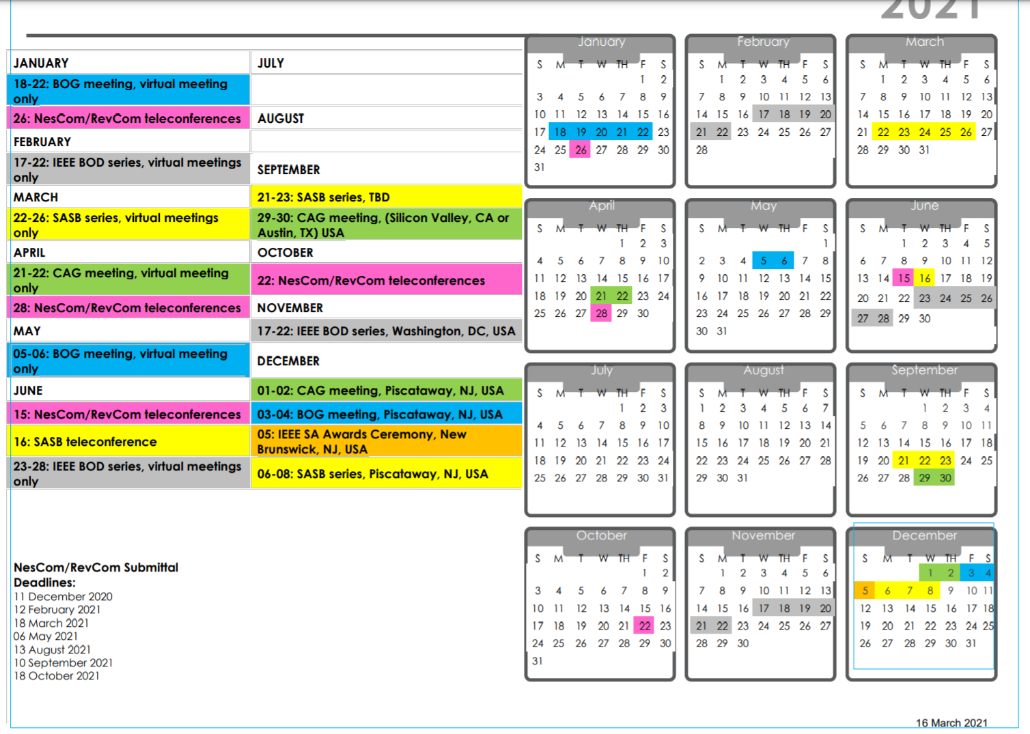

Slide 23
NesCom/RevCom Submittal Deadlines:
11 December 2020
12 February 2021
18 March 2021
06 May 2021 – May 4th EC call
13 August 2021 – Aug 3rd EC call
10 September 2021 – Sept 7th call
18 October 2021 – Oct 5th call

