Slide 1
IEEE 802 LMSC Restructuring ad hoc
Operational Efficiency Sub-ad hoc
5 April 2021
DCN ec-21-0065-00-00EC

Slide 2
Goals
  PAR Process:
    Document a proposed review process to present to the EC
      Consider greater consistency across working groups?
    Identify other efficiency improvement in PAR/CSD
      Review CSD format for updates/improvement?
      Other steps we should add/delete/modify?
  Training:
    Better characterize the issues in the current process (define the problem)

Slide 3
Agenda
Proposed Agenda
Review
Discuss ideas for PAR process improvements
Plan for work on improving leadership training
AoB

Slide 4
Actions
Schedule virtual meeting to develop PAR process proposal
  Ben
Present to EC in April call
  Ben and everyone who joins the call

Slide 5
Operational Efficiency Ideas: PARs
Adopt handling PARs in between plenary sessions
  Allow consideration on monthly EC interim electronic meetings that precede a NesCom meeting
  Retain the same review process level of rigor
  > 30 day review period
  Can announce prior to EC call n, review by EC on call n+1
  Additional work for WGs:
    Need to review PARs on monthly (electronic or in person)
    Otherwise the same process
  Additional work for EC
    Need to review PARs more often
    May or may not see more PARs
    So workload likely distributed more evenly

Slide 6
Requirements for the PAR review process
Maintain or improve upon current level of review rigor
  Assure PARs and CSDs get the same or greater exposure
  Ensure enough time for review, comment, revision and response
  Posting and noticing at least 30 (45?) days ahead of EC meeting
Possible improvements:
  More flexibility and time for groups to review and prepare comment
  More time for originating group to improve based in input
  Could increase review period and still improve response and efficiency
Align with NESCOM schedule
  More opportunities to move new projects forward
  NESCOM schedule varies year by year (??)

Slide 7
Proposed Recommendation
Amend rules to allow consideration at any duly noticed EC meeting
  Identify the necessary rules that need to change
  Develop proposed text for rules committee
Develop annual calendar for 802 PAR review process
  Posting (submission) deadlines
  Comment deadline
  Response / revision deadline

Slide 8
Calendar
2021 NESCOM
802 EC
Source: https://standards.ieee.org/content/dam/ieee-standards/standards/web/governance/sasb/2021calendar.pdf
Jan 26th [11 Dec 2020]
April 28th [18 March 2021]
June 15th [06 May 2021]
October 22nd [10 Sep 2021]
(Not complete?)
Source: https://grouper.ieee.org/groups/802/
March 18th closing
May 4th teleconference
June 1st with pre-submit
September 7th teleconference
October 5th with pre-submit

Slide 9
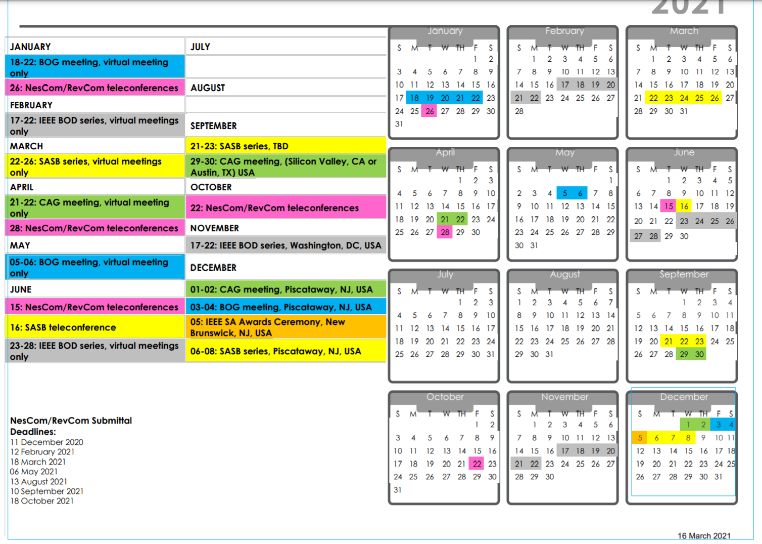

Slide 10
Training
Identified issues so far:
  Observed some participants don’t know the process and rules
    Frequent debates on calls that are clearly settled if the rules and guidance documents are brought into the discussion
  Hierarchy of rules not understood
Solutions not obvious
  Rules and guidance documents readily available now
    Links on 802 home page, WG home pages
  This is included in the newbie training now
  Informed leadership is readily available (and mostly consistent)
Objective: ensure better training of leadership
  Training and qualification of TG/TF leaders
  Mentorship of new leaders –
    Starting with pre-PAR activities, continue throughout
    Leverage experienced folks other than WG chairs

