Slide 1
IEEE 802 Executive Secretary Report for 2021 March Electronic
Jon Rosdahl IEEE 802 Executive Secretary jrosdahl@ieee.org

Slide 2
IEEE 802 EC Opening Plenary March 5, 2021
1 Item:
6.02 Current / Future venues

Slide 3
6.02 Current / Future venues
Status of Future Venue Contracts
2021-07 - Madrid Spain
Formal Decision due today
2021-11 – Vancouver, Canada
in contact - Meeting with Face to Face Events every 6 weeks
Go/No Go decision will be July 6th (or July 9th)
2022-03 – Disney Springs Hilton
Contract executed –
Start more contacting in July
G0/No Go Decision to be made November 2nd

Slide 4
Future Venue Contract Status
2022-07 - Sheraton Le Centre Montreal
Contract executed
2022-11 - Marriott Marquis Queen’s Park
Replacement for 2020-11
Contract with Marriott for review
Expecting to complete contract execution this month

Slide 5
Contracts in process
2024-03 Hyatt Regency Denver
Rebooking from 2021 March
Expected end of month
2024-07 Sheraton Montreal
Contract negotiations stalled with COVID.
Need to complete
2024-11 – Tentatively looking at Bangkok, but Face to Face Events and Mtg Events are proposing other possible venues.

Slide 6
2023-07 Berlin
Estrell Berlin is in the process of completing the contract processing.
Face to Face Events is meeting with them every 2 weeks and getting close to completion.
Report from Face to Face Events is expected to be presented at April 6th Monthly EC Telecon

Slide 7
Motion for addressing March 2021
Whereas the IEEE 802 EC voted to approve Hyatt Regency Chicago as the venue location for 2024 March (April 7, 2020), and we have had to move the Hyatt Regency Denver from 2021 March;
Move to approve the “Hyatt Regency Chicago” hotel to be the venue for the March 2026 Plenary.
Moved: Rosdahl
2nd: Shellhammer
Results: 9-3-0 Motion passes.
Notes:
Motion on April 7th: 3. Motion to approve March 2024 Venue: Motion: Move to approve the "Hyatt Regency Chicago" hotel as the venue location for the March 2024
Note that in working with Denver and Chicago, these new dates work better from them anyway.

Slide 8
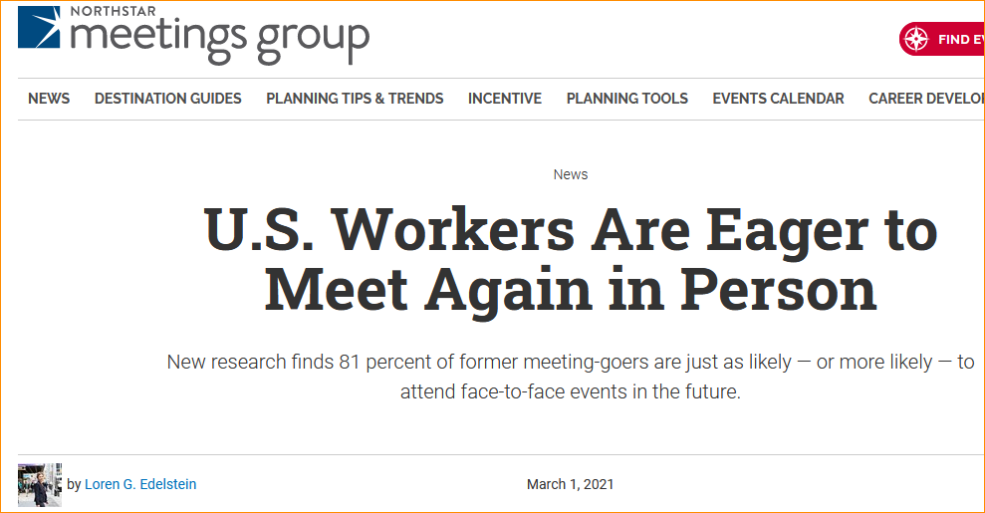
In the news
https://www.northstarmeetingsgroup.com/News/Industry/Homebound-US-Workers-Want-to-Meet-In-Person-MMB-Survey?utm_source=eNewsletter&utm_medium=Email&utm_campaign=eltrMtgNews&oly_enc_id=0895B1365067B7U

Slide 9
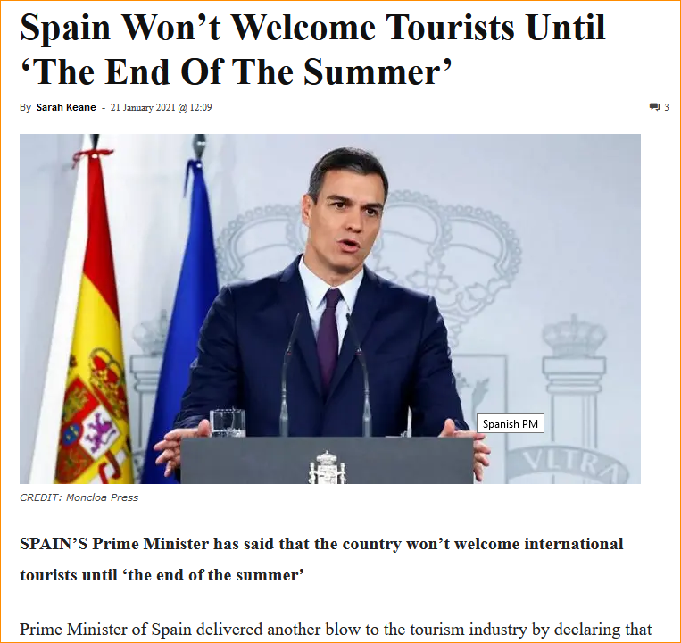
Report from Spain
https://www.euroweeklynews.com/2021/01/21/spain-wont-welcome-tourists-until-the-end-of-the-summer/
Notes:
https://www.euroweeklynews.com/2021/01/21/spain-wont-welcome-tourists-until-the-end-of-the-summer/

Slide 10
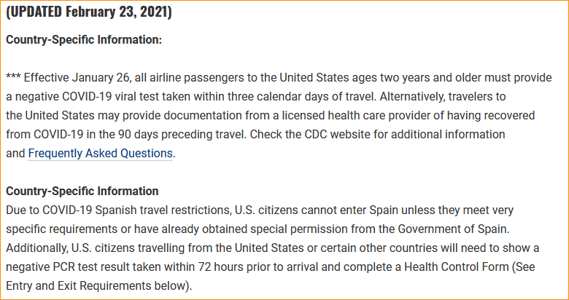
US Embassy current state for Spain
https://es.usembassy.gov/covid-19-information/

Slide 11
Motion for July 2021 Venue
Move to change the 2021 July 802 Plenary Session from in-person to an Electronic Session. The dates will be confirmed at the April 6th, 2021 EC Monthly Telecon.
Moved: Rosdahl
2nd Shellhammer
Results: unanimous

Slide 12
Current Commitments
2021 | November | Hyatt Regency Vancouver
2022 | March | Hilton Buena Vista Palace
2022 | July | Sheraton Le Centre Montreal
2022 | November | Marriott Marquis Queen’s Park
2023 | March | Hilton Atlanta
2023 | July | Estrel Berlin
2023 | November | Hawaiian Village
2024 | March | Hyatt Regency Denver
2024 | July | Sheraton Le Centre Montreal
2024 | November | Marriott Marquis Queen’s Park -- TBC
2025 | March | Hilton Atlanta
2025 | July | Marriott Madrid Auditorium
2025 | November
2026 | March | Hyatt Regency Chicago
2026 | July
2026 | November
2027 | March
2027 | July
2027 | November | Hawaiian Village

Slide 13
Straw poll request
For the 2021 March Electronic Plenary, a request is made for each WG to conduct a strawpoll with the following question:
When do you expect the next in person 802.x Session will be?
September 2021
November 2021
after 2021
No Answer
Please report the result
if you choose to ask a different question, please include the question in your result report.

Slide 14
IEEE 802 EC Closing Plenary March 18th, 2021
3 items:
8.043 – Executive Secretary Report
8.06 -- Monthly 802 EC Telecons
8.07 -- Call for Tutorials for July

Slide 15
8.043 – Executive Secretary Report

Slide 16
8.06 Monthly IEEE 802 EC Telecons
Dec 1, 2020 – WebEx ID: 173 080 6337
Jan 5, 2021 – WebEx ID: 173 839 3616
Feb 2, 2021 – WebEx ID: 173 839 3616
Mar 2, 2021 – WebEx ID: 173 839 3616
password: 802ec
Call Time: 13:00-15:00 ET (1pm – 3pm ET)

Slide 17
8.07 Call for Tutorials for July
Tutorials to be held in person: 15 March 2021
Tutorials to be held electronic: 9 and 10 March 2021 at 9am ET
Tutorial Request form: http://www.ieee802.org/802_tutorials/802_Tutorial_Request_Form.doc
As a reminder, please refer to Chair's Guidelines section 2.5 Tutorials for the logistics for participating in sponsoring/presenting a Tutorial.
Note that Tutorial times are limited to 80 minutes with 10 minutes to allow for presenters to setup and depart.
All requests for Tutorials must be made by 21 May 2021
Notes:
All official tutorial request forms must be submitted no later than 45 days in advance of the Plenary Session.
Approved Tutorial Requests will be assigned a time slot based on the order in which they were received.
The Final Tutorial Schedule will be posted at http://802world.org/plenary and http://ieee802.org no less than 30 days in advance of the Plenary Session.

