Slide 1
IEEE 802 Mar 2021 Public Visibility Standing Committee Report
IEEE 802 Mar 2021 Plenary
Opening Mtg – 05 Mar 2021
Update - PV SC – 10 Mar 2021

Slide 2
PV Standing Committee Members
Members from each of 802 WGs and TAGs
John D’Ambrosia Chair 802, 802.3
Roger Marks 802, 802.1
Dorothy Stanley 802.11
Phil Beecher 802.15
Jay Holcomb 802.18
Benjamin Rolfe 802.19, 802.24
2
13 Nov 2020

Slide 3
802 Public Visibility SC Scope, Duties, Membership
Scope and Duties
To raise industry awareness in timely fashion of IEEE 802 WG / TAG activities
Develop social media content based on IEEE 802 WG / TAG activities
Twitter - https://twitter.com/ieee802
LinkedIn – https://www.linkedin.com/company/ieee802
IEEE-SA 802 - https://standards.ieee.org/featured/802/index.html
Content
Review Pre 802 Plenary meetings for social media messaging: PARs to be considered, Tutorials, [802.3] Call-for-Interests, New Task Force formations
Review Post 802 Plenary meetings for social media messaging: Study Group formations, IEEE 802 Position Approvals
Other 802 related material for social media messaging: Press Releases, White Paper publications, Other 802 approved news, 802 WG / TAG Activities with IEEE-SA
IEEE-SA Standards Board Related - PAR Approvals, Standards Approval, Standards Publication,
Membership
Membership in the Standing Committee is open to anyone that wishes to participate (ideally at least one participant from each 802 WG and TAG)
13 Nov 2020

Slide 4
Agenda – 10 Mar 2021 Meeting Time: 3pm to 4:30pm ET, http://bit.ly/38borEz
Agenda
Review of Social Media Stats
Future Tech Talks
Other content

Slide 5
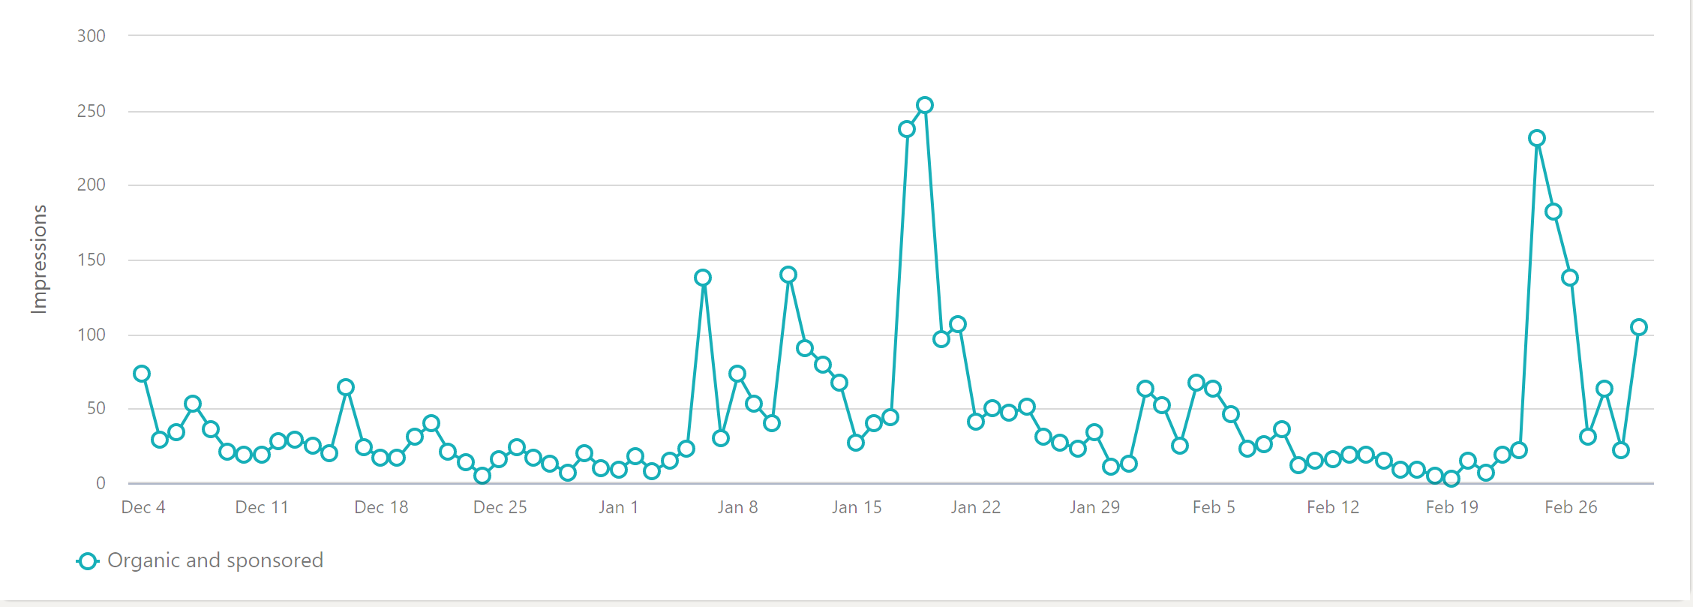
Social Media Related Tools
Twitter
Twitter (@IEEE802)
206 followers (+15% Nov1)
Last 90 days (Dec 4 - Mar 4)
21 Tweets
10.4K Impressions
Top 3 Tweets – Ethernet Tech Talk, 802.1 Emerging Technology Award, Computer Society Webinar – Wireless Standards
LinkedIn
229 followers (+36% since Nov 1)
Last 90 days
18 Posts
3474 impressions
LinkedIn

Slide 6
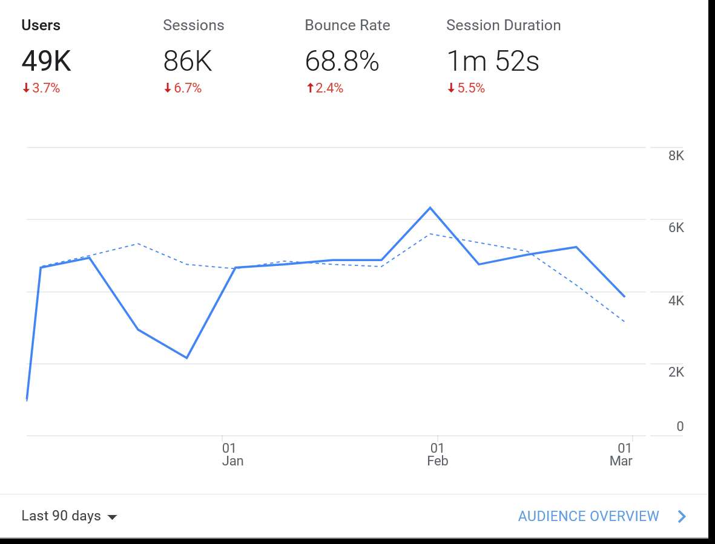
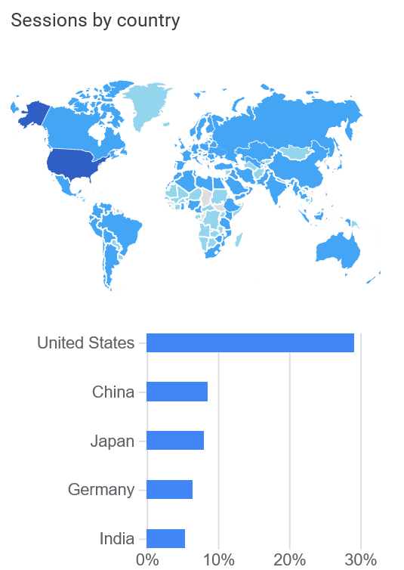
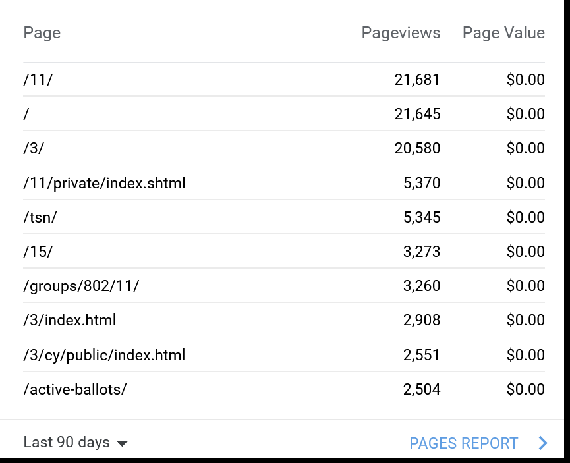
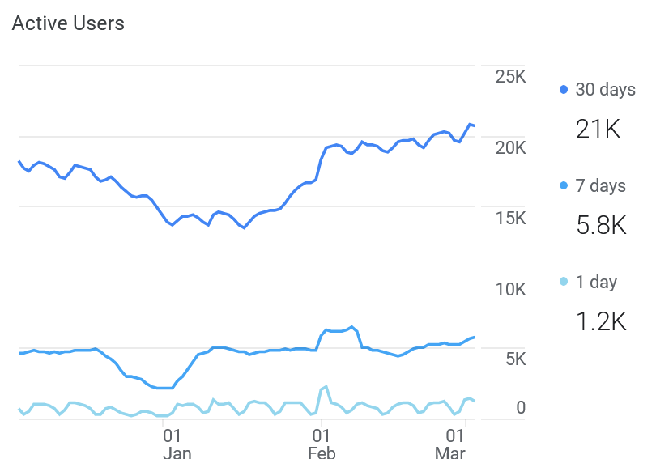
Google Analytics 802 (as of Mar 4)

Slide 7
Content Efforts - IEEE EA Tech Talks
Reference - https://innovationatwork.ieee.org/events/techtalk-panel-802/
Recordings of Tech Talks available at above URL
4/14/21 – 802 & 802.24 (Godfrey)
5/26/21 – 802.11 – State of Wireless (Stanley)
Past Talks Views as of 3/10
IEEE 802: Connecting the World Views - 434
Ethernet Broadband Assessment Views - 154
Industrial Ethernet Views – 116
WLAN Sensing (Hanxiao, Da Silva) Views - 146
IEEE 802.22: TV White Space (Mody) Views - 98
IEEE 802.3: State of Ethernet (Law) Views - 169
IEEE 802.18: 802 and the Regulatory World (Holcomb) Views - 68

Slide 8
Content Efforts – IEEE Computer Society Webinars
https://www.computer.org/education/standards-activities-board-webinars
IEEE 802 Networking Standards – Wired
172 attendees
520 registered
33% rate
Avg time watching is 19 minutes (this webinar was 42 minutes so avg. person is watching just about half of it)
198 views on YouTube
IEEE 802 Networking Standards – Wireless
93 attendees
364 registered
25% rate
Avg time watching: 21 minutes (full webinar length is 58, so watching about a third of it)
86 views on YouTube

Slide 9
3/10 PV SC Agenda
Google Analytics Review
Content Development (new webinars on hold for summer)
Tech Talks
Traditional Tech Talks
Applications Across 802
Computer Society
IEEE SA
Replacement “Meet IEEE 802” Video Series (IEEE SA - IEEE 802)
Metrix – Tying PV efforts to increased participation?

Slide 10
Closing Report Update
To Be added

