Slide 1
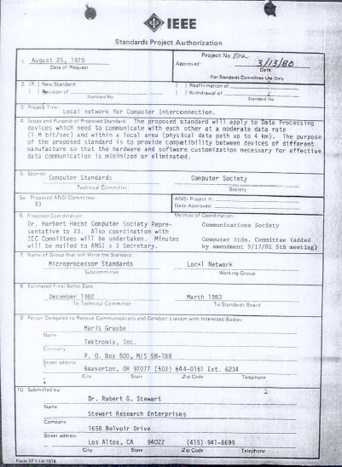
IEEE 802 LMSC 02 February 2021 Electronic Meeting 1-3pm ET
DCN ec-21-0023-00-00EC

Slide 2
1.00 Meeting called to order/role call
2.00 Review/approve agenda
2.01 Participation Slide Set URL:
https://ieee802.org/sapolicies.shtml
https://standards.ieee.org/content/dam/ieee-standards/standards/web/documents/other/Participant-Behavior-Individual-Method.pdf
Participant behavior is guided by IEEE Code of Ethics & Conduct
Participants shall act independently of others, including employers
Standards activities shall allow the fair & equitable consideration of all viewpoints

Slide 3
3.00 Chair’s Announcements
Reminder #1: Use IMAT to log your attendance
Reminder #2: Please enable mute when you are not speaking
Reminder #3: Please use the Chat function to request being put in the queue
Reminder#4: Encourage feedback on “Addressing Participants Concerns” draft chairs guideline, see next slide

Slide 4
Reminder#4 to submit feedback on Substitute Chair’s Guideline Text for Ombudsman
Substitute text for an Ombudsman Guideline
Consider adding a new subclause 2.16 “Addressing Participants Concerns”
Provides guidance to 802 participants and 802 officers
https://mentor.ieee.org/802-ec/dcn/20/ec-20-0236-00-00EC-addressing-participants-concerns.docx
Next Steps
Request review by 802 EC colleagues
Collect comments, revise as appropriate, once consensus is achieved, submit for 802 EC approval

Slide 5
Additional possible item if time allows

Slide 6
tbd Monthly EC teleconference call scheduling
Parsons to summarize feedback from his request to confirm a fixed sweet spot for holding EC teleconferences
Potential sweet spots
3-5pm ET southern summer (November to March) 20:00-22:00 UTC
4-6pm ET northern summer (April to October) 20:00-22:00 UTC
Next meeting scheduled for 1-3pm ET Tuesday 02 March 2021

Slide 7
tbd 802 restructuring ad hoc status
2nd Electronic meeting held 19 January 2021
Discussion focused on refining 802’s scope statement (meeting notes: EC-21-0011-01-00EC)
Draft 802 scope statement from Geoff and Roger:
IEEE 802 develops and maintain standards specifying data link and physical layer protocols to support packet transmission and delivery among network-layer clients.
• Protocols are specified for various physical channels with sufficient detail to allow multivendor interoperability across the interfaces to the communication medium.
• Interoperability is also specified for transmission of network-layer packets via a set of data links.
• Supplementary specifications detail related functionality, including control, management, channel coexistence, and power distribution.
• Supporting outputs include future-looking documentation, standards body interactions, and regulatory contributions.
Suggested additions from Nikolich via EC reflector
a) add 'security and privacy protocols' and 'object positioning' to the Supplementary specification bullet.
b) replace 'regulatory contributions' with 'contributions to regulatory bodies'
c) I'm not sure what 'future looking documentation' means, please elaborate
d) replace 'maintain standards' with 'maintain high quality, market relevant network technology standards'
e) we should retain 'scope flexibility' to allow for as-yet-unknown features to become part of the 802 family

Slide 8
tbd 802 restructuring ad hoc status
Next Steps
Solicit additional input via EC reflector
1 hour meetings held at least once per month, report out status each plenary
3rd meeting scheduled for 13:00-14:00 ET Tuesday 16 February 2021
Deliverable: a well vetted and socialized recommendation for EC consideration December 2021.

Slide 9
Adjourn EC Meeting

