Slide 1
IEEE 802 Executive Secretary Report for 2020 December 1 Telecon
Jon Rosdahl
IEEE 802 Executive Secretary
jrosdahl@ieee.org

Slide 2
3.02 Future Venue Update
For the 2020 November Electronic Plenary, a request was made for each WG to conduct a straw poll with the following question:
  When do you expect the next in person 802.x Session will be?
Responses were received by 802.1, 802.3, 802.11, 802.15 and 802.18.

Slide 3
802.1 Straw Polls:
When do you expect the next in person 802.1 Session will be?
  A.- March 2021 3 6%
  B.- May 2021 7 13%
  C.- July 2021 12 23%
  D.- Sept 2021 11 21%
  E.- November 2021 9 17%
  F.- after 2021 7 13%
  No Answer 3 6%
    Total 52

Slide 4
802.3 Straw Polls
When do you expect the next in person 802.3 Session will be?
  March 2021 8 4%
  May 2021 15 7%
  July 2021 44 20%
  September 2021 31 14%
  November 2021 20 9%
  After 2021 36 16%
  No answer 71 32%
  Total 225

Slide 5
802.11 Straw Poll
When do you expect the next in person 802.11 Session will be?
  A – March 2021 17 ( 8%)
  B – May 2021 14 ( 6%)
  C – July 2021 57 ( 26%)
  D – Sept 2021 29 ( 13%)
  E – November 2021 16 ( 7%)
  F – after 2021 25 ( 12%)
  No Answer 59 ( 27%)
  Total 217

Slide 6
802.15 Straw poll
When do you expect the next in person 802.15 Session will be?
  A. March 2021 4 8%
  B. May 2021 1 2%
  C. July 2021 8 16%
  D. Sept 2021 10 20%
  E. November 2021 10 20%
  F. after 2021 6 12%
  G. No Answer 5 10%
  Did not respond 6 12%
  Total 50

Slide 7
802.18 Straw Poll
When do you expect the next in person 802.18 session will be?
A. March 2021 3 ( 8%)
B. May 2021 1 ( 3%)
C. July 2021 12 ( 31%)
D. September 2021 9 ( 23%)
E. November 2021 4 ( 10%)
F. 2022 or later 2 ( 5%)
No Answer 8 ( 21%)
  Total 39

Slide 8
Assorted notes/comments
802.1
  in addition to personal preference to not travel until there is a vaccine, several mentioned that their employers already had travel restrictions in place until the end of either Q1 (at least 3) or Q2 (at least 2) 2021.
802.11
  At least one company has restrictions announced until end of June 2021
  Many companies have indicated that travel policy would be reviewed in January 2021.
802.18
  there are .11 and .15 folks included in the straw poll

Slide 9
How Many Attendees to be viable?
802.1: 90
802.3: 150
802.11: 175
802.15: 45
802.18: 20
802.19: 10 (normally 15-20)
802.24: 7 (but usually 15 is preferred to get cross cutting perspective)
  Total: 497 (if all unique) estimate ~475 unique individuals
Notes:
Note from 802.24: nobody attends IEEE 802 just for 802.24 – it’s value is in the proximity and coordination with other WGs and TAGs.

Slide 10
Space that is prepared for March
802.1: (90) 90 – 20 = 110 seats
802.3: (140) 90 – 75 – 60 – 15 – 15 = 165 seats
802.11: (180) 100 – 60 – 60 – 30 = 250 seats
802.15: (60) 30 – 25 – 5 – 5 = 65 seats
802.18/.19/.24: 30 = 30 seats
802 EC: US22 +SR30 = 52 seats
  Total Capacity: 620 seats
The yellow highlighted text shows how the large plenary room is composed.

Slide 11
Considerations for holding In Person Sessions.
Safety – Travel and Attendance
VISA requirements – 60-90 days in advance usually given/needed.
Corporate Travel Restrictions
Travel Planning Lead time for attendees
Current Colorado Condition – No indoor meetings at this time and would need to get to level 2 before 100 per room.
IEEE has still indicated for 1st Half of year no nonessential Travel

Slide 12
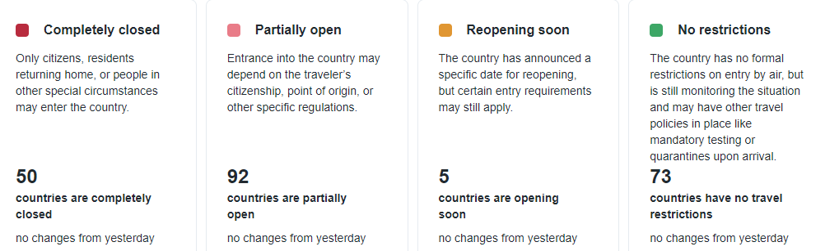
2020 Dec 1 Travel Restrictions

Slide 13
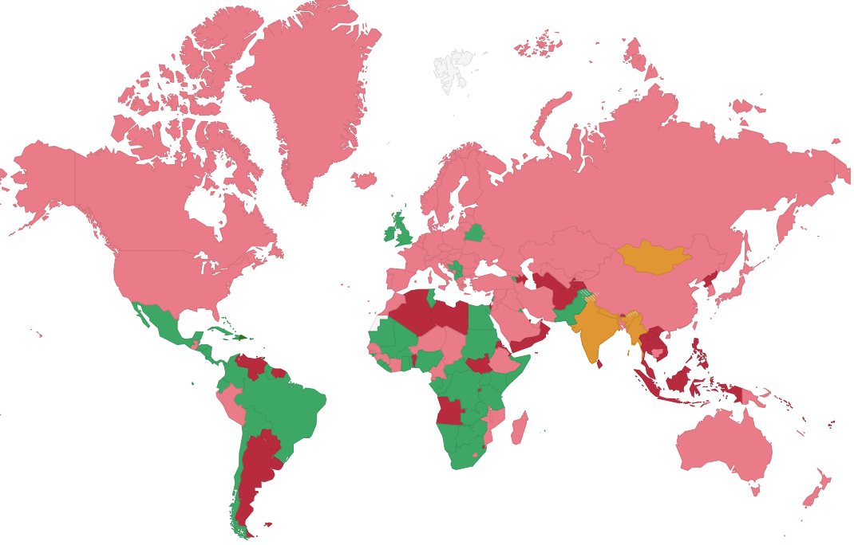

Slide 14
Travel Restriction issues
14 Day Self-isolation on arrival (sometimes each way).
COVID-19 Negative test within 48 hours
COVID-19 Test at airport
Vaccine is available by July 1
VISA Request times:
Nonimmigrant Visa Type | Appointment Wait Time
Visitor Visa | Emergency Appointments Only
Student/Exchange Visitor Visas | Emergency Appointments Only
All Other Nonimmigrant Visas | Emergency Appointments Only

Slide 15
Motion convert the March 2021 to Electronic Session
Move to change the 2021 March 802 Plenary Session from in-person to an Electronic Session. The dates will be similar to the original dates and be confirmed at the January EC Telecon.
Moved: Rosdahl
2nd: Parsons
Results: Unanimous approved.

