Slide 1
IEEE 802 Executive Secretary Report for 2020 November Electronic Closing Plenary Report
Jon Rosdahl
IEEE 802 Executive Secretary
jrosdahl@ieee.org

Slide 2
4.021 Future Venue Report
For the 2020 November Electronic Plenary, a request was made for each WG to conduct a strawpoll with the following question:
  When do you expect the next in person 802.x Session will be?
Responses were received by 802.1, 802.3, 802.11, 802.15 and 802.18.

Slide 3
802.1 Straw Polls:
When do you expect the next in person 802.1 Session will be?
  A.- March 2021 3 6%
  B.- May 2021 7 13%
  C.- July 2021 12 23%
  D.- Sept 2021 11 21%
  E.- November 2021 9 17%
  F.- after 2021 7 13%
  No Answer 3 6%
When do you expect to next attend in person an 802.1 Session?
  A.- March 2021 2 4%
  B.- May 2021 8 15%
  C.- July 2021 14 27%
  D.- Sept 2021 9 17%
  E.- November 2021 9 17%
  F.- 2022 or later 7 13%
  No Answer 3 6%

Slide 4
802.3 Straw Polls
When do you expect the next in person 802.3 Session will be?
  March 2021 8 4%
  May 2021 15 7%
  July 2021 44 20%
  September 2021 31 14%
  November 2021 20 9%
  After 2021 36 16%
  No answer 71 32%
  Total 225

Slide 5
802.11 Straw Poll
When do you expect the next in person 802.11 Session will be?
  A.– March 2021 17/217 ( 8%)
  B.- May 2021 14/217 ( 6%)
  C. - July 2021 57/217 ( 26%)
  D.- Sept 2021 29/217 ( 13%)
  E.- November 2021 16/217 ( 7%)
  F.- after 2021 25/217 ( 12%)
  No Answer 59/217 ( 27%)

Slide 6
802.15 Straw poll
When do you expect the next in person 802.15 Session will be?
  A. March 2021 4 8%
  B. May 2021 1 2%
  C. July 2021 8 16%
  D. Sept 2021 10 20%
  E. November 2021 10 20%
  F. after 2021 6 12%
  G. No Answer 5 10%
  Did not respond 6 12%
  Total Participants 50
Based upon your affiliation’s and other restrictions, as well as your personal comfort level, when is the earliest you expect to be able to attend an 802.x face-to-face meeting?
  A. March 2021 5 10%
  B. May 2021 3 6%
  C. July 2021 6 12%
  D. Sept 2021 8 16%
  E. November 2021 11 22%
  F. after 2021 12 24%
  G. No Answer 3 6%
  Did not respond 3 6%
  Total Participants 51

Slide 7
802.18 Straw Poll
When do you expect the next in person 802.18 session will be?
A. March 2021 3/39 ( 8%)
B. May 2021 1/39 ( 3%)
C. July 2021 12/39 ( 31%)
D. September 2021 9/39 ( 23%)
E. November 2021 4/39 ( 10%)
F. 2022 or later 2/39 ( 5%)
No Answer 8/39 ( 21%)
Based upon your affiliation’s and other restrictions, as well as your personal comfort level, when is the earliest you expect to be able to attend an 802.x face-to-face meeting, with info as of today?
A. March 2021 7/38 ( 18%)
B. May 2021 0/38 ( 0%)
C. July 2021 12/38 ( 32%)
D. September 2021 7/38 ( 18%)
E. November 2021 4/38 ( 11%)
F. 2022 or later 2/38 ( 5%)
No Answer 6/38 ( 16%)

Slide 8
Assorted notes/comments
802.1
  in addition to personal preference to not travel until there is a vaccine, several mentioned that their employers already had travel restrictions in place until the end of either Q1 (at least 3) or Q2 (at least 2) 2021.
802.11
  At least one company has restrictions announced until end of June 2021
  Many companies have indicated that travel policy would be reviewed in January 2021.
802.15
  For graphing slide, “No Answer” and “No Response” were combined.
802.18
  there are .11 and .15 folks included in the strawpoll

Slide 9
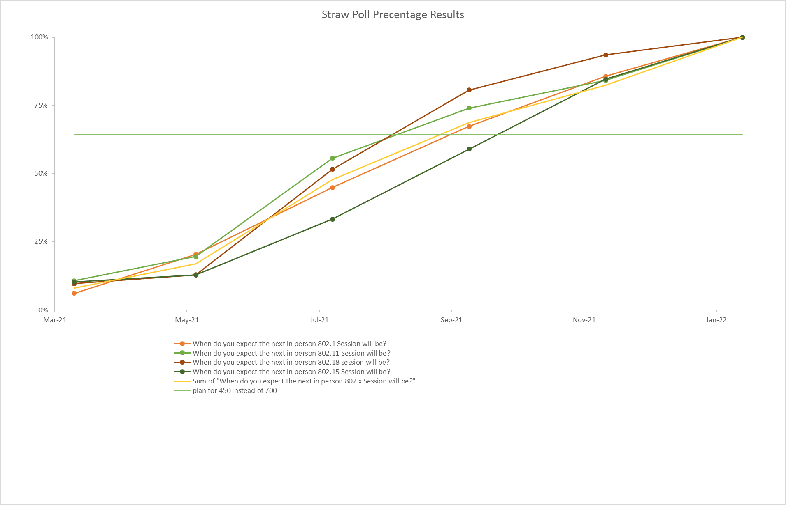
Notes:
Credit to Andrew Myles for helping with the graph

Slide 10
Monthly IEEE 802 EC Telecons
Dec 1, 2020 – WebEx ID: 173 080 6337
Jan 5, 2021 – WebEx ID: 173 839 3616
Feb 2, 2021 – WebEx ID: 173 839 3616
Mar 2, 2021 – WebEx ID: 173 839 3616
password: 802ec
Call Time: 13:00-15:00 ET (1pm – 3pm ET)

Slide 11
8.07 Call for Tutorials for March
Tutorials to be held in person: 15 March 2021
  Tutorials to be held electronic: 9 and 10 March 2021 at 9am ET
Tutorial Request form: http://www.ieee802.org/802_tutorials/802_Tutorial_Request_Form.doc
As a reminder please refer to Chair's Guidelines section 2.5 Tutorials for the logistics for participating in sponsoring/presenting a Tutorial.
Note that Tutorial times are limited to 80 minutes with 10 minutes to allow for presenters to setup and depart.
All requests for Tutorials must be made by 29 January 2021
Notes:
All official tutorial request forms must be submitted no later than 45 days in advance of the Plenary Session.
Approved Tutorial Requests will be assigned a time slot based on the order in which they were received.
The Final Tutorial Schedule will be posted at http://802world.org/plenary and http://ieee802.org no less than 30 days in advance of the Plenary Session.

