Slide 1
IEEE 802 LAN/MAN SC
802 Executive Committee
06 October 2020
Electronic Meeting
DCN ec-20-0196-03EC

Slide 2
1.00 Meeting called to order
      Please use IMAT to record attendance
2.00 Review/approve agenda
2.01 Participation Slide Set URL:
https://ieee802.org/sapolicies.shtml
https://standards.ieee.org/content/dam/ieee-standards/standards/web/documents/other/Participant-Behavior-Individual-Method.pdf
Participant behavior is guided by IEEE Code of Ethics & Conduct
Participants shall act independently of others, including employers
Standards activities shall allow the fair & equitable consideration of all viewpoints

Slide 3
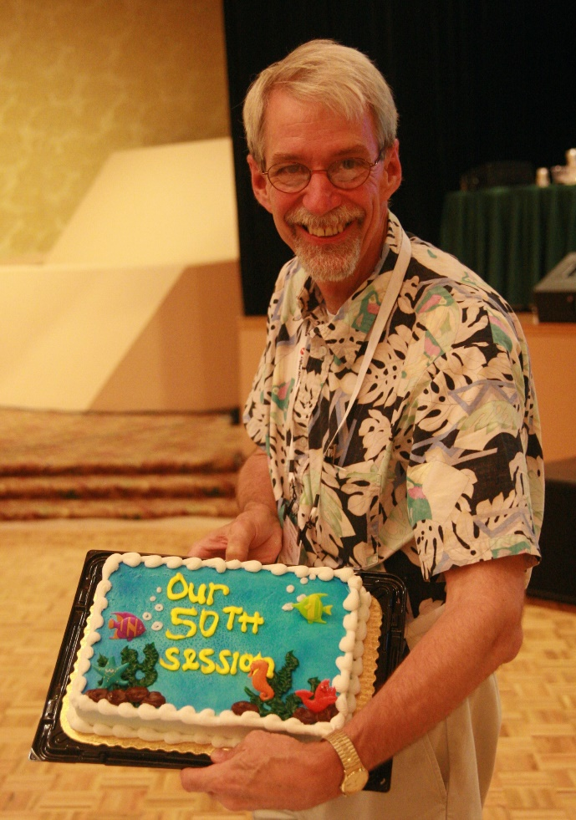
2.99 IEEE 802.15 In memoriam: Dr Robert F. Heile
Bob was a contributor to various IEEE 802 WGs since the 1980s in the areas 802.3, 802.11, and 802.15. He was the Chair of IEEE 2030.5 Working Group for Smart Energy Profile, Co-Chair IEEE P2030 Task Force 3 on Smartgrid Communications, Chair of the ZigBee Alliance, and Director of Standards for the Wi-SUN Alliance. Bob was heile active in the wireless community and globally regarded for his expertise and evangelism of mesh networks.
He will be missed by many for his guidance, expertise, and friendship.
Our deepest condolences to Bob’s family: his wife Bonnie and daughters Sarah and Beth.
May he rest in peace (but I really think he’s going to be active in other arenas).

Slide 4
Top 10 Reasons for Bob Not Attending the 2013 Geneva Plenary Session.
There was a part of Bob that was very private, and he kept his illness a secret from most people starting with the Geneva session. This mystery caused many in the WG to speculate why he wasn’t there. Clint Powell captured the top ten reasons for his absence…

Slide 5
10. Forgot to register early
9. Didn’t want to take the heat for Nanjing...or fall out from Geneva
8. Didn’t want to take anymore heat on Okinawa
7. American Airlines frequent flier miles roll-over after 10M
6. Wanted internet connectivity
5. Fell behind in his yodeling lessons
4. Didn’t want to miss the East Coast Hurricane Season
3. No (free) coffee at breaks
2. Wanted to tick off Pat and make sure he never wants to Chair the WG
1. Suddenly had an epiphany -“This wireless #&^% just don’t work”

Slide 6

So Long and Thanks for All the Fish!

Slide 7
3.00 Chair’s Announcements
Please use IMAT to record your attendance
Jodi Haasz filling in for Jonathan Goldberg while on family leave
November 2020 plenary schedule layout
(see next slide)

Slide 9
November 2020 plenary Ad Hoc and Standing Cmte mtgs
1. 802 Tutorial:(Dorothy Stanley as Host)
10:00 AM- 11:20 AM ET Tuesday, Oct 13 2020
2.IEEE 802 Orientation: (Roger Marks)
10:00 AM - 11:30 AM ET Wednesday, Oct 28 2020
3. 802 Wireless Chairs Standing Committee (WCSC) (Dorothy Stanley) 3:00 PM - 4:30 PM ET Wednesday, Oct 28 2020
4. IEEE 802 EC - Opening Meeting, Nov Electronic Plenary Session: (Paul Nikolich) 1:00 PM - 3:00 PM ET Friday, Oct 30 2020
5. 802 Public Visibility SC - (John D'Ambrosia)
1:00 PM - 2:00 PM ET Wednesday, Nov 4 2020
6. 802/JTC1/SC6 Standing Committee (Andrew Myles)
4:00 PM - 6:00 PM ET Tuesday, Nov 3 2020
7. 802/ITU Standing Committee (Glenn Parsons) -
4:00 PM - 5:00 PM ET Wednesday, Nov 11 2020
8. 802/IETF Standing Committee (Dorothy Stanley)
12:00 PM - 1:00 PM ET Wednesday, Nov 11 2020
9. 802 Chair's Open Office Hour (Paul Nikolich)
9:00 AM - 10:00 AM ET Thursday, Nov 12 2020
10. Next Plenary Venue Space Planning AdHoc (Jon Rosdahl)-- Discuss March Plenary space
10-11am ET Thursday, 12 Nov 10am ET
11. IEEE 802 EC - Closing Meeting, Nov Electronic Plenary Session: (Paul Nikolich) 1:00 PM - 5:00 PM ET Friday, Nov 13 2020

Slide 10
3.03 Monthly EC telecons
Continuation of monthly 1-3pm ET 802 EC telecons on the 1st Tuesday of each month, unless otherwise notified.
Final 2020 Monthly EC telecon: 01 December 2020
2021 schedule:
05 Jan., 02 Feb., 02 Mar., 06 Apr., 04 May, 01 Jun., 06 Jul., 03 Aug., 07 Sep., 05 Oct., 02 Nov., 07 Dec.

Slide 11
3.04 Elimination of Ombudsman role
The IEEE SA is unable to provide complete confidentiality to the 802 Ombudsman role.
In order not to set the expectation that complete confidentiality is provided by the 802 Ombudsman, the role is eliminated.
Regardless, all 802 leaders have always been open to anyone expressing concerns and to help confidentially resolve them. We shall continue this best practice in lieu of providing the 802 Ombudsman role.
Guido Hiertz, sincere thanks for your service as 802 Ombudsman in 2019 and 2020.

Slide 12
3.05 802 Leadership Appointments
As announced by the 802 Chair’s 18 Sept. 2020 email:
  Appointed: Pat Kinney to serve as Temporary 802.15 WG Chair
  Appointed: Rick Alfvin to serve as Temporary 802.15 WG Vice Chair
  Appointments are valid until 802.15 WG leadership elections can be held sometime within the next six months.
  Appointed: Dorothy Stanley to serve as the Wireless Chairs Standing Committee Chair through March 2022.
  Jon Rosdahl assumed 100% responsibility for managing wireless interims.

