Slide 1
IEEE 802 LMSC 01 September 2020 802 Executive Committee Electronic Meeting
DCN ec-20-017700-00EC

Slide 2
1.00 Meeting called to order
Please use IMAT to record attendance
2.00 Review/approve agenda
2.01 Participation Slide Set URL:
https://standards.ieee.org/content/dam/ieee-standards/standards/web/documents/other/Participant-Behavior-Individual-Method.pdf
Participant behavior is guided by IEEE Code of Ethics & Conduct
Participants shall act independently of others, including employers
Standards activities shall allow the fair & equitable consideration of all viewpoints

Slide 3
3.00 Executive Session
Participation in 802 Executive Committee Executive Session is limited to 802 Executive Committee members
Nikolich, Gilb, Marks, Zimmerman, Rosdahl, D’Ambrosia, Parsons, Law, Stanley, Kinney, Heile, Holcomb, Shellhammer, Godfrey, Chaplin, Thompson, Das, Mody, and IEEE staff Goldberg and Haasz
All non-802 Executive Committee members please leave the call now
At the end of the Executive Session anyone may re-join the meeting

Slide 4
4.00 Chair’s Announcements

Slide 5
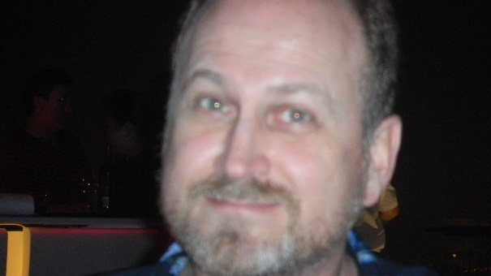
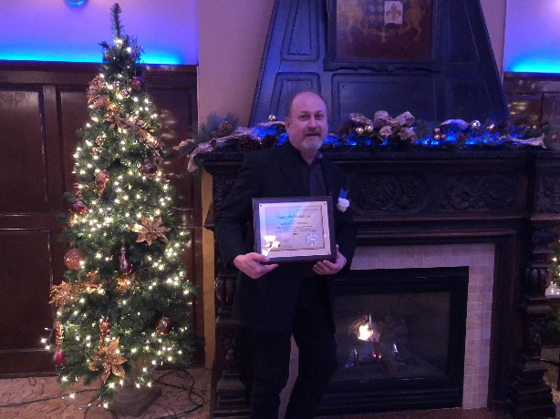
IEEE 802.3 In memoriam: David Chalupsky
David was a contributor to IEEE 802.3 since the 2000s in the areas of BASE-T and higher speed Ethernet standards. He was the chair of IEEE P802.3bq and IEEE P802.3bz projects as well as two of the preceding Study Groups. In 2018 he was recognized with the IEEE-SA Standards Medallion. David was highly active in the Ethernet community and regarded for his expertise and contributions.
Our deepest condolences to David’s family.
May he rest in peace.

Slide 6
4.00 Chair’s Announcements
Please use IMAT to record your attendance
802/SA Task Force meeting held 17 August 2020
Discussed
Webex, DirectVote, Framemaker licenses
Mentor replacement
Meeting notes at https://mentor.ieee.org/802-ec/dcn/20/ec-20-0172-00-00EC-17-august-2020-802-sa-task-force-meeting-notes.docx

