Slide 1
IEEE 802 40th Anniversary
Public Visibility Campaign Proposal
John D’Ambrosia
Futurewei, U.S. Subsidiary of Huawei
ec-19-0162-00-00EC
September 27, 2019

Slide 2
Introduction
IEEE 40th Anniversary Public Visibility Campaign Proposal
To develop a proposal for a 40th Anniversary public visibility campaign, we reached out to the following:
  IEEE Marketing
  IEEE Standards Association Marketing
  IEEE PR Agency – Finn Partners
    https://www.finnpartners.com/sectors/associations.html
    https://www.finnpartners.com/#out-with-the-old-in-with-the-transformative
IEEE “Lunar Launch” Marketing Plan discussed as model
Exploring how to leverage general IEEE-SA Marketing Awareness Program

Slide 3
Strategy Overview
Create a broad and global awareness campaign of IEEE 802 LAN/MAN Standards Committee and how the Standards developed by thousands of IEEE 802 technical experts over the past 40 years has enabled the industry to connect the world, which continuously evolves for the future.
Focus on the general technology audience (Tech standards, developers, and industry implementers) with the goal of reaching a broader audience.
Emphasize key applications enabled by the IEEE 802 standards / technologies portfolio.
Leverage a combination of 802 technical experts and broader technology industry experts who have media training and can focus on specific topics that resonate with the media based on current trends
Coordination of messaging plans
  IEEE 802 40th Anniversary Campaign as part of website and the recruitment efforts package
  IEEE-SA New Identity Roll-out

Slide 4

Overview
802 has paved the way for innovation in connectivity that have changed and continually influence our lives in ways large and small.
We will invite our audience to explore how 802 has created the hyper-connected world we enjoy today through a virtual reality interactive experience, starting with the inception of the IEEE 802 project, through its evolution of different working groups, market adoption of different 802-based solutions, all the way through how 802 will affect technology of the future.
Interactive hotspots will reveal audio, video, written commentary from prominent 802 Working Group members, End users, and Impact Creators. Including:
How different standards work together
Bridging (IEEE 802.1 WG)
Ethernet (IEEE 802.3 WG)
Wireless LAN, Wi-Fi® (IEEE 802.11)
IoT and Wireless Specialty Networks (IEEE 802.15)
High Profile Application Spaces
Notes:
Applications Space Experts; hyper scale data centers, social media, mobile apps, streaming video, etc.
Future - gaming, augmented reality, virtual reality
Industry Experts from Google, Facebook, Verizon, ATT, Automotive OEMs….and so on

Slide 5
Integrated Campaign Approach
Promotion
Leverage 3.4 million followers
IEEE will collaborated with IEEE China team for social media outlets in China: Weibo; Wechat
Social Media Posts
Paid Ads
Media Outreach and articles
Leveraging IEEE social media alias
Collaborate with Technical Activities and Computer Society
Content
Destination
Transmitter Articles, Videos and Audio
Promoted by social media posts
Leverage 802 technical experts
Transmitter Interactive Experience
Link to 802 marketing webpage
Social media’s primary demographic is 18-35
Average monthly social engagement is approx. 392,000 per month (likes, comments, shares) (ytd)
Traditional media 35+ will gain this target audience

Slide 6
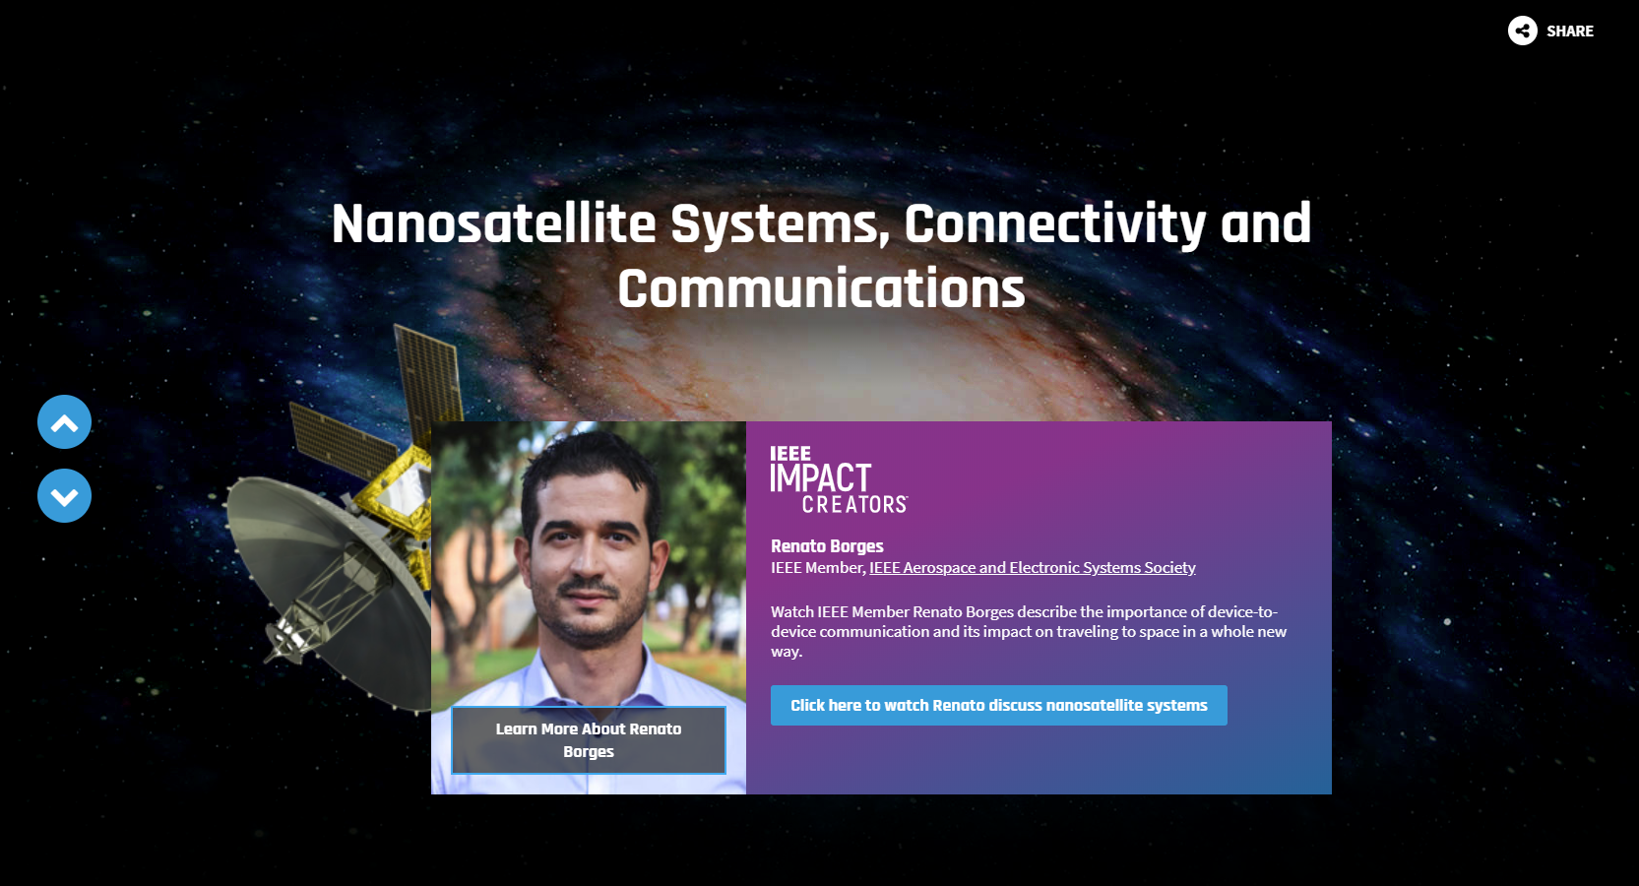
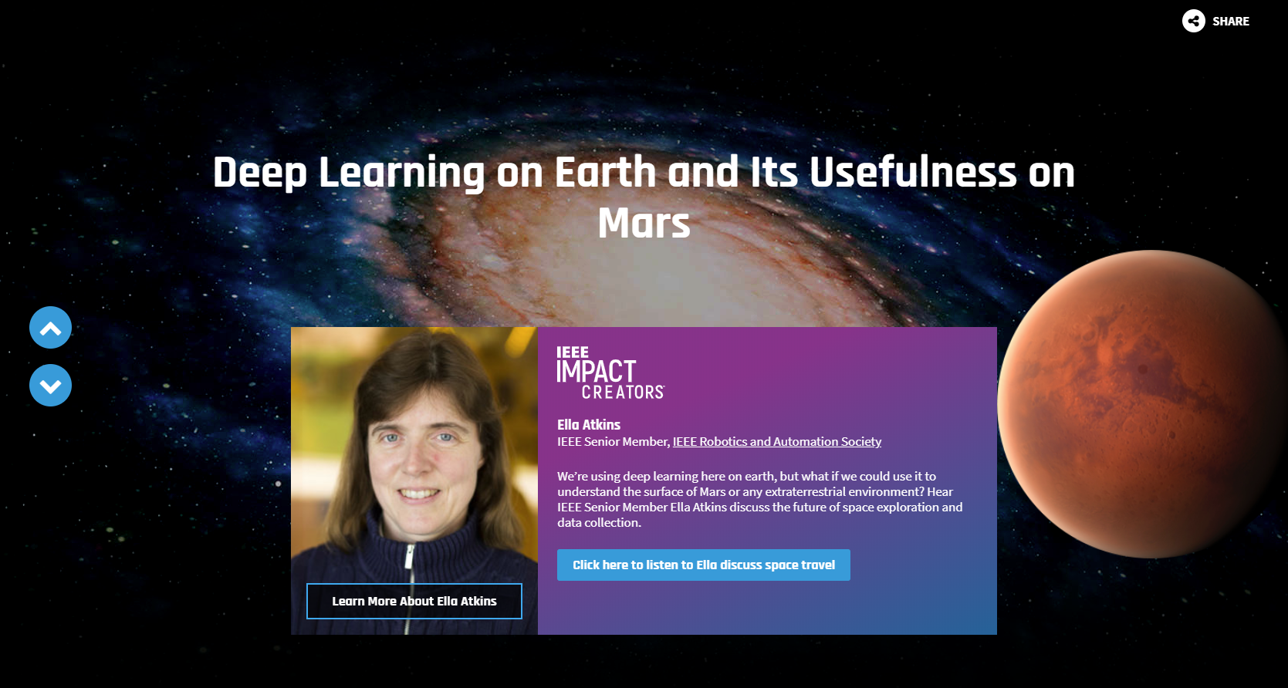
Our Inspiration for Lunar Landing to be transformed for 802 - leveraging Impact Creators theme
IEEE Transmitter Website
To see the full interactive experience on the IEEE Transmitter website please visit: https://transmitter.ieee.org/natural-capital-2019/
Notes:
Key Application Spaces
802.1 Bridging and 802.3 Ethernet data center bridging, time synchronous networks, enterprise networks, data centers, computing, intra vehicular automotive networking, mobile backhaul, POE enabled security cameras, passive optical networking for broadband access, long distance optical transport (carrier networks, multiple system operators),
802.11 Wireless LANs – any and all applications and devices using Wi-Fi; smart phones, smart devices, social media, inter vehicular connectivity, enterprises, small office, home office, residential, streaming TV, …….too many list
802.15 Wireless Specialty Networks – Internet of Things, Smart Utility Networks, Sensor Networks,
802.19 Coexistence WG ensuring wireless 802 networks coexist
802.18 Radio Regulatory TAG– influencing regulators worldwide to ensure license exempt spectrum is widely available
802.24 Vertical Network Applications – identify new application areas for 802 networks

Slide 7
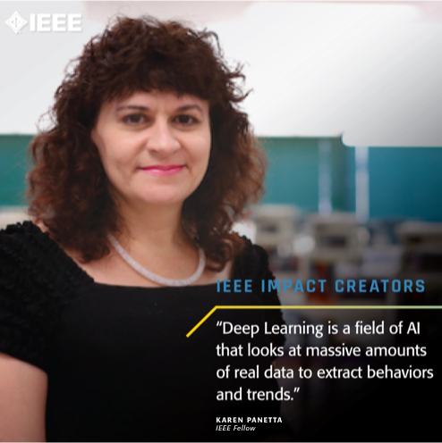
Social media is changing to be more personalized
Through this change Impact Creators was created to optimize social media
IEEE Impact Creators are the IEEE members used to
convey the IEEE story to top tier media, social media
and IEEE Transmitter.
https://transmitter.ieee.org/impact-creators/
Goal: Focus on the 802 spokespeople behind the technology.
These types of stories are embraced by the new
algorithms employed by social media platforms.

Slide 8
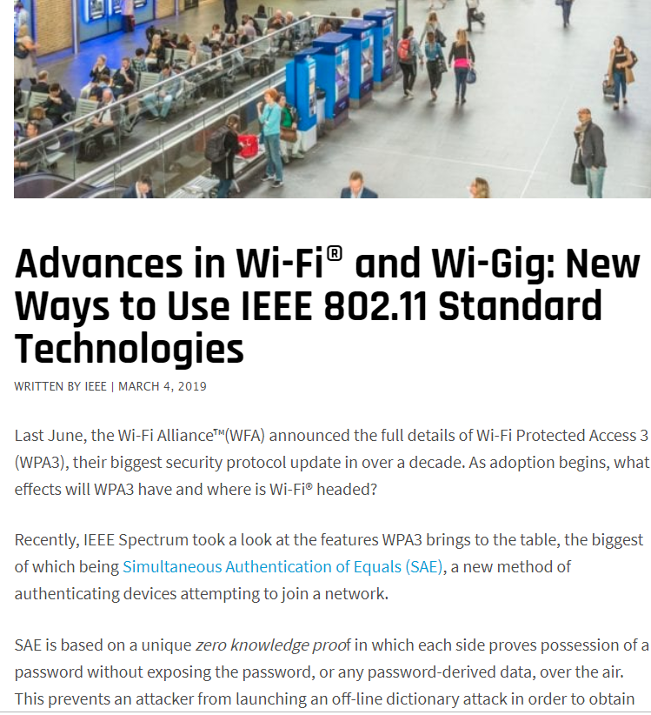
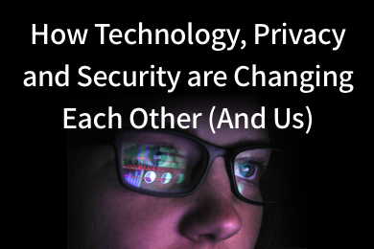
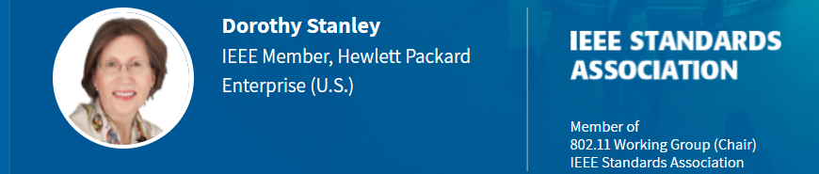
Samples of Impact Creators
Featured content from 802.11 Working Group Chair
2019 Cybersecurity Impact Theme Campaign
Notes:
Transmitter article: https://transmitter.ieee.org/advances-in-wi-fi-and-wi-gig-new-ways-to-use-ieee-802-11-standard-technologies/

Slide 9
Theme: An 802 Interactive Experience:
How Far We’ve Come and Where We will Trend
Impact Creator explain the birth of the 802 project
The market success of 802 standards encourages expansion
An Impact Creator discussing limitless future technology due to 802
The Birth of 802
802 Expansion
802’s Effect on Future Tech
High Quality Drives Early Adoption
Market Relevance
802: The Future
IEEE 802 and the success of Ethernet and Wireless
An Impact Creator will discuss why 802 standards are essential for today’s innovative companies*
Discussion of emerging application areas for potential IEEE 802 standards
These points could be explored for each individual spokesperson based on key media pitches

Slide 10

















Media Stories We Can Tell and media for pitching
UK
Brazil
Strategic stories that achieve media results
IEEE technologists discuss what the world may look like without standards for Ethernet or Wi-Fi
Pushing the limits of future technology through 802 standards
  Driving the future of connected, autonomous vehicles
  Making IoT possible with 802 standards
Economic and societal impacts of 802 technologies
Suggested topics from the below - noted in blue how to position to press
Wi-Fi: From the Beginning to Wi-Fi 6
  The history of Wi-Fi from the creation of a standard to today’s Wi-Fi 6
What will be the next Ethernet speed - 800 Gbit or 1.6 Terabit?
  How the next generation of Ethernet speed will support future tech
Speciality wireless networks and their role in the 802 community
  Developing specialty wireless networks for IoT devices to communicate and interoperate
The geographical, economic and social diversity of the IEEE 802 community
  Bringing diverse minds to the table to create one of the world’s most important technical standards
The growing importance of time-synchronous networks
  The key component to the future of networking: time
What 802 is doing to address low latency network requirements
  How 802 standards address real time applications
India
Japan
China
US
Global
*Stories to be told across regions including: US, UK, Brazil, China, Japan, India. (Germany and Korea TBD)*
*Content from Transmitter interviews within the interactive experience will also be used for pitch content and to drive media back to the landing page*

Slide 11
Interactive Experience Components
Video shoot with 802 related experts that can be cut into smaller videos
Audio clips from other Impact Creators in other 802 content areas
Written quotes from other Impact Creators in other 802 content areas

Slide 12
Social Media Posts and Paid Ads
IEEE-SA | Promote | Creation of 12 posts to share content that is being placed on the site and drive traffic to site on Facebook, twitter, Weibo and Wechat as relevant. Content to be shared by John with others to help promote.
 | Amplify | Paid ads to drive traffic to site to build awareness and drive engagement. Utilize social media alias Leverage IEEE Technical Activities and Computer Society
IEEE 802 | Partner | Leverage IEEE 802 community to amplify IEEE-SA promotions
Notes:
Social media main demographic (18-36)

Slide 13
Our 802 Thought Leaders - Impact Creators
802 Working Group + Standards
All 802 Executive Members (or their delegates)
Bob Heile
Dorothy Stanley
John Rosdahl
David Law
Bob Metcalfe (John D to pursue)
IEEE Impact Creators
Babak Beheshti - thought leader on wireless networking
Kevin Curran - thought leader on cybersecurity, edge computing and wireless
Shawn Chandler - thought leader on IoT
Geoff Mulligan - thought leader on IoT, networking, standards
Shervin Shirmohammadi - thought leader on autonomous vehicles, wireless
Notes:
add bob metcalf (sp?) to list

Slide 14
METRICS
METRICS | GOAL
Social Engagement (likes, comments and shares) | 75,000
Video Views | 100,000
Transmitter Articles | 4
Transmitter Pageviews | 35,000
Pieces of Unique Media Coverage 802 market pageviews | 18-36 TBD

Slide 15
BUDGET BREAKDOWN | 2019 | 2020
Research spokespeople for content for media and transmitter | $5000
Wireframes initial designs | $9,000 | $6,000
Wireframes and design finalizing
Video shoots | $2,000
Video + Audio production |  | $12,000
Drafting 4 Transmitter articles | $4,000
Traditional outreach and management in 6 countries (US, UK, Brazil, China, Japan, India) |  | $20,000
Outreach and management in Germany, Korea ($5000 each market) |  | $10,000
Ads (creation and paid placement) |  | $15,000
IEEE 802 Web Page Development (IEEE-SA) Miscellaneous |  | $10,000 $7,000
TOTAL | $20,000 | $80,000
Notes:
Cost for Germany would add estimated $4-5000
Cost for Korea would add estimated $4-5000

Slide 16
Statement of Work Details
BREAKDOWN
Transmitter wireframes initial designs | 1
Video shoots + video/audio production | 1-2 (via Skype)
Transmitter articles | 4
Traditional outreach and management in 8 countries (US, UK, Brazil, China, Japan, India, Germany, Korea) | 10-12 pitches across all regions
Ads (creation and paid placement) | 7-10
Social media posts Secured coverage (Traditional Media) - Secured coverage is defined as an article in traditional media IEEE 802 Marketing Website | 12 18-36 1

Slide 17
Timeline
Begin Development of Public Visibility Campaign - Fall 2019
Goal: Launch week of February 24
IEEE 802 Marketig Website to be completed prior to launch and tested - managed by SA. Leverage campaign assets as appropriate. Concept to follow: https://standards.ieee.org/events/802-11.html
"Recruitment efforts”- to be completed around 40th Anniversary campaign - managed by SA - focus more on younger professionals
IEEE 802 40th Anniversary Celebration (March 2020 plenary) to be managed by 802

Slide 18
802 EC Motion
Move to authorize allocation of an additional $80,000 for expenses related to the IEEE 802 40th Anniversary Public Visibility Campaign
Move: D’Ambrosia
Second:

