Slide 1
802.1 consent agenda Motions for EC agenda, including supporting material
Closing IEEE 802 EC
July 2018, San Diego

Slide 2
Agenda - 1
PARs to NesCom (ME)
  P802.1CF PAR extension: Recommended Practice for Network Reference Model and Functional Description of IEEE 802 Access Network
  P802.1Qcr PAR modification – Amendment: Asynchronous Traffic Shaping
  P802.1Qcz PAR – Amendment: Congestion Isolation
  P802.1Qdd PAR - Amendment: Resource Allocation Protocol
Drafts to Sponsor ballot (ME)
  IEEE P802.1CF - Recommended Practice for Network Reference Model and Functional Description of IEEE 802 Access Network
  IEEE P802.1AS-Rev - Timing and Synchronization for Time-Sensitive Applications

Slide 3
Agenda - 2
Drafts to RevCom (ME)
  P802.1AE-Rev – Media Access Control (MAC) Security
  P802.1Xck - Port-Based Network Access Control Amendment: YANG Data Model
  P802.1AC-2016/Cor 1 - Media Access Control (MAC) Service Definition - Corrigendum 1: Logical Link Control (LLC) Encapsulation EtherType
  P802.1Qcy - Amendment: Virtual Station Interface (VSI) Discovery and Configuration Protocol (VDP) Extension to Support Network Virtualization Overlays Over Layer 3 (NVO3)

Slide 4
Agenda - 3
Liaisons (II)
  Liaison to 3GPP RAN3 on P802.1CM TSN for Fronthaul
  Liaison to MEF Forum on MEF CFM YANG
  Liaison to OPC Foundation on IEC/IEEE 60802 Joint Project
Liaisons (ME)
  Liaison response to ITU-T SG15 on CFM Data Models (re: LS123)
External Communications (ME)
  Press release on 802.1CM-2018 publication
  eBlast on IEC/IEEE 60802 Joint Project – TSN Industrial Profile
Items to SC6 (ME)
  Drafts to SC6 for information under the PSDO: P802.1AS-Rev
  Standards to SC6 for adoption under the PSDO:
    802.1CM-2018, 802.1Q-2018, 802.1Qcc-2018, 802.1Qcp-2018, 802.1AR-2018, 802.1AC-2016/Cor-1, 802.1Qcy-2018, 802.1Xck-2018, 802.1AE-2018

Slide 5
PARs to NesCom

Slide 6
Motion
Approve forwarding P802.1CF PAR extension in http://ieee802.org/1/files/public/docs2018/cf-messenger-1st-par-extension-v1.pdf to Nescom
  This PAR introduces no new functionality and is exempt from the CSD requirement (OM 9.2)
In the WG (y/n/a): 38, 1, 0
  Proposed: Max Riegel Second: Hao Wang
In EC, mover: John Messenger Second: David Law
  (y/n/a): <y>,<n>,<a>
Notes:
Circulated to EC in http://www.ieee802.org/secmail/msg22575.html on July 3rd.

Slide 7
Motion
Approve forwarding P802.1Qcr PAR modification in http://www.ieee802.org/1/files/public/docs2018/cr-PAR-modification-0718-v01.pdf to NesCom
Approve CSD documentation in https://mentor.ieee.org/802-ec/dcn/16/ec-16-0056-00-ACSD-802-1qcr.pdf
In the WG (y/n/a): 40, 0, 0
  Proposed: Johannes Specht Second: János Farkas
In EC, mover: John Messenger Second: David Law
  (y/n/a): <y>,<n>,<a>
Notes:
Responses to PAR comments: http://www.ieee802.org/secmail/msg22624.html Wednesday 17:02 PT

Slide 8
Motion
Approve forwarding P802.1Qcz PAR documentation in http://ieee802.org/1/files/public/docs2018/cz-PAR-0718-v01.pdf to NesCom
Approve CSD documentation in http://www.ieee802.org/1/files/public/docs2018/cz-CSD-0718-v01.pdf
In the WG (y/n/a): 35, 0, 5
  Proposed: Paul Congdon Second: Geoff Garner
In EC, mover: John Messenger Second: David Law
  (y/n/a): <y>,<n>,<a>
Notes:
Responses to PAR comments: http://www.ieee802.org/secmail/msg22624.html Wednesday 17:02 PT

Slide 9
Motion
Approve forwarding P802.1Qdd PAR documentation in http://www.ieee802.org/1/files/public/docs2018/dd-PAR-0718-v01.pdf to NesCom
Approve CSD documentation in http://www.ieee802.org/1/files/public/docs2018/dd-CSD-0718-v01.pdf
In the WG (y/n/a): 40, 0, 0
  Proposed: Feng Chen Second: Mike Potts
In EC, mover: John Messenger Second: David Law
  (y/n/a): <y>,<n>,<a>
Notes:
Responses to PAR comments: http://www.ieee802.org/secmail/msg22624.html Wednesday 17:02 PT

Slide 10
Drafts to Sponsor Ballot

Slide 11
MOTION
Conditionally approve sending P802.1CF/D2.2 to Sponsor Ballot
Confirm the CSD for P802.1CF in https://mentor.ieee.org/omniran/dcn/13/omniran-13-0086-00-ecsg-proposed-par-and-5c.docx
In the WG, mover: Max Reigel Second: Hao Wang
  Forwarding draft (y/n/a): 36, 0, 2
  Confirm the CSD (y/n/a): 38, 0, 2
In the EC, mover: John Messenger Second: David Law
  (y/n/a): , ,

Slide 12
Supporting information P802.1CF
Last WG recirculation on D2.1 closed July 5th
  100% approval (> 75%),
  80% response rate (> 50%),
  no technical,
  no technical required,
  no editorial required
  comments.
  no unresolved comments
  no DISAPPROVE vote
D2.0 comment resolution:
  http://www.ieee802.org/1/files/private/cf-drafts/d2/802-1cf-d2-0-dis.pdf
D2.1 comment resolution:
  http://www.ieee802.org/1/files/private/cf-drafts/d2/802-1cf-d2-1-dis.pdf
WG Recirculation ballot in July; comment resolution July 30th concall
Possible second recirculation ballot in August with comment resolution at the September interim meeting if required.
CATEGORY | All responses
 | Total | %
YES | 22 | 100%
NO | 0
ABSTAIN | 23
No. of voting members | 55
Voters responding | 44 | 80%
Ex officio votes | 1
No of comments | 10
TR | 0
T | 0
ER | 0

Slide 13
Motion
Conditionally approve sending P802.1AS-Rev D8.0 to Sponsor Ballot
Confirm the CSD for P802.1AS-Rev in http://www.ieee802.org/1/files/public/docs2014/new-802-1AS-rev-draft-csd-1114-v2.pptx
P802.1AS-Rev D7.0 had 88% approval at the end of the last WG ballot
In the WG (y/n/a): 38, 0, 1
  Proposed: János Farkas Second: Geoff Garner
In EC, mover: John Messenger Second: David Law
  (y/n/a): <y>,<n>,<a>

Slide 14
Supporting information P802.1AS-Rev
WG ballot closed: 7 May 2018
1 vote changed during the ballot comment resolution, resulting in
  4 outstanding Disapprove votes
  0 outstanding Must Be satisfied comments
Response rate requirement met (75% > 50%)
Comment resolution available here: http://www.ieee802.org/1/files/private/as-rev-drafts/d7/802-1AS-rev-d7-0-dis-v01.pdf
Recirculation ballot will be conducted during August with comment resolution during the September Interim and on the TSN TG calls. A possible final recirculation in September if required with comment resolution on the TSN TG calls.
Ballot results:

Slide 15
Supporting information P802.1AS-Rev
Voters with outstanding Disapprove votes:
  Boiger, Christian
  Cummings, Rodney
  Gunther, Craig
  Pannell, Don
These voters have indicated that they are satisfied with the disposition of their comments, but they would like to see the next draft.

Slide 16
Drafts to RevCom

Slide 17
Motion
Approve sending P802.1AE-Rev D1.3 to RevCom
  This maintenance PAR has no CSD.
  P802.1AE-Rev D1.3 had 98% approval at the end of the last sponsor recirculation ballot
In the WG (y/n/a): 39, 0, 0
  Proposed: Weis Second: McIntosh
In EC, mover: John Messenger Second: David Law
  (y/n/a): <y>,<n>,<a>

Slide 18
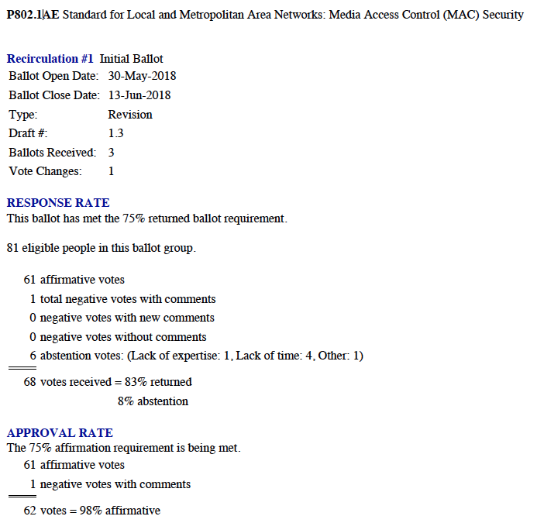
Supporting information for
P802.1AE-Rev to RevCom
  See
  http://www.ieee802.org/1/files/private/ae-rev-drafts/d1/802-1AE-rev-d1-3-dis.pdf
  for supporting documentation.
  1 outstanding Disapprove with 4 Must Be Satisfied comments on initial Sponsor Ballot.
Notes:
The report is for D1.3, and shows the unsatisfied comments from the initial sponsor ballot (which was D1.2).

Slide 19
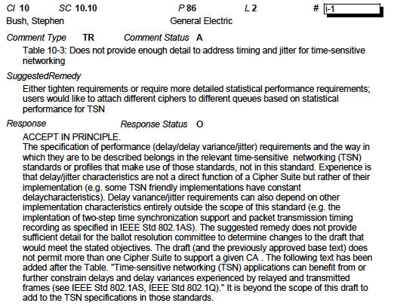
P802.1AE-REV outstanding comments (1)

Slide 20
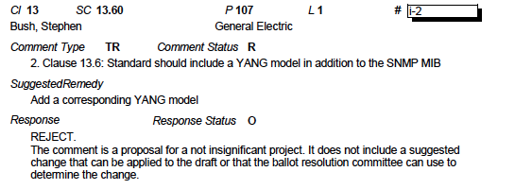
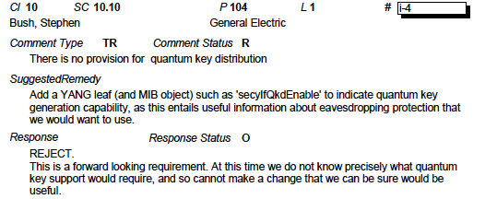
P802.1AE-REV outstanding comments (2)

Slide 21
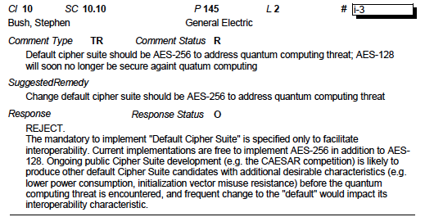
P802.1AE-REV outstanding comments (3)

Slide 22
Motion
Conditionally approve sending P802.1Xck D2.2 to RevCom
Approve CSD documentation in
  https://mentor.ieee.org/802-ec/dcn/15/ec-15-0070-00-ACSD-802-1xck.docx
In the WG Proposed: Seaman Second: Weis
  Forwarding draft to RevCom (y/n/a): 39, 0, 1
  CSD (y/n/a): 38, 0, 1
In EC, mover: John Messenger Second: David Law
  (y/n/a): <y>,<n>,<a>

Slide 23
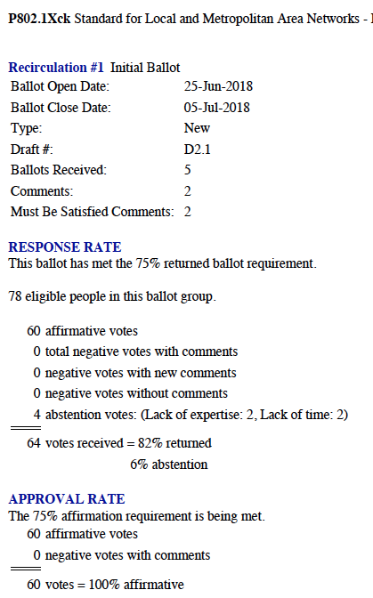
Supporting Information for P802.1Xck to RevCom
Ballot closed: 5 July 2018
No Disapprove votes
2 Must Be Satisfied comments (MEC) (no other comments)
Comment resolution available here:
  http://www.ieee802.org/1/files/private/xck-drafts/d2/802-1Xck-d2-1-dis-v01.pdf
Recirculation ballot will start immediately following this plenary meeting with resolution on the Security TG calls and a further recirculation if necessary.

Slide 24
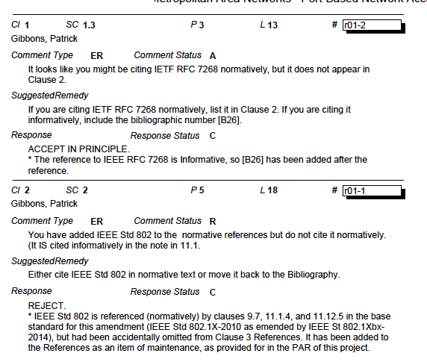
P802.1Xck outstanding comments
Notes:
Std 802 is referenced in the base. This amendment adds the missing entry in the normative references as a bugfix, allowed by PAR scope.

Slide 25
MOTION
Approve sending P802.1AC-2016-Cor-1/D2.0 to RevCom
No CSD for this maintenance PAR
P802.1AC-2016-Cor-1/D2.0 had 100% approval at the end of the last sponsor recirculation ballot.
In the WG, mover: Congdon Second: Rouyer
  Forwarding draft to RevCom (y/n/a): 39, 0, 0
In the EC, mover: Messenger Second: Law
  (y/n/a): , ,
Notes:
LLC Encapsulation EtherType

Slide 26
Supporting material for P802.1AC-2016-Cor-1 to RevCom
Recirculation #1
Ballot Open Date: 24-May-2018
Ballot Close Date: 03-Jun-2018
Type: New
Draft #: 2.0
Ballots Received: 1 (one additional approve)
RESPONSE RATE
This ballot has met the 75% returned ballot requirement.
66 eligible people in this ballot group.
60 affirmative votes
0 total negative votes with comments
0 negative votes with new comments
0 negative votes without comments
0 abstention votes
60 votes received = 90% returned
0% abstention
APPROVAL RATE
The 75% affirmation requirement is being met.
60 affirmative votes
0 negative votes with comments
60 votes = 100% affirmative

Slide 27
Motion
Conditionally approve sending P802.1Qcy D2.5 to RevCom
Approve CSD documentation for P802.1Qcy in https://mentor.ieee.org/802-ec/dcn/15/ec-15-0072-00-ACSD-802-1qcn.pdf
P802.1Qcy D2.3 had 100% approval at the end of the last Sponsor recirculation ballot
In the WG (y/n/a): 40, 0, 0
  Proposed: János Farkas Second: Paul Bottorff
In EC, mover: John Messenger Second: David Law
  (y/n/a): <y>,<n>,<a>
  * Note that the designation has been changed from P802.1Qcn to P802.1Qcy because of confusion of Qcn with the acronym for Quantized Congestion Notification (QCN).

Slide 28
Supporting information P802.1Qcy
Ballot closed: 17 June 2018
1 vote changed during the ballot comment resolution, resulting in
  0 outstanding Disapprove votes
  0 outstanding Must Be satisfied comments
Comment resolution available here: http://www.ieee802.org/1/files/private/cy-drafts/d2/802-1Qcy-d2-3-dis-v1.pdf
Recirculation ballot will be conducted during August with comment resolution during the September Interim and on the TSN TG calls. A possible final recirculation in October if required with comment resolution on the TSN TG calls.
Ballot results:
Notes:
Expecting final recirculation to be clean, as 100% approval.

Slide 29
Liaisons

Slide 30
Motion
Approve liaison of the following response to 3GPP RAN3
  http://www.ieee802.org/1/files/public/docs2018/liaison-response-3GPP-RAN3-0718-v01.pdf
In the WG (y/n/a): 38, 0, 0
  Proposed: János Farkas Second: Jessy Rouyer
In EC, for information
Notes:
P802.1CM TSN for Fronthaul

Slide 31
Motion
Approve liaison of the following letter to MEF Forum
  http://www.ieee802.org/1/files/public/docs2018/liaison-MEF-CFM-YANG-0718-v01.pdf
In the WG (y/n/a): 38, 0, 0
  Proposed: Scott Mansfield Second: Jessy Rouyer
In EC, for information
Notes:
MEF CFM YANG

Slide 32
Motion
Approve liaison of the following response to OPC Foundation
  http://www.ieee802.org/1/files/public/docs2018/liaison-response-OPCF-0718-v01.pdf
In the WG (y/n/a): 37, 0, 0
  Proposed: János Farkas Second: Jessy Rouyer
In EC, for information
Notes:
New liaison partner. Subject: 60802 Joint Project on TSN Profile for Industrial

Slide 33
Motion
Approve liaison of the following response (to LS 123) to ITU-T SG15
  http://www.ieee802.org/1/files/public/docs2018/liaison-response-ITU-T-SG15-LS123-CFM-Data-Models-0718-v01.pdf
  granting the IEEE LMSC chair (or his delegate) editorial license.
  This approval is under LMSC OM “Procedure for communication with government bodies”
In the WG (y/n/a): 38, 0, 0
  Proposed: Scott Mansfield Second: Jessy Rouyer
In the EC, mover: Messenger Second: Law
  (y/n/a): , ,
Notes:
Response to their liaison LS123 on CFM Data Models

Slide 34
Motion
Approve the press release on IEEE Std 802.1CM in http://www.ieee802.org/1/files/public/docs2018/cm-draft-press-release-0718-v01.pdf, to be released with editorial changes as deemed necessary
In the WG (y/n/a): 39, 0, 1
  Proposed: János Farkas Second: Jessy Rouyer
In EC, mover: John Messenger Second: David Law
  (y/n/a): <y>,<n>,<a>
Notes:
Circulated: http://www.ieee802.org/secmail/msg22605.html Monday 9 July 18:04 PT

Slide 35
Motion
Approve the eblast on the IEC/IEEE 60802 Joint Project in http://www.ieee802.org/1/files/public/docs2018/60802-draft-cfp-0718-v01.pdf, to be released with editorial changes as deemed necessary
In the WG (y/n/a): 38, 0, 0
  Proposed: János Farkas Second: Jessy Rouyer
In EC, mover: John Messenger Second: David Law
  (y/n/a): <y>,<n>,<a>
Notes:
eBlast release circulation: http://www.ieee802.org/secmail/msg22607.html Monday 9 July 23:45 PT

Slide 36
JTC1 SC6 PSDO items

Slide 37
MOTION
Approve liaison of the following draft(s) to ISO/IEC JTC1/SC6 for information under the PSDO agreement
  P802.1AS-Rev
Proposed: Congdon Second: Rouyer
For_38_Against_0_Abstain_0__
EC proposed: John Messenger Second: David Law
For____Against___Abstain____

Slide 38
MOTION
Approve submission of the following project(s) to ISO/IEC JTC1/SC6 for adoption under the PSDO agreement, once approved and published:
  802.1CM-2018 (*)
  802.1Q-2018 (*)
  802.1Qcc-2018 (**)
  802.1Qcp-2018 (**)
  802.1AR-2018 (**)
  802.1AC-2016/Cor-1 (***)
  802.1Qcy-2018
  802.1Xck-2018
  802.1AE-2018
In WG: Proposed: Congdon Second: Rouyer
For_38_Against_0_Abstain_0__
EC proposed: John Messenger Second: David Law
For____Against___Abstain____
Note: *published; **approved; ***under corrigendum process

