Slide 1
Executive Secretary Agenda Items November 2016 Plenary
Jon Rosdahl
IEEE 802 Executive Secretary
jrosdahl@ieee.org

Slide 2
802 Exec Sec Agenda Items
5.142 II Current and Future Venue Report

Slide 3
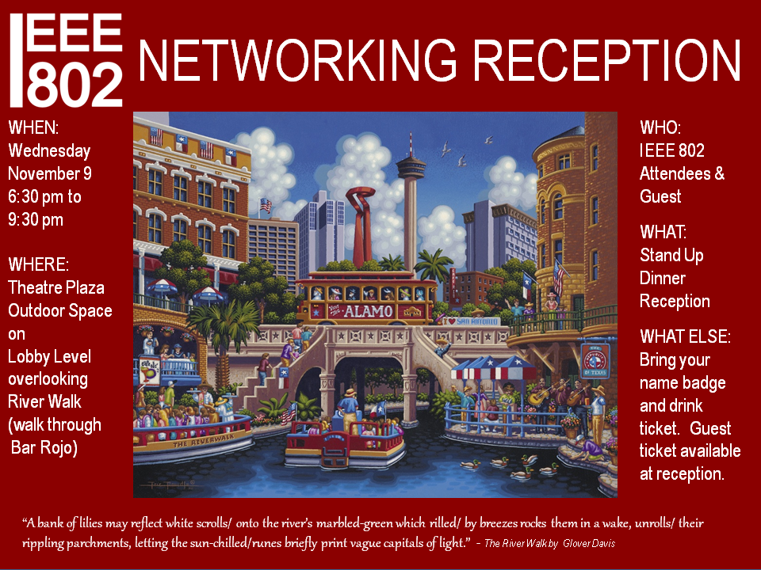

Slide 4
IEEE 802 Top 10
Social tickets are included with meeting registration for all paid IEEE 802 participants and their guests
What?
*networking +
* 1 complimentary drink +
* entertainment & a view of the River Walk
Guest drink ticket is available upon entrance to the reception.

Slide 5
IEEE 802 Top 10
2. Registration & Information Hours
Monday - Thursday
7:30 AM - 5 PM
Friday 7:30 AM – 1:30 PM
3. After Hours (including evenings)
Please text Darcel at:
+1 (604)808-9624 and if no reply,
please call!!

Slide 6
IEEE 802 Top 10
4. Meeting Space Requests or Issues
Contact Darcel
Text or Call: +1604-808-9624
    darcel@facetoface-events.com
Skype: darcelmoro
5. AV Issues
Contact Darcel.
Note: The default input for every meeting projector is VGA. Presenters without a video output on their computer are responsible to supply their own VGA dongle.
6. Network Issues
Contact Darcel, she will inform Verilan.

Slide 7
IEEE 802 Top 10
7. Food & Beverage Hours
Continental Breakfast 7:30 – 9 AM
Morning Coffee 9 – 11 AM
Afternoon Coffee & Tea 2 – 4pm
Afternoon Snacks
802.3 & 802.1 at 3 PM
Wireless Groups at 3:30 PM

Slide 8
IEEE 802 Top 10
8. Hotel Outlets:
PERKS is open 24 hours – coffee, drinks, pizzas, salad, and many more options
More info and options available at Meeting Information & posted on meeting boards.

Slide 9


Slide 10
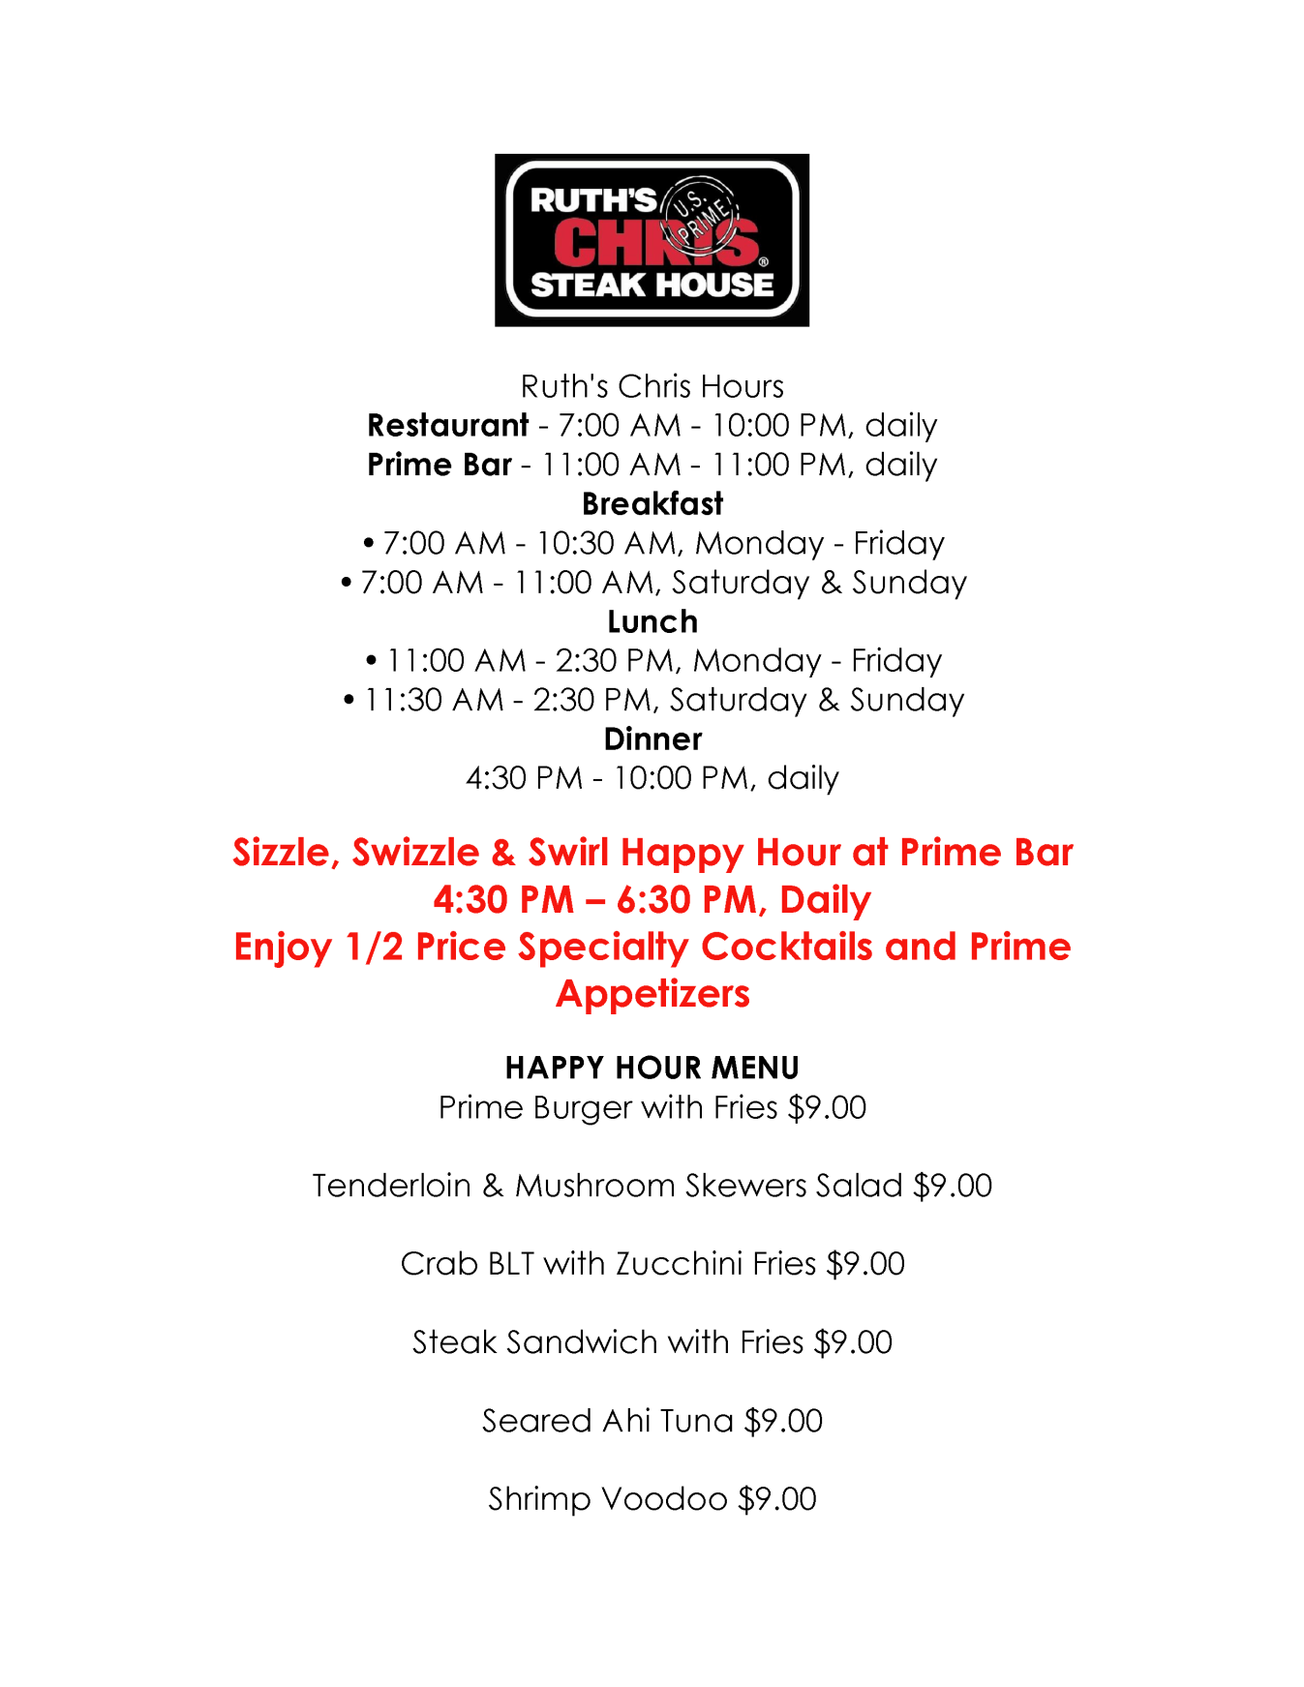

Slide 11
IEEE 802 Top 10
9. OFFICES:
  EVENT (FTF) - Crockett C (ext. 6115)
  NOC (VeriLAN) - Crockett D
Updates to WG Voter List – please email updates to both Dawn and Darcel
Thank you!

Slide 12
Network and Wired Cafe
WIRED CAFÉ
A wired café is situated in the Texas Ballroom Foyer. Please report any disruption of service in the café to VeriLAN staff.
NETWORK HELP DESK
For attendees experiencing difficulties accessing the meeting network a Help Desk will be located in Texas Ballroom Foyer.

Slide 13
5.142 Current and Future Venue Report
2017 – Vancouver, BC Canada
  Hyatt Regency and Fairmont Hotel
2018 – Asia Venue
  Bob Heile is assigned to help
  Report from Bob

Slide 14
Friday Closing EC Plenary
4.xx: II Future Venues –
8.044 II Executive Secretary Report
8.06 II Announcement of 802 EC Interim Telecon
(Tuesday 7 Feb 2017 1300-1500 ET)
8.07 II Call for Tutorials for March 2016 Plenary
(Monday March 13, 2016– Deadline – 27 January 2016)

Slide 15
Future Venue Insight
Future 802 Plenary Sessions:
  March 2017 Hyatt Regency/Fairmont – Vancouver
  July 2017 Estrel Hotel – Berlin
  Nov 2017 Caribe Hotel and Convention Center - Orlando
  March 2018 Hyatt Regency O’Hare – Rosemont, IL
  July 2018 Manchester Grand Hyatt – San Diego
  Nov 2018 Suzhou, China - TBC

Slide 16
802 Plenary March 2017
Save the Date: 13-17 March 2017
Registration target to open 9 December 2017
Hotel Information:
  Hyatt Regency Vancouver/Fairmont Hotel, Vancouver, Canada

Slide 17
*F8.045 Executive secretary report
LMSC 802 – P&P list of major duties:
  Oversee Venue selection –
  Present summaries of venue options.
  Oversee activities related to facilities and services
  Carry out Duties of Treasurer if Treasurer unavailable
Chairs Guideline list of major duties:
  1) 802 Meetings: Efficiency Improvement
  2) 802 Plenary Sessions: Facilities and Services
  3) IEEE 802 Registration Database
  4) Assist IEEE 802 Treasurer

Slide 18
*F8.06 – Announcement of 802 EC Interim Telecon (Tuesday 4 February 2017, 1-3pm ET)
Agenda for Interim EC meeting
– Tuesday 4 February 2017 1-3PM ET
Initial Proposed Draft Agenda
  Welcome/Intro/Approve Agenda - Nikolich 5 min
  Report: EC Action Item Summary - D’Ambrosia 10 min
  Report: March 2017 Plenary Status - Rosdahl 3 min
  Report on 2018 Future Venue options - Rosdahl/Heile 5 min
  Other Reports from WG Chairs
Per Chairs Guideline – Confirm during the Closing EC Plenary.

Slide 19
*F8.07 – Call for Tutorials for Nov 2016 Plenary
Tutorials to be held Monday, 13 March 2017
Tutorial Request form: http://www.ieee802.org/802_tutorials/802_Tutorial_Request_Form.doc
As a reminder please refer to Chair's Guidelines section 2.5 Tutorials for the logistics for participating in sponsoring/presenting a Tutorial.
Note that Tutorial times are 80 minutes with 10 minutes to allow for presenters to setup and depart.
All requests for Tutorials must be made by 27 January 2017
Notes:
All official tutorial request forms must be submitted no later than 45 days in advance of the Plenary Session.
Approved Tutorial Requests will be assigned a time slot based on the order in which they were received. The Final Tutorial Schedule will be posted at http://802world.org/plenary and http://ieee802.org no less than 14 days in advance of the Plenary Session.

