Slide 1
Suggestions on Proposed Draft Report:
IEEE 802 EC 5G/IMT-2020 SC
Document Number:
IEEE 802-EC-16-0099-04-5GSG
Date Submitted:
2016-06-29
Source:
Stephen PALM
Broadcom
Re:
5G/IMT-2020 Standing Committee
Base Contribution:
IEEE 802-EC-16-0094-04-5GSG
Purpose:
For discussion at 5GSG meeting of 2016-06-29
Summary:
Some suggestions on 802-EC-16-0094-04-5GSG
1

Slide 2
Proposed Draft Report:
IEEE 802 EC 5G/IMT-2020 SC
Document Number:
IEEE 802-EC-16-0094-04-5GSG
Date Submitted:
2016-06-28
Source:
Roger Marks Voice: +1 802 capable
EthAirNet Associates* E-mail: r.b.marks@ieee.org
*<http://standards.ieee.org/faqs/affiliationFAQ.html>
Re:
5G/IMT-2020 Standing Committee
Base Contribution:
[none]
Purpose:
For discussion at 5GSG meeting of 2016-06-29
Summary:
This document is a proposal for a draft final report of the IEEE 802 EC 5G/IMT-2020 Standing Committee. This is significantly based on 802-EC-16-0065-10-5GSG (“IEEE 802 EC 5G/IMT-2020 SC draft report”, or “5G SC report layout”). However, it is also quite different. 802-EC-16-0065-10-5GSG includes material intended for a final report as well as material relevant to planning the production of that report; the current contribution addresses only the former. Also, this contribution is streamlined with respect to 802-EC-16-0065-10-5GSG, leaving out some material that was addressed by in the course of discussions but may not be critical to a summary report. The report uses the methodology of identifying specific Candidate Approaches to the actions under consideration, analyzing those Candidate Approaches rather than all possible approaches to those actions. The proposal could form the basis of a final draft report. Additional material could be added. The structure of the proposal could be adapted as the structure of a text-based report, for which the slide format could serve as a summary.
2

Slide 3
Proposed Draft Report: IEEE 802 EC 5G/IMT-2020 SC
3
Roger Marks - EthAirNet Associates
roger@ethair.net +1 802 227 2253
29 June 2016
IEEE 802-EC-16-0094-04-5GSG
2016-06-28

Slide 4
4
Table of Contents
Introduction
Authorized Scope
Views of 5G
Actions Considered
A. IEEE “5G”
B1. IMT-2020 – single technology
B2. IMT-2020 – set of technologies
B3. IMT-2020 – external proposal
Conclusions
Next Steps
Appendix 1: Authorization by EC Ballot
Appendix 2: Meeting History
Appendix 3: Process
Appendix 4: Cost/Benefit Approach
Appendix 5: Relevant IEEE 802 Standards and Projects

Slide 5
Introduction
5
The IEEE 802 EC 5G/IMT-2020 Standing Committee was chartered by EC ballot (2016-02 to 2017)
see Appendix 1
Glenn Parsons served as Chair
The Standing Committee held face-to-face and electronic meetings
see Appendix 2
documents: https://mentor.ieee.org/802-ec/documents?is_group=5GSG
Standing Committee web site: http://ieee802.org/Stand_Com/5G
This document provides the requested report

Slide 6
Authorized Scope
6
To provide a report on the following items to the EC:
Costs and benefits of creating an IEEE “5G” specification
Note: The IEEE concept likely would have a different scope that what others are currently calling 5G.
Costs and benefits of providing a proposal for IMT-2020, considering possible models of a proposal:
as a single technology,
as a set of technologies,
or as one or more technologies within a proposal from external bodies (e.g., 3GPP)
During its lifetime, to act as the communication point with other IEEE organizations on this topic.
Added Note

Slide 7
7
Views of 5G
• 5G is understood many ways.
• Facets that distinguish 5G may include:
Technology: radical new technologies or technology sets
could include spectrum-related technology issues
millimeter wave spectrum
technologies designed for unlicensed use
Service: provides new services or new service sets
Performance: new levels of performance to users, or to operators
Operator ecosystem, either:
next step for the existing 2G/3G/4G incumbent mobile operators
an opportunity for new operators
Standards: set of interoperability standards rolled out by an ecosystem according to a roadmap
Other Characteristic: a marketing label, a revolution, etc.

Slide 8
8
5G Context for this study
• Action A: creating an IEEE 5G specification
could support incumbent mobile operators
via existing cellular ecosystem
could support new operators
creation/support of new ecosystems
this might be a very different 5G
would need to identify requirements
could do both
• Action B: providing a proposal for IMT-2020
supports the 5G of the existing cellular ecosystem
usage scenarios and requirements specified in IMT-2020 process
802 could help shape requirements (needs to act soon)
• Actions A and B are not contradictory or exclusive

Slide 9
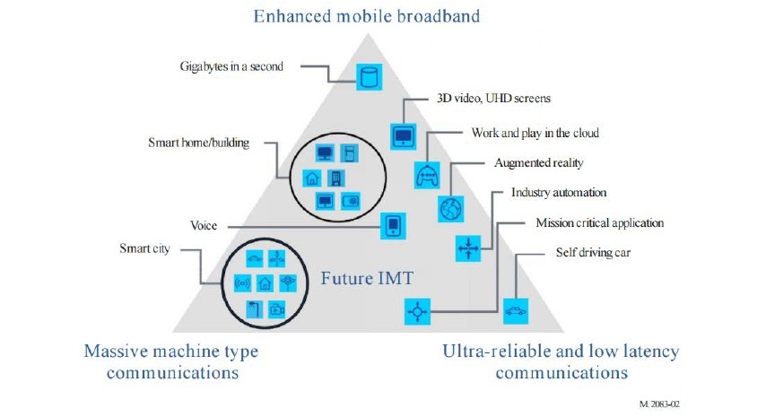
IMT-2020 (per ITU-R M.2083 – Figure 2)’s 5G
9

Slide 10
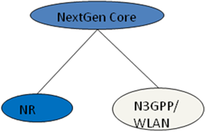
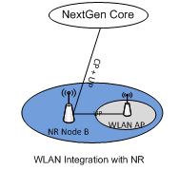
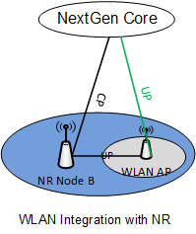
3GPP “NextGen Core” and New RAT (NR)
New slide
3GPP is developing a 5G Core Network named as “NextGen Core” and a new 5G “New RAT” (NR)
There may be several candidate architectures by which 802.11 can be integrated into 3GPP 5G network, e.g.
(1) 802.11 WLAN interfaces directly to “NextGen Core”
(2) 802.11 WLAN interfaces with “New RAT” base station e.g. similar to “dual connectivity” architecture used by LWA/LWIP
[see R2-163969]
(3) 802.11 WLAN data plane interfaces with “New RAT” base station, while control plane interfaces with “Next Gen Core”

Slide 11
What are all the derivatives of options for IEEE?
11

Slide 12
12
Action A: IEEE “5G” specification
Candidate Approach
• specify an 802 access network
could be based on P802.1CF
“network reference model defines a generic foundation for the description of IEEE 802 access networks, which may include multiple network interfaces, multiple network access technologies, and multiple network subscriptions, aimed at unifying the support of different interface technologies, enabling shared network control and use of software-defined networking (SDN) principles”
provides an external view into general 802 access network
could support many 802 MACs
could plug into incumbent mobile operator networks
for example, expand the notion of LWA so that the cellular network supports 802 rather than 802.11
gives 802 a strong supporting role in cellular 5G networks
could support integration into other operator networks
e.g. cable TV or fixed telecom
gives 802 a central role in non-cellular 5G networks
feasible for 802 access network to support both
need not promote it as an “IEEE 5G” network

Slide 13
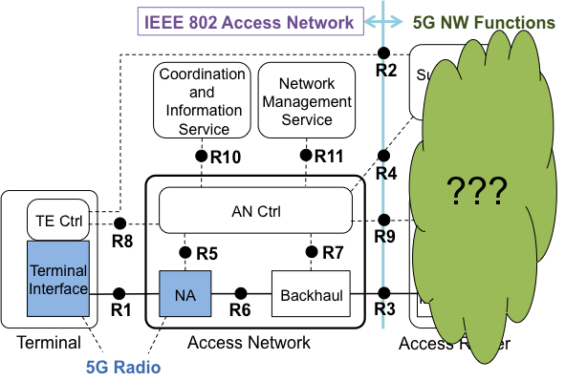
13
P802.1CF Interface option to 5G

Slide 14
14
Action A: Routes to success
802 Access Network
• engage with 3GPP to specify interface details
could support many 802 MACs
• engage with other parties to specify interface details
build partnership with other operator communities
• support internationalization
standardize within partner communities
standardize in JTC1
standardize in ITU-R (WP 5A) in support of spectrum needs
WP 5A: “Land mobile service excluding IMT”
refer to WP 5A’s “Guide to the use of ITU-R texts relating to the land mobile service, including wireless access in the fixed service”
could standardize in ITU-R IMT-2020 (see Action B)

Slide 15
15
Action A: Possible partners
802 Access Network
• IEEE
ComSoc standards; esp. IEEE 1904 Access Networks Working Group
• 3GPP
• ITU-R (WP 5A; WP 5D)
• IETF, Broadband Forum, CableLabs, MEF, ETSI BRAN, Open Networking Foundation, Wi-Fi Alliance, ZigBee Alliance, Ethernet Alliance, WiMAX Forum, CPRI, …

Slide 16
16
Action A – IEEE 802 Access Network
Objective
Adoption of IEEE 802 Access Network specification in multiple disparate operator networks.
Strength | Weakness | Opportunity | Threat
1. Builds on traditional 802 presentation of interface to support many networks | 1. Could require compromises in the support of any specific network | 1. Can be applied in both 3GPP networks and in alternative networks | 1. Coordination efforts required– may not be accepted
2. Enhances interoperation with identified end-to-end networks | 2. Requires liaison activity to coordinate interface requirements. | 2. Offers an advantage for end-to-end networks to use 802 | 2. Specifications may come too late or under-perform
3. Encourages other end-to-end networks to adapt 802 | 3. May requires liaison activity to coordinate interface requirements | 3. Increases value of the entire range of 802 MAC/PHYs | 3. Non-802 technologies may be used at the specified interface
Description
Specify an IEEE 802 Access Network, incorporating IEEE 802 MAC/PHYs and supporting standards, with a unified interface to end-to-end networks. Promote standardization of the integration of the IEEE 802 Access Network into end-to-end networks.
Cost | Benefit
IEEE 802 needs to develop Access Network spec; 802 MAC/PHYs need to develop complementary specs; external ecosystems need to be developed | Makes IEEE 802 the central player in heterogeneous access and in access networks for 5G of all forms; IEEE has no responsibility to specify end-to-end

Slide 17
17
Action B: IMT-2020 proposal
Candidate Approaches
• B1: Direct IMT-2020 – single technology
Develop and submit an IEEE proposal to adopt some IEEE 802.11 radio interface technology into IMT-2020 RIT.
• B2: Direct IMT-2020 – set of technologies
Develop and submit an IEEE proposal to adopt coherent set of IEEE 802 radio interface technologies into IMT-2020 RIT, possibly integrated in an IEEE 802 Access Network.
• B3: IMT-2020 – external partner proposal
Support development of a 3GPP proposal incorporating references to the use of IEEE 802.11, or an IEEE 802 Access Network.
Added “Direct”
Added “Partner”

Slide 18
18
Action B1: single technology
Candidate Approach: more detail
IEEE 802.11 radio interface technology based on IEEE P802.11ay
Addressing eMBB usage scenario
Targeting indoor hotspot test environment

Slide 19
This slide was “missing”?
19
Action B2: set of technologies
Candidate Approach: more detail
Develop and submit an IEEE proposal to adopt coherent set of IEEE 802 radio interface technologies into IMT-2020 RIT, possibly integrated in an IEEE 802 Access Network.
(scenarios)

Slide 20
20
Action B3: external partner proposal
Candidate Approach: more detail
Support development of a 3GPP proposal incorporating reference to the use of IEEE 802.11, or an IEEE 802 Access Network.
Reference 802 network presumed to operate in non-IMT bands
for example, 802.11ax in 5 GHz bands, 802.11ay in 60 GHz, etc.
would not be proposed as IMT-2020 RIT
Does not preclude parallel action B1 or B2 to propose IMT-2020 RIT
Serves as a feature enhancement to 3GPP network operation
not evaluated against IMT-2020 technical requirements
3GPP meets IMT-2020 technical requirements with 3GPP SRIT
requires technical analysis to select appropriate architectural models for integration with 3GPP network
requires coordination with 3GPP on details

Slide 21
21
Action B1 – IMT-2020 proposal,
single technology
Objective
IMT-2020 recognition for some IEEE 802.11 radio interface.
Strength | Weakness | Opportunity | Threat
1. An 802.11 radio interface can be recognized as IMT-2020 | 1. Difficult application process; may require new standards to meet requirements | 1. IMT-2020 recognition can add marketing value | 1. May become more difficult to convince regulators to identify more RLAN spectrum
2. Allows independent IEEE proposal | 2. Requires 3GPP to agree to merge result into a SRIT | 2. Allows 802.11 to optimize proposal | 2. 3GPP may prefer alternative and may not agree
3. Allows IEEE to propose use of unlicensed technology for IMT | 3. Unclear how technologies built for unlicensed use would fit into IMT spectrum | 3. IMT recognition can promote use of that 802.11 radio interface in IMT spectrum | 3. May become more difficult to attain more RLAN spectrum
Description
Develop and submit an IEEE proposal to adopt some form of IEEE 802.11 radio interface technology into IMT-2020.
Cost | Benefit
Developing standards, preparing and pitching proposal, developing administration support, supporting evaluations, negotiating SRIT, perpetual maintenance | Marketing value. Possibility of better access to spectrum, particularly by targeting a specific segment of new mm-wave spectrum to be identified for IMT

Slide 22
22
Action B2 – IMT-2020 proposal,
set of technologies
Objective
Strength | Weakness | Opportunity | Threat
1. 802 radio interfaces can be recognized as IMT-2020 | 1. Difficult application process; may require new stds, and internal coordination, to meet requirements | 1. IMT-2020 recognition can add marketing value | 1. May become more difficult to convince regulators to identify more 802-friendly spectrum
2. Allows independent IEEE proposal | 2. Requires 3GPP to agree to merge result into a SRIT | 2. Allows 802 to optimize proposal | 2. 3GPP may prefer alternative and may not agree
3. Allows IEEE to propose use of unlicensed technology for IMT | 3. Unclear how technologies built for unlicensed use would fit into IMT spectrum | 3. IMT recognition can promote use of those 802 radio interfaces in IMT spectrum | 3. May become more difficult to attain more 802-friendly spectrum
Objective
IMT-2020 recognition for several IEEE 802 radio interfaces.
Description
Develop and submit an IEEE proposal to adopt coherent set of IEEE 802 radio interface technologies into IMT-2020, possibly integrated in an IEEE 802 Access Network.
Cost | Benefit
Developing standards, preparing and pitching proposal, developing administration support, supporting evaluations, negotiating SRIT, perpetual maintenance | Marketing value. Possibility of better access to spectrum, particularly by targeting a specific segment of new mm-wave spectrum to be identified for IMT

Slide 23
23
Action B3 – IMT-2020 proposal,
external proposal
Objective
3GPP incorporation of IEEE 802 features, referenced in IMT-2020.
Strength | Weakness | Opportunity | Threat
1. IEEE 802 technologies are referenced in IMT-2020 | 1. 3GPP would make the final decisions about the details of the proposal | 1. Encourages use of IEEE 802 in 3GPP 5G networks | 1. Focus on 3GPP may reduce applicability of 802 radio interfaces to non-cellular networks
2. No need for IEEE 802 radio interfaces to meet IMT-202o requirements or be evaluated in ITU-R WP 5D | 2. IEEE 802 radio interfaces are not identified as IMT-2020 and are not applicable to IMT spectrum, including new mm-wave IMT spectrum to be identified | 2. A peripheral role in IMT-2020 | 2. IEEE 802 radio interfaces would be in a weaker position than IMT-2020 radio interfaces for IMT spectrum, including new mm-wave IMT spectrum to be identified
Description
Support development of a 3GPP proposal for IMT-2020 incorporating references to the use of IEEE 802.11 or an IEEE 802 Access Network.
Cost | Benefit
Development of the interface, and coordination with 3GPP on integration of the interface | Encourages use of IEEE 802 in 3GPP 5G networks; aligns with industry momentum.

Slide 24
Integration of 802.11 in 3GPP 5G networks
New slide
Different architectures may suit different operator deployments and use cases, e.g.
Some architectures imply increased load on backhaul
“Dual connectivity” architectures may not allow for macro coverage if NR base station operates at higher frequency than WLAN
Availability of specifications for the different architectures depends on future 3GPP progress, decisions and specification timeline
Out of the control of IEEE
Commercial deployment of the different architectures depends on handset vendor roadmaps, cellular infrastructure vendor roadmaps and network operator decisions
Out of the control of IEEE
Any technical activities for 5G undertaken by IEEE 802.11 should focus on enablers / building blocks / interfaces that are as generic as possible and can be utilized by any architecture.
Consider gap analysis for any necessary specification work (eg: “802.11 as a component”)

Slide 25
Proposed Approach – 2 prongs:
New slide
Ensure relevant IEEE technologies are part of the incumbent operator 5G universe
Complementary - Propose we only recommend world class winning technologies that already have a foothold in 3GPP to ensure credibility with ITU-R.
Focus on some specific use cases/environment. E.g. In-home entertainment, Indoor Hotspot, Outdoor Hotspot, Community
Liaise with 3GPP as the Release 13/14 features and specifications evolve into Release 15/16/NR/…
IMT-2020 requirements will evolve in ITU-R and need to be tracked
IEEE deliverables must ensure that a 5G network including 3GPP and IEEE/WFA technologies meets the appropriate IMT-2020 requirements
Ensure IEEE technologies work for independents

Slide 26
Next Steps
26
Actions toward B3 (Incumbents)
“Exploring further involvement of IEEE in this work should be initiated by liaison to 3GPP”
Per IEEE 802-EC-16-0065-10-5GSG
Actions towards A
?
Identify those who will perform the Actions
Added from here

Slide 27
27
Conclusions
[tbd]

Slide 28
28
Appendix 1:
Authorization by EC Ballot
Motion: Approve the creation of the IEEE 802 5G/IMT-2020 standing committee (per 5.6 2 of the LMSC P&P) with the following scope and organization:
• To provide a report on the following items to the EC:
▫ Costs and benefits of creating an IEEE 5G specification
▫ Costs and benefits of providing a proposal for IMT-
2020, considering possible models of a proposal:
● as a single technology,
● as a set of technologies,
● or as one or more technologies within a proposal from external bodies (e.g., 3GPP)
• During its lifetime, to act as the communication point
with other IEEE organizations on this topic.
Organization: The committee is chartered for 6 months (i.e., due July 2016 at the 802 plenary) as an EC SC (type 2). Any 802 WG voting member may participate as a voting member of the committee.
Start of ballot: Monday January 25, 2016
Close of ballot: February 4, 2016 11:59PM AOE

Slide 29
29
Appendix 2:
Meeting History
•
•
•
•
•
•
•
•
•
June 1 – 10am ET
June 8 – 6pm ET
June 15 – 10am ET
June 24 – 9-12 ET
June 29 – 6pm ET
July 6 – 10am ET
July 13 – 6pm ET
July 20 – 10am ET
July 25 & 26
•
•
•
•
•
March 30 – 10am ET
April 13 - 10am ET
April 20 – 6pm ET
April 27 – 10am ET
May 11 – 10am ET
May 20 – 1-4pm HAST
May 25 – 9-12 CEST

Slide 30
30
Appendix 3: Process
Discuss options
Applicable to the four actions to be analyzed
Include and describe at least one Candidate Approach to each proposed action
Expand cost/benefit for each
Standing Committee conclusions
Straw-poll views on the possible actions
Recommend way forward for preference
Consensus sought

Slide 31
31
Appendix 4: Cost/Benefit Approach
Provide requested cost-benefit analysis
But without monetary cost, only relative costs
quantitative pros vs cons
Strengths, Weaknesses, Opportunities and Threats
Brainstorm all costs and benefits
e.g., resource cost, standards development cost, installation cost, operational cost, energy cost, etc.
Are there unexpected costs?
Are there unanticipated benefits?
Estimate value relative to a baselin

Slide 32
32
Appendix 5: IEEE 802 Standards or Projects of Possible Relevance
802.1
P802.1CF – OmniRAN architecture
P802.1CM – TSN for Fronthaul
802.3
802.11
P802.11ax – high aggregate throughput. High density of users.
IEEE Std 802.11ad – high individual throughput, short range
P802.11ay – next generation of 802.11ad
P802.11ah - <1 GHz for IoT requirements
802.15
P802.15.3d
100Gb/s THz project
P802.15.7 REVa, Optical Wireless Communications
P802.15.4 family
802.16
802.16
802.16.1
802.21
P802.21.1

