Slide 1
P802.1CF within the scope of 5G
Max Riegel (Nokia)
802.1 OmniRAN TG chair
2016-03-15

Slide 2
What is 5G?
Main source of requirements is NGMN 5G White Paper http://ngmn.org/fileadmin/ngmn/content/images/news/ngmn_news/NGMN_5G_White_Paper_V1_0.pdf
Table of Contents
  Executive Summary
  Introduction
  5G Vision
    Business Context
    Use Cases
    Business Models
  Requirements
  Technology and Architecture
  Spectrum
  IPR
  Way Forward
  Conclusions
  Annexes
Mainly spectrum and radio aspects were introduced to 802.11 by https://mentor.ieee.org/802.11/dcn/15/11-15-0547-00-0wng-ngmn-5g-white-paper-overview.pptx
This presentation covers networking aspects in relation to the scope of P802.1CF

Slide 3
Participation in 5G/IMT-2020
IEEE 802 radios match 5G requirements
5G Technology Directions
IEEE 802 technologies
Extreme broadband
  ..
  ..
M2M
  ..
  ..
Critical communication
  ..
  ..
Extreme Broadband
High throughput, consistent QoE
5G Radio
Requirements
M2M
Low cost,
low battery consumption
Critical communication
Low latency,
high reliability

Slide 4
Assumptions about network integration of the various Radio Access Technologies
From the NGMN Alliance 5G whitepaper:
Fully leveraging capabilities of IEEE 802 technologies capabilities would require that IEEE 802 provides an appropriate network interface to the 5G core.

Slide 5
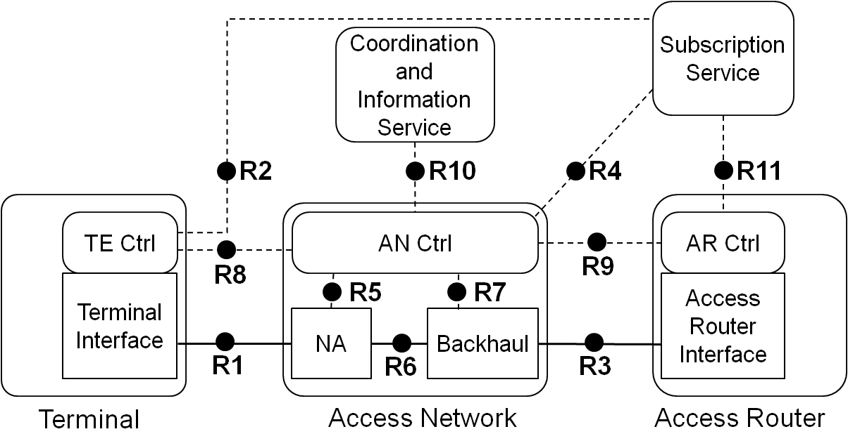
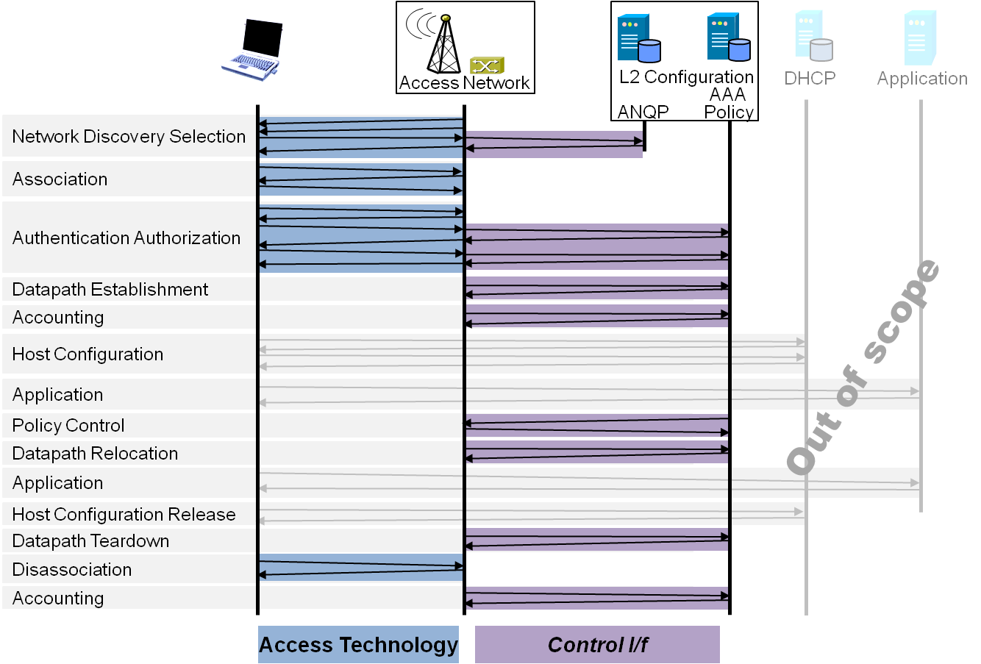
P802.1CF: Network Reference Model and Functional Description of IEEE 802 Access Network
Overview
References, definitions, acronyms and abbreviations
Conformance
Network Reference Model
  Basic concepts and terminology
  Overview of NRM
  Basic, enhanced and comprehensive NRM
  Deployment scenarios
Functional Design and Decomposition
  Access Network Setup
  Network Discovery and Selection
  Association and Disassociation
  Authentication and Trust Establishment
  Data path establishment,
  relocation and teardown
  Authorization, QoS and policy control
  Monitoring and statistics
  Fault diagnostics and maintenance
SDN Abstraction
Annex:
  PICS proforma
  Privacy Engineering
  Applicability to non-IEEE 802 PHY layer technologies
  Bibliography

Slide 6
P802.1CF Interface option to 5G
IEEE 802 Access Network
5G NW Functions
Subscription
Service
Coordination and Information
Service
R2
R10
R4
R11
TE Ctrl
AN Ctrl
AR Ctrl
R8
R9
Terminal
Interface
R5
R7
Access Router
Interface
NA
Backhaul
R1
R6
R3
Terminal
Access Network
Access Router
5G Radio

Slide 7
Conclusion
IEEE 802 radio technologies require an own version of radio access network to fully unleash their capabilities.
P802.1CF provides a generic approach for an IEEE 802 radio access network.
NGMN has demanding expectations on the upcoming mobile networks.
P802.1CF can fulfill NGMN expectations and requirements for the 5G radio access network.
  Except wide area high mobility, which is not in scope

Slide 8
Evaluation of options
IEEE 5G
  Benefits: complete set of RAN and Core specs
  Costs: huge standardization efforts
IMT-2020 – single technology
  Benefits: single RAN profile required; no Core
  Costs: small standardization efforts
IMT-2020 – set of technologies
  Benefits: multiple RAN profiles; no Core
  Costs: modest standardization efforts
IMT-2020 – external proposal
  Benefits: t.b.d.: no - special RAN profile; no Core
  Costs: depends

