Slide 1

Update on
ITU-T FG IMT-2020
Glenn Parsons
glenn.parsons@ericsson.com
March 2016

Slide 2
ITU-T FG IMT-2020 – First Phase
ITU-T SG13 – the Parent Study Group
Limited life time: June – Dec 2015
The Initial Objectives:
  produce materials of standards gap analysis of IMT-2020 in order to identify the relevant scope of ITU-T Recommendations on the fixed network of IMT-2020. Non-Radio topics only
First Phase was completed successfully and the gap analysis report discussed and approved by ITU-T SG13 in Dec.,2015.

Slide 3
ITU-T FG IMT2020 – Second Phase
ITU-T SG13 approved to extend the lifetime of the FG for one year to the end of 2016 with new ToR as indicated below:
  Explore demonstrations or prototyping with other groups, notably the open source community
  Enhance aspects related to Networks softwarization and ICN;
  Continue to refine and develop the IMT-2020 network architecture
  Continue the study of fixed mobile convergence aspects
  Continue to study network slicing for the front haul/back haul network
  Continue to define new traffic models and associated QoS and OAM aspects applicable to IMT-2020 networks

Slide 4
FG IMT-2020 – New Structure
The new structure for the FG is as follow:
  WG1: Architecture and Framework/Fixed Mobile Convergence (FMC)
  WG2: Network Softwarization/Transport FH/BH supporting slicing and Transport SDN
  WG3: Information Centric Networking (ICN)
  WG4: End-to-End Network Management

Slide 5
FG IMT2020 – Working Methods
Conference calls - many
Face-to-face meetings
  Seoul, 8-11 March 2016
  Beijing, 17-20 May 2016
  US, early September (TBD)
  Geneva, late Nov (TBD)

Slide 6
FG IMT2020- Current Work
During recent conference calls, it was initially agreed to develop the following draft recommendations:
- Network Management framework for IMT-2020
- Network Management requirements
- Requirements of IMT-2020 from non-radio network perspective
- Framework of IMT-2020 from non-radio network perspective
Other Planned Activities:
- Create a catalogue of open source software on NW Softwarization
- Mapping open source software in end-to-end slicing
- Explore Interaction among multiple open source software
- Plan a number of PoCs

Slide 7
ITU-T Focus Group on
IMT-2020 Wireline
March 14 2016
Peter Ashwood-Smith - Chairman
peter.ashwoodsmith@huawei.com
802.1 liaison
http://www.ieee802.org/1/files/public/docs2016/liaison-SG13-LS139_IMT2020-0216.zip

Slide 8
More to 5G than just the radio side… its cloud
FG looks at non radio aspects.
C-RAN INSTANCE
SLICE CONTROLLER
METRO N/W
CONTROLLER
MASTER
SLICE CONTROLLER
C-RAN INSTANCE
SLICE CONTROLLER
C-RAN INSTANCE
SLICE CONTROLLER
UE SLICE
CTRL
FH SLICE
CTRL
IDC SLICE
CTRL
DC FABRIC
CTRL
DC SERVER
CTRL
UE SLICE
CTRL
FH SLICE
CTRL
IDC SLICE
CTRL
DC FABRIC
CTRL
DC SERVER
CTRL
DC
CONTROLLER
))))
))))
CN
CN
400 GE
CN
CN
DWDM
RAT / CN
CN
CN
DWDM
400 GE
RAT/ CN
CN
CN
RAT / CN
))))
CN / MEC
CN
RAT/ CN
))))
RAT
CN
CN
))))
CN / MEC
CN/MEC
CN
))))
RAT
RAT/ CN
Idle/off
DC POD
CN/MEC
Idle/off
RAT/MEC
DC POD
RAT/ CN
Idle/off
RAT/MEC
DWDM
IDC/I-CRAN
Idle/off
DWDM
Packet/Optical
Analog
Analog
Notes:
We expect to see SDN and Transport SDN play important roles in the integration of the various networks under one orchestration umbrella. T-SDN can be used to control the microwave links between antenna sites, likewise T-SDN can be used to control the metro network where the front-haul and back-haul wire-line is executed. SDN again plays a role managing the network and servers that resides in the data center where the NFV functions and/or C-RAN functions execute.
Various applications/services can reside on top of the 5G orchestration system which provide them with an unprecedented flexibility to operate on the entire 5G network end to end and if suitable hooks are provided into the C-RAN functions and the EPC functions the 5G applications can co-ordinate all the behavior of their slice of a 5G network end to end.

Slide 9
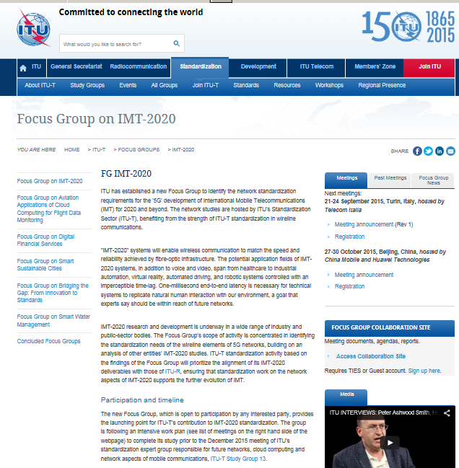
ITU-T 5G wireline FG-IMT-2020 Phase I -2015 Summary
ITU Focus Group to study the requirements and standardization needs of the wireline in support of 5G (non Radio)
Huawei chair (Peter Ashwood-Smith) in May 2015
Vice chairs CMCC(Y.Wantg), ETRI(N.Ko), NTT (Y.Goto), Telecom Italia (L.Pesando)
Parent Group SG-13
Completely Free format to explore ‘gaps’ required to support the 5G vision (IMT.VISION)
Parallel work in 5 main areas to minimize overlap with other 5G SDO’s:
  High level network architecture, championed by Dr Namseok Ko, ETRI, Korea;
  Network softwarization, championed by Prof Akihiro Nakao, University of Tokyo, Japan;
  End-to-end quality of service, championed by Dongwook Kim, ex KT Corporation;
  Olivia Heeyun Choi, KT Corporation;
  Front haul / back haul, championed by Dr Frank Effenberger, Huawei Technologies;
  Dr Gyaneshwar C. Gupta, Oki Electric Industry Co., Ltd.
  Emerging networking technologies - information centric networking (ICN), championed
  by Dr Paul Polakos, Cisco Systems; Dr Marc Mosko, PARC.
Led production of final document with 85 identified gaps in 5 areas and delivery to SG-13 in December 2015.
Meeting | San Diego (8-9 June 2015) | Geneva (13-14 July 2015) | Turin (21-24 September 2015) | Beijing (27-30 October 2015)
Input docs | 34 | 26 | 34 | 27
Output docs | 1 | 7 | 6 | 2
Meeting report | O-001 | O-002 | O-009 | O-015
Remote participants | 18 | 30 | 22 | 11
Total participants | 60 | 75 | 55 | 63
+ multiple conference
Calls, Work Shops etc.

Slide 10
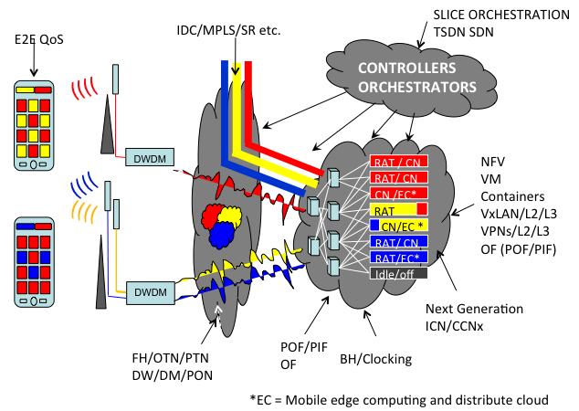
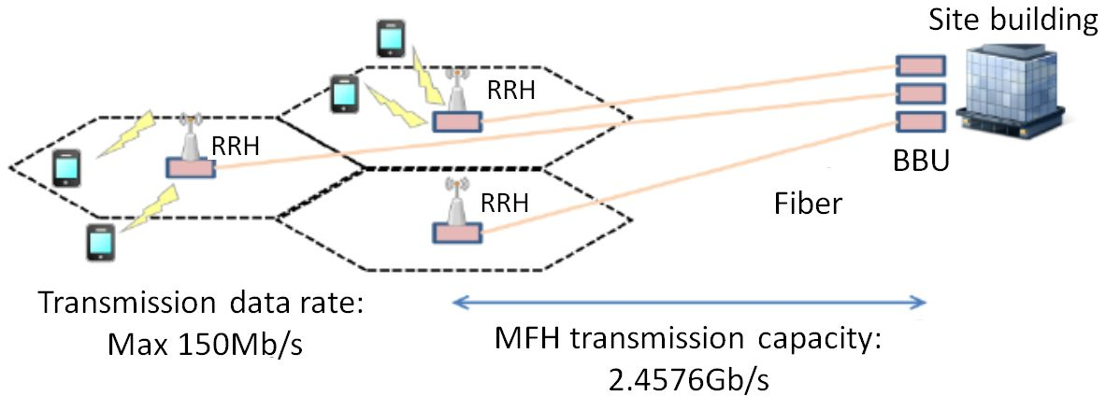
First Output Document Structure:
Executive Summary + Gaps + Supplemental info
A.17 OAM protocols | Priority: High
Description: OAM protocols are not standardized in some parts of IMT networks such as the front haul network. Standard OAM protocols should be studied for fault management and performance management between network equipment that may be commonly used across the IMT-2020 network.
Related work:
A.18 End-to-end network management in a multi-domain environment | Priority: High
Description: Multiple network management protocols in different network domains make it difficult to support unified network operations over multiple network domains. A unified end-to-end network management should be considered to ensure compatibility and flexibility for the operation and management of an IMT-2020 network.
Related work: SG13
A.19 Mobility management for distributed flat network | Priority: High
Description: As the IMT-2020 core network is envisioned to be a flat distributed network, which is composed of the multiple distributed gateways to cope with traffic explosion and latency requirements of applications, mobility management should be studied aligning with those architectural changes.
Related work: 3GPP, SG13

Slide 11
ITU-T 5G wireline FG-IMT-2020 Phase II (2016)
Renewed end of 2015 for all of 2016 (Ashwood-Smith chair), Vice Chairs same with one substitution within NTT.
New Terms of Reference as follows:
  Demonstrations or prototyping with other groups (e.g., with open source community);
  Network softwarization and ICN;
  Network architecture refinement;
  Fixed mobile convergence;
  Network slicing for front haul/back haul;
  New traffic models and associated QoS and OAM aspects applicable to IMT-2020 architecture.
Four meetings in 2016 – First is March in Seoul next is Beijing in early May, Palo Alto in September and concluding meeting likely November in Geneva.
  First meeting had demos of: LTE eNodeB virtualization via containers, CPRI over Packet, and Fabric-As-A-Service on ODL. Video demo recordings are available via the ITU-T FG SharePoint.
Expected year end outputs 1: Several draft recommendations close to final ready to be progressed by ITU in 2017.
Expected year end outputs 2: Proof of concept of softwarization, possibly joint open source orchestrator with hopefully end to end demos to be done at final meeting.
We of course welcome collaboration with other interested SDO.

