Slide 1
IEEE SA Overview
Bruce Kraemer
IEEE 802 Plenary Waikoloa, HI, 17 July 2015

Slide 2
Charter

Slide 3
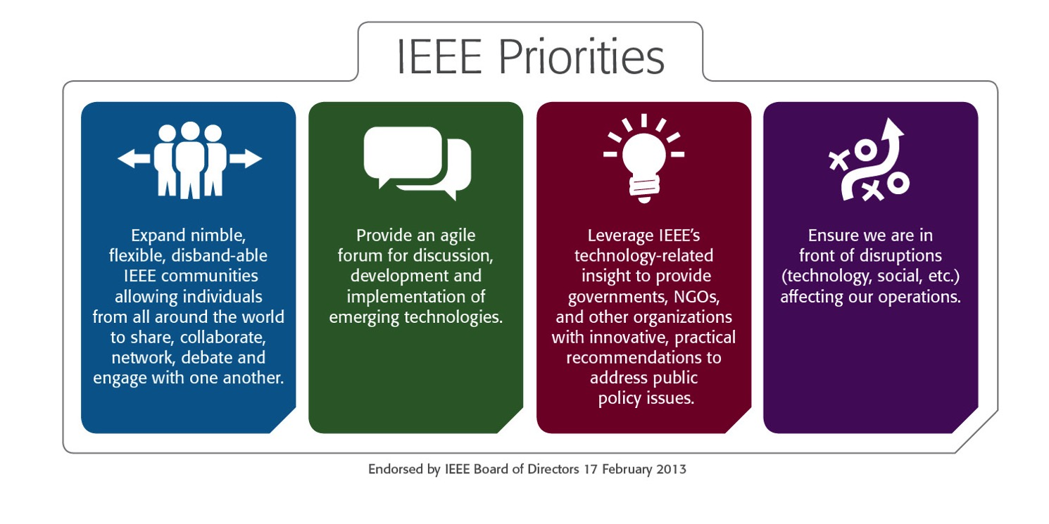
IEEE Priorities

Slide 4
Standards Association Charter
  IEEE Constitution & Bylaws Section I-303
  Major Boards: EAB, MGA, PSPB, TAB, IEEE-USA, SA
    Clause 6: Standards Association
    “shall coordinate, develop, approve and revise standards and conduct other standards-related activities in fields of interest to the IEEE”
IEEE Policies – Section 8 – Standards Activities
The objectives of the IEEE's standards activities are
To develop and publish broadly accepted standards and other standards-related documents that will advance the theory and practice of electrical engineering, electronics, computer science, radio, and allied branches of engineering or the related arts and sciences, and
To work with other standardizing bodies, both national (of any country) and international, to take available needed standards in the field of electrotechnology.

Slide 5
SA Vision & Mission
IEEE Standards Association (IEEE-SA)
Vision
Be recognized as a preferred global provider of high-quality, market-relevant technology standards and of services
Mission
Advancing technology for the benefit of humanity by providing a globally open, inclusive and transparent environment for market relevant, voluntary consensus standardization

Slide 6
Operational
Structure

Slide 7
Entities and Relationships
IEEE MEMBERS
Board of Directors (BOD)
Exec Director & Staff
Standards Association
  7,000 individual SA members
  20,000 participants
  200+ corporate SA members
  1,000+ active standards
  550+ projects
Technical
Activities
Publication
Activities
Member & Geographic
Activities
Educational
Activities
IEEE-USA
Standards
Activities
SA Exec Director & Staff
  80 full time staff
Computer Society
Sponsor
IEEE-SA Board of Governors
(BOG)
WG
WG
Sponsor
WG
WG
WG
Communications Society
Sponsor
WG
Standards Board
(SASB)
Corporate Advisory Group
(CAG)
RAC
ICAP
Sponsor
WG
WG
WG
Administrative Committee
(AdCom)
Audit Committee
(AudCom)
Industry Connections Committee
(IC Com)
New Standards Committee
(NesCom)
Patent Committee
(PatCom)
Procedures Committee
(ProCom)
Standards Review Committee
(RevCom)

Slide 8
SA Entity Relationship diagram
International SDOs, Gov’t Agencies
Corporate Relationships (Entity model & IEEE)
BoD Engagements
2030 Plans
SA
Strategic plan, Objectives, Initiatives, Metrics
Bylaws, Operations, PR
TAB
Education
Society Relationships, Support/Assistance

Slide 9
Operational
Statistics

Slide 10


IEEE Standards Development Process
ISTO
ICCOM
Standards
Identify Sponsor
Partners & Format
Research/
Experience
Sponsor ballot
&
Public Review
Project approval
Develop draft standard
Standards Board approval
Publish Standard
Amend & Revise standard
Develop Certification Tests
ICAP
Build
Products
New

Slide 11
How Long Does a Standards Project take?
Average
2.7 years
557 active PARS
11
10
9
8
7
6
5
4
3
2
1
0
Years

Slide 12
Active PARs by Sponsor ( Feb 2015)

Slide 13
Records of IEEE Standard Related-Patent Letters of Assurance (Feb 2015)
IEEE 31™ - 754™
IEEE 802
IEEE 1003.1™ - 1101.1™
IEEE 1149.1™ - 1149.10™
IEEE 1212.1™ - 1355.1™
IEEE 1363™ - 1364™
1029
Computer
Society
IEEE 1390™ - 11073-20601™
171
Engineering in Medicine & Biology
IEEE C37.30.2™ - C57.163™
6
Power & Energy
1206

Slide 14
Demographics

Slide 15
Member Demographics (1)

Slide 16
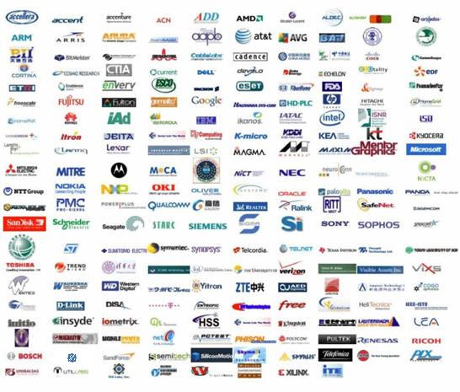
IEEE-SA Corporate Program
Influence technology development
  Incubate new technologies, standards and related services in a rapidly changing environment
  Shape the direction of technology and its market place applications
Drive the development of corporate standards to stay competitive
  Gain advanced knowledge by engaging in corporate standards projects
Network with global thought leaders

Slide 17
IEEE & BoD

Slide 18











Reinforcing IEEE Innovation Leadership
Incubated progress in 12 technology areas
Four graduated initiatives: Cloud Computing, Life Sciences, Smart Grid and Transportation Electrification
IEEE Smart Materials

Slide 19

TAB Outreach to SA
Ensure better mutual understanding of vision, strategies and operations
Strengthen trust and cooperation
Visit to SA Board of Governors
Cooperation in IEEE Internet Initiative
TAB AdHoc Committee on Technical Support for Standards
TAB FDC AdHoc Committee on Emerging Technology Needs
Cooperation through
  TAB representatives in some SA committees
  SA representatives in some TAB committees

Slide 20
SA Entity Relationship diagram
International SDOs, Gov’t Agencies
Corporate Relationships (Entity model & IEEE)
BoD Engagements
2030 Plans
SA
Strategic plan, Objectives, Initiatives, Metrics
Bylaws, Operations, PR
TAB
Education
Society Relationships, Support/Assistance

Slide 21
Back-up

Slide 22
History

Slide 23
Historical Milestones
1912 Institute of Radio Engineers (IRE) formed
1963 The AIEE merged with the IRE to form the IEEE in January 1963.
April 1963 the IEEE formed its first Standards Board.
1998, The IEEE Standards Board was reorganized, and given additional autonomy as the IEEE Standards Association.
  An Industry Advisory board was formed
In 2004 a Corporate Advisory Group (CAG) was formed and corporate membership begun

Slide 24

39
92

