Slide 1
IEEE Internet Initiative
16 July 2014

Slide 2
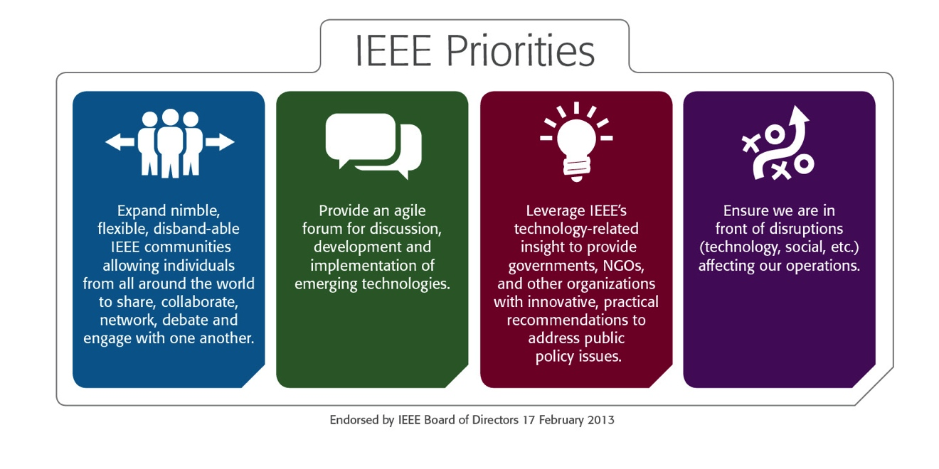
IEEE Internet Initiative
Multi-year initiative focused on building trust and confidence in the Internet, and its technology underpinning
Focus on Internet governance, cybersecurity, privacy and identity management
Rooted in IEEE’s mission to foster technological innovation and excellence for the benefit of humanity and its role in inspiring a global community
Aligns with and supports the IEEE priorities

Slide 3
IEEE Internet Initiative
Initiative approved by BoD January 2014
BoD Committee appointed by President de Marca to:
Develop a high-level plan for IEEE involvement in global Internet governance, with focus on the technical aspects, starting already in 2014
Lay the foundation for a long-term engagement of IEEE in the Internet governance space, with the aim to restore trust to its technical foundations and standards and preserve its global character and integrity
Members
Director and President, Standards Association and Committee Chair, Ms. Karen Bartleson
Director and Delegate, Division V, Ms. Susan K. Land
Dr. José Luiz Ribeiro, Brazilian Internet Steering Committee
Dr. Konstantinos Karachalios, Managing Director, IEEE Standards Association

Slide 4
IEEE Internet Initiative: Why IEEE
Depth and breadth of IEEE’s technical experience
Technology neutrality
Political/national neutrality
Global footprint
IEEE has been at the heart of the evolution of the Internet from the start
IEEE mission: “Advancing Technology for Humanity”

Slide 5
IEEE Internet Initiative
As a leading global advocate of open innovation, collaboration, and inclusiveness, IEEE is committed to mobilizing its global technical community to advocate for a participatory policy process; to build trustful technology platforms that address privacy and security issues by technical design; and to amplify the voice of the technical community in the political decision-making process
IEEE’s goal is to strengthen confidence in the integrity of Internet technologies and to play a core role as a convenor, connector, and thought-leader in key governance, privacy and security debates
IEEE embraces the value of an of open and globally coherent Internet
Central to this is a national and international policy-making process that ensures that standards, technologies, public policies, and governance procedures contribute to the development of public confidence in the Internet

Slide 6
IEEE Internet Initiative Goals
Become a strategic hub for convening the technical communities globally and locally in questions/discussions related to Internet technologies and governance
Reinforce the political impact of the voice of the technical community
Support the development of trustworthy technical solutions, including new standards

Slide 7
IEEE Internet Initiative Framework
United collection of activities, projects and programs
Leverage
IEEE’s Future Directions Initiatives
Strength of IEEE’s diverse technical communities (IEEE Societies, Sections, Chapters, Standards groups) and volunteers
Established relationships/partnerships
IEEE’s activities (in expanding its global footprint) in countries and regions
IEEE Regional Offices
IEEE Professional Staff/IEEE Operational Units
Utilize the expertise of external service providers for strategic counsel, public relations/public affairs, social media and content curation and development
Develop new programs under the umbrella of Internet governance, cybersecurity, privacy and personal identity management

Slide 8
IEEE Internet Initiative Highlights
Contributions to open consultations (e.g., ICANN Draft Strategic Plan, NETmudial)
Exploring new and deepening existing relationships (e.g., Internet Society, Anti Phishing Working Group, International Association of Privacy Professionals)
Developing messaging and talking points
Planning underway for Europe IEEE event in December in partnership with Europe Public Policy Working Group
Mobilizing IEEE communities/engaging IEEE members
Hosting of discussions (round-tables, outreaches, and digital events)
Staff core team mobilized; additional resources being identified/defined

Slide 9
Thank You!

