Slide 1
IEEE 802 Marketing Update
July 2013 Plenary
Date: 2013-07-15
Author
John D’Ambrosia, Dell

Slide 2
Abstract
Agenda Items
Monday:
5.11 II PR Update & Notices
5.12 MI Planning Activities - Ethernet 40th Celebration

Slide 3
Supporting Documents
802-EC-13/0036r0, PR Update –
https://mentor.ieee.org/802-ec/dcn/13/ec-13-0036-00-00SA-802-pr-update.docx
802-EC/13/0041r0, Ethernet 40th Mktg / PR Activities –
https://mentor.ieee.org/802-ec/dcn/13/ec-13-0041-00-00EC-ethernet-40th-mktg-pr.pptx
802-EC/13/0041r0, Ethernet 40th Slides –
https://mentor.ieee.org/802-ec/dcn/13/ec-13-0042-00-00EC-ethernet-40th-slides.pptx
802-EC/13/0041r0, Ethernet Video Library –
https://mentor.ieee.org/802-ec/dcn/13/ec-13-0043-00-00EC-ethernet-40th-video-lib.doc

Slide 4
Marketing “Execution”
Focus on social media and content
Press Releases
Videos
Contributed Articles
Interviews
Speakerships
Other

Slide 5
“High Level” Overview
2013 Celebration
Ethernet 40th Anniversary
Ethernet Standard 30th Anniversary
November IEEE 802 2013 Plenary Celebration
Featured Guests: Bob Metcalfe
David Boggs
Others TBD
2014 IEEE 802 Suite of Stds “Future of Networking”

Slide 6
IEEE 802 November Plenary Celebration
Bridging Mktg Event > Ethernet 40th to “Future of Networking”
Featured Guests Update
  Bob Metcalfe / David Boggs agreed to appear
    Thanks to Mr. Geoff Thompson for arranging!
  Due to scheduling – event needs to be Monday, 11/11
  Motion – approve switching tutorials to Tuesday night
  Motion – approve budget for speaker travel
Final agenda & budget of event TBD
Further exploration regarding video recording of event pending
Post PR / Mktg efforts starting

Slide 7
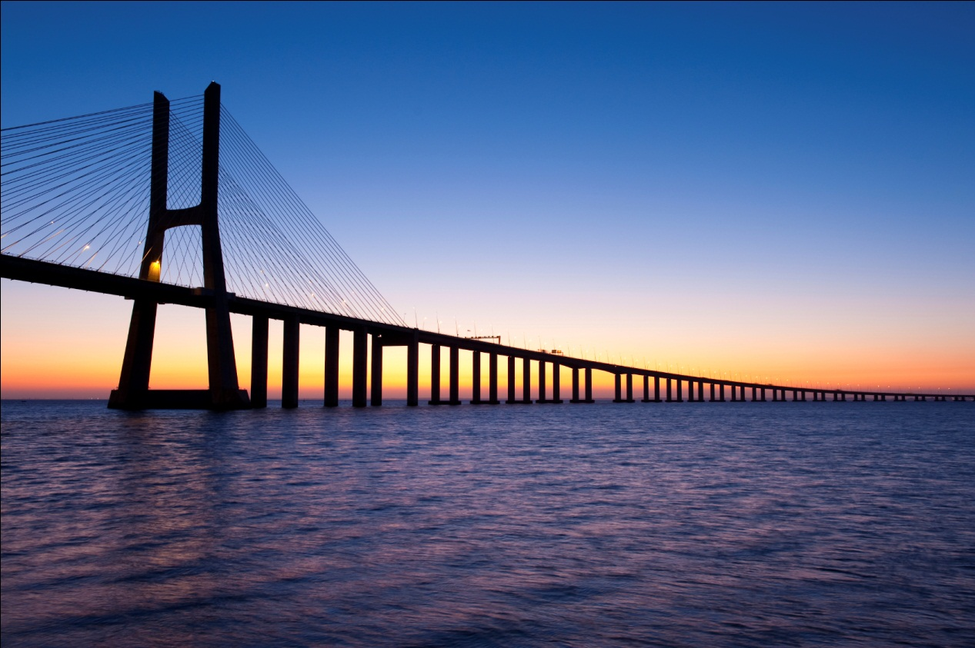
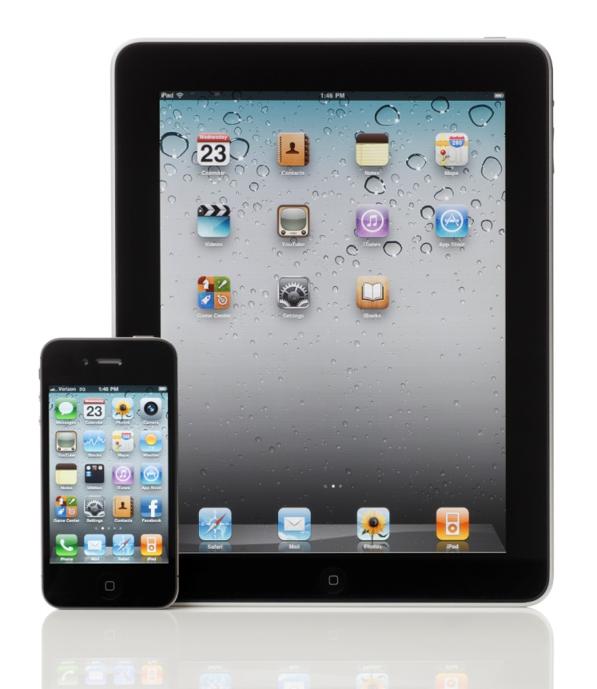
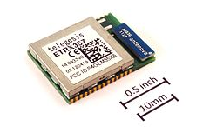

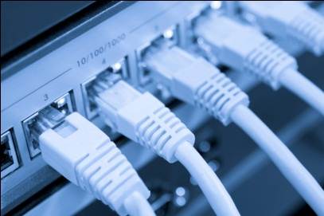
2014: Bridging to the Future of Networking
Developing marketing plan for marketing of “IEEE 802 Suite of Standards”
Evolving IEEE 802.3 / 40th communications strategy
  John Day Automotive article on in-vehicle Ethernet “Ethernet: 40 Years Old and Still Solving New Problems” by Steve Carlson
  Wireless Development and Design article “The End-to-End Ethernet Success Story” by Bruce Kraemer and John D’Ambrosia on Ethernet's impact on the wireless space with IEEE 802
Common platform for collaboration between IEEE 802 Group and IEEE-SA

Slide 8
Motion
Background: Bob Metcalfe / David Boggs able to support Monday night 11/11 session for Ethernet 40th Celebration. Anticipated that length of event to last up to two tutorial slots.
Motion: Move to support Ethernet 40th Anniversary Celebration @ IEEE 802 Nov 2013 Plenary on Monday, Nov 11
  Move “standard” tutorial sessions on Tuesday, Nov 12
  Extend formal invitation to Bob Metcalfe and David Boggs as featured guests
Moved: D’Ambrosia
Second: Law
Results (y/n):
Motion:

Slide 9
Motion
Background: Associated travel expenses for featured guests at Ethernet 40th Anniversary (Bob Metcalfe / David Boggs). Anticipate up to $1k per speaker.
Includes following:
  Waive Meeting Fees
  Travel plus meals / incidentals
    Boggs: SFO >DFW Airfare
    Metcalfe: Austin > Dallas RT Mileage
  Hotel Accommodations (via comp rooms or reimbursement)
Motion: Approve following for guest speakers for Ethernet 40th Anniversary
  Waive Meeting Fees
  Up to $1,000 per speaker to cover noted travel plus meals / incidentals, and if necessary hotel accommodations
  Use of comp rooms if available
Moved: D’Ambrosia
Second: Law
Results (y/n):
Motion:

