Slide 1
IEEE 802 Marketing Update July 2013 Plenary
Date: 2013-0715
Author
John D’Ambrosia, Dell

Slide 2
Abstract
Agenda Items
Monday:
5.11 II PR Update & Notices
5.12 MI Planning Activities - Ethernet 40th Celebration

Slide 3
Supporting Documents
802-EC-13/0036r0, PR Update –
https://mentor.ieee.org/802-ec/dcn/13/ec-13-0036-00-00SA-802-pr-update.docx
802-EC/13/0041r0, Ethernet 40th Mktg / PR Activities –
https://mentor.ieee.org/802-ec/dcn/13/ec-13-0041-00-00EC-ethernet-40th-mktg-pr.pptx
802-EC/13/0041r0, Ethernet 40th Slides –
https://mentor.ieee.org/802-ec/dcn/13/ec-13-0042-00-00EC-ethernet-40th-slides.pptx
802-EC/13/0041r0, Ethernet Video Library –
https://mentor.ieee.org/802-ec/dcn/13/ec-13-0043-00-00EC-ethernet-40th-video-lib.doc

Slide 4
Marketing “Execution”
Focus on social media and content
Press Releases
Videos
Contributed Articles
Interviews
Speakerships
Other

Slide 5
“High Level” Overview
2013 Celebration
Ethernet 40th Anniversary
Ethernet Standard 30th Anniversary
November IEEE 802 2013 Plenary Celebration
Featured Speakers: Bob Metcalfe
David Boggs
Others TBD
2014 IEEE 802 Suite of Stds “Future of Networking”

Slide 6
IEEE 802 November Plenary Celebration
Bridging Mktg Event > Ethernet 40th to “Future of Networking”
Speaker update
Bob Metcalfe / David Boggs agreed to speak
Thanks to Mr. Geoff Thompson for arranging!
Due to scheduling – event needs to be Monday, 11/11
Motion – approve switching tutorials to Tuesday night
Motion – approve budget for speaker travel
Final agenda & budget of event TBD
Further exploration regarding video recording of event pending
Post PR / Mktg efforts starting

Slide 7
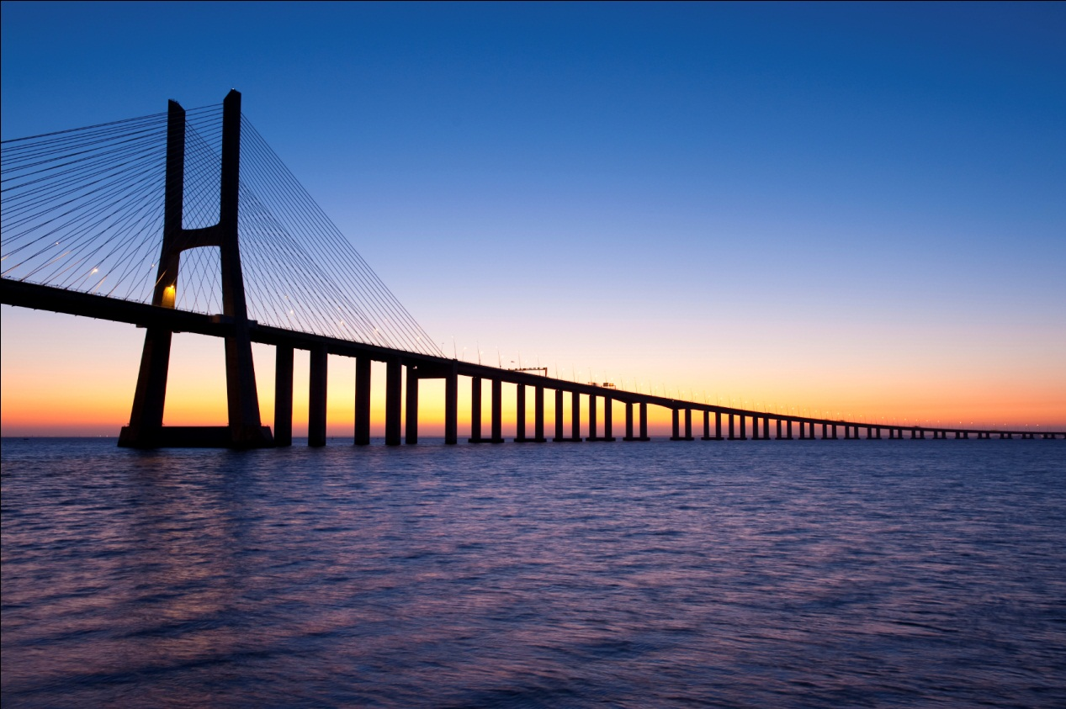
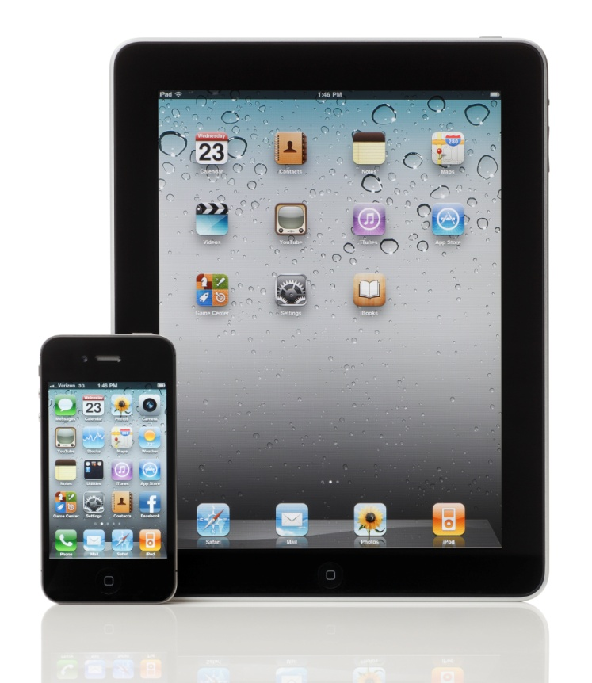
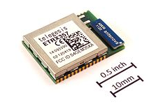
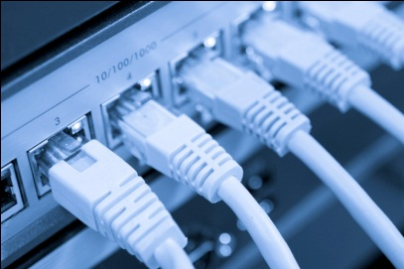
2014: Bridging to the Future of Networking
Common platform for collaboration between IEEE 802 Group and IEEE-SA
Developing marketing plan; evolving IEEE 802.3 / 40th communications strategy
John Day Automotive article on in-vehicle Ethernet “Ethernet: 40 Years Old and Still Solving New Problems” by Steve Carlson
Wireless Development and Design article “The End-to-End Ethernet Success Story” by Bruce Kraemer and John D’Ambrosia on Ethernet's impact on the wireless space with IEEE 802

Slide 8
Motion
Background: Bob Metcalfe / David Boggs able to support Monday night 11/11 session for Ethernet 40th Celebration. Anticipated that length of event to last up to two tutorial slots.
Motion: Move to support Ethernet 40th Anniversary Celebration @ IEEE 802 Nov 2013 Plenary on Monday, Nov 11
Move “standard” tutorial sessions on Tuesday, Nov 12
Extend formal invitation to Bob Metcalfe and David Boggs as guest speakers
Moved: D’Ambrosia
Second:
Results (y/n):
Motion:

Slide 9
Motion
Background: Associated travel expenses for guest speakers at Ethernet 40th Anniversary (Bob Metcalfe / David Boggs). Anticipate up to $1k per speaker.
Includes following:
Waive Meeting Fees
Travel plus meals / incidentals
Boggs: SFO >DFW Airfare
Metcalfe: Austin > Dallas RT Mileage
Hotel Accommodations (via comp rooms or reimbursement)
Motion: Approve following for guest speakers for Ethernet 40th Anniversary
Waive Meeting Fees
Up to $1,000 per speaker to cover noted travel plus meals / incidentals, and if necessary hotel accommocations
Use of comp rooms if available
Moved: D’Ambrosia
Second:
Results (y/n):
Motion:

