Slide 1
Author’s Name | Company | Address | Phone | email
Michael GUNDLACH, WG 6 chairman | Nokia Siemens Networks, Munich, Germany | Nokia Siemens Networks St.-Martin-Str. 76 81541 Munich, Germany | +49 89 5159 35126 | michael.gundlach@nsn.com
Document Title: DYSPAN-SC P1900.6 Slide Set for Presentation at joint 1900.6/1900.7 session in Beijing
Document Date: October 08, 2012
Document No: DCN 6-12-0078-00-CNTS
Notice: This document has been prepared to assist IEEE DYSPAN-SC and its Working Groups. It is offered as a basis for discussion and is not binding on the contributing individual(s) or organization(s). The material in this document is subject to change in form and content after further study. The contributor(s) reserve(s) the right to add, amend or withdraw material contained herein.
Release: The contributor grants a free, irrevocable license to the IEEE to incorporate material contained in this contribution, and any modifications thereof, in the creation of an IEEE Standards publication; to copyright in the IEEE’s name any IEEE Standards publication even though it may include portions of this contribution; and at the IEEE’s sole discretion to permit others to reproduce in whole or in part the resulting IEEE Standards publication. The contributor also acknowledges and accepts that this contribution may be made public by IEEE DYSPAN-SC.
Patent Policy and Procedures: The contributor is familiar with the IEEE Patent Policy and Procedures including the statement "IEEE standards may include the known use of patent(s), including patent applications, provided the IEEE receives assurance from the patent holder or applicant with respect to patents essential for compliance with both mandatory and optional portions of the standard." Early disclosure to IEEE DYSPAN-SC and its Working Groups of patent information that might be relevant to the standard is essential to reduce the possibility for delays in the development process and increase the likelihood that the draft publication will be approved for publication. Please notify the Chair as early as possible, in written or electronic form, if patented technology (or technology under patent application) might be incorporated into a draft standard being developed within the IEEE DYSPAN-SC.
If you have questions, contact the IEEE Patent Committee Administrator at <patcom@ieee.org>.

Slide 2
      IEEE DySPAN-SC 1900.6
      Spectrum Sensing Interfaces and Data Structures for Dynamic Spectrum Access and other Advanced Radio Communication Systems
      Standard and Working Group Activities
Michael Gundlach
1900.6 WG Chair

Slide 3
Contents
    IEEE DySpan-SC
        General Remarks
        History
        Officers
        Working Groups
    1900.6 Working Group
        History, Scope, Officers
    1900.6 Work
        Existing standard
        Amendment
        Work Plan and Status
        Examples for Use Cases, Data Sources, and Interfaces
    Résumé

Slide 4
IEEE DySpan-SC
General Remarks
  IEEE DySPAN Standards Committee (DySPAN-SC)
  Standards development projects in the areas of
      dynamic spectrum access,
      cognitive radio,
      interference management,
      coordination of wireless systems,
      advanced spectrum management, and
      policy languages and ontologies
    for next generation radio systems

Slide 5
IEEE DySpan-SC
History
IEEE P1900 Standards Committee was established in 2005 jointly by the IEEE Communications Society (ComSoc) and the IEEE Electromagnetic Compatibility (EMC) Society.
Objective: to develop supporting standards dealing with new technologies and techniques being developed for next generation radio and advanced spectrum management
2007 reorganization as Standards Coordinating Committee 41 (SCC41),
"Dynamic Spectrum Access Networks (DySPAN)"
2010 renamed as IEEE DySPAN-SC, with the 1900.x working groups under ComSoc as sponsor
2012 DySPAN-SC has been accepted by CSDB (Communications Society Decision Board) as sponsor for the 1900.x working groups

Slide 6
IEEE DySpan-SC
Officers
  Officers
      Chair: Dr. Hiroshi Harada, NICT (Japan)
      Vice-Chair: Max Riegel, Nokia Siemens Networks (Germany)
      Secretary: Dr. Yohannes Alemseged Demessie, NICT (Japan)
      Treasurer: Dr. Oliver Holland, Kings College London (UK)

Slide 7
IEEE DySpan-SC
Working Groups (1/2)
  1900.1
      Working Group on Definitions and Concepts for Dynamic Spectrum Access: Terminology Relating to Emerging Wireless Networks, System Functionality, and Spectrum Management
        Chair: Bernd Bochow, Fraunhofer (Germany)
        Vice-Chair: Dr. Oliver Holland, Kings College London (UK)
        Secretary: Dr. Michael Gundlach, Nokia Siemens Networks (Germany)
  1900.2
      Working Group on Recommended Practice for the Analysis of In-Band and Adjacent Band Interference and Coexistence Between Radio Systems
        Chair: Dr. Stephen Berger
      Standard published, WG inactive
  1900.3
      Working Group on Recommended Practice for Conformance Evaluation of Software Defined Radio (SDR) Software Modules
        Chair: Dr. Douglas Sicker
      WG disbanded
  1900.4
      Working Group on Architectural Building Blocks Enabling Network-Device Distributed Decision Making for Optimized Radio Resource Usage in Heterogeneous Wireless Access Networks
        Chair: Dr. Masayuki Ariyoshi, NEC (Japan)
        Vice-Chair: Dr. Hiroshi Harada, NICT (Japan)

Slide 8
IEEE DySpan-SC Overview
Working Groups (2/2)
  1900.5
      Working Group on Policy Language and Policy Architectures for Managing Cognitive Radio for Dynamic Spectrum Access Applications
        Chair: Lynn Grande, General Dynamics C4 Systems (USA)
        Vice-Chair: Jim Hoffmeyer (USA)
        Secretary: Yuriy Posherstnik, Army (USA)
  1900.6
      Working Group on Spectrum Sensing Interfaces and Data Structures for Dynamic Spectrum Access and other Advanced Radio Communication Systems
        Chair: Dr. Michael Gundlach, Nokia Siemens Networks (Germany)
        Secretary: HaNguyen Tran, NICT (Japan)
  1900.7
      White Space Radio Working Group
        Chair: Dr. Stanislav Filin, NICT (Japan)
        Vice-Chair: Dr. Oliver Holland, Kings College London (UK)
        Secretary: Dr. Muhammad Zeeshan Shakir, King Abdullah University of Science and Technology (Saudi Arabia)
  DSA-VE
      IEEE DySPAN-SC ad hoc on Dynamic Spectrum Access in Vehicular Environments (DSA-VE)
        Chair: Bernd Bochow, Fraunhofer (Germany)
      dormant

Slide 9
1900.6 Overview
History, Scope, Officers
  IEEE 1900.6 Working Group on Spectrum Sensing Interfaces and Data Structures for Dynamic Spectrum Access and other Advanced Radio Communication Systems
  IEEE 1900.6-2011 was published on April 22nd 2011 – http://standards.ieee.org/findstds/standard/1900.6-2011.html
  Since June 2011, the 1900.6 Working Group works on a new project:
      1900.6a: Standard for Spectrum Sensing Interfaces and Data Structures for Dynamic Spectrum Access and other Advanced Radio Communication Systems - Amendment: Procedures, Protocols and Data Archive Enhanced Interfaces.
        Scope: This Amendment to the IEEE Std 1900.6TM adds procedures, protocols and message format specifications for the exchange of sensing related data, control data and configuration data between spectrum sensors and their clients. In addition, it adds specifications for the exchange of sensing related and other relevant data and specifies related interfaces between the data archive and other data sources.
        Purpose: This amendment provides specifications to allow integrating 1900.6 based distributed sensing systems into existing and future dynamic spectrum access radio communication systems. It enables existing legacy systems to benefit so as to widen the potential adoption of the IEEE 1900.6 interface as an add-on to these systems and to claim standard conformance for an implementation of the interface. In addition it facilitates sharing of spectrum sensing data and other relevant data among 1900.6 based entities and external data archives.
  Officers
      Chair: Michael Gundlach, Nokia Siemens Networks
      Secretary: HaNguyen Tran, NICT

Slide 10
      1900.6 Work
      Existing standard
IEEE Standard for Spectrum Sensing Interfaces and Data Structures for Dynamic Spectrum Access and Other Advanced Radio Communication Systems
Sponsor: IEEE Communications Society and IEEE Standards Coordinating Committee 41
Approved 2 February 2011 by IEEE-SA Standards Board
Approved 4 August 2011 by American National Standards Institute
Contents:
interfaces and data structures to exchange sensing-related information
logical interface and supporting data structures
without constraining the sensing technology, client design, or data link between sensor and client
service primitives and generic procedures

Slide 11
Motivation and Approach
Evolution of wireless communication
  Demand for more spectrum resources
  Making better use of underutilized spectrum
Advanced radio communication systems
  Spectrum measurement
    Detecting underutilized spectrum
  Cognitive radio
    Making communication systems aware of their environment and internal state and deciding about their radio operating behavior
  Dynamic spectrum access
    Real-time adjustment of spectrum utilization in response to changing circumstances and objectives

Slide 12
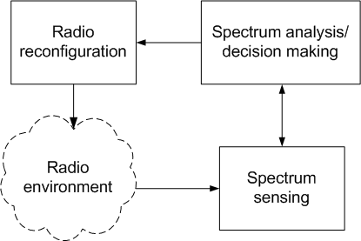
Cognitive radio system (CRS)
Functional block diagram of CRS
  Spectrum sensing
  Spectrum analysis, decision making
  Radio reconfiguration

Slide 13
      Interfaces – Scope of the P1900.6 standard
Cognitive
Engine
Cognitive Engine / Data Archive
IEEE DySPAN-SC 1900.6 Interfaces
Sensor A
Sensor B
The client role can be taken by Cognitive Engine, Sensor, and Data Archive
CE/DA-S interface between cognitive engine or data archive and sensor to exchange
sensing information and sensing control information.
S-S interface between sensor and sensor to exchange sensing information and
sensing control information.
CE-CE/DA interface between cognitive engine and cognitive engine or data archive to
exchange sensing information and sensing control information.

Slide 14
      Spectrum Sensing
sensing: In the context of radio frequency spectrum, it refers to the act of measuring information indicative of spectrum occupancy (information may include frequency ranges, signal power levels, bandwidth, location information, etc.). Sensing may include determining how the sensed spectrum is used.
sensing control information: Information describing the status and configuration of IEEE 1900.6 logical entities as well as information controlling and configuring the acquisition and processing of sensing information.
sensing information: Any information acquired by and obtained from sensors, including related spatiotemporal state information such as position, time, and confidence of acquisition.
sensor: A logical entity that performs sensing within a radio system. Sensors may also act as clients of other Sensors.
distributed sensing: The process of sensing where sensors are distributed in acquisition time, space, frequency, and function.
Source: IEEE Standard for Spectrum Sensing Interfaces and Data Structures for Dynamic Spectrum Access and Other Advanced Radio Communication Systems (1900.6 – 2011)

Slide 15
Technical aspects of the IEEE 1900.6-2011 standard
Five objectives
Reporting data format of the sensing parameters
  Data formats of these parameters
Performance metrics for spectrum sensing
  Spectrum sensing and channel use in sensing methods
Single device sensing
  Reference case for the case of sensing techniques based on multiple sensing devices (type of sensing information and control information)
Multiple device sensing
  Cooperative sensing and collaborative sensing between different sensors and their clients
Usage of spectrum sensing CR for the investigation of policy violations
  Deployment of spectrum sensing functionalities for policy verifications

Slide 16
What is “sensing” (as used in 1900.6)?
  Sensing means spectrum measurement
  Sensing can be provided by
    Single sensing device
    Sharing and exchanging the sensing related information
      improves quality
      distributed sensing is described in informative annex of standard

Slide 17
What are “sensors” (as used in 1900.6)?
  General properties:
    Sensors may or may not be collocated with the cognitive engine (CE)
    A sensor may be embedded (or plugged) into a client without CE capability, e.g. a notebook or mobile phone
    A sensor may be based on an embedded or dedicated radio frequency (RF) device, able to sense a portion of RF spectrum
    The behavior of sensors may be configured and controlled by its client (e.g. CE)

Slide 18
Distributed spectrum sensing
  Single-device sensing:
  embedded spectrum sensor (single sensing device)
  Multi-device sensing:
  information from multiple sources
    Same signal in different time
    Same signal in different locations
    In different frequency
    The sensors my communicate amongst each other
  Distributed spectrum sensing:
    a sensing database (SDB) collects, processes, manages and provides sensing related information corresponding to a geolocation area
    A view on long-term spectrum usage is possible in SDB

Slide 19
Sensing related information
  Sensing information (measurement information obtained from a sensor)
    position, time, measurement values (signal/noise power levels), bandwidth, frequency, signal type, modulation type, traffic pattern, …
  Sensing control (describes status/configuration of a sensor)
  Sensor information (parameters to describe capabilities of sensor)
  Regulatory requirements

Slide 20
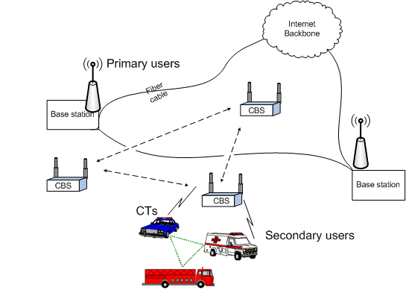
  Technical aspects of the IEEE 1900.6-2011 standard
  Emergency services

Slide 21
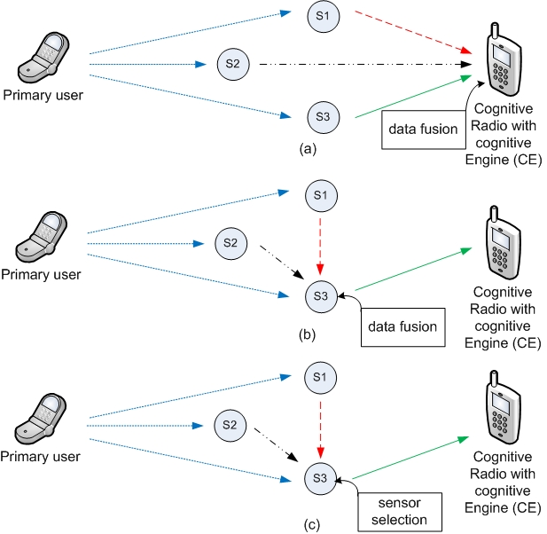
  Technical aspects of the IEEE 1900.6-2011 standard
  Distributed sensing

Slide 22
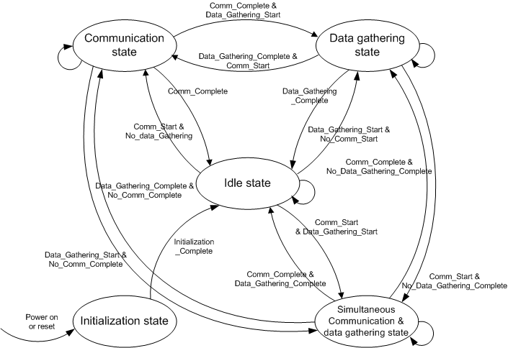
State diagram
State diagram of IEEE 1900.6 logical entity

Slide 23
State description
Initialization state
  The initialization state includes functions that shall be executed before sensing information exchange, for example, obtaining the control/application ID.
Idle state
  This is the state when there is no usage of the logical interface.
Data gathering state
  The data gathering state includes functions that shall be executed for obtaining measurement results. It also includes functions that shall be executed for obtaining sensing information for the control/application.
Communication state
  The communication state includes functions that shall be executed for transportation of sensing-related information from an IEEE 1900.6 logical entity to another IEEE 1900.6 logical entity using the communication subsystem.
Simultaneous communication and data gathering state
  In the simultaneous communication and data gathering state, communication for sensing information exchange and data gathering take place at the same time. For example, the measurement module performs spectrum measurement at frequency f1 and the communication subsystem is transporting sensing information at another frequency f2. The sensor may also receive sensing control information during execution of the measurement.

Slide 24
Scope and usage of Data Archive
Data Archive
Regulatory & policy information
Raw information
Processed information
Sensing related information
Raw information
The DA can be a part of a CR system; it stores sensing-related information obtained from multiple sources such as spectrum sensors, CEs, other DAs, or other external data repositories. The DA also stores regulatory and policy information obtained from regulatory repositories. The IEEE 1900.6 logical interface can be used to convey sensing-related information and processed information. However, regulatory information exchange may need another interface.

Slide 25
Summary: Contents of Standard
  Reference model (slide 10)
  Information description (slide 16)
  State diagram (slides 17, 18) and State transitions
  Generic procedures
      Primitives
  Typical procedures for use cases, to obtain sensing information
      CE – Sensor procedure
      DA – Sensor procedure
      CE – DA procedure
      CE – CE procedure
      Sensor - Sensor
  Informative annexes
      Use cases
      Use case classification: long-term / short-term spectrum usage
      Implementation of distributed sensing (slide 15)
      Scope and usage of Data Archive (slide 19)

Slide 26
1900.6 Work
Amendment
Title:
  IEEE Standard for Spectrum Sensing Interfaces and Data Structures for Dynamic Spectrum Access and other Advanced Radio – Amendment: Procedures, Protocols and Data Archive Enhanced Interfaces
Scope:
  This Amendment to the IEEE Standard 1900.6™ adds procedures, protocols and message format specifications for the exchange of sensing related data, control data and configuration data between spectrum sensors and their clients. In addition, it adds specifications for the exchange of sensing related and other relevant data and specifies related interfaces between the data archive and other data sources.
Planning
  Project kick off was in Brussels meeting (June 2011)
  Regular web conferences: every 2nd to 3rd week
  Face-to-face meetings (plenary and interim meetings): about 4 per year
  Submission for sponsor ballot: February 2013
  Presentation of slide set to other bodies
  Liaison (formal or informal) to other groups started or foreseen, respectively

Slide 27
Work Plan
System Engineering Document start
Definition of changes and extension Interfaces, further details as outlined in PAR draft
Verification and validation, producing 1st standards draft ; WG 1900.6 internal letter ballots
Objectives / Use Cases / Technical Revision / Requirements
Approval from DySPAN-SC for sponsor ballot
First SED draft available
Table of contents, structure, links to documents to be used as input
Submission for sponsor ballot
Submission to RevCom
June 2011
March 2012
June 2012
Time line
October 2012
January 2013
February 2013
21 October 2013

Slide 28
Work Method
Stage 1 – Identification of issue (template 1)
Identification of issue
Stage 2 - Solution proposal (template 2)
no
WG acceptance (straw poll)
reject
Proposed solution (may be several solution proposals)
Stage 3 - Detailed Solution proposal (template 3)
no
WG acceptance (straw poll)
Provide detailed solution
Editor responsible
rework needed
no
WG acceptance (vote)
Include in SED
reject
Contributor responsible
no
Include in Draft (vote)
Include in Draft
(confirmation by vote)
reject

Slide 29
Use cases for available and new interface(s)
  Available interfaces (defined in 1900.6 base line standard)
  Between sensors and their clients
  Interface(s) to be defined
  Between data archive and other data sources

Slide 30
Use cases for available interfaces
Use cases from the perspective of spectrum usage
  Substitute primary operation
    longer duration – SPOLD
    shorter duration – SPOSD
  and others
Use cases from the perspective of spectrum sensing
  Distributed sensing models – DSM
  and others

Slide 31
  Candidates for other data sources
  Regulatory database
  Geolocation database

Slide 32
Further interfaces
Interface to geolocation database (using DA as proxy)
Constantly update geolocalized spectrum maps
Interface between regulatory DB and SDB
Buses, taxis, or commuter trains, which periodically repeat their path, can be used as vehicular sensors able to collect periodic information about spectrum usage

Slide 33
Résumé
IEEE 1900.6 Work since 2005
Standard on Spectrum Sensing Interfaces and Data Structures available
Amendment considering new interfaces and new use cases being developed
  Use cases available
  Solutions (primitives) being developed
  Standard available mid next year
Collaboration with other fora desirable, e. g. related to data base interface protocols
Links:
  www.dyspan-sc.org
  https://mentor.ieee.org/1900.6/documents

Slide 34
Thank you!

