Slide 1
IEEE 1900.5 Contribution
Author’s Name | Affiliation | Address | Phone | email
Tony Rennier | Foundry Inc. | Severn, MD | 301.485.9679 | trennier@foundryinc.com
Document Title: Agenda, Admin and Chair’s Notes for IEEE 1900.5 WG Meeting on 7 January 2022
Document Date: 7 January 2022
Document No: 5-21-0022-00-agen
Notice: This document has been prepared to assist IEEE DySPAN-SC and its Working Groups. It is offered as a basis for discussion and is not binding on the contributing individual(s) or organization(s). The material in this document is subject to change in form and content after further study. The contributor(s) reserve(s) the right to add, amend or withdraw material contained herein.
Release: The contributor grants a free, irrevocable license to the IEEE to incorporate material contained in this contribution, and any modifications thereof, in the creation of an IEEE Standards publication; to copyright in the IEEE’s name any IEEE Standards publication even though it may include portions of this contribution; and at the IEEE’s sole discretion to permit others to reproduce in whole or in part the resulting IEEE Standards publication. The contributor also acknowledges and accepts that this contribution may be made public by IEEE DySPAN-SC.
Patent Policy and Procedures: The contributor is familiar with the IEEE Patent Policy and Procedures including the statement "IEEE standards may include the known use of patent(s), including patent applications, provided the IEEE receives assurance from the patent holder or applicant with respect to patents essential for compliance with both mandatory and optional portions of the standard." Early disclosure to IEEE DySPAN-SC and its Working Groups of patent information that might be relevant to the standard is essential to reduce the possibility for delays in the development process and increase the likelihood that the draft publication will be approved for publication. Please notify the Chair <trennier@foundryinc.com> as early as possible, in written or electronic form, if patented technology (or technology under patent application) might be incorporated into a draft standard being developed within the IEEE DySPAN-SC Committee. If you have questions, contact the IEEE Patent Committee Administrator at < patcom@ieee.org >.

Slide 2
Electronic Meeting Details
IEEE 1900.5 Meetings
https://ieeesa.webex.com/meet/trennier | 1736136765
Join by phone
+1-646-992-2010 United States Toll (New York City)
+1-213-306-3065 United States Toll (Los Angeles)
Access code: 173 613 6765
Notes:
September 22, 2008
2

Slide 3
Rules
IEEE DySPAN-SC rules
https://ieee.app.box.com/v/PandP-DySPAN-SC
IEEE 1900.5 WG rules
http://grouper.ieee.org/groups/dyspan/files/individual-WG-PnPs.pdf
Roberts Rules (latest edition) as needed…

Slide 4
Current Membership
11/5/21 | WG Status | First Name | Last Name | Affiliation
 | 14 | Total
 | 9.3324
 | Member | Julia | Andrusenko | JHU/APL
x | Member | Carlos | Caicedo | Syracuse University (Secretary)
x | Member | David | Chester | L3Harris
 | Member | Lynn | Grande | Southern Cloud
 | Member | Brent | Josefiak | L3Harris
x | Member | Mitch | Kokar | VIStology & Northeastern University
x | Member | Alex | Lackpour | Drexel University (Vice Chair)
x | Member | Eric | Lindahl | CDS2
x | Member | Reinhard | Schrage | SchrageConsult
x | Member | Kael | Stilp | MITRE
x | Member | John | Stine | MITRE
 | Member | Timothy | Woods | ANDRO Computational Solutions, LLC
 | Member | Daniel | Zahirniak | Joint Electronic Warfare Center (JEWC)
x | Participant | Ed | Coyle | Georgia Institute of Technology
 | Participant | Sean | Furman | ANDRO Computational Solutions, LLC
x | Participant | Shastri | Jayram | University of Johannesburg
 | Participant | Joel | Johnson | L3Harris
 | Participant | Chad | Lau | L3Harris
 | Participant | Jakub | Moskal | Vistology
 | Participant | Becca | Rousseau | MITRE
x | Member | Tony | Rennier | Foundry Inc (Chair)
 | Participant | V | Prasad | Wireless and Mobile Communication, TU Delft
Quorum? - Yes
Quorum > ½ membership (8 members)
2 meetings to get in, 2 meetings to get out

Slide 5
Draft Agenda
1/7/22 080:00-10:00 all times ET
Administrivia
Roll Call / Quorum Check
Approve Agenda
Copyright Slides
Patent Slides
Approval of recent minutes
Status on 1900.5 Revision
Status on 1900.5.1
Status on 1900.5.2 Revision
Approval of 1900.5.2R Comment Resolution Group
Review of other 1900 activities (1900.1, Leadership meeting etc.)
1900.5 Marketing Opportunities
1900.5 meeting planning and review
AoB
Any modifications?
Notes:
September 22, 2008
5

Slide 6
Approval of Agenda
Motion to approve Agenda contained in Doc #: 5-22-0001-00-agen
Mover:
Second:
Vote:

Slide 7
Instructions for Chairs of standards development activities
At the beginning of each standards development meeting the chair or a designee is to:
Show the following slides (or provide them beforehand)
Advise the standards development group participants that:
IEEE SA’s copyright policy is described in Clause 7 of the IEEE SA Standards Board Bylaws and Clause 6.1 of the IEEE SA Standards Board Operations Manual;
Any material submitted during standards development, whether verbal, recorded, or in written form, is a Contribution and shall comply with the IEEE SA Copyright Policy;
Instruct the Secretary to record in the minutes of the relevant meeting:
That the foregoing information was provided and that the copyright slides were shown (or provided beforehand).
1/4/22
Doc #:5-21-0002-00-agen

Slide 8
IEEE SA Copyright Policy
By participating in this activity, you agree to comply with the IEEE Code of Ethics, all applicable laws, and all IEEE policies and procedures including, but not limited to, the IEEE SA Copyright Policy.
Previously Published material (copyright assertion indicated) shall not be presented/submitted to the Working Group nor incorporated into a Working Group draft unless permission is granted.
Prior to presentation or submission, you shall notify the Working Group Chair of previously Published material and should assist the Chair in obtaining copyright permission acceptable to IEEE SA.
For material that is not previously Published, IEEE is automatically granted a license to use any material that is presented or submitted.
1/4/22
Doc #:5-21-0002-00-agen

Slide 9
IEEE SA Copyright Policy
The IEEE SA Copyright Policy is described in the IEEE SA Standards Board Bylaws and IEEE SA Standards Board Operations Manual
IEEE SA Copyright Policy, see Clause 7 of the IEEE SA Standards Board Bylaws https://standards.ieee.org/about/policies/bylaws/sect6-7.html#7 Clause 6.1 of the IEEE SA Standards Board Operations Manual https://standards.ieee.org/about/policies/opman/sect6.html
IEEE SA Copyright Permission
https://standards.ieee.org/content/dam/ieee-standards/standards/web/documents/other/permissionltrs.zip
IEEE SA Copyright FAQs
http://standards.ieee.org/faqs/copyrights.html/
IEEE SA Best Practices for IEEE Standards Development
http://standards.ieee.org/develop/policies/best_practices_for_ieee_standards_development_051215.pdf
Distribution of Draft Standards (see 6.1.3 of the SASB Operations Manual)
https://standards.ieee.org/about/policies/opman/sect6.html

Slide 10
Instructions for the WG Chair
The IEEE SA strongly recommends that at each WG meeting the chair or a designee:
Show slides 1 through 4 of this presentation
Advise the WG attendees that:
IEEE’s patent policy is described in Clause 6 of the IEEE SA Standards Board Bylaws;
Early identification of patent claims which may be essential for the use of standards under development is strongly encouraged;
There may be Essential Patent Claims of which IEEE is not aware. Additionally, neither IEEE, the WG, nor the WG Chair can ensure the accuracy or completeness of any assurance or whether any such assurance is, in fact, of a Patent Claim that is essential for the use of the standard under development.
Instruct the WG Secretary to record in the minutes of the relevant WG meeting:
That the foregoing information was provided and that slides 1 through 4 (and this slide 0, if applicable) were shown;
That the chair or designee provided an opportunity for participants to identify patent claim(s)/patent application claim(s) and/or the holder of patent claim(s)/patent application claim(s) of which the participant is personally aware and that may be essential for the use of that standard
Any responses that were given, specifically the patent claim(s)/patent application claim(s) and/or the holder of the patent claim(s)/patent application claim(s) that were identified (if any) and by whom.
The WG Chair shall ensure that a request is made to any identified holders of potential essential patent claim(s) to complete and submit a Letter of Assurance.
It is recommended that the WG Chair review the guidance in IEEE SA Standards Board Operations Manual 6.3.5 and in FAQs 14 and 15 on inclusion of potential Essential Patent Claims by incorporation or by reference.
Note: WG includes Working Groups, Task Groups, and other standards-developing committees with a PAR approved by the IEEE SA Standards Board.
08 June 2021 – Slide 0 – optional to be shown

Slide 11
Participants have a duty to inform the IEEE
Participants shall inform the IEEE (or cause the IEEE to be informed) of the identity of each holder of any potential Essential Patent Claims of which they are personally aware if the claims are owned or controlled by the participant or the entity the participant is from, employed by, or otherwise represents
Participants should inform the IEEE (or cause the IEEE to be informed) of the identity of any other holders of potential Essential Patent Claims
Early identification of holders of potential Essential Patent Claims is encouraged
08 June 2021 – Slide 1

Slide 12
Ways to inform ieee
Cause an LOA to be submitted to the IEEE SA (patcom@ieee.org); or
Provide the chair of this group with the identity of the holder(s) of any and all such claims as soon as possible; or
Speak up now and respond to this Call for Potentially Essential Patents
If anyone in this meeting is personally aware of the holder of any patent claims that are potentially essential to implementation of the proposed standard(s) under consideration by this group and that are not already the subject of an Accepted Letter of Assurance, please respond at this time by providing relevant information to the WG Chair
08 June 2021 – Slide 2

Slide 13
Other Guidelines for IEEE Working Group Meetings
All IEEE SA standards meetings shall be conducted in compliance with all applicable laws, including antitrust and competition laws.
Don’t discuss the interpretation, validity, or essentiality of patents/patent claims.
Don’t discuss specific license rates, terms, or conditions.
Relative costs of different technical approaches that include relative costs of patent licensing terms may be discussed in standards development meetings.
Technical considerations remain the primary focus.
Don’t discuss or engage in the fixing of product prices, allocation of customers, or division of sales markets.
Don’t discuss the status or substance of ongoing or threatened litigation.
Don’t be silent if inappropriate topics are discussed. Formally object to the discussion immediately.
---------------------------------------------------------------
For more details, see IEEE SA Standards Board Operations Manual, clause 5.3.10 and Antitrust and Competition Policy: What You Need to Know at http://standards.ieee.org/develop/policies/antitrust.pdf
08 June 2021 – Slide 3

Slide 14
Patent-related information
The patent policy and the procedures used to execute that policy are documented in the:
IEEE SA Standards Board Bylaws (http://standards.ieee.org/develop/policies/bylaws/sect6-7.html#6)
IEEE SA Standards Board Operations Manual (http://standards.ieee.org/develop/policies/opman/sect6.html#6.3)
Material about the patent policy is available at http://standards.ieee.org/about/sasb/patcom/materials.html
If you have questions, contact the IEEE SA Standards Board Patent Committee Administrator at patcom@ieee.org
08 June 2021 – Slide 4

Slide 15
Minutes for approval
Motion to approve 12/9/21 WG minutes contained in Doc #: 5-21-00XX-00-mins
Mover:
Second:
Vote:

Slide 16
Current Status for 1900.5 Revision
11/5/21
User's stories continued
Considering whether a PAR mod is needed to support the open concept
Consider Oliver’s POV
12/9/21
12/8/21 Ad-hoc
Started on question of boundaries of the standard details of interfaces and others
Interfaces need definitions e.g. floating point format – supports interoperability
Write time decisions
Discuss approaches to policy verification - human readable XML ??
Add AI agent to list of stakeholders??

Slide 17
Current Status for 1900.5.1
11/5/21
Preparing for Plenary
Making progress
Serving as a panelist for meetings addressing ML and AI ethics looking at how policy (like P1900.5.1) can be facilitating a dynamic range of permission granting and revoking “Consent Fatigue”
12/9/21
Had a nice ad-hoc today
Suggestion to take one or more business cases and show the assembler level solution
Should we look at Agile User story format?
Begin consideration for an 1900.5.1 Amendment
Still looking at grammar issues

Slide 18
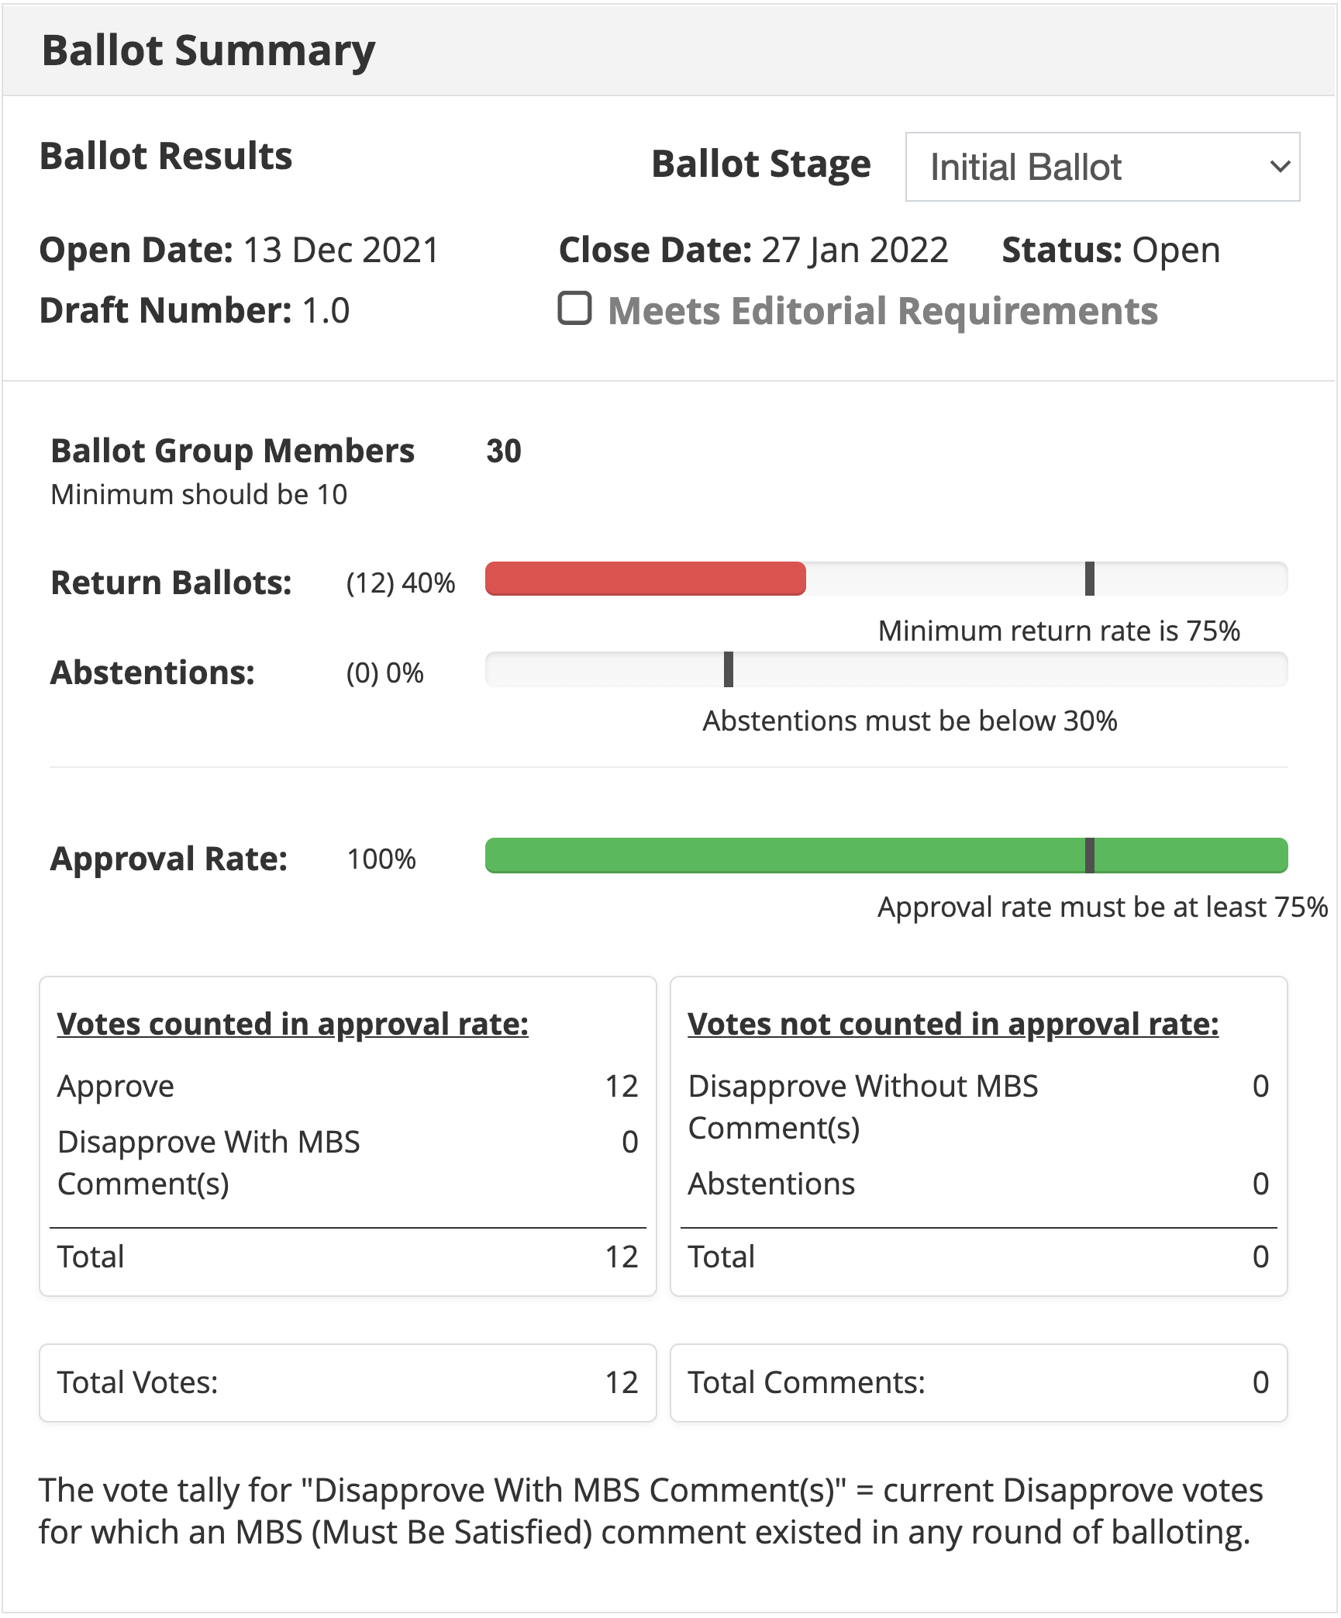
Current Status for 1900.5.2 Revision
10/1/21
PAR actions approved by NESCOM 9/23/21
Reinitiating SA Ballot
Looking to recover first ballot members
11/5/21
SA Ballot Invitation closed
Awaiting new draft addressing MEC comments
SA Ballot to begin shortly
New draft available on Monday
Shooting for 45 days
Will form Comment Resolution Group in the December WG
12/7/21
Awaiting DySPAN-SC approval
1/9/22
SA Ballot
Began 12/13/21
Ends 1/27/22
12 approvals to Date
No Comments

Slide 19
1900.5.2R Comment Resolution Group
Motion to approve the following membership in the 1900.5.2R Comment Resolution Group
John, Kael, ?
Mover:
Second:
Vote:

Slide 20
Other DySPAN-SC Activities
2022-2023 Officer Elections completed, all officers re-elected
Chair – Oliver Holland
Vice Chair – Stephen Berger
Secretary – Alex Lackpour
Treasurer – Lynn Grande
Potential New Projects
SC2 CIL Language→ Project is still being developed by Bob Baxley in the NSF POWDER SDR testbed. Recommend that we contact Bob in a few months once he has finished his project on leveraging the CIL in that project.
National Spectrum Consortium (NSC) -> NTR
Plenary Meeting
Location: online virtual meeting if pandemic continues to impose expected restrictions
Option: End of March, first week of April 2022.
Next leadership meeting
January 24th, 2022, 5pm UTC (12pm EST)
Leadership meeting is schedule to recur at 12pm ET throughout the year.

Slide 21
Other DySPAN-SC Activities
1900.1 WG report – Francesco reports
Next meeting on Thursday Dec 9th at 10am EST (3pm UTC)
1900.2 WG report – Stephen reports
No WG meetings planned this week.
1900.6 WG report – Oliver reports
Currently four voting members
P1900.6b
Four sessions this week
Goal is to complete the comments resolution and initiate the recirculation
1900.6R
Plan to discuss mapping of use cases
1900.8 WG – Alex reports
Meeting on Tuesday at 11am EST – discussing an annotated outline for the standard with the newly appointed Technical Editor.

Slide 22
1900.5 Marketing Inputs
12/7/21
Offer to share 1900.5.2 with DECT Forum

Slide 23
1900.5 Meeting Planning and Review
P1900.5 Revision Ad-hoc 1/7/22 1300 ET
P1900.5 Revision Ad-hoc 1/21/22 1300 ET
P1900.5 Revision Ad-hoc 2/5/22 1300 ET
P1900.5 WG Mtg 2/5/221 1430 ET
Spring Plenary Choose between week of:
3/21?
3/28?
4/4?

Slide 24
1900.5 AOB
9/3/21
Julia has coauthored a book and mentioned P1900.5 in the bio
Dr. Karen Haigh Cognitive-EW
Considering a DySPAN 2021 conference paper
Deadline in one month – can we agree and write down what we are planning
Capitalize on opportunities do more concretely say what we are doing and collect feedback
10/1/21
DySPAN 2021 missed this time

Slide 25
1900.5 Adjourn

