Slide 1
IEEE 1900.5 Contribution
Author’s Name | Affiliation | Address | Phone | email
Tony Rennier | Foundry Inc. | Severn, MD | 301.485.9679 | trennier@foundryinc.com
Document Title: Agenda, Admin and Chair’s Notes for IEEE 1900.5 WG Meeting on 4 June 2021
Document Date: 4 June 2021
Document No: 5-21-0010-00-agen
Notice: This document has been prepared to assist IEEE DySPAN-SC and its Working Groups. It is offered as a basis for discussion and is not binding on the contributing individual(s) or organization(s). The material in this document is subject to change in form and content after further study. The contributor(s) reserve(s) the right to add, amend or withdraw material contained herein.
Release: The contributor grants a free, irrevocable license to the IEEE to incorporate material contained in this contribution, and any modifications thereof, in the creation of an IEEE Standards publication; to copyright in the IEEE’s name any IEEE Standards publication even though it may include portions of this contribution; and at the IEEE’s sole discretion to permit others to reproduce in whole or in part the resulting IEEE Standards publication. The contributor also acknowledges and accepts that this contribution may be made public by IEEE DySPAN-SC.
Patent Policy and Procedures: The contributor is familiar with the IEEE Patent Policy and Procedures including the statement "IEEE standards may include the known use of patent(s), including patent applications, provided the IEEE receives assurance from the patent holder or applicant with respect to patents essential for compliance with both mandatory and optional portions of the standard." Early disclosure to IEEE DySPAN-SC and its Working Groups of patent information that might be relevant to the standard is essential to reduce the possibility for delays in the development process and increase the likelihood thatthe draft publication will be approved for publication. Please notify the Chair <trennier@foundryinc.com> as early as possible, in written or electronic form, if patented technology (or technology under patent application) might be incorporated into a draft standard being developed within the IEEE DySPAN-SC Committee. If you have questions, contact the IEEE Patent Committee Administrator at < patcom@ieee.org >.

Slide 2
Electronic Meeting Details
IEEE 1900.5 Meetings
https://ieeesa.webex.com/meet/trennier | 1736136765
Join by phone
+1-646-992-2010 United States Toll (New York City)
+1-213-306-3065 United States Toll (Los Angeles)
Access code: 173 613 6765
Notes:
September 22, 2008
2

Slide 3
Rules
IEEE DySPAN-SC rules
https://ieee.app.box.com/v/PandP-DySPAN-SC
IEEE 1900.5 WG rules
http://grouper.ieee.org/groups/dyspan/files/individual-WG-PnPs.pdf
Roberts Rules (latest edition) as needed…

Slide 4
Current Membership
WG Status | First Name | Last Name | Affiliation
Member | Julia | Andrusenko | JHU/APL
Member | Carlos | Caicedo | Syracuse University (Secretary)
Member | David | Chester | L3Harris
Member | Lynn | Grande | Southern Cloud
Member | Mitch | Kokar | VIStology & Northeastern University
Member | Alex | Lackpour | Drexel University (Vice Chair)
Member | Eric | Lindahl | CDS2
Member | Jakub | Moskal | Vistology
Member | Becca | Rousseau | MITRE
Member | Reinhard | Schrage | SchrageConsult
Member | Kael | Stilp | MITRE
Member | John | Stine | MITRE
Member | Timothy | Woods | ANDRO Computational Solutions, LLC
Member | Daniel | Zahirniak | Joint Electronic Warfare Center (JEWC)
Member | Brent | Josefiak | L3Harris
Participant | Sean | Furman | ANDRO Computational Solutions, LLC
Member | Tony | Rennier | Foundry Inc (Chair)
Quorum > ½ membership (9 members)
2 meetings to get in, 2 meetings to get out

Slide 5
Draft Agenda
6/4/21 14:30-16:30 all times ET
Administrivia
Copyright Slides
Patent Slides
Status 1900.5a
Status on 1900.5.1
Status on 1900.5.2a
Review of other 1900 activities (1900.1, Leadership meeting etc.)
1900.5 marketing opportunities
1900.5 meeting planning and review
AoB
Adjourn
Any modifications?
Notes:
September 22, 2008
5

Slide 6
Instructions for Chairs of standards development activities
At the beginning of each standards development meeting the chair or a designee is to:
Show the following slides (or provide them beforehand)
Advise the standards development group participants that:
IEEE SA’s copyright policy is described in Clause 7 of the IEEE SA Standards Board Bylaws and Clause 6.1 of the IEEE SA Standards Board Operations Manual;
Any material submitted during standards development, whether verbal, recorded, or in written form, is a Contribution and shall comply with the IEEE SA Copyright Policy;
Instruct the Secretary to record in the minutes of the relevant meeting:
That the foregoing information was provided and that the copyright slides were shown (or provided beforehand).
5/30/21
Doc #:5-21-0002-00-agen

Slide 7
IEEE SA Copyright Policy
By participating in this activity, you agree to comply with the IEEE Code of Ethics, all applicable laws, and all IEEE policies and procedures including, but not limited to, the IEEE SA Copyright Policy.
Previously Published material (copyright assertion indicated) shall not be presented/submitted to the Working Group nor incorporated into a Working Group draft unless permission is granted.
Prior to presentation or submission, you shall notify the Working Group Chair of previously Published material and should assist the Chair in obtaining copyright permission acceptable to IEEE SA.
For material that is not previously Published, IEEE is automatically granted a license to use any material that is presented or submitted.
5/30/21
Doc #:5-21-0002-00-agen

Slide 8
IEEE SA Copyright Policy
The IEEE SA Copyright Policy is described in the IEEE SA Standards Board Bylaws and IEEE SA Standards Board Operations Manual
IEEE SA Copyright Policy, see Clause 7 of the IEEE SA Standards Board Bylaws https://standards.ieee.org/about/policies/bylaws/sect6-7.html#7 Clause 6.1 of the IEEE SA Standards Board Operations Manual https://standards.ieee.org/about/policies/opman/sect6.html
IEEE SA Copyright Permission
https://standards.ieee.org/content/dam/ieee-standards/standards/web/documents/other/permissionltrs.zip
IEEE SA Copyright FAQs
http://standards.ieee.org/faqs/copyrights.html/
IEEE SA Best Practices for IEEE Standards Development
http://standards.ieee.org/develop/policies/best_practices_for_ieee_standards_development_051215.pdf
Distribution of Draft Standards (see 6.1.3 of the SASB Operations Manual)
https://standards.ieee.org/about/policies/opman/sect6.html

Slide 9
Instructions for the WG Chair
The IEEE-SA strongly recommends that at each WG meeting the chair or a designee:
Show slides #1 through #4 of this presentation
Advise the WG attendees that:
IEEE’s patent policy is described in Clause 6 of the IEEE-SA Standards Board Bylaws;
Early identification of patent claims which may be essential for the use of standards under development is strongly encouraged;
There may be Essential Patent Claims of which IEEE is not aware. Additionally, neither IEEE, the WG, nor the WG Chair can ensure the accuracy or completeness of any assurance or whether any such assurance is, in fact, of a Patent Claim that is essential for the use of the standard under development.
Instruct the WG Secretary to record in the minutes of the relevant WG meeting:
That the foregoing information was provided and that slides 1 through 4 (and this slide 0, if applicable) were shown;
That the chair or designee provided an opportunity for participants to identify patent claim(s)/patent application claim(s) and/or the holder of patent claim(s)/patent application claim(s) of which the participant is personally aware and that may be essential for the use of that standard
Any responses that were given, specifically the patent claim(s)/patent application claim(s) and/or the holder of the patent claim(s)/patent application claim(s) that were identified (if any) and by whom.
The WG Chair shall ensure that a request is made to any identified holders of potential essential patent claim(s) to complete and submit a Letter of Assurance.
It is recommended that the WG Chair review the guidance in IEEE-SA Standards Board Operations Manual 6.3.5 and in FAQs 14 and 15 on inclusion of potential Essential Patent Claims by incorporation or by reference.
Note: WG includes Working Groups, Task Groups, and other standards-developing committees with a PAR approved by the IEEE-SA Standards Board.

Slide 10
Participants have a duty to inform the IEEE
Participants shall inform the IEEE (or cause the IEEE to be informed) of the identity of each holder of any potential Essential Patent Claims of which they are personally aware if the claims are owned or controlled by the participant or the entity the participant is from, employed by, or otherwise represents
Participants should inform the IEEE (or cause the IEEE to be informed) of the identity of any other holders of potential Essential Patent Claims
Early identification of holders of potential Essential Patent Claims is encouraged

Slide 11
Ways to inform IEEE
Cause an LOA to be submitted to the IEEE-SA (patcom@ieee.org); or
Provide the chair of this group with the identity of the holder(s) of any and all such claims as soon as possible; or
Speak up now and respond to this Call for Potentially Essential Patents
If anyone in this meeting is personally aware of the holder of any patent claims that are potentially essential to implementation of the proposed standard(s) under consideration by this group and that are not already the subject of an Accepted Letter of Assurance, please respond at this time by providing relevant information to the WG Chair

Slide 12
Other guidelines for IEEE WG meetings
All IEEE-SA standards meetings shall be conducted in compliance with all applicable laws, including antitrust and competition laws.
Don’t discuss the interpretation, validity, or essentiality of patents/patent claims.
Don’t discuss specific license rates, terms, or conditions.
Relative costs of different technical approaches that include relative costs of patent licensing terms may be discussed in standards development meetings.
Technical considerations remain the primary focus
Don’t discuss or engage in the fixing of product prices, allocation of customers, or division of sales markets.
Don’t discuss the status or substance of ongoing or threatened litigation.
Don’t be silent if inappropriate topics are discussed … do formally object.
---------------------------------------------------------------
For more details, see IEEE-SA Standards Board Operations Manual, clause 5.3.10 and Antitrust and Competition Policy: What You Need to Know at http://standards.ieee.org/develop/policies/antitrust.pdf

Slide 13
Patent-related information
The patent policy and the procedures used to execute that policy are documented in the:
IEEE-SA Standards Board Bylaws (http://standards.ieee.org/develop/policies/bylaws/sect6-7.html#6)
IEEE-SA Standards Board Operations Manual (http://standards.ieee.org/develop/policies/opman/sect6.html#6.3)
Material about the patent policy is available at
http://standards.ieee.org/about/sasb/patcom/materials.html
If you have questions, contact the IEEE-SA Standards Board Patent Committee Administrator at patcom@ieee.org

Slide 14
Current Status for 1900.5a
5/7/21
Last ad-hoc very productive
Focusing on PMP and giving it some detail
Considering the meaning of a hierarchical policy sets
Adopting a good strategy… finally
Related presentation on Future creators given by Tim

Slide 15
Current Status for 1900.5.1
5/7/21
Provided overview of variants
Still high level
Working with 1900.5.2a draft schema
Creating a 1900.5.1 Ontology
.1 Rules will be used on .2a to develop a down to earth (and lengthy) example
Working toward a new ad-hoc to review progress

Slide 16
Current Status for 1900.5.2a
5/7/21
Moving to Sponsor ballot – electronic ballot passed
6/4/21
Ready to submit to MEC and DySPAN-SC

Slide 17
Other DySPAN-SC Activities
DARPA SC2 CIL standardization
Alex contacted Bob Baxley – CTO of Bastille Networks – who is implementing a centralized spectrum broker for 5G networks based on the SC2 CIL information-exchange protocol.
Bob’s recommendation was that we get back into contact in several months (November 2021) to see if the spectrum broker technology is sufficiently mature for standardization, or not.
National Spectrum Consortium (NSC) standards
Three are three NSC WGs: spectrum superiority, 5G, and regulatory.
The WGs recently initiated their white paper writing process.
We should not expect to be able to review their white papers for several months.
We should continue to monitor the NSC WGs and be prepared to receive and review their recommendation white papers by the end of calendar year 2021.
NTIA Incumbent Informing Capability (IIC)
Tony and Alex met with Mike Cotton and discussed the feasibility of standardizing the IIC.
Mike recommended that we contact Mike DiFrancisco (VTARC) engineer to discuss the feasibility of standardizing. He is responsible for shepherding the development of the IIC.
Tony and Alex met with Mike DiFrancisco and discussed the feasibility.
Mike’s opinion was that it wasn’t clear how standardization should proceed at this time.
We noted that the IIC resembles the CBRS SAS that was standardized by the WinnForum. There may be some scalability issues with IEEE DySPAN-SC standardizing this new technology vs. WinnForum.
Mike recommended that we get in contact in a few months to resume the discussion. It is a bit too early in the IIC development process to standardize it.
Stephen offered to contact coordinators of ISART and Silicon Flatirons to discuss how they…

Slide 18
Other DySPAN-SC Activities (cont)
Discussion on IEEE web/email tools
Oliver created a new listserv mailing list for DySPAN-SC.
Oliver will explain the listserv settings to Alex offline.
DySPAN-SC website
Oliver recommends using a common template for the WGs
Alex will attempt to complete the webpage development by the June meeting
Next Leadership meeting:
Next leadership meeting: June 28th, 2021 @ 4PM UTC (Noon EDT)

Slide 19
1900.5 Marketing Inputs
5/7/21
NSC NTR
NTIA discussion on IIC
Augment ESC
Focus on test ranges
Sensor-based sharing not practical
More of a reservation system
Eric meeting with NEIM on spectrum management

Slide 20
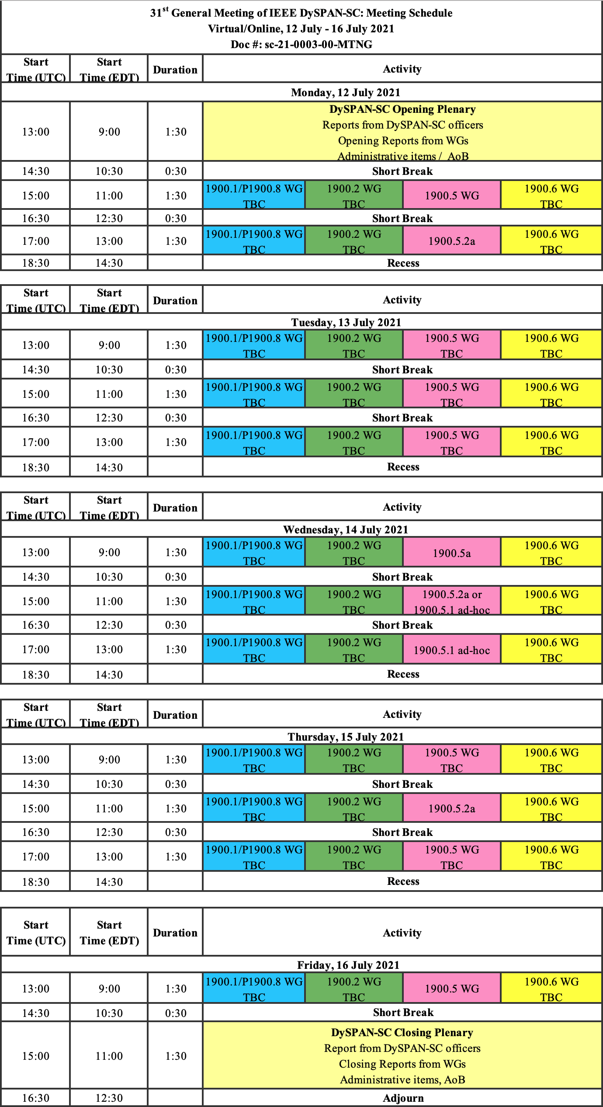
1900.5 Meeting Planning and Review
1900.5a Ad- hoc 6/11/21 1300-1500 ET
1900.5 WG 7/2/21 0830-1030 ET
Cancel?

Slide 21
1900.5 AOB
TBD

Slide 22
1900.5 Adjourn

