Slide 1
IEEE 1900.5 Contribution
Author’s Name | Affiliation | Address | Phone | email
Tony Rennier | Foundry Inc. | Severn, MD | 301.485.9679 | trennier@foundryinc.com
Document Title: Agenda, Admin and Chair’s Notes for IEEE 1900.5 WG Meeting on 21-23 July 2020
Document Date: 21-23 July 2020
Document No: 5-20-0034-00-agen
Notice: This document has been prepared to assist IEEE DySPAN-SC and its Working Groups. It is offered as a basis for discussion and is not binding on the contributing individual(s) or organization(s). The material in this document is subject to change in form and content after further study. The contributor(s) reserve(s) the right to add, amend or withdraw material contained herein.
Release: The contributor grants a free, irrevocable license to the IEEE to incorporate material contained in this contribution, and any modifications thereof, in the creation of an IEEE Standards publication; to copyright in the IEEE’s name any IEEE Standards publication even though it may include portions of this contribution; and at the IEEE’s sole discretion to permit others to reproduce in whole or in part the resulting IEEE Standards publication. The contributor also acknowledges and accepts that this contribution may be made public by IEEE DySPAN-SC.
Patent Policy and Procedures: The contributor is familiar with the IEEE Patent Policy and Procedures including the statement "IEEE standards may include the known use of patent(s), including patent applications, provided the IEEE receives assurance from the patent holder or applicant with respect to patents essential for compliance with both mandatory and optional portions of the standard." Early disclosure to IEEE DySPAN-SC and its Working Groups of patent information that might be relevant to the standard is essential to reduce the possibility for delays in the development process and increase the likelihood thatthe draft publication will be approved for publication. Please notify the Chair <trennier@foundryinc.com> as early as possible, in written or electronic form, if patented technology (or technology under patent application) might be incorporated into a draft standard being developed within the IEEE DySPAN-SC Committee. If you have questions, contact the IEEE Patent Committee Administrator at < patcom@ieee.org >.

Slide 2
Electronic Meeting Details
IEEE 1900.5 Meetings
https://ieeesa.webex.com/meet/trennier | 1736136765
Join by phone
+1-646-992-2010 United States Toll (New York City)
+1-213-306-3065 United States Toll (Los Angeles)
Access code: 173 613 6765
Notes:
September 22, 2008
2

Slide 3
Rules
IEEE DySPAN-SC rules
  https://ieee.app.box.com/v/PandP-DySPAN-SC
IEEE 1900.5 WG rules
  http://grouper.ieee.org/groups/dyspan/files/individual-WG-PnPs.pdf
Roberts Rules (latest edition) as needed…

Slide 4
Current Membership
Quorum 12/15? - Yes
Quorum 12/17? - No
12/15-17/20 | WG Status | First Name | Last Name | Affiliation
x | Member | Julia | Andrusenko | JHU/APL
xy | Member | Carlos | Caicedo | Syracuse University (Secretary)
x | Member | David | Chester | L3Harris
x | Member | Lynn | Grande | Southern Cloud
x | Member | Mitch | Kokar | VIStology & Northeastern University
x | Member | Alex | Lackpour | Drexel University
x | Member | Jakub | Moskal | Vistology
 | Member | V | Prasad | Wireless and Mobile Communication, TU Delft
xy | Member | Reinhard | Schrage | SchrageConsult
 | Member | Kael | Stilp | MITRE
y | Member | John | Stine | MITRE
 | Member | Darcy | Swain-Walsh | MITRE (Vice Chair)
xy | Member | Tony | Rennier | Foundry Inc (Chair)
 | Member | Jameson | Dempsey | Google
xy | Member | Timothy | Woods | ANDRO Computational Solutions, LLC
xy | Member | Eric | Lindahl | CDS2
 | Member | Corrigan | Johnson | Chesapeake Technology International
xy | Member | Becca | Rousseau | MITRE
xy | Member | Wesley | Eddy | Google
 | Participant | Kevin | Andryc | L3Harris
Quorum > ½ membership (10 members)
2 meetings to get in, 2 meetings to get out

Slide 5
Draft Agenda
12/15/20 9:00-10:30 all times EDT
Administrivia
  Roll Call / Quorum Check
  Approve Agenda
  Copyright Slides
  Patent Slides
  Approval of recent minutes
  iMeet discussion
  Election Chair Report
Status 1900.5a
Status on 1900.5.1
Status on 1900.5.2a
Review of other 1900 activities (1900.1, Leadership meeting etc.)
1900.5 Marketing Opportunities
1900.5 meeting planning and review
AoB
Break
Ad Hoc sessions (Review and planning for subgroup activities as needed)
Any modifications? No
Notes:
September 22, 2008
5

Slide 6
Draft Agenda
12/17/20 9:00-10:30 all times EDT
Administrivia
  Roll Call / Quorum Check
  Approve Agenda
  Copyright Slides
  Patent Slides
  Approval of recent minutes
  iMeet discussion
Updated Status 1900.5a
Updated Status on 1900.5.1
Updated Status on 1900.5.2a
Review of other 1900 activities (1900.1, Leadership meeting etc.)
1900.5 Marketing Opportunities
1900.5 meeting planning and review
AoB
Break
Ad Hoc sessions (Review and planning for subgroup activities as needed)
Any modifications? No
Notes:
September 22, 2008
6

Slide 7
Approval of Agenda
Motion to approve Agenda contained in Doc #: 5-20-0034-00-agen
Mover: Dave
Second: Carlos
Vote: UC

Slide 8
Instructions for Chairs of standards development activities
At the beginning of each standards development meeting the chair or a designee is to:
    Show the following slides (or provide them beforehand)
    Advise the standards development group participants that:
    IEEE SA’s copyright policy is described in Clause 7 of the IEEE SA Standards Board Bylaws and Clause 6.1 of the IEEE SA Standards Board Operations Manual;
    Any material submitted during standards development, whether verbal, recorded, or in written form, is a Contribution and shall comply with the IEEE SA Copyright Policy;
    Instruct the Secretary to record in the minutes of the relevant meeting:
    That the foregoing information was provided and that the copyright slides were shown (or provided beforehand).

Slide 9
IEEE SA Copyright Policy
By participating in this activity, you agree to comply with the IEEE Code of Ethics, all applicable laws, and all IEEE policies and procedures including, but not limited to, the IEEE SA Copyright Policy.
    Previously Published material (copyright assertion indicated) shall not be presented/submitted to the Working Group nor incorporated into a Working Group draft unless permission is granted.
    Prior to presentation or submission, you shall notify the Working Group Chair of previously Published material and should assist the Chair in obtaining copyright permission acceptable to IEEE SA.
    For material that is not previously Published, IEEE is automatically granted a license to use any material that is presented or submitted.

Slide 10
IEEE SA Copyright Policy
    The IEEE SA Copyright Policy is described in the IEEE SA Standards Board Bylaws and IEEE SA Standards Board Operations Manual
      IEEE SA Copyright Policy, see
      Clause 7 of the IEEE SA Standards Board Bylaws
      https://standards.ieee.org/about/policies/bylaws/sect6-7.html#7
      Clause 6.1 of the IEEE SA Standards Board Operations Manual
      https://standards.ieee.org/about/policies/opman/sect6.html
    IEEE SA Copyright Permission
      https://standards.ieee.org/content/dam/ieee-standards/standards/web/documents/other/permissionltrs.zip
    IEEE SA Copyright FAQs
      http://standards.ieee.org/faqs/copyrights.html/
    IEEE SA Best Practices for IEEE Standards Development
      http://standards.ieee.org/develop/policies/best_practices_for_ieee_standards_development_051215.pdf
    Distribution of Draft Standards (see 6.1.3 of the SASB Operations Manual)
      https://standards.ieee.org/about/policies/opman/sect6.html

Slide 11
Instructions for the WG Chair
The IEEE-SA strongly recommends that at each WG meeting the chair or a designee:
  Show slides #1 through #4 of this presentation
  Advise the WG attendees that:
    IEEE’s patent policy is described in Clause 6 of the IEEE-SA Standards Board Bylaws;
    Early identification of patent claims which may be essential for the use of standards under development is strongly encouraged;
    There may be Essential Patent Claims of which IEEE is not aware. Additionally, neither IEEE, the WG, nor the WG Chair can ensure the accuracy or completeness of any assurance or whether any such assurance is, in fact, of a Patent Claim that is essential for the use of the standard under development.
  Instruct the WG Secretary to record in the minutes of the relevant WG meeting:
    That the foregoing information was provided and that slides 1 through 4 (and this slide 0, if applicable) were shown;
    That the chair or designee provided an opportunity for participants to identify patent claim(s)/patent application claim(s) and/or the holder of patent claim(s)/patent application claim(s) of which the participant is personally aware and that may be essential for the use of that standard
    Any responses that were given, specifically the patent claim(s)/patent application claim(s) and/or the holder of the patent claim(s)/patent application claim(s) that were identified (if any) and by whom.
  The WG Chair shall ensure that a request is made to any identified holders of potential essential patent claim(s) to complete and submit a Letter of Assurance.
  It is recommended that the WG Chair review the guidance in IEEE-SA Standards Board Operations Manual 6.3.5 and in FAQs 14 and 15 on inclusion of potential Essential Patent Claims by incorporation or by reference.
  Note: WG includes Working Groups, Task Groups, and other standards-developing committees with a PAR approved by the IEEE-SA Standards Board.
(Optional to be shown)

Slide 12
Participants have a duty to inform the IEEE
  Participants shall inform the IEEE (or cause the IEEE to be informed) of the identity of each holder of any potential Essential Patent Claims of which they are personally aware if the claims are owned or controlled by the participant or the entity the participant is from, employed by, or otherwise represents
  Participants should inform the IEEE (or cause the IEEE to be informed) of the identity of any other holders of potential Essential Patent Claims
  Early identification of holders of potential Essential Patent Claims is encouraged
Slide #1

Slide 13
Ways to inform IEEE
Cause an LOA to be submitted to the IEEE-SA (patcom@ieee.org); or
Provide the chair of this group with the identity of the holder(s) of any and all such claims as soon as possible; or
Speak up now and respond to this Call for Potentially Essential Patents
If anyone in this meeting is personally aware of the holder of any patent claims that are potentially essential to implementation of the proposed standard(s) under consideration by this group and that are not already the subject of an Accepted Letter of Assurance, please respond at this time by providing relevant information to the WG Chair
Slide #2

Slide 14
Other guidelines for IEEE WG meetings
All IEEE-SA standards meetings shall be conducted in compliance with all applicable laws, including antitrust and competition laws.
  Don’t discuss the interpretation, validity, or essentiality of patents/patent claims.
  Don’t discuss specific license rates, terms, or conditions.
    Relative costs of different technical approaches that include relative costs of patent licensing terms may be discussed in standards development meetings.
      Technical considerations remain the primary focus
  Don’t discuss or engage in the fixing of product prices, allocation of customers, or division of sales markets.
  Don’t discuss the status or substance of ongoing or threatened litigation.
  Don’t be silent if inappropriate topics are discussed … do formally object.
---------------------------------------------------------------
For more details, see IEEE-SA Standards Board Operations Manual, clause 5.3.10 and
Antitrust and Competition Policy: What You Need to Know at http://standards.ieee.org/develop/policies/antitrust.pdf
Slide #3

Slide 15
Patent-related information
  The patent policy and the procedures used to execute that policy are documented in the:
    IEEE-SA Standards Board Bylaws (http://standards.ieee.org/develop/policies/bylaws/sect6-7.html#6)
    IEEE-SA Standards Board Operations Manual (http://standards.ieee.org/develop/policies/opman/sect6.html#6.3)
  Material about the patent policy is available at
  http://standards.ieee.org/about/sasb/patcom/materials.html
  If you have questions, contact the IEEE-SA Standards Board Patent Committee Administrator at patcom@ieee.org
Slide #4

Slide 16
Minutes for approval
Motion to approve 10/2/20 WG minutes contained in Doc #: 5-20-0035-00-mins
Mover: Reinhard
Second: Dave
Vote: UC

Slide 17
Minutes for approval
Motion to approve 11/6/20 WG minutes contained in Doc #: 5-20-0036-00-mins
Mover: Dave
Second: Reinhard
Vote: UC

Slide 18
iMeet
11/6/20
All have been invited and accepted
Discussion on how to leverage for WG items?
12/15/20
Consider email notices Q for Alex

Slide 19
Election Chair Report
11/6/20
  Nominations closing today
  Will send notices to nominees
  Dave did not nominate anyone
  Vice Chair and Secretary two nominations shared
  Two weeks for nominees to respond 11/20/20
12/15/20
  The P1900.5 Working Group officers for the calendar years 2021 and 2022 term are as follows:
    Chair – Tony Rennier
    Vice Chair – Alex Lackpour
    Secretary -- Carlos Caicedo

Slide 20
Current Status for 1900.5a
10/2/20
  Held meeting 10/2/20 1pm EDT
  Exploring the hierarchical nature of system, network, and device policies
  Meeting planned with 1900.4 Chair 10/6/20 08:30 EDT
11/6/20
  Ad-hoc schedule for Nov? Suggestion to move to the 11/20/20 10am EDT
  Contribution Spectrum Highways reviewed in the last ad-hoc 10/30/20
12/15/20
  Ad-hoc scheduled today 2pm EST
  Looking at Use Cases
    Addressing the hierarchical scheme Tim and Wes report the fit looks good
  Returning to the question of document structure in Jan
  Had ad-hoc
    Will author capabilities statements
    Continue to discuss Alex list of hard questions

Slide 21
Current Status for 1900.5.1
11/6/20
  Reference implementation of 1900.5.1
    Shooting for an April F2F demonstration - postponed
    Looking at Java but doesn’t support operator overload, C++ a better option
    Has integrated JAVA and C++ into solution
    New OWL API release integrated (thanks Jakub)
    10/2/20 great progress ad-hoc desired Dec plenary
  Coming soon (year end) a more accessible interface
  Reviewing a paper from Oxford CL that aligns well with the approach taken in 1900.5.1 on rules vs ontology reasoning
12/15/20
  Working on a more comfortable interface
  Reference implementation sometimes crashes computer
  Will discuss next steps in ad-hoc
  Will schedule ad-hoc to review reference implementation
IEEE Communications Society/Dynamic Spectrum Access Networks Standards Committee P1900.5.1/Draft 3 IEEE Draft Standard Policy Language for Dynamic Spectrum Access Systems Recommendation: APPROVE – 12/2/20

Slide 22
Current Status for 1900.5.2a
10/2/20
  Schema expected Nov 6 meeting Ad-hoc
  Looking at RADAR exemplar
11/6/20
  Awaiting update XML schema
  Tentative end of year to start process
12/15/20
  Kael is continuing on the schema
  Becca working on verification rules
    Addressing options modeling
  Few more changes to vote on the latest draft Feb

Slide 23
Other DySPAN-SC Activities
11/30/20 Leadership meeting
  1900.1 WG (Francesco reports)
    Next SG meeting is scheduled for early December.
    Goal is to create a draft PAR by end of 2020 and submit it in early January.
  1900.2 WG (Stephen reports)
    No response yet to request for comments on 1900.2 revision.
    Stephen recommends a minimal revision and update to the standard.
    Attendees to the first 1900.2 meeting in 2019 are automatically members of the WG. Other members can be added as requested.
  1900.6 WG (Oliver reports)
    1900.6b
      Continuing to finalize comment resolutions – five comments remain
      Hope to complete resolution before mid-December meeting
    1900.6
      NesCom is likely to approve the PAR extension this week.

Slide 24
Other DySPAN-SC Activities
Discussion on new projects
  DARPA SC2 Language standardization
    No updates
  DySPAN Study Group on Machine Learning for DSA Radio Networks
    Discussion of draft PAR on Machine Learned Spectrum Awareness
      Oliver recommended that “member” be added to the list of participants.
      Oliver recommended extending the duration to take the full four years granted for IEEE standards development. No penalty if the WG finishes earlier and avoids asking for an extension until the four year expires.
  National Spectrum Consortium
No updates
Next Leadership meeting:
  January 25th at 14:00 UTC. Oliver will finalize via email.

Slide 25
1900.5 Marketing Inputs
10/2/20
  A recent RFI from DoD on Dynamic Spectrum Sharing was released a few days ago:
  Spectrum Highways Repost is publicly released
11/6/20
  SCMs proposed for DSA in a NSF Spectrum Innovation Initiative Program (Protobuff a Google thing)
12/15/20
  Possible discussions in the NSC meeting this week

Slide 26
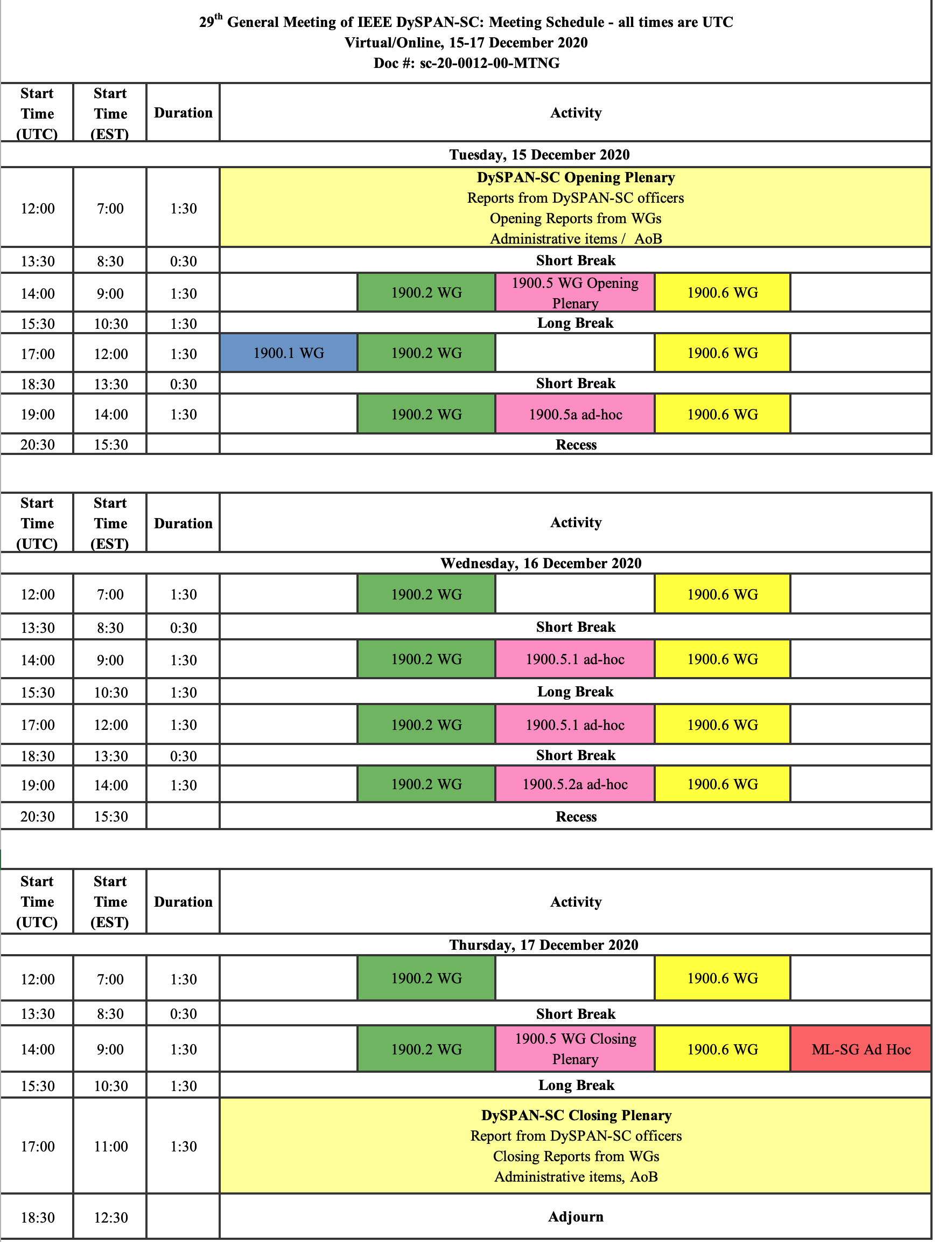
1900.5 Meeting Planning and Review
WG meetings
  This week
  2/5/21 2pm EDT
  3/5/21 8am EDT
1900.5a Ad-hoc
  1/22/21 1pm EDT
  2/19/21 1pm EDT

Slide 27
1900.5 Adjourn

