Slide 1
IEEE 1900.5 Contribution
Author’s Name | Affiliation | Address | Phone | email
Tony Rennier | Foundry Inc. | Severn, MD | 301.485.9679 | trennier@foundryinc.com
Document Title: Agenda, Admin and Chair’s Notes for IEEE 1900.5 WG Meeting on 05 June 2020
Document Date: 04 September 2020
Document No: 5-20-0029-00-agen
Notice: This document has been prepared to assist IEEE DySPAN-SC and its Working Groups. It is offered as a basis for discussion and is not binding on the contributing individual(s) or organization(s). The material in this document is subject to change in form and content after further study. The contributor(s) reserve(s) the right to add, amend or withdraw material contained herein.
Release: The contributor grants a free, irrevocable license to the IEEE to incorporate material contained in this contribution, and any modifications thereof, in the creation of an IEEE Standards publication; to copyright in the IEEE’s name any IEEE Standards publication even though it may include portions of this contribution; and at the IEEE’s sole discretion to permit others to reproduce in whole or in part the resulting IEEE Standards publication. The contributor also acknowledges and accepts that this contribution may be made public by IEEE DySPAN-SC.
Patent Policy and Procedures: The contributor is familiar with the IEEE Patent Policy and Procedures including the statement "IEEE standards may include the known use of patent(s), including patent applications, provided the IEEE receives assurance from the patent holder or applicant with respect to patents essential for compliance with both mandatory and optional portions of the standard." Early disclosure to IEEE DySPAN-SC and its Working Groups of patent information that might be relevant to the standard is essential to reduce the possibility for delays in the development process and increase the likelihood thatthe draft publication will be approved for publication. Please notify the Chair <trennier@foundryinc.com> as early as possible, in written or electronic form, if patented technology (or technology under patent application) might be incorporated into a draft standard being developed within the IEEE DySPAN-SC Committee. If you have questions, contact the IEEE Patent Committee Administrator at < patcom@ieee.org >.

Slide 2
Electronic Meeting Details
IEEE 1900.5 Meetings
Hosted by Tony Rennier
Meeting number: 624 724 824
Password: nfKJw7Jg
https://foundryinc.my.webex.com/foundryinc.my/j.php?MTID=m692e0f8e641247be995567a1addab5a4
Join by video system
Dial 624724824@foundryinc.my.webex.com
You can also dial 173.243.2.68 and enter your meeting number.
Join by phone
+1-510-338-9438 USA Toll
Access code: 624 724 824
Notes:
September 22, 2008
2

Slide 3
Rules
IEEE DySPAN-SC rules
  https://ieee.app.box.com/v/PandP-DySPAN-SC
IEEE 1900.5 WG rules
  http://grouper.ieee.org/groups/dyspan/files/individual-WG-PnPs.pdf
Roberts Rules (latest edition) as needed…

Slide 4
Current Membership
9/4/20 | WG Status | First Name | Last Name | Affiliation
 | 17 | Total
 | Member | Julia | Andrusenko | JHU/APL
 | Member | Carlos | Caicedo | Syracuse University (Secretary)
 | Member | David | Chester | L3Harris
 | Member | Lynn | Grande | Southern Cloud
 | Member | Mitch | Kokar | VIStology & Northeastern University
 | Member | Alex | Lackpour | Drexel University
 | Member | Jakub | Moskal | Vistology
 | Member | V | Prasad | Wireless and Mobile Communication, TU Delft
 | Member | Reinhard | Schrage | SchrageConsult
 | Member | Kael | Stilp | MITRE
 | Member | John | Stine | MITRE
 | Member | Darcy | Swain-Walsh | MITRE (Vice Chair)
 | Member | Tony | Rennier | Foundry Inc (Chair)
 | Member | Jameson | Dempsey | Google
 | Member | Timothy | Woods | ANDRO Computational Solutions, LLC
 | Member | Eric | Lindahl | CDS2
 | Member | Wesley | Eddy | Google
 | Participant | Mark | McHenry | Shared Spectrum Company
 | Participant | Becca | Rousseau | MITRE
 | Participant | Corrigan | Johnson | Chesapeake Technology International
Quorum? -
Quorum > ½ membership (9 members)
2 meetings to get in, 2 meetings to get out

Slide 5
Draft Agenda
9/4/20 8:00-10:00 all times EDT
Administrivia
  Roll Call / Quorum Check
  Approve Agenda
  Copyright Slides
  Patent Slides
  Approval of recent minutes
Status 1900.5a
Status on 1900.5.1
Status on 1900.5.2a
Review of other 1900 activities (1900.1, Leadership meeting etc.)
1900.5 marketing inputs
1900.5 meeting planning and review
AoB
Break
Ad Hoc sessions (Review and planning for subgroup activities as needed)
  1900.5.2a ad-hoc
Any modifications? –
Notes:
September 22, 2008
5

Slide 6
Approval of Agenda
Motion to approve Agenda contained in Doc #:5-20-0029-00-agen
Mover:
Second:
Vote:

Slide 7
INSTRUCTIONS FOR CHAIRS OF STANDARDS DEVELOPMENT ACTIVITIES
At the beginning of each standards development meeting the chair or a designee is to:
Show the following slides (or provide them beforehand)
Advise the standards development group participants that:
IEEE SA’s copyright policy is described in Clause 7 of the IEEE SA Standards Board Bylaws and Clause 6.1 of the IEEE SA Standards Board Operations Manual;
Any material submitted during standards development, whether verbal, recorded, or in written form, is a Contribution and shall comply with the IEEE SA Copyright Policy;
Instruct the Secretary to record in the minutes of the relevant meeting:
That the foregoing information was provided and that the copyright slides were shown (or provided beforehand).

Slide 8
IEEE SA Copyright Policy
By participating in this activity, you agree to comply with the IEEE Code of Ethics, all applicable laws, and all IEEE policies and procedures including, but not limited to, the IEEE SA Copyright Policy.
    Previously Published material (copyright assertion indicated) shall not be presented/submitted to the Working Group nor incorporated into a Working Group draft unless permission is granted.
    Prior to presentation or submission, you shall notify the Working Group Chair of previously Published material and should assist the Chair in obtaining copyright permission acceptable to IEEE SA.
    For material that is not previously Published, IEEE is automatically granted a license to use any material that is presented or submitted.

Slide 9
IEEE SA Copyright Policy
    The IEEE SA Copyright Policy is described in the IEEE SA Standards Board Bylaws and IEEE SA Standards Board Operations Manual
      IEEE SA Copyright Policy, see
      Clause 7 of the IEEE SA Standards Board Bylaws
      https://standards.ieee.org/about/policies/bylaws/sect6-7.html#7
      Clause 6.1 of the IEEE SA Standards Board Operations Manual
      https://standards.ieee.org/about/policies/opman/sect6.html
    IEEE SA Copyright Permission
      https://standards.ieee.org/content/dam/ieee-standards/standards/web/documents/other/permissionltrs.zip
    IEEE SA Copyright FAQs
      http://standards.ieee.org/faqs/copyrights.html/
    IEEE SA Best Practices for IEEE Standards Development
      http://standards.ieee.org/develop/policies/best_practices_for_ieee_standards_development_051215.pdf
    Distribution of Draft Standards (see 6.1.3 of the SASB Operations Manual)
      https://standards.ieee.org/about/policies/opman/sect6.html

Slide 10
Participants have a duty to inform the IEEE
  Participants shall inform the IEEE (or cause the IEEE to be informed) of the identity of each holder of any potential Essential Patent Claims of which they are personally aware if the claims are owned or controlled by the participant or the entity the participant is from, employed by, or otherwise represents
  Participants should inform the IEEE (or cause the IEEE to be informed) of the identity of any other holders of potential Essential Patent Claims
  Early identification of holders of potential Essential Patent Claims is encouraged
Slide #1

Slide 11
Ways to inform IEEE
Cause an Letter of Assurance (LOA) to be submitted to the IEEE-SA (patcom@ieee.org); or
Provide the chair of this group with the identity of the holder(s) of any and all such claims as soon as possible; or
Speak up now and respond to this Call for Potentially Essential Patents
If anyone in this meeting is personally aware of the holder of any patent claims that are potentially essential to implementation of the proposed standard(s) under consideration by this group and that are not already the subject of an Accepted Letter of Assurance, please respond at this time by providing relevant information to the WG Chair
Slide #2

Slide 12
Other guidelines for IEEE WG meetings
All IEEE-SA standards meetings shall be conducted in compliance with all applicable laws, including antitrust and competition laws.
  Don’t discuss the interpretation, validity, or essentiality of patents/patent claims.
  Don’t discuss specific license rates, terms, or conditions.
    Relative costs of different technical approaches that include relative costs of patent licensing terms may be discussed in standards development meetings.
      Technical considerations remain the primary focus
  Don’t discuss or engage in the fixing of product prices, allocation of customers, or division of sales markets.
  Don’t discuss the status or substance of ongoing or threatened litigation.
  Don’t be silent if inappropriate topics are discussed … do formally object.
---------------------------------------------------------------
For more details, see IEEE-SA Standards Board Operations Manual, clause 5.3.10 and
Antitrust and Competition Policy: What You Need to Know at http://standards.ieee.org/develop/policies/antitrust.pdf
Slide #3

Slide 13
Patent-related information
  The patent policy and the procedures used to execute that policy are documented in the:
    IEEE-SA Standards Board Bylaws (http://standards.ieee.org/develop/policies/bylaws/sect6-7.html#6)
    IEEE-SA Standards Board Operations Manual (http://standards.ieee.org/develop/policies/opman/sect6.html#6.3)
  Material about the patent policy is available at
  http://standards.ieee.org/about/sasb/patcom/materials.html
  If you have questions, contact the IEEE-SA Standards Board Patent Committee Administrator at patcom@ieee.org
Slide #4

Slide 14
Minutes for approval
Motion to approve 7/21-23/20 WG minutes contained in Doc #: 5-20-0028-00-mins
Mover:
Second:
Vote:

Slide 15
Current Status for 1900.5a
7/21/20
  Continuing to address scope around the move to CWN
  Need to allow innovation as high priority
9/4/20
  Looking at overlap with 1900.4
  TBD

Slide 16
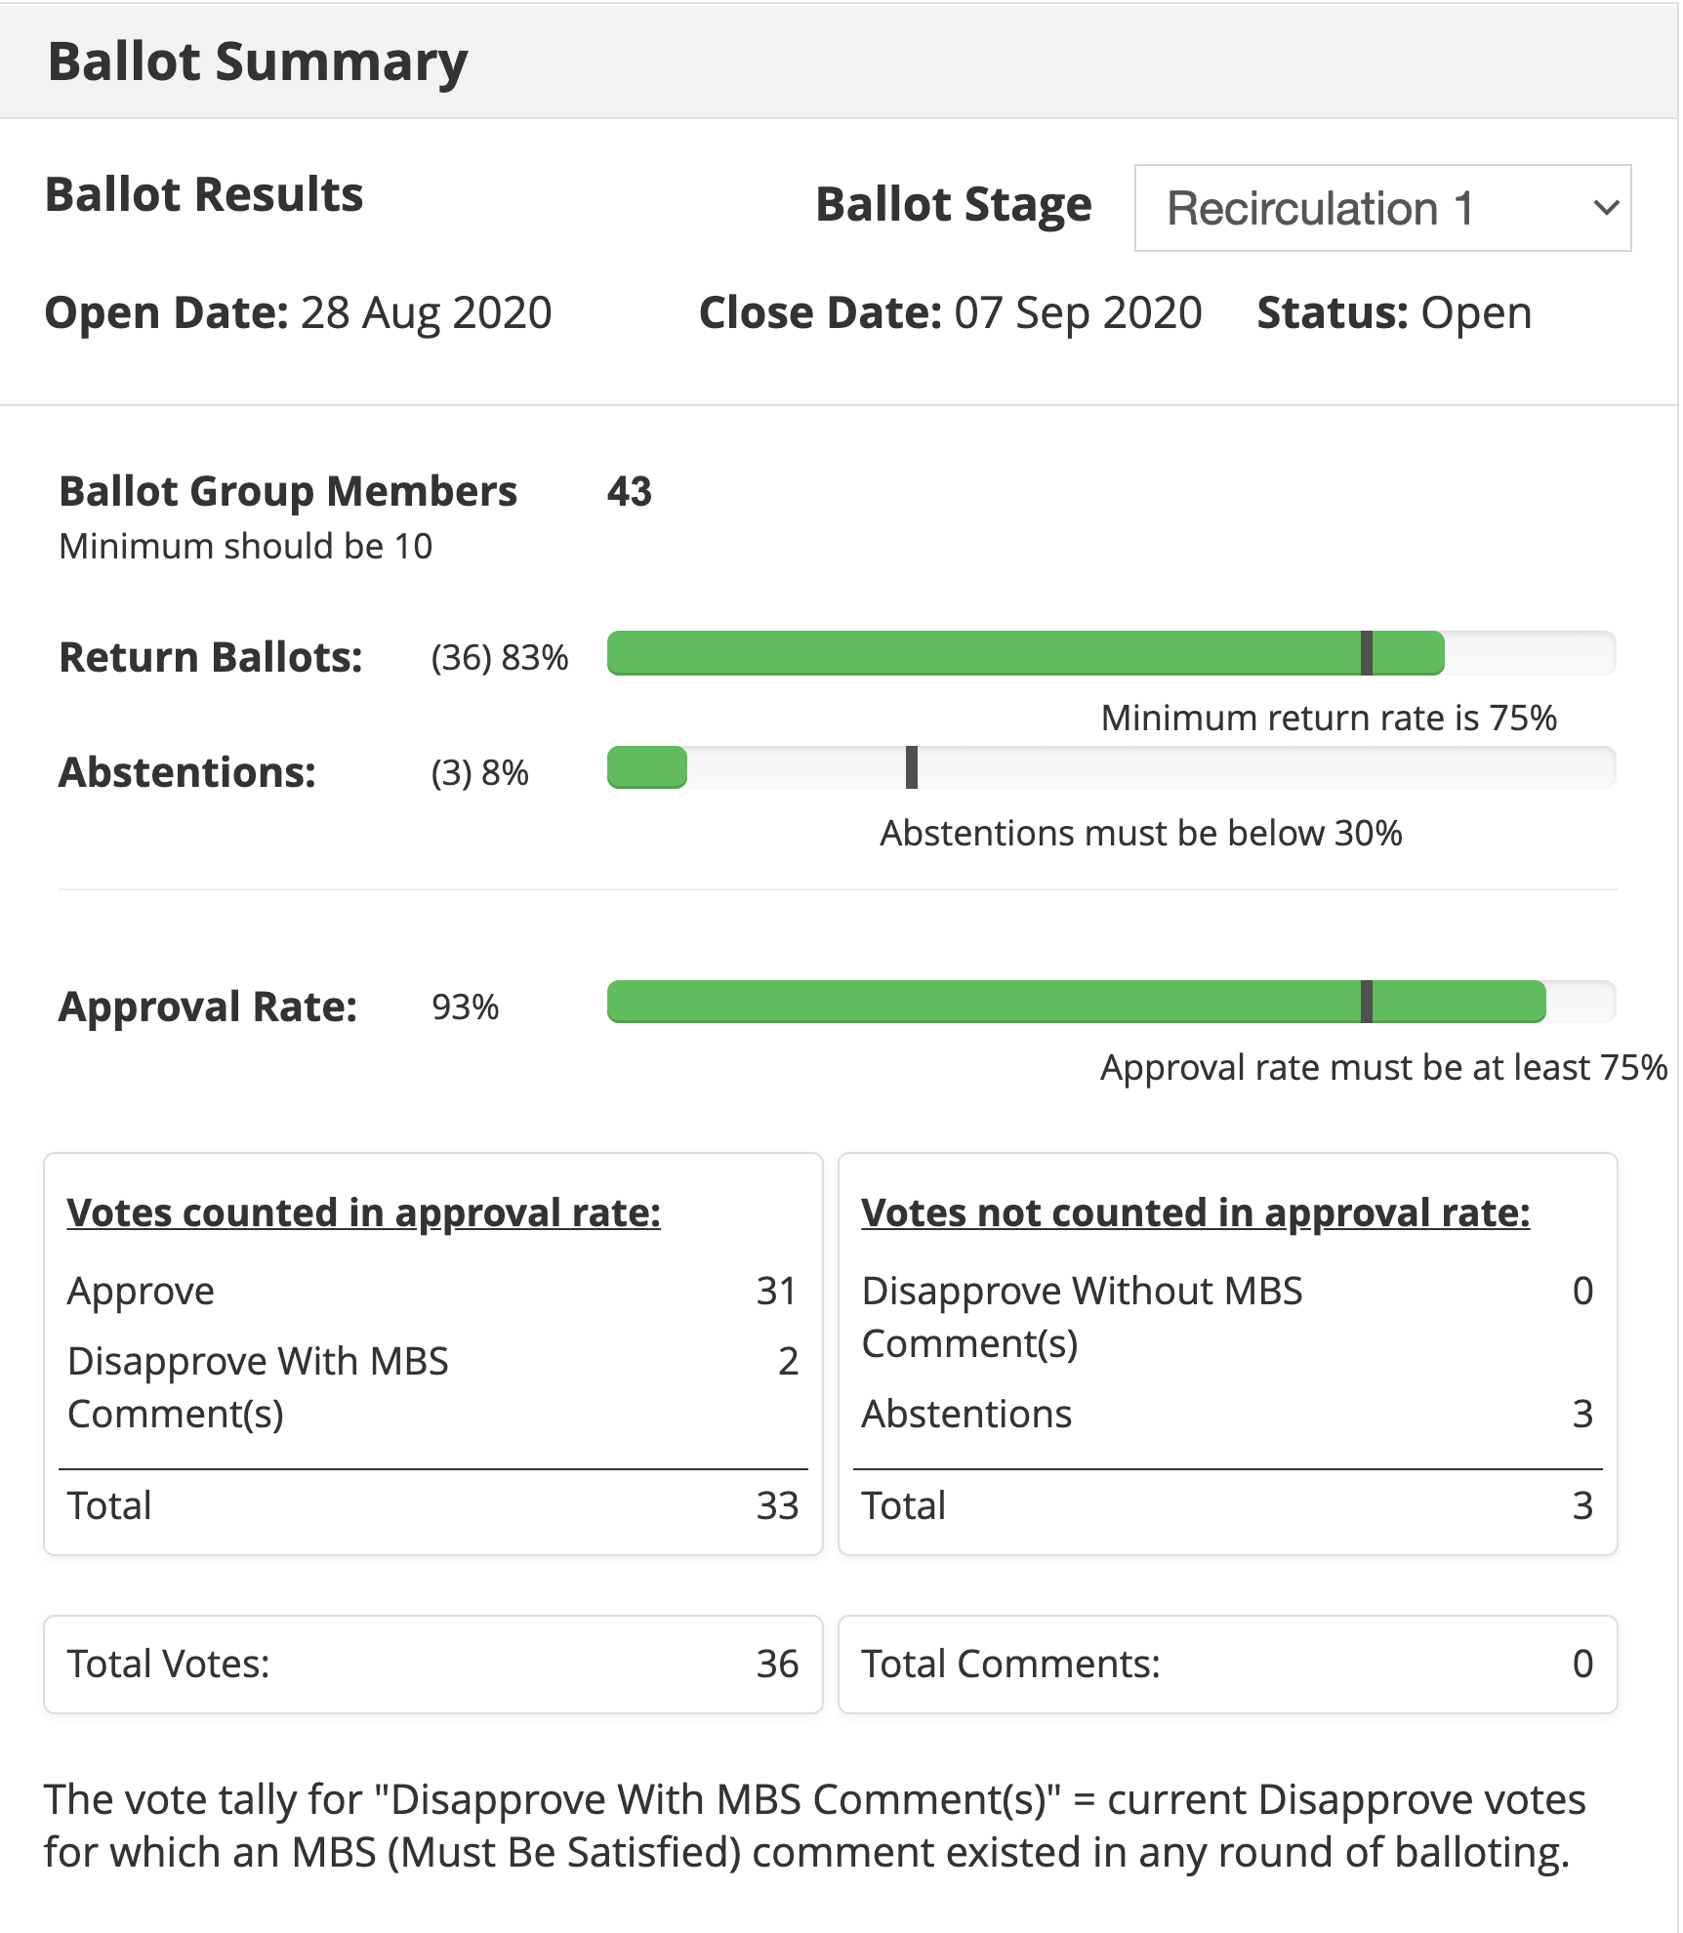
Current Status for 1900.5.1
9/4/20
  CRG submitted sponsor ballot response to WG
  WG approved sponsor ballot response by email ballot
    Voting occurred 7/29-20 until 8/13/20
    17 members, 14 approve, 3 no response
    14/17 = 82.35% > 66% required
  Sponsor ballot recirculation began 8/28/20
  Schedule
    Full review of drafting - 3/17 √
    First WG Ballot - 2/19 √
    WG Recirc - 10/19 √
    Sponsor Ballot - 11/19 √
    Sponsor Recirc - 8/20 √
    Sponsor Recirc 2 - 9/20 – if needed
    Submit to REVCOM – NLT 13 Oct 2020
  Reference implementation of 1900.5.1
    Shooting for an April F2F demonstration - postponed
    Looking at Java but doesn’t support operator overload, C++ a better option
    Has integrated JAVA and C++ into solution
    New OWL API release integrated (thanks Jakub)
  Coming soon (year end) a more accessible policy language
TOTAL COMMENTS: 0
MUST BE SATISFIED COMMENTS: 2 ??? (Not sure what to make of this)

Slide 17
Current Status for 1900.5.2a
7/21/20
  Still few more details getting worked smallish
    Polarization
    Power turnability
    Harmonics
    Antenna Pointing
    Planar approximations
9/4/20
  TBD

Slide 18
Other DySPAN-SC Activities
Updates from 8/24/20 meeting
  1900.1 WG (Alex reports)
    Alex forwarded a 1900.5a contribution from Dave Chester on theory of operation of cognitive and Intelligent radio networks to 1900.1 participants for consideration of inclusion.
  1900.2 WG (Sent apologies)
    Tony reports that it is possible that NIST will have a contribution when the WG resumes activity.
  Restarting 1900.4 WG
    Oliver will finalize the adaptation of 1900.4 WG as an individual-based WG vs. entity-based
    Current chair/members wants to transition to new participants.
  1900.6 WG (Oliver reports)
    1900.6b: Continued resolution of comments

Slide 19
Other DySPAN-SC Activities
Machine Learning standardization Study Group
  Met three times, next meeting is scheduled for Sept 14th, 14:00 UTC
  Selected a SG Secretary: Immanuel Freedman
  Created iMeet workspace and reflector mailing list
  Status:
    Identified a high value use case for incumbent radar detection required for the CBRS band’s Environmental Sensing Capability (ESC).
      Jesse Caulfield is motivated in standardizing the use of ML for this use case to reduce his company’s operating costs through commodification of ML technology.
    Reviewing ITU’s recently completed focus group of applying ML to IMT2020 networks and beyond.
      ITU developed a reference architecture for automating the creation and management of ML pipelines within 5G networks based on operator’s “ML intent”.
        We think this is a valuable and interesting approach, but very ambitious to standardize (many functions and capabilities are represented in the reference architecture) and therefore might be out of scope for our study group.
        We contacted a lead engineer for the ITU’s reference architecture (Vishnu Ram), but haven’t received a reply yet.
      Next, we want to attract participation from other stake holders for applying ML to the CBRS band use case (specifically NIST and other ESC developers)
      We also want to explore the viability of adding a second use case that includes a Reinforcement Learning agent for making control decisions within the cognitive controller of a DSA radio network.
  Recommendation – review the IEEE’s 5 Criteria for feasibility

Slide 20
Other DySPAN-SC Activities
Updates from 4/27/20 meeting (cont)
  1900.5a interfaces (Cross WG collaboration)
    Last ad hoc was canceled, reschedule for May 15th at 1pm ET
    Pivotal question: including external interfaces in 1900.5a revision
  Restarting 1900.4 WG
    Oliver will finalize the adaptation of 1900.4 WG as an individual-based WG vs. entity-based

Slide 21
1900.5 Marketing Inputs
6/5/20
  NTR
7/21/20

Slide 22
1900.5 Meeting Planning and Review
10/2/20 1900.5 WG 14:30 -16:00 EDT
  Will reschedule for 7/10/20 1430-1630 – check with DySPAN

Slide 23
AOB

Slide 24
1900.5 Adjourn
1900.5.2a Ad-hoc

