Slide 1
IEEE 1900.5 Contribution
Author’s Name | Affiliation | Address | Phone | email
Tony Rennier | Foundry Inc. | Severn, MD | 301.485.9679 | trennier@foundryinc.com
Document Title: Agenda, Admin and Chair’s Notes for IEEE 1900.5 WG Meeting on 21-23 July 2020
Document Date: 21-23 July 2020
Document No: 5-20-0022-00-agen
Notice: This document has been prepared to assist IEEE DySPAN-SC and its Working Groups. It is offered as a basis for discussion and is not binding on the contributing individual(s) or organization(s). The material in this document is subject to change in form and content after further study. The contributor(s) reserve(s) the right to add, amend or withdraw material contained herein.
Release: The contributor grants a free, irrevocable license to the IEEE to incorporate material contained in this contribution, and any modifications thereof, in the creation of an IEEE Standards publication; to copyright in the IEEE’s name any IEEE Standards publication even though it may include portions of this contribution; and at the IEEE’s sole discretion to permit others to reproduce in whole or in part the resulting IEEE Standards publication. The contributor also acknowledges and accepts that this contribution may be made public by IEEE DySPAN-SC.
Patent Policy and Procedures: The contributor is familiar with the IEEE Patent Policy and Procedures including the statement "IEEE standards may include the known use of patent(s), including patent applications, provided the IEEE receives assurance from the patent holder or applicant with respect to patents essential for compliance with both mandatory and optional portions of the standard." Early disclosure to IEEE DySPAN-SC and its Working Groups of patent information that might be relevant to the standard is essential to reduce the possibility for delays in the development process and increase the likelihood thatthe draft publication will be approved for publication. Please notify the Chair <trennier@foundryinc.com> as early as possible, in written or electronic form, if patented technology (or technology under patent application) might be incorporated into a draft standard being developed within the IEEE DySPAN-SC Committee. If you have questions, contact the IEEE Patent Committee Administrator at < patcom@ieee.org >.

Slide 2
Electronic Meeting Details
IEEE 1900.5 Meetings
Hosted by Tony Rennier
Meeting number: 624 724 824
Password: nfKJw7Jg
https://foundryinc.my.webex.com/foundryinc.my/j.php?MTID=m692e0f8e641247be995567a1addab5a4
Join by video system
Dial 624724824@foundryinc.my.webex.com
You can also dial 173.243.2.68 and enter your meeting number.
Join by phone
+1-510-338-9438 USA Toll
Access code: 624 724 824
Notes:
September 22, 2008
2

Slide 3
Rules
IEEE DySPAN-SC rules
  https://ieee.app.box.com/v/PandP-DySPAN-SC
IEEE 1900.5 WG rules
  http://grouper.ieee.org/groups/dyspan/files/individual-WG-PnPs.pdf
Roberts Rules (latest edition) as needed…

Slide 4
Current Membership
7/21-23/2020 | WG Status | First Name | Last Name | Affiliation
 | 17 | Total
xy | Member | Julia | Andrusenko | JHU/APL
y | Member | Carlos | Caicedo | Syracuse University (Secretary)
xy | Member | David | Chester | L3Harris
x | Member | Lynn | Grande | Southern Cloud
 | Member | Mitch | Kokar | VIStology & Northeastern University
 | Member | Alex | Lackpour | Drexel University
 | Member | Jakub | Moskal | Vistology
 | Member | V | Prasad | Wireless and Mobile Communication, TU Delft
xy | Member | Reinhard | Schrage | SchrageConsult
y | Member | Kael | Stilp | MITRE
xy | Member | John | Stine | MITRE
 | Member | Darcy | Swain-Walsh | MITRE (Vice Chair)
xy | Member | Tony | Rennier | Foundry Inc (Chair)
x | Member | Jameson | Dempsey | Google
xy | Member | Timothy | Woods | ANDRO Computational Solutions, LLC
xy | Member | Eric | Lindahl | CDS2
xy | Member | Wesley | Eddy | Google
 | Participant | Becca | Rousseau | MITRE
x | Participant | Corrigan | Johnson | Chesapeake Technology International
 | Participant | Thor | Berglie | SSC
 | Participant | Yuriy | Posherstnik | US Army RDECOM CERDEC
 | Participant | Kevin | Rump | Alion
 | Participant | Mat | Sherman | BAE Systems (Former Chair)
x | Participant | Mark | McHenry | SSC
Quorum 7/21? - Yes
Quorum 7/23? - Yes
Quorum > ½ membership (9 members)
2 meetings to get in, 2 meetings to get out

Slide 5
Draft Agenda
7/21/19 9:00-10:30 all times EDT
Administrivia
  Roll Call / Quorum Check
  Approve Agenda
  Copyright Slides
  Patent Slides
  Approval of recent minutes
Status on 1900.5.1
Status on 1900.5.2a
Status 1900.5a
Review of other 1900 activities (1900.1, Leadership meeting etc.)
1900.5 marketing inputs
1900.5 meeting planning and review
AoB
Break
Ad Hoc sessions (Review and planning for subgroup activities as needed)
  1900.5.2a
Any modifications? No
Notes:
September 22, 2008
5

Slide 6
Approval of Agenda
Motion to approve Agenda contained in Doc #: 5-20-0022-00-agen
Mover: Lynn
Second: Dave
Vote: UC

Slide 7
INSTRUCTIONS FOR CHAIRS OF STANDARDS DEVELOPMENT ACTIVITIES
At the beginning of each standards development meeting the chair or a designee is to:
Show the following slides (or provide them beforehand)
Advise the standards development group participants that:
IEEE SA’s copyright policy is described in Clause 7 of the IEEE SA Standards Board Bylaws and Clause 6.1 of the IEEE SA Standards Board Operations Manual;
Any material submitted during standards development, whether verbal, recorded, or in written form, is a Contribution and shall comply with the IEEE SA Copyright Policy;
Instruct the Secretary to record in the minutes of the relevant meeting:
That the foregoing information was provided and that the copyright slides were shown (or provided beforehand).

Slide 8
IEEE SA Copyright Policy
By participating in this activity, you agree to comply with the IEEE Code of Ethics, all applicable laws, and all IEEE policies and procedures including, but not limited to, the IEEE SA Copyright Policy.
    Previously Published material (copyright assertion indicated) shall not be presented/submitted to the Working Group nor incorporated into a Working Group draft unless permission is granted.
    Prior to presentation or submission, you shall notify the Working Group Chair of previously Published material and should assist the Chair in obtaining copyright permission acceptable to IEEE SA.
    For material that is not previously Published, IEEE is automatically granted a license to use any material that is presented or submitted.

Slide 9
IEEE SA Copyright Policy
    The IEEE SA Copyright Policy is described in the IEEE SA Standards Board Bylaws and IEEE SA Standards Board Operations Manual
      IEEE SA Copyright Policy, see
      Clause 7 of the IEEE SA Standards Board Bylaws
      https://standards.ieee.org/about/policies/bylaws/sect6-7.html#7
      Clause 6.1 of the IEEE SA Standards Board Operations Manual
      https://standards.ieee.org/about/policies/opman/sect6.html
    IEEE SA Copyright Permission
      https://standards.ieee.org/content/dam/ieee-standards/standards/web/documents/other/permissionltrs.zip
    IEEE SA Copyright FAQs
      http://standards.ieee.org/faqs/copyrights.html/
    IEEE SA Best Practices for IEEE Standards Development
      http://standards.ieee.org/develop/policies/best_practices_for_ieee_standards_development_051215.pdf
    Distribution of Draft Standards (see 6.1.3 of the SASB Operations Manual)
      https://standards.ieee.org/about/policies/opman/sect6.html

Slide 10
Participants have a duty to inform the IEEE
  Participants shall inform the IEEE (or cause the IEEE to be informed) of the identity of each holder of any potential Essential Patent Claims of which they are personally aware if the claims are owned or controlled by the participant or the entity the participant is from, employed by, or otherwise represents
  Participants should inform the IEEE (or cause the IEEE to be informed) of the identity of any other holders of potential Essential Patent Claims
  Early identification of holders of potential Essential Patent Claims is encouraged
Slide #1

Slide 11
Ways to inform IEEE
Cause an Letter of Assurance (LOA) to be submitted to the IEEE-SA (patcom@ieee.org); or
Provide the chair of this group with the identity of the holder(s) of any and all such claims as soon as possible; or
Speak up now and respond to this Call for Potentially Essential Patents
If anyone in this meeting is personally aware of the holder of any patent claims that are potentially essential to implementation of the proposed standard(s) under consideration by this group and that are not already the subject of an Accepted Letter of Assurance, please respond at this time by providing relevant information to the WG Chair
Slide #2

Slide 12
Other guidelines for IEEE WG meetings
All IEEE-SA standards meetings shall be conducted in compliance with all applicable laws, including antitrust and competition laws.
  Don’t discuss the interpretation, validity, or essentiality of patents/patent claims.
  Don’t discuss specific license rates, terms, or conditions.
    Relative costs of different technical approaches that include relative costs of patent licensing terms may be discussed in standards development meetings.
      Technical considerations remain the primary focus
  Don’t discuss or engage in the fixing of product prices, allocation of customers, or division of sales markets.
  Don’t discuss the status or substance of ongoing or threatened litigation.
  Don’t be silent if inappropriate topics are discussed … do formally object.
---------------------------------------------------------------
For more details, see IEEE-SA Standards Board Operations Manual, clause 5.3.10 and
Antitrust and Competition Policy: What You Need to Know at http://standards.ieee.org/develop/policies/antitrust.pdf
Slide #3

Slide 13
Patent-related information
  The patent policy and the procedures used to execute that policy are documented in the:
    IEEE-SA Standards Board Bylaws (http://standards.ieee.org/develop/policies/bylaws/sect6-7.html#6)
    IEEE-SA Standards Board Operations Manual (http://standards.ieee.org/develop/policies/opman/sect6.html#6.3)
  Material about the patent policy is available at
  http://standards.ieee.org/about/sasb/patcom/materials.html
  If you have questions, contact the IEEE-SA Standards Board Patent Committee Administrator at patcom@ieee.org
Slide #4

Slide 14
Minutes for approval
Motion to approve 6/5/20 WG minutes contained in Doc #: 5-20-0023-00-mins
Mover: Dave
Second: Lynn
Vote: UC

Slide 15
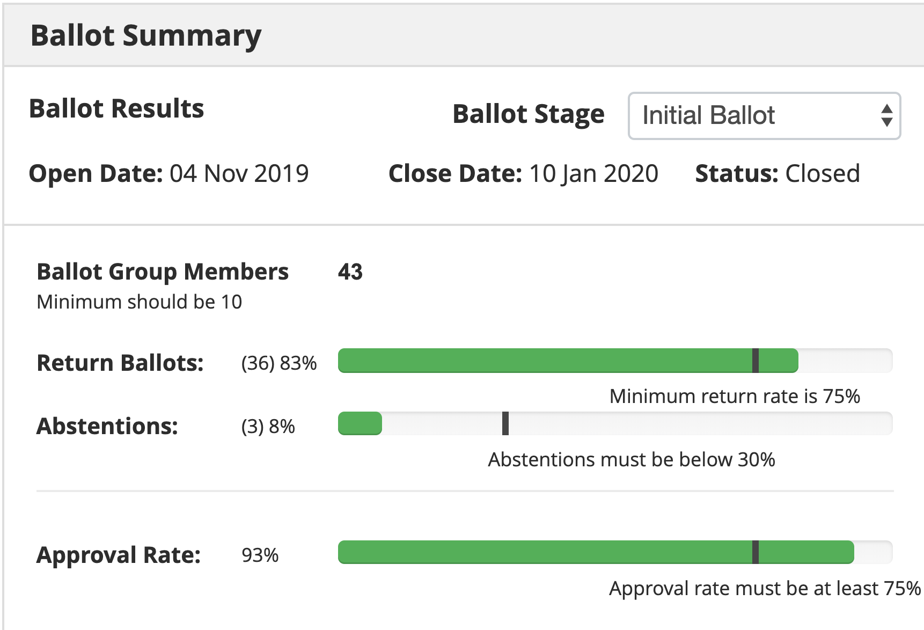
Current Status for 1900.5.1
7/21/20
  1900.5.1 Comment Resolution Group
    Met 4/3
      Reviewed comments
    Final draft with CRS nearly complete
      D3 document formatting/template problems getting resolved
      Tweaks to the CRS required
      WG needs to vote soon so we can start our 10-day recirculation
        This week or email ballot??
  Schedule
    Full review of drafting - 3/17 √
    First WG Ballot - 2/19 √
    WG Recirc - 10/19 √
    Sponsor Ballot - 11/19 √
    Sponsor Recirc - 7/20
    Submit to REVCOM - 8/20
  Reinhard working on a reference implementation of 1900.5.1
    Shooting for an April F2F demonstration - postponed
    Looking at Java but doesn’t support operator overload, C++ a better option
    Has integrated JAVA and C++ into solution
    New OWL API release integrated (thanks Jakub)
  Coming soon (year end) a more accessible policy language
    Working on defining preprocessor to enable easier policy creation
    Using John’s contributions as use cases
TOTAL COMMENTS: 106
MUST BE SATISFIED COMMENTS: 92 (91 Editorial, 1 Substantive)
Draft Notes
There seems to be a problem with this version of the document. I am not able to open beyond page 11 on my Mac. Jen from IEEE was able to open it, but page numbering seems broken. We see Section 5 in the TOC starting out OK but then jumping back to page 7.
This version of the document should be D3.00. Line 1.
Jenn tells me that Annex F is blank.
Jenn also has provided some feedback on the CR sheet attached and in red. Mostly small things, copy and paste stuff.
The CR sheet also refers to Appendix G rather than Annex G.

Slide 16
Current Status for 1900.5.2a
5/1/20
  Lots of internal discussion
    Confidence with location index
    Configuration models for directionality
    Carlos continuing detailed review
    Planning June draft proposal
6/5/20
  Posted a new contribution
  New final draft planned for July
7/21/20
  Still few more details getting worked smallish
    Polarization
    Power turnability
    Harmonics
    Antenna Pointing
    Planar approximations

Slide 17
Current Status for 1900.5a
6/4/20
  Held Ad-hoc 5/15/20, minutes posted on mentor
    Actions:
      Dave Chester is planning on delivering a draft use case in time for mid-June ad hoc meeting
      Use case development
        Alex started listing the elements that define a use case required for 1900.5a (see end of these notes)
        Loon’s use case of High Altitude Platforms for cellular networks
        CBRS band use cases. i.e., vertical and horizontal sharing scenarios.
    Held discussion on how to address external and internal system interfaces in the 1900.5a standard
    Held group discussion about adopting a hierarchical architecture for Policy-based spectrum management (PBSM) of DSA radio networks
  Dave Chester posted “Hierarchical Cognitive Network Characteristics and Potential Supporting Technologies from the Tactical Perspective” on Mentor
7/21/20
  Continuing to address scope around the move to CWN
  Need to allow innovation as high priority

Slide 18
Other DySPAN-SC Activities
7/21/20 Leadership meeting
  1900.1 Study Group initial meeting well attended
    25 interested 16 attended up from 4
  Machine Learning

Slide 19
IEEE DySPAN-SC
IEEE 1900.1: Standard Definitions and Concepts for Spectrum Management and Advanced Radio System Technologies
IEEE 1900.2: Recommended Practice for Interference and Coexistence Analysis
IEEE 1900.4: Standard for Architectural building blocks enabling network-device distributed decision making for optimized radio resource usage in heterogeneous wireless access networks
IEEE 1900.5: Standard on Policy Language and Policy Architectures for Managing Cognitive Radio for Dynamic Spectrum Access Applications
IEEE 1900.6: Standard on interfaces and data structures for exchanging spectrum sensing information for dynamic spectrum access systems
IEEE 1900.7: Standard on radio interface for white space dynamic spectrum access radio systems supporting fixed and mobile operation
Slide 19

Slide 20
1900.5 Marketing Inputs
6/5/20
  NTR
7/21/20
  TBD

Slide 21
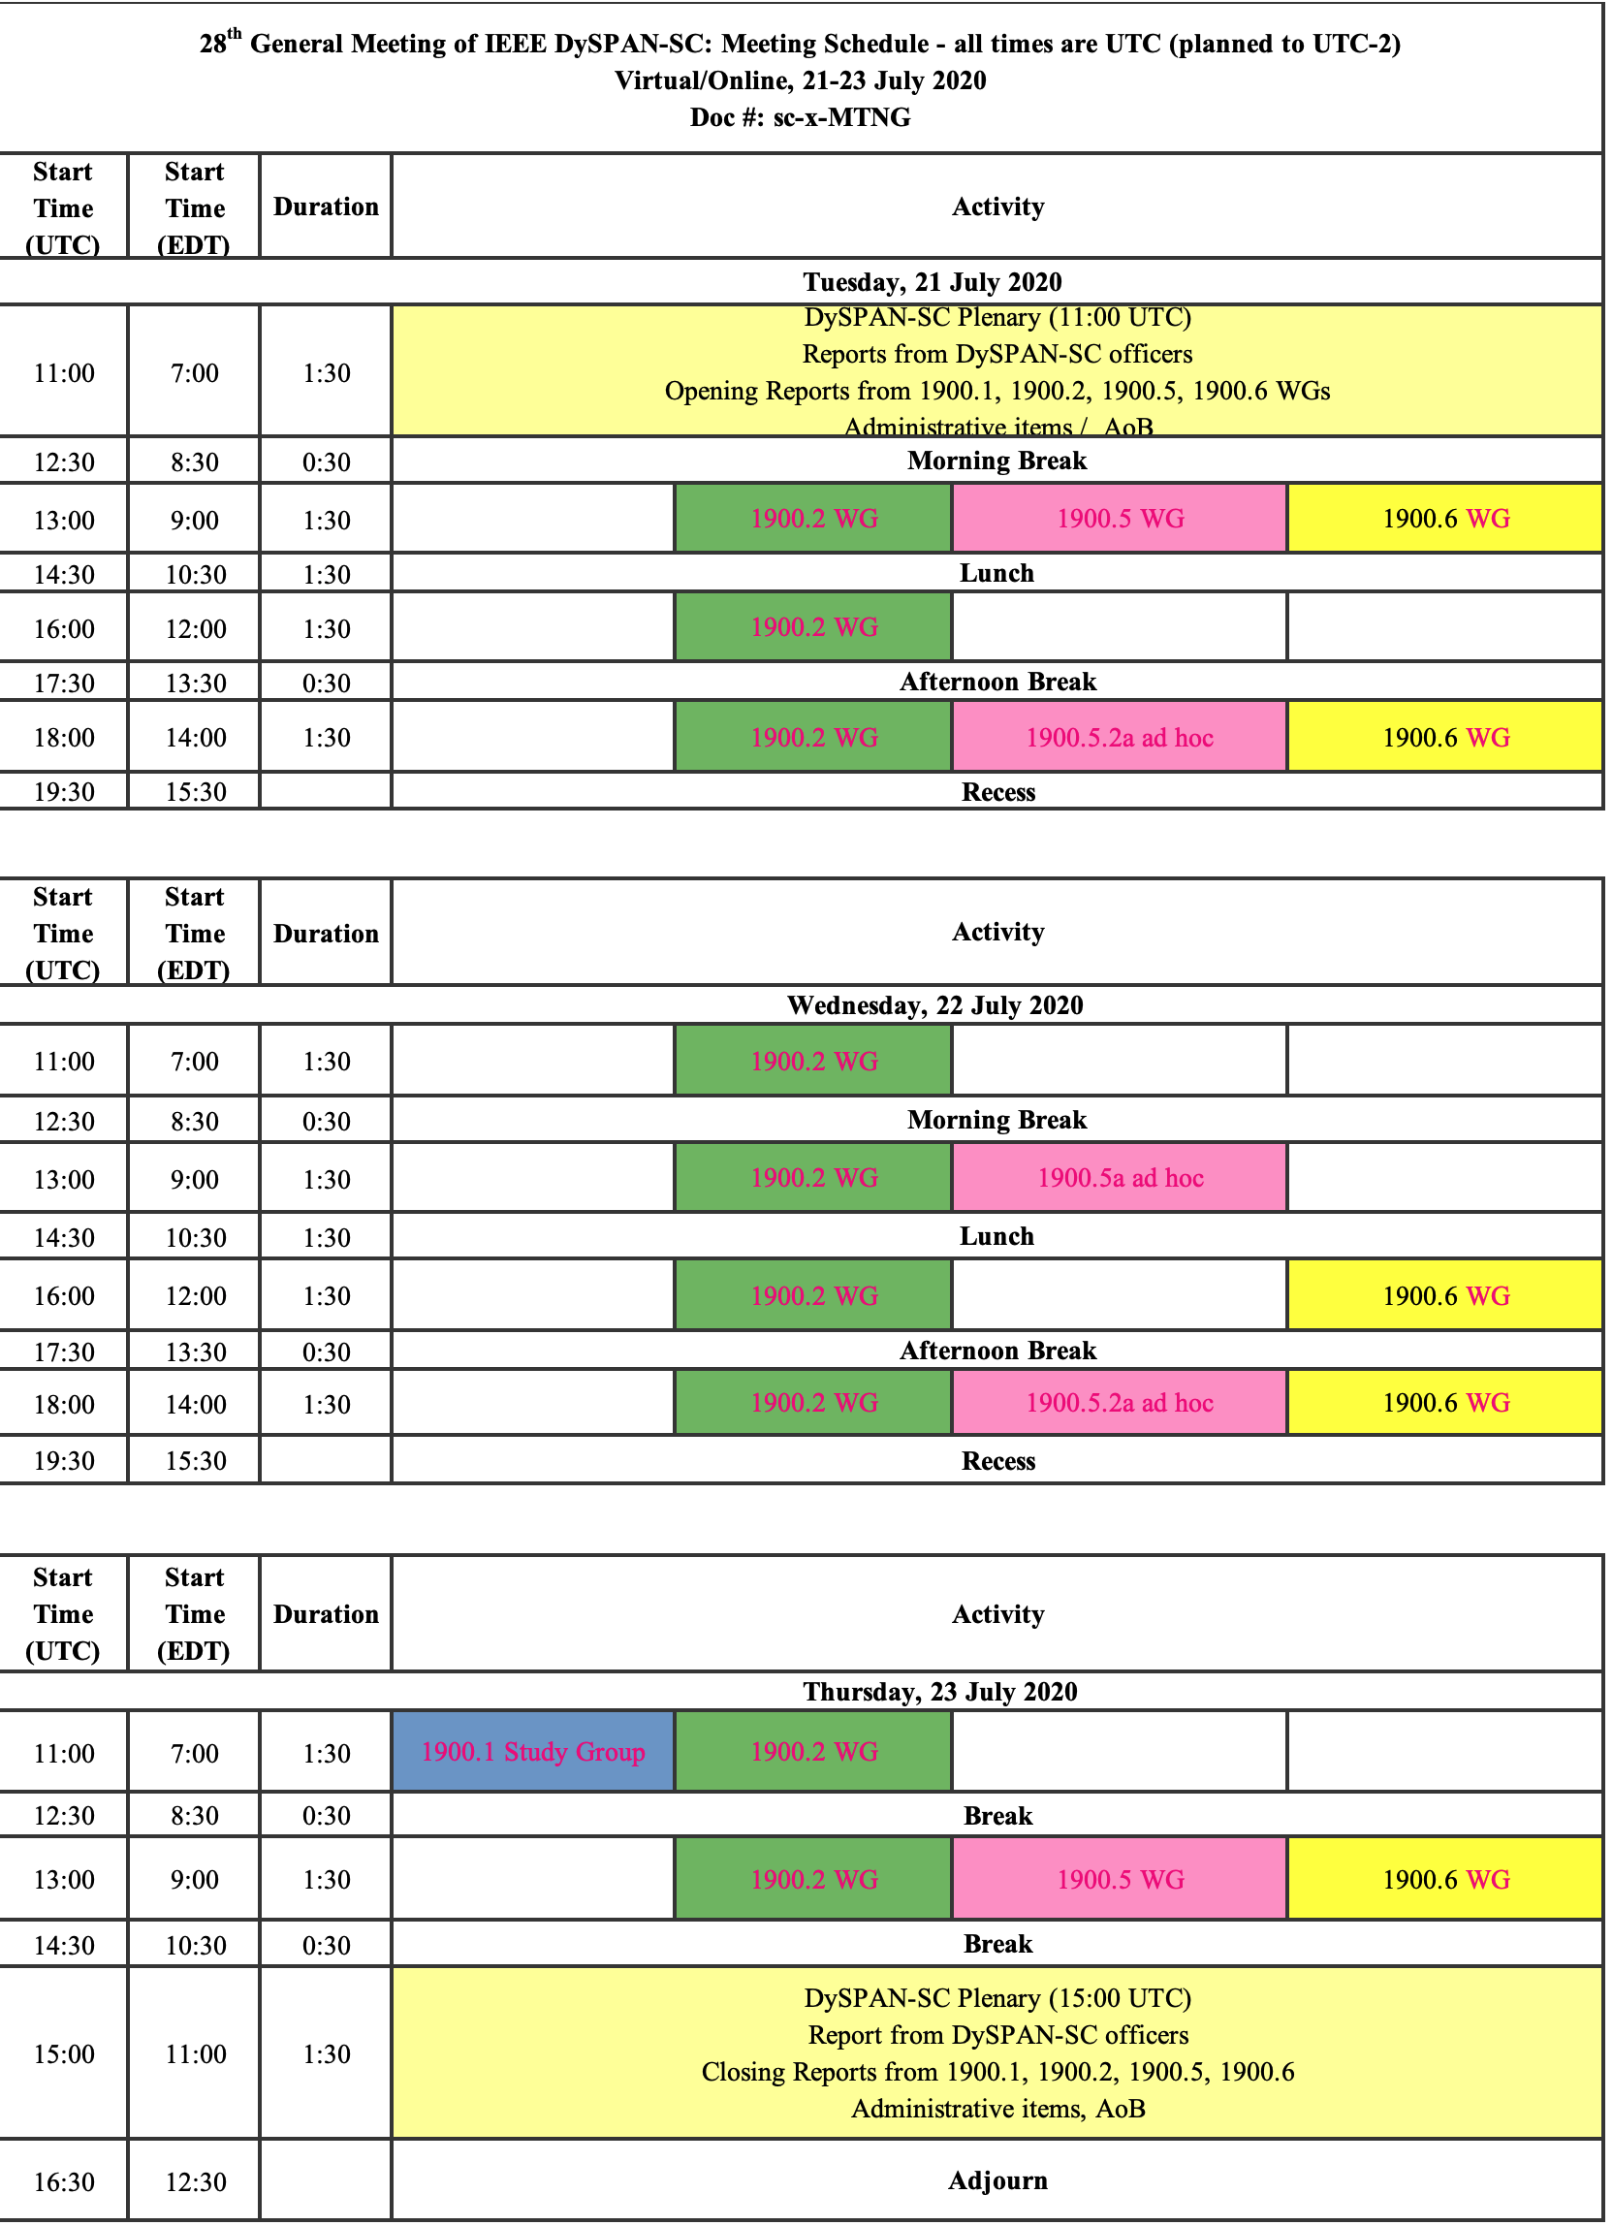
1900.5 Meeting Planning and Review
WG meetings
  This week
  8/7/20 2pm EDT
  9/4/20 8am EDT
1900.5a Ad-hoc
  8/7/20 1pm EDT
  9/4/20 1pm EDT
Plenary Dec 15-17 On-line Only – Tentative good

Slide 22
1900.5 Adjourn

Slide 23
1900.5.2a Ad-hoc

Slide 24
1900.5 WG Closing Meeting

Slide 25
Rules
IEEE DySPAN-SC rules
  https://ieee.app.box.com/v/PandP-DySPAN-SC
IEEE 1900.5 WG rules
  http://grouper.ieee.org/groups/dyspan/files/individual-WG-PnPs.pdf
Roberts Rules (latest edition) as needed…

Slide 26
Draft Agenda
7/23/19 9:00-10:30 all times EDT
Administrivia
  Roll Call / Quorum Check
  Approve Agenda
  Copyright Slides
  Patent Slides
  Approval of recent minutes
Status on 1900.5.1
Status on 1900.5.2a
Status 1900.5a
1900.5 meeting planning and review
AoB
Any modifications? - No
Notes:
September 22, 2008
26

Slide 27
Approval of Agenda
Motion to approve Agenda day 2 contained in Doc #: 5-20-0022-00-agen
Mover: Carlos
Second: Dave
Vote: UC

Slide 28
INSTRUCTIONS FOR CHAIRS OF STANDARDS DEVELOPMENT ACTIVITIES
At the beginning of each standards development meeting the chair or a designee is to:
Show the following slides (or provide them beforehand)
Advise the standards development group participants that:
IEEE SA’s copyright policy is described in Clause 7 of the IEEE SA Standards Board Bylaws and Clause 6.1 of the IEEE SA Standards Board Operations Manual;
Any material submitted during standards development, whether verbal, recorded, or in written form, is a Contribution and shall comply with the IEEE SA Copyright Policy;
Instruct the Secretary to record in the minutes of the relevant meeting:
That the foregoing information was provided and that the copyright slides were shown (or provided beforehand).

Slide 29
IEEE SA Copyright Policy
By participating in this activity, you agree to comply with the IEEE Code of Ethics, all applicable laws, and all IEEE policies and procedures including, but not limited to, the IEEE SA Copyright Policy.
    Previously Published material (copyright assertion indicated) shall not be presented/submitted to the Working Group nor incorporated into a Working Group draft unless permission is granted.
    Prior to presentation or submission, you shall notify the Working Group Chair of previously Published material and should assist the Chair in obtaining copyright permission acceptable to IEEE SA.
    For material that is not previously Published, IEEE is automatically granted a license to use any material that is presented or submitted.

Slide 30
IEEE SA Copyright Policy
    The IEEE SA Copyright Policy is described in the IEEE SA Standards Board Bylaws and IEEE SA Standards Board Operations Manual
      IEEE SA Copyright Policy, see
      Clause 7 of the IEEE SA Standards Board Bylaws
      https://standards.ieee.org/about/policies/bylaws/sect6-7.html#7
      Clause 6.1 of the IEEE SA Standards Board Operations Manual
      https://standards.ieee.org/about/policies/opman/sect6.html
    IEEE SA Copyright Permission
      https://standards.ieee.org/content/dam/ieee-standards/standards/web/documents/other/permissionltrs.zip
    IEEE SA Copyright FAQs
      http://standards.ieee.org/faqs/copyrights.html/
    IEEE SA Best Practices for IEEE Standards Development
      http://standards.ieee.org/develop/policies/best_practices_for_ieee_standards_development_051215.pdf
    Distribution of Draft Standards (see 6.1.3 of the SASB Operations Manual)
      https://standards.ieee.org/about/policies/opman/sect6.html

Slide 31
Participants have a duty to inform the IEEE
  Participants shall inform the IEEE (or cause the IEEE to be informed) of the identity of each holder of any potential Essential Patent Claims of which they are personally aware if the claims are owned or controlled by the participant or the entity the participant is from, employed by, or otherwise represents
  Participants should inform the IEEE (or cause the IEEE to be informed) of the identity of any other holders of potential Essential Patent Claims
  Early identification of holders of potential Essential Patent Claims is encouraged
Slide #1

Slide 32
Ways to inform IEEE
Cause an Letter of Assurance (LOA) to be submitted to the IEEE-SA (patcom@ieee.org); or
Provide the chair of this group with the identity of the holder(s) of any and all such claims as soon as possible; or
Speak up now and respond to this Call for Potentially Essential Patents
If anyone in this meeting is personally aware of the holder of any patent claims that are potentially essential to implementation of the proposed standard(s) under consideration by this group and that are not already the subject of an Accepted Letter of Assurance, please respond at this time by providing relevant information to the WG Chair
Slide #2

Slide 33
Other guidelines for IEEE WG meetings
All IEEE-SA standards meetings shall be conducted in compliance with all applicable laws, including antitrust and competition laws.
  Don’t discuss the interpretation, validity, or essentiality of patents/patent claims.
  Don’t discuss specific license rates, terms, or conditions.
    Relative costs of different technical approaches that include relative costs of patent licensing terms may be discussed in standards development meetings.
      Technical considerations remain the primary focus
  Don’t discuss or engage in the fixing of product prices, allocation of customers, or division of sales markets.
  Don’t discuss the status or substance of ongoing or threatened litigation.
  Don’t be silent if inappropriate topics are discussed … do formally object.
---------------------------------------------------------------
For more details, see IEEE-SA Standards Board Operations Manual, clause 5.3.10 and
Antitrust and Competition Policy: What You Need to Know at http://standards.ieee.org/develop/policies/antitrust.pdf
Slide #3

Slide 34
Patent-related information
  The patent policy and the procedures used to execute that policy are documented in the:
    IEEE-SA Standards Board Bylaws (http://standards.ieee.org/develop/policies/bylaws/sect6-7.html#6)
    IEEE-SA Standards Board Operations Manual (http://standards.ieee.org/develop/policies/opman/sect6.html#6.3)
  Material about the patent policy is available at
  http://standards.ieee.org/about/sasb/patcom/materials.html
  If you have questions, contact the IEEE-SA Standards Board Patent Committee Administrator at patcom@ieee.org
Slide #4

Slide 35
Current Status for 1900.5.1
7/23/20
  CR sheet complete
  Looking at Word Formatting issues
    Downloaded new IEEE SA template
    Checking to see if there integration issues with Microsoft 365
  Will have a WG eBallot soon…
TOTAL COMMENTS: 106
MUST BE SATISFIED COMMENTS: 92 (91 Editorial, 1 Substantive)

Slide 36
Current Status for 1900.5.2a
7/23/20
  Held an ad-hoc Tuesday
  Covered last few changes
    Still a few details getting worked
  Updated draft standard expected by next meeting

Slide 37
Current Status for 1900.5a
7/23/20
  Held ad-hoc
  Working addressing mission policy Use case Counter U-UAS
  Identified iMeet as a possible resource
  Opening a discussion with 1900.4 as to overlap
  Oliver made email introduction

Slide 38
1900.5 Meeting Planning and Review
WG meetings
  8/7/20 2pm EDT – cancel
  9/4/20 8am EDT
1900.5a Ad-hoc
  8/7/20 1pm EDT – consider moving outside 8/3-7/20
  9/4/20 1pm EDT

Slide 39
1900.5 AOB
TBD

Slide 40
1900.5 Adjourn

