Slide 1
IEEE 1900.5 Contribution
Author’s Name | Affiliation | Address | Phone | email
Tony Rennier | Foundry Inc. | Severn, MD | 301.485.9679 | trennier@foundryinc.com
Document Title: Agenda, Admin and Chair’s Notes for IEEE 1900.5 WG Meeting on 06 March 2020
Document Date: 06 March 2020
Document No: 5-20-0004-00-agen
Notice: This document has been prepared to assist IEEE DySPAN-SC and its Working Groups. It is offered as a basis for discussion and is not binding on the contributing individual(s) or organization(s). The material in this document is subject to change in form and content after further study. The contributor(s) reserve(s) the right to add, amend or withdraw material contained herein.
Release: The contributor grants a free, irrevocable license to the IEEE to incorporate material contained in this contribution, and any modifications thereof, in the creation of an IEEE Standards publication; to copyright in the IEEE’s name any IEEE Standards publication even though it may include portions of this contribution; and at the IEEE’s sole discretion to permit others to reproduce in whole or in part the resulting IEEE Standards publication. The contributor also acknowledges and accepts that this contribution may be made public by IEEE DySPAN-SC.
Patent Policy and Procedures: The contributor is familiar with the IEEE Patent Policy and Procedures including the statement "IEEE standards may include the known use of patent(s), including patent applications, provided the IEEE receives assurance from the patent holder or applicant with respect to patents essential for compliance with both mandatory and optional portions of the standard." Early disclosure to IEEE DySPAN-SC and its Working Groups of patent information that might be relevant to the standard is essential to reduce the possibility for delays in the development process and increase the likelihood thatthe draft publication will be approved for publication. Please notify the Chair <trennier@foundryinc.com> as early as possible, in written or electronic form, if patented technology (or technology under patent application) might be incorporated into a draft standard being developed within the IEEE DySPAN-SC Committee. If you have questions, contact the IEEE Patent Committee Administrator at < patcom@ieee.org >.

Slide 2
Electronic Meeting Details
IEEE 1900.5 Meetings
Hosted by Tony Rennier
Meeting number: 624 724 824
Password: nfKJw7Jg
https://foundryinc.my.webex.com/foundryinc.my/j.php?MTID=m692e0f8e641247be995567a1addab5a4
Join by video system
Dial 624724824@foundryinc.my.webex.com
You can also dial 173.243.2.68 and enter your meeting number.
Join by phone
+1-510-338-9438 USA Toll
Access code: 624 724 824
Notes:
September 22, 2008
2

Slide 3
Rules
IEEE DySPAN-SC rules
  https://ieee.app.box.com/v/PandP-DySPAN-SC
IEEE 1900.5 WG rules
  http://grouper.ieee.org/groups/dyspan/files/individual-WG-PnPs.pdf
Roberts Rules (latest edition) as needed…

Slide 4
Current Membership
Quorum 3/6/20?
Yes
3/6/20 | WG Status | First Name | Last Name | Affiliation
 | 13 | Total
x | Member | Julia | Andrusenko | JHU/APL
x | Member | Carlos | Caicedo | Syracuse University (Secretary)
x | Member | David | Chester | L3Harris
x | Member | Lynn | Grande | Southern Cloud
 | Member | Mitch | Kokar | VIStology & Northeastern University
x | Member | Alex | Lackpour | Drexel University
x | Member | Jakub | Moskal | Vistology
 | Member | V | Prasad | Wireless and Mobile Communication, TU Delft
x | Member | Reinhard | Schrage | SchrageConsult
x | Member | Kael | Stilp | MITRE
x | Member | John | Stine | MITRE
 | Member | Darcy | Swain-Walsh | MITRE (Vice Chair)
x | Member | Tony | Rennier | Foundry Inc (Chair)
 | Participant | Jameson | Dempsey | Loon, LLC
x | Participant | Timothy | Woods | ANDRO Computational Solutions, LLC
x | Participant | Eric | Lindahl | CDS2
 | Participant | Thor | Berglie | SSC
 | Participant | Yuriy | Posherstnik | US Army RDECOM CERDEC
 | Participant | Kevin | Rump | Alion
 | Participant | Mat | Sherman | BAE Systems (Former Chair)
 | Participant | Stephen | Berger | TEM Consulting
Quorum > ½ membership (7 members)
2 meetings to get in, 2 meetings to get out

Slide 5
Draft Agenda
3/6/20 8:00-10:00 all times EST
Administrivia
  Roll Call / Quorum Check
  Approve Agenda
  Copyright Slides
  Patent Slides
  Approval of recent minutes
Status on 1900.5.1
Status on 1900.5.2a
Status 1900.5a
Review of other 1900 activities (1900.1, Leadership meeting etc.)
1900.5 marketing inputs
1900.5 meeting planning and review
AoB
Ad Hoc sessions (Review and planning for subgroup activities as needed)
  TBD
Any modifications? No
Notes:
September 22, 2008
5

Slide 6
Approval of Agenda
Motion to approve Agenda contained in Doc #:5-20-0004-00-agen
Mover: Reinhard
Second: Carlos
Vote: UC

Slide 7
INSTRUCTIONS FOR CHAIRS OF STANDARDS DEVELOPMENT ACTIVITIES
At the beginning of each standards development meeting the chair or a designee is to:
Show the following slides (or provide them beforehand)
Advise the standards development group participants that:
  IEEE SA’s copyright policy is described in Clause 7 of the IEEE SA Standards Board Bylaws and Clause 6.1 of the IEEE SA Standards Board Operations Manual;
  Any material submitted during standards development, whether verbal, recorded, or in written form, is a Contribution and shall comply with the IEEE SA Copyright Policy;
  Instruct the Secretary to record in the minutes of the relevant meeting:
  That the foregoing information was provided and that the copyright slides were shown (or provided beforehand).

Slide 8
IEEE SA Copyright Policy
By participating in this activity, you agree to comply with the IEEE Code of Ethics, all applicable laws, and all IEEE policies and procedures including, but not limited to, the IEEE SA Copyright Policy.
    Previously Published material (copyright assertion indicated) shall not be presented/submitted to the Working Group nor incorporated into a Working Group draft unless permission is granted.
    Prior to presentation or submission, you shall notify the Working Group Chair of previously Published material and should assist the Chair in obtaining copyright permission acceptable to IEEE SA.
    For material that is not previously Published, IEEE is automatically granted a license to use any material that is presented or submitted.

Slide 9
IEEE SA Copyright Policy
    The IEEE SA Copyright Policy is described in the IEEE SA Standards Board Bylaws and IEEE SA Standards Board Operations Manual
      IEEE SA Copyright Policy, see
      Clause 7 of the IEEE SA Standards Board Bylaws
      https://standards.ieee.org/about/policies/bylaws/sect6-7.html#7
      Clause 6.1 of the IEEE SA Standards Board Operations Manual
      https://standards.ieee.org/about/policies/opman/sect6.html
    IEEE SA Copyright Permission
      https://standards.ieee.org/content/dam/ieee-standards/standards/web/documents/other/permissionltrs.zip
    IEEE SA Copyright FAQs
      http://standards.ieee.org/faqs/copyrights.html/
    IEEE SA Best Practices for IEEE Standards Development
      http://standards.ieee.org/develop/policies/best_practices_for_ieee_standards_development_051215.pdf
    Distribution of Draft Standards (see 6.1.3 of the SASB Operations Manual)
      https://standards.ieee.org/about/policies/opman/sect6.html

Slide 10
Participants have a duty to inform the IEEE
  Participants shall inform the IEEE (or cause the IEEE to be informed) of the identity of each holder of any potential Essential Patent Claims of which they are personally aware if the claims are owned or controlled by the participant or the entity the participant is from, employed by, or otherwise represents
  Participants should inform the IEEE (or cause the IEEE to be informed) of the identity of any other holders of potential Essential Patent Claims
  Early identification of holders of potential Essential Patent Claims is encouraged
Slide #1

Slide 11
Ways to inform IEEE
Cause an Letter of Assurance (LOA) to be submitted to the IEEE-SA (patcom@ieee.org); or
Provide the chair of this group with the identity of the holder(s) of any and all such claims as soon as possible; or
Speak up now and respond to this Call for Potentially Essential Patents
If anyone in this meeting is personally aware of the holder of any patent claims that are potentially essential to implementation of the proposed standard(s) under consideration by this group and that are not already the subject of an Accepted Letter of Assurance, please respond at this time by providing relevant information to the WG Chair
Slide #2

Slide 12
Other guidelines for IEEE WG meetings
All IEEE-SA standards meetings shall be conducted in compliance with all applicable laws, including antitrust and competition laws.
  Don’t discuss the interpretation, validity, or essentiality of patents/patent claims.
  Don’t discuss specific license rates, terms, or conditions.
    Relative costs of different technical approaches that include relative costs of patent licensing terms may be discussed in standards development meetings.
      Technical considerations remain the primary focus
  Don’t discuss or engage in the fixing of product prices, allocation of customers, or division of sales markets.
  Don’t discuss the status or substance of ongoing or threatened litigation.
  Don’t be silent if inappropriate topics are discussed … do formally object.
---------------------------------------------------------------
For more details, see IEEE-SA Standards Board Operations Manual, clause 5.3.10 and
Antitrust and Competition Policy: What You Need to Know at http://standards.ieee.org/develop/policies/antitrust.pdf
Slide #3

Slide 13
Patent-related information
  The patent policy and the procedures used to execute that policy are documented in the:
    IEEE-SA Standards Board Bylaws (http://standards.ieee.org/develop/policies/bylaws/sect6-7.html#6)
    IEEE-SA Standards Board Operations Manual (http://standards.ieee.org/develop/policies/opman/sect6.html#6.3)
  Material about the patent policy is available at
  http://standards.ieee.org/about/sasb/patcom/materials.html
  If you have questions, contact the IEEE-SA Standards Board Patent Committee Administrator at patcom@ieee.org
Slide #4

Slide 14
Minutes for approval
Motion to approve 2/7/20 WG minutes contained in Doc #: 5-20-0005-00-mins
Mover:
Second:
Vote:

Slide 15
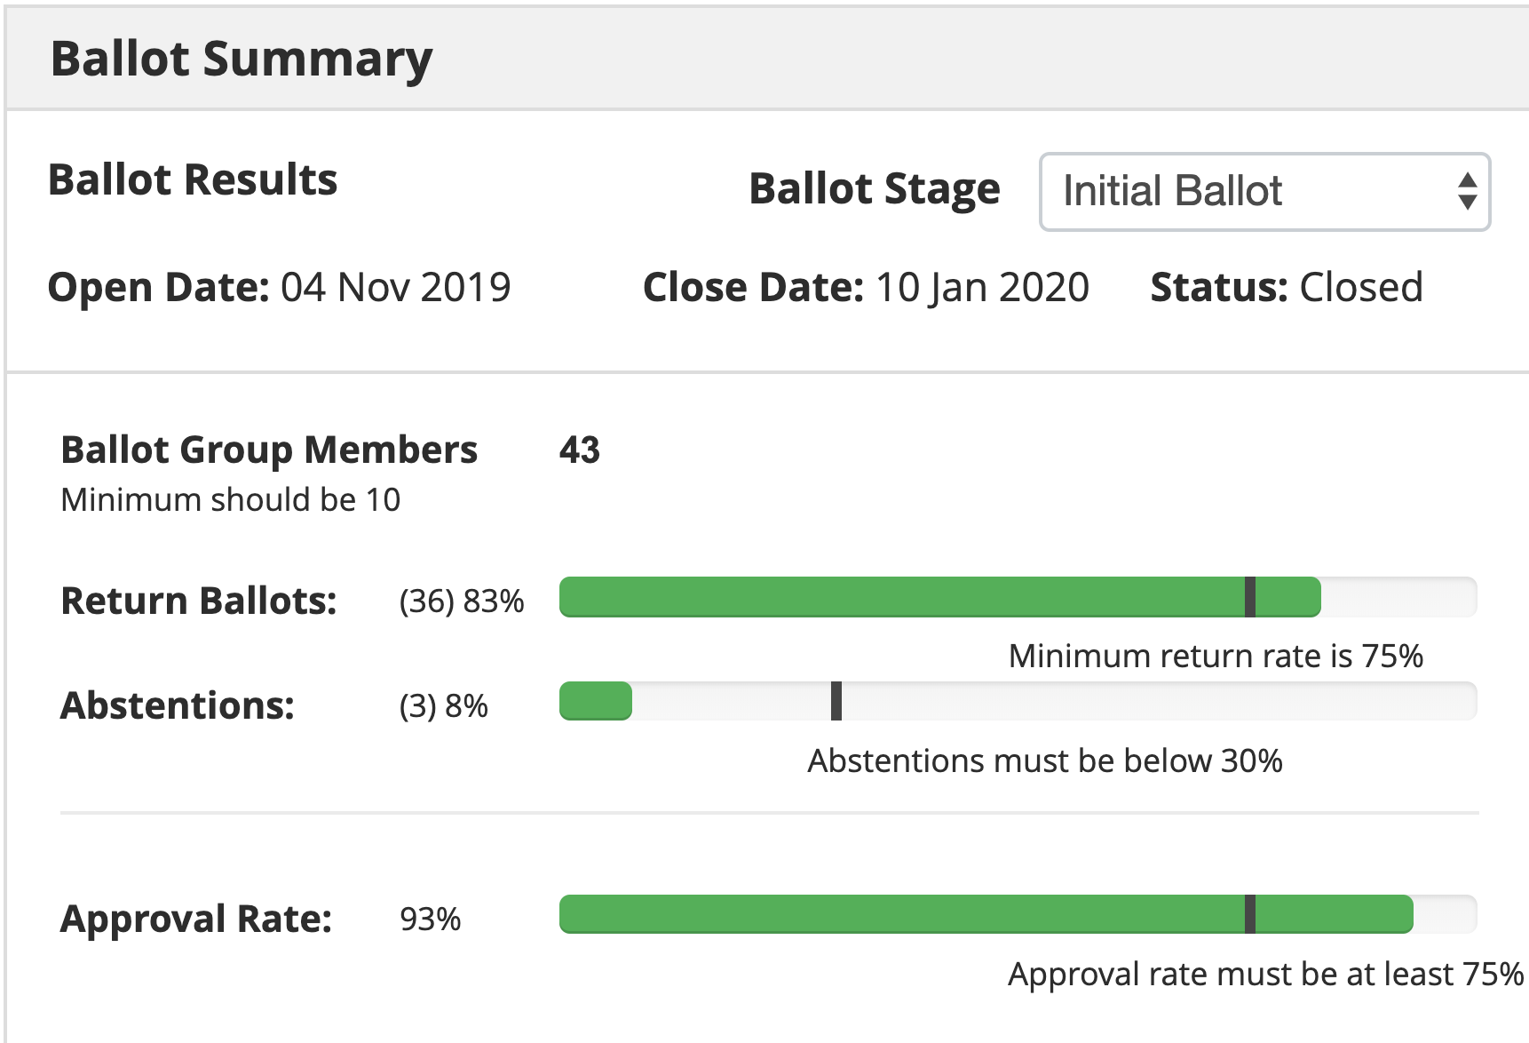
Current Status for 1900.5.1
3/6/20
  1900.5.1 Comment Resolution Group
    Formed at last meeting
    Met 2/18
      Reviewed comments
      Generated revealing discussion on the way the standard is intended to be used
      Actions taken to further consider needed changes considering the usage description
  Schedule
    Full review of drafting - 3/17 √
    First WG Ballot - 2/19 √
    WG Recirc - 10/19 √
    Sponsor Ballot - 11/19 √
    Sponsor Recirc - 4/20
    Sponsor Recirc 2 - 6/20
    Submit to REVCOM - 8/20
  Reinhard working on a reference implementation of 1900.5.1
    Shooting for an April F2F demonstration
  Working on comment resolution
    Planning another CRG 2 or 3 weeks prior to F2F week of 3/20 2:30 EDT?
TOTAL COMMENTS: 106
MUST BE SATISFIED COMMENTS: 92 (91 Editorial, 1 Substantive)

Slide 16
Current Status for 1900.5.2a
2/7/20
  Have a complete update along with schemas and verification rules
  Make decision on moving to sponsor ballot at April meeting
3/6/20
  Met with Carlos on schema changes
    Specifying default values
  Editorial and rule updates coming in
  Still working toward a draft for approval for sponsor ballot at F2F

Slide 17
Current Status for 1900.5a
2/7/20
  Exploring ideas working hard to set scope for the refresh
3/6/20
  Last ad-hoc more details emerging from discussion
  Still at a fundamental stage
    Scope is still a matter for debate
    Working relationship between parent and .1 and .2
    Establishing a sound systems engineering process

Slide 18
Other DySPAN-SC Activities
2/24/20 Meeting Notes
  Upcoming Leadership Meetings
    March 23rd (Monday)
    Plenaries 1st week of April (April 7th - 9th)
  WG Reports
    1900.1 WG (Francesco)
      Trying to enlarge the WG and gain more interest
      Because 1900.1 PAR is expired, would like to create a study group on whether to revise 1900.1 and this will trigger a wide call for participation within the IEEE
      Requesting approval to create a 1900.1 revision study group
      Oliver requests that Francesco create a short description of the study group goals and scope that is voted on my the DySPAN-SC at the April meeting
    1900.2 WG (Stephen)
      WG met on 2/21/20 to further discuss ideas for refreshing the standard
      No commitment yet from members to work on the refresh
        Default action is a limited revision for errata/improvements and reference update
      50/50 on the prospect of getting sponsor support for adding Risk Management to the standard
    1900.6
      Made minor revisions to the draft
      Started sponsor ballets within the WG a week ago
      Planning on at least one session between the plenaries

Slide 19
Other DySPAN-SC Activities
2/24/20 Meeting Notes (cont)
  DARPA SC2 Language standardization
    Alex sent email to John Chapin asking about his interest, but did not hear a response yet
    John is working on a paper on the SC2 collaboration language
  Machine Learning standardization Study Group
    No additional discussion
    Action Oliver: Will initiate the email ballot on the ML Study Group
      14 day email voting ballot period
  National Spectrum Consortium
    No response from NSC leadership (Sal)
  Restarting 1900.4 WG
    Oliver needs to formalize status with chair

Slide 20
1900.5 Marketing Inputs
12/4
  Andy Clegg (Google) interested again in SCM
    PAL protection of interest
    DAA coordination
    WG1 WINNForum
  John teases new projects DoD
2/7/20
  Waiting on response from Andy Clegg
  PACOM investigate spectrum sharing with coalition partners
3/6/20
  CBRS up and coming

Slide 21
1900.5 Meeting Planning and Review
3/6/20 1900.5 WG 08:00 -10:00 EST
4/7-9/20 DySPAN-SC Plenary with 1900.5 WG
  Time Zone: Eastern Daylight Time (UTC - 4)
  Location: F2F in Cape Canaveral, Florida
  Planning to attend in person: Dave, Lynn, Oliver, Tony, Reinhart, Carlos is a maybe, Eric Lyndal, Julia TBD, Kael, Mitch or Jakub
  Attempt to stick to meeting schedule that is compatible with Eastern USA Time Zones
    Meeting times: 9am – 5:30pm EDT
    Opening Plenary: 9am on April 7th
    Closing Plenary: 2nd AM session on April 9th
    Action Item (Alex, by Feb 15th): Send out scheduled times spreadsheet

Slide 22
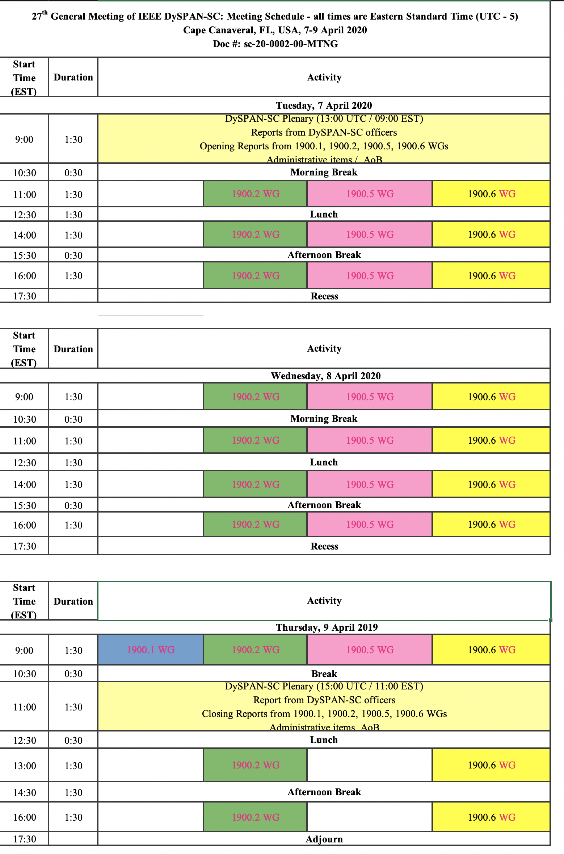
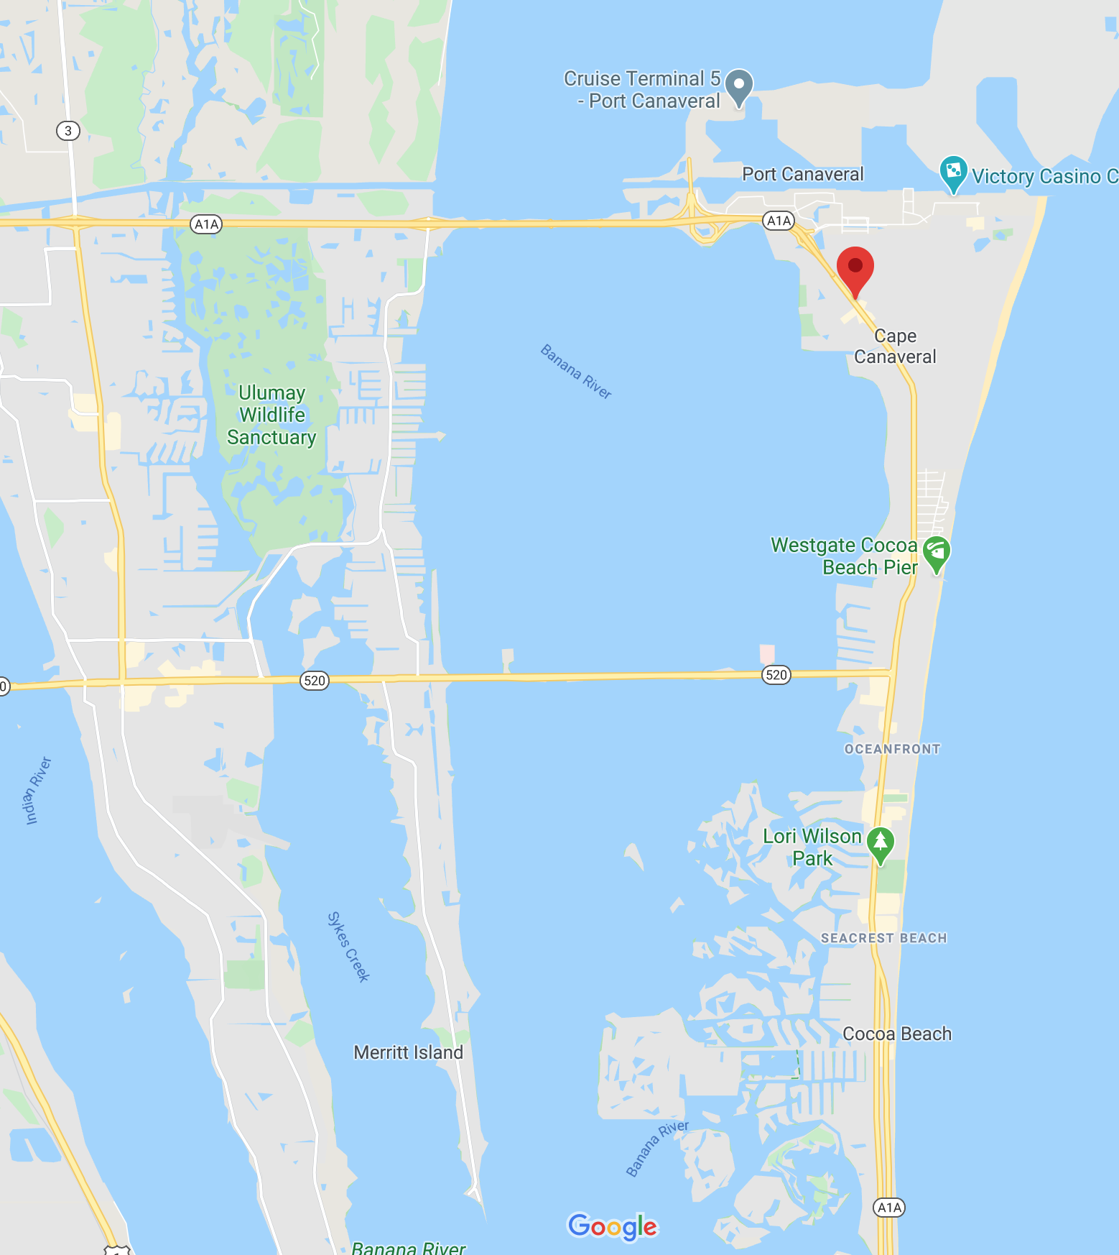
701 Astronaut Blvd, Cape Canaveral, FL 32920 www.Radisson.com Cape Canaveral, FL

Slide 23
AoB
  2/7/20
    None

Slide 24
Ad Hoc Sessions
3/6/20

