Slide 1
IEEE 1900.5 Contribution
Author’s Name | Affiliation | Address | Phone | email
Tony Rennier | Foundry Inc. | Severn, MD | 301.485.9679 | trennier@foundryinc.com
Document Title: Agenda, Admin and Chair’s Notes for IEEE 1900.5 WG Meeting on 07-08 November 2019
Document Date: 07-08 November 2019
Document No: 5-19-0037-00-agen
Notice: This document has been prepared to assist IEEE DySPAN-SC and its Working Groups. It is offered as a basis for discussion and is not binding on the contributing individual(s) or organization(s). The material in this document is subject to change in form and content after further study. The contributor(s) reserve(s) the right to add, amend or withdraw material contained herein.
Release: The contributor grants a free, irrevocable license to the IEEE to incorporate material contained in this contribution, and any modifications thereof, in the creation of an IEEE Standards publication; to copyright in the IEEE’s name any IEEE Standards publication even though it may include portions of this contribution; and at the IEEE’s sole discretion to permit others to reproduce in whole or in part the resulting IEEE Standards publication. The contributor also acknowledges and accepts that this contribution may be made public by IEEE DySPAN-SC.
Patent Policy and Procedures: The contributor is familiar with the IEEE Patent Policy and Procedures including the statement "IEEE standards may include the known use of patent(s), including patent applications, provided the IEEE receives assurance from the patent holder or applicant with respect to patents essential for compliance with both mandatory and optional portions of the standard." Early disclosure to IEEE DySPAN-SC and its Working Groups of patent information that might be relevant to the standard is essential to reduce the possibility for delays in the development process and increase the likelihood thatthe draft publication will be approved for publication. Please notify the Chair <trennier@foundryinc.com> as early as possible, in written or electronic form, if patented technology (or technology under patent application) might be incorporated into a draft standard being developed within the IEEE DySPAN-SC Committee. If you have questions, contact the IEEE Patent Committee Administrator at < patcom@ieee.org >.

Slide 2
Electronic Meeting Details
IEEE 1900.5 Meetings
Hosted by Tony Rennier
Meeting number: 624 724 824
Password: nfKJw7Jg
https://foundryinc.my.webex.com/foundryinc.my/j.php?MTID=m692e0f8e641247be995567a1addab5a4
Join by video system
Dial 624724824@foundryinc.my.webex.com
You can also dial 173.243.2.68 and enter your meeting number.
Join by phone
+1-510-338-9438 USA Toll
Access code: 624 724 824
Notes:
September 22, 2008
2

Slide 3
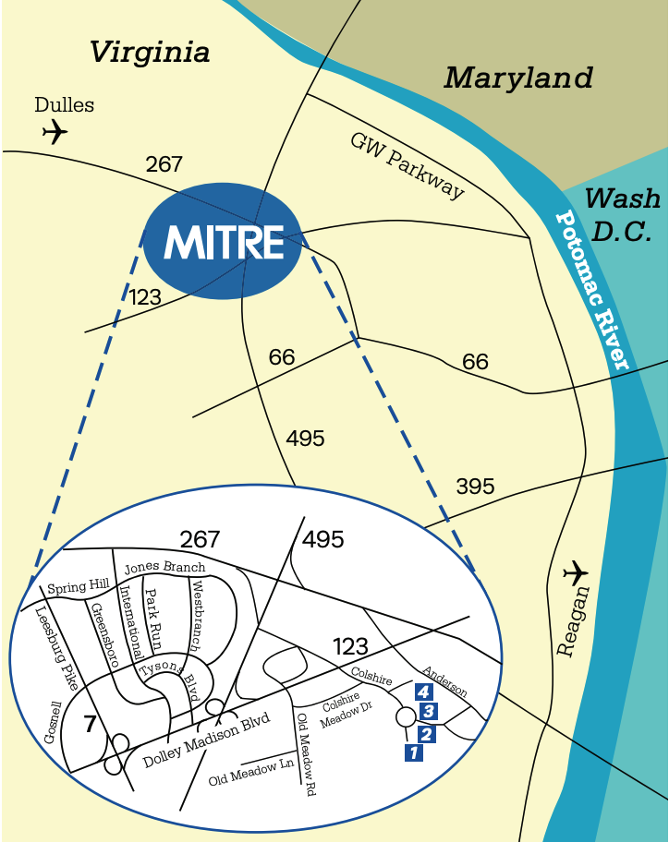
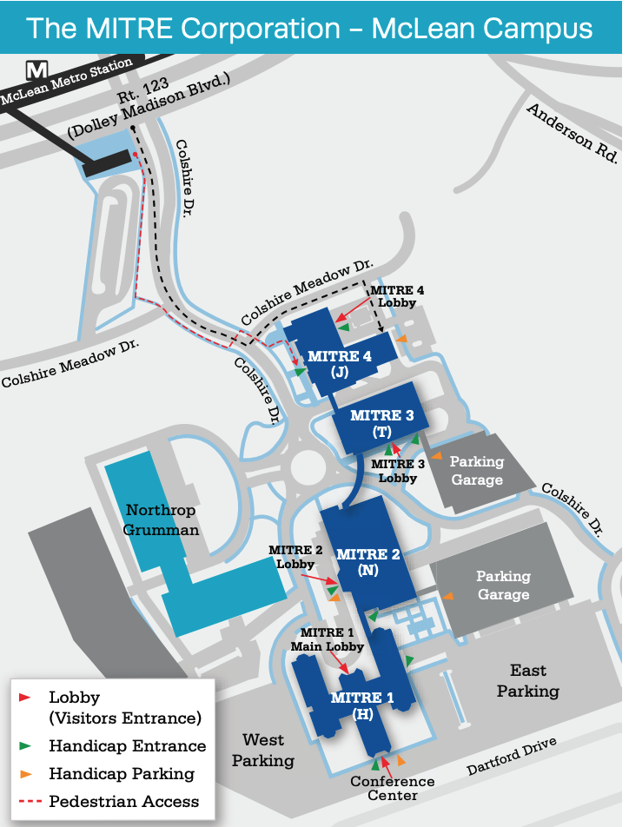
Face to Face Details
Address:
MITRE-4 Building (J)
7596 Colshire Drive
McLean, VA 22102-7539
PoC: John A Stine, Ph.D.
Department Head
Operations Research
(703)-983-6281
jstine@mitre.org
Notes:
You can download a map of the McLean Campus at this URL:
https://www.mitre.org/sites/default/files/pdf/mclean-campus-map.pdf
We are a short walk from the McLean Metro Station.
If you intend on attending in person, I will need to know beforehand. If you are a U.S. citizen, please provide me your name. If you are a foreign national, please provide me your name, citizenship, the company or organization you represent, and the country of that company and organization. I need this information by 31 October.
Those who are driving will need a parking pass to park on campus. Please let me know if you will be driving and I will send you one. The parking is underneath MITRE 4 with the entrance to the parking garage on the side of the building opposite the street. The parking pass, however, is good for any of MITRE’s parking garages or lots.

Slide 4
Rules
IEEE DySPAN-SC rules
  https://ieee.app.box.com/v/PandP-DySPAN-SC
IEEE 1900.5 WG rules
  http://grouper.ieee.org/groups/dyspan/files/individual-WG-PnPs.pdf
Roberts Rules (latest edition) as needed…

Slide 5
Current Membership
11/7-8/19 | 11/7-8/19 | WG Status | First Name | Last Name | Affiliation
 |  | 15 | Total
 |  | Member | Julia | Andrusenko | JHU/APL
 |  | Member | Carlos | Caicedo | Syracuse University (Secretary)
 |  | Member | David | Chester | L3Harris
 |  | Member | Lynn | Grande | Southern Cloud
 |  | Member | Mitch | Kokar | VIStology & Northeastern University
 |  | Member | Alex | Lackpour | Drexel University
 |  | Member | Li | Li | Communications Research Centre Canada
 |  | Member | Jakub | Moskal | Vistology
 |  | Member | V | Prasad | Wireless and Mobile Communication, TU Delft
 |  | Member | Tony | Rennier | Foundry Inc (Chair)
 |  | Member | Reinhard | Schrage | SchrageConsult
 |  | Member | Mat | Sherman | BAE Systems (Former Chair)
 |  | Member | Kael | Stilp | MITRE
 |  | Member | John | Stine | MITRE
 |  | Member | Darcy | Swain-Walsh | MITRE (Vice Chair)
 |  | Participant
 |  | Participant | Kevin | Rump | Alion
 |  | Participant | Haitao | Zhao
 |  | Participant | Demetrio | Bucaneg
 |  | Participant | Piotr | Karocki
 |  | Participant | Werner | Hoelzl
Quorum 11/7? -
Quorum 11/8? -
Quorum > ½ membership (8 members)
2 meetings to get in, 2 meetings to get out

Slide 6
Draft Agenda
11/7/19 9:00-17:00 all times EST
Administrivia
  Roll Call / Quorum Check
  Approve Agenda
  Copyright Slides
  Patent Slides
  Approval of recent minutes
Status on 1900.5.1
Status on 1900.5.2a
Status 1900.5a
Review of other 1900 activities (1900.1, Leadership meeting etc.)
1900.5 marketing inputs
1900.5 meeting planning and review
AoB
Break
Ad Hoc sessions (Review and planning for subgroup activities as needed)
  1900.5.2a
  1900.5a
  1900.5.1
11/8/19 9:00-17:00 all times EST
Ad Hoc sessions (Review and planning for subgroup activities as needed)
Any modifications?
Notes:
September 22, 2008
6

Slide 7
Approval of Agenda
Motion to approve Agenda contained in Doc #:5-19-0037-00-agen
Mover:
Second:
Vote:

Slide 8
INSTRUCTIONS FOR CHAIRS OF STANDARDS DEVELOPMENT ACTIVITIES
At the beginning of each standards development meeting the chair or a designee is to:
Show the following slides (or provide them beforehand)
Advise the standards development group participants that:
IEEE SA’s copyright policy is described in Clause 7 of the IEEE SA Standards Board Bylaws and Clause 6.1 of the IEEE SA Standards Board Operations Manual;
Any material submitted during standards development, whether verbal, recorded, or in written form, is a Contribution and shall comply with the IEEE SA Copyright Policy;
Instruct the Secretary to record in the minutes of the relevant meeting:
That the foregoing information was provided and that the copyright slides were shown (or provided beforehand).

Slide 9
IEEE SA Copyright Policy
By participating in this activity, you agree to comply with the IEEE Code of Ethics, all applicable laws, and all IEEE policies and procedures including, but not limited to, the IEEE SA Copyright Policy.
    Previously Published material (copyright assertion indicated) shall not be presented/submitted to the Working Group nor incorporated into a Working Group draft unless permission is granted.
    Prior to presentation or submission, you shall notify the Working Group Chair of previously Published material and should assist the Chair in obtaining copyright permission acceptable to IEEE SA.
    For material that is not previously Published, IEEE is automatically granted a license to use any material that is presented or submitted.

Slide 10
IEEE SA Copyright Policy
    The IEEE SA Copyright Policy is described in the IEEE SA Standards Board Bylaws and IEEE SA Standards Board Operations Manual
      IEEE SA Copyright Policy, see
      Clause 7 of the IEEE SA Standards Board Bylaws
      https://standards.ieee.org/about/policies/bylaws/sect6-7.html#7
      Clause 6.1 of the IEEE SA Standards Board Operations Manual
      https://standards.ieee.org/about/policies/opman/sect6.html
    IEEE SA Copyright Permission
      https://standards.ieee.org/content/dam/ieee-standards/standards/web/documents/other/permissionltrs.zip
    IEEE SA Copyright FAQs
      http://standards.ieee.org/faqs/copyrights.html/
    IEEE SA Best Practices for IEEE Standards Development
      http://standards.ieee.org/develop/policies/best_practices_for_ieee_standards_development_051215.pdf
    Distribution of Draft Standards (see 6.1.3 of the SASB Operations Manual)
      https://standards.ieee.org/about/policies/opman/sect6.html

Slide 11
Participants have a duty to inform the IEEE
  Participants shall inform the IEEE (or cause the IEEE to be informed) of the identity of each holder of any potential Essential Patent Claims of which they are personally aware if the claims are owned or controlled by the participant or the entity the participant is from, employed by, or otherwise represents
  Participants should inform the IEEE (or cause the IEEE to be informed) of the identity of any other holders of potential Essential Patent Claims
  Early identification of holders of potential Essential Patent Claims is encouraged
Slide #1

Slide 12
Ways to inform IEEE
Cause an Letter of Assurance (LOA) to be submitted to the IEEE-SA (patcom@ieee.org); or
Provide the chair of this group with the identity of the holder(s) of any and all such claims as soon as possible; or
Speak up now and respond to this Call for Potentially Essential Patents
If anyone in this meeting is personally aware of the holder of any patent claims that are potentially essential to implementation of the proposed standard(s) under consideration by this group and that are not already the subject of an Accepted Letter of Assurance, please respond at this time by providing relevant information to the WG Chair
Slide #2

Slide 13
Other guidelines for IEEE WG meetings
All IEEE-SA standards meetings shall be conducted in compliance with all applicable laws, including antitrust and competition laws.
  Don’t discuss the interpretation, validity, or essentiality of patents/patent claims.
  Don’t discuss specific license rates, terms, or conditions.
    Relative costs of different technical approaches that include relative costs of patent licensing terms may be discussed in standards development meetings.
      Technical considerations remain the primary focus
  Don’t discuss or engage in the fixing of product prices, allocation of customers, or division of sales markets.
  Don’t discuss the status or substance of ongoing or threatened litigation.
  Don’t be silent if inappropriate topics are discussed … do formally object.
---------------------------------------------------------------
For more details, see IEEE-SA Standards Board Operations Manual, clause 5.3.10 and
Antitrust and Competition Policy: What You Need to Know at http://standards.ieee.org/develop/policies/antitrust.pdf
Slide #3

Slide 14
Patent-related information
  The patent policy and the procedures used to execute that policy are documented in the:
    IEEE-SA Standards Board Bylaws (http://standards.ieee.org/develop/policies/bylaws/sect6-7.html#6)
    IEEE-SA Standards Board Operations Manual (http://standards.ieee.org/develop/policies/opman/sect6.html#6.3)
  Material about the patent policy is available at
  http://standards.ieee.org/about/sasb/patcom/materials.html
  If you have questions, contact the IEEE-SA Standards Board Patent Committee Administrator at patcom@ieee.org
Slide #4

Slide 15
Minutes for approval
Motion to approve 9/6/19 WG minutes contained in Doc #: 5-19-0038-00-mins
Mover:
Second:
Vote:

Slide 16
Minutes for approval
Motion to approve 10/4/19 WG minutes contained in Doc #: 5-19-0039-00-mins
Mover:
Second:
Vote:

Slide 17
Current Status for 1900.5.1
10/4/19
  Reinhard to delivered a final draft of 1900.5.1 on 9/17/19
  Jenn helped Reinhard obtain IEEE approval for the use of any copyrights material in the draft.
  Reinhard obtained W3C approval for use of any of their copyright material in the draft.
  Tony submitted that draft to MEC on 9/18/19
  Tony to initiated the start of the 30 day ballot invitation on 9/16/19
  Tony distributed the draft and initiated 1900.5 WG letter ballot for a NLT 10/5/19 response to begin a sponsor ballot on 9/21/19
  Oliver to initiate a 1900 letter ballot for approval to begin sponsor ballot as soon as the 1900.5 WG letter ballot achieves 2/3 approval
  Reinhard to address any MEC comments on the draft as they come in
  Tony to take whatever other steps are necessary to ensure that sponsor ballot opens by 10/16/19
11/7/19
  1900.5 WG Letter Ballot to being Sponsor Ballot completed 10/7/19, final tally was 14 approve and 1 abstain
  1900 Letter Ballot on Moving P1900.5.1 Draft 1.0 to Sponsor Ballot completed 10/26/19, final tally was 6 approve and 1 abstain
  Sponsor Ballot Group formed 10/17/19
  MEC provided comments 10/22/19
  Reinhard addressed MEC comments 11/4/19
  Sponsor Ballot Initiated 11/5/19
  NESCOM consideration for one year PAR extension 11/7/19

Slide 18
Working Schedule for 1900.5.1
Full review of drafting 3/17 √
First WG Ballot 2/19 √
WG Recirc 10/19 √
Sponsor Ballot 11/19 √ (Prior to PAR Extension)
Sponsor Recirc 2/20
Sponsor Recirc 2 5/20
Submit to REVCOM 8/20
Proposed Update
Requires PAR Extension 11/19

Slide 19
Current Status for 1900.5.2a
9/6/19
  PAR Revision Approved
  Looking for new Ad-hoc in Sept
  Looking for closure end of Sept
10/4/19
  Held two ad-hocs in Sept
  Noted some recent required changes
  Planned for the end of Oct.
    Possible ad-hoc afternoon 18th of October 2pm EDT
  Possible WG ballot after F2F (Nov 2019)
11/7/19

Slide 20
Current Status for 1900.5 Revision
9/6/19
  Lynn/Tony committed to comments on Dave’s draft
10/4/19
  NTR
11/7/19

Slide 21
Other DySPAN-SC Activities
Oct 2019 Leadership meetings
  WG Reports
    1900.1 WG (Francisco reports)
      No updates
    1900.2 WG (Stephen reports)
      Minimal revision is required, updating references
      Planning to issue a letter ballot soon, should attract attention from WG members and spur member participation
      Stephen plans to have a 1900.2 WG meeting soon to formalize the membership
    1900.5 WG (Tony reports)
      Committee to discuss PAR review meets in early November
      DySPAN-SC approved moving to sponsor ballot – waiting for NEC approval
      F2F meeting next week, McLean, VA
      1900.5 becomes an inactive standard if it isn’t revised by the end of the year. It’s not a major issue if the standard becomes non-active for a short time. It will become active once it is revised.
    1900.6 WG (Oliver reports)
      Continuing with formal WG meetings
      Final circulation ballot on 1900.6b
      Move to a sponsor ballot soon after it is approved in the WG
      Need having comment resolution ballot meetings on 1900.6b

Slide 22
Other DySPAN-SC Activities (Cont)
Oct 2019 Leadership meetings
  DySPAN-SC Elections
    Nominations are open until 11/18/19
  Potential New Projects
    DARPA SC2 Language standardization
      Action Item (Alex, by Nov 14th) engage Paul Tilghman at DySPAN workshop and discuss his progress on standardizing SC2’s inter-network/PU dynamic collaboration language
    Machine Learning standardization
      Action Item (Alex, by Nov 14th): engage Paul Tilghman at DySPAN workshop and discuss his progress on standardizing ML for wireless networks within 3GPP, 802.11, etc...
      Discussion on the ITU’s new WGs on Machine Learning
        Focus appears to be on standardizing the format of data in training datasets and the process by which ML models are trained and validated using datasets
        Option 1: Study Group – 6 month duration
          Assess the potential of such a standard (define the bounds)
          Presumes that there is a high probability of a standard being created
        Option 2: Research group – 1 year duration
          Study the feasibility of a new topic
        The study and research groups can be created within the IEEE SA
        Action Item (Alex, by Nov 18th): Write a description of the goals of the study/research group for defining the scope of the P1900 ML WG
        Action Item (Oliver, by end of November): Approach Jonathan @ IEEE about creating an appropriate WG option for a “AI/ML for DSA” study

Slide 23
Other DySPAN-SC Activities (Cont)
Oct 2019 Leadership meetings
  Potential New Projects (cont)
    National Spectrum Consortium
      Oliver emailed Sal (NSC Chair), waiting for response
      Potential new standards on DSA coming out of the NSC
    Restarting the 1900.4 WG
      Used within academia as a benchmark for DSA architecture
      Planning move to a individual vs entity based WG
  Proposed next Plenary meeting date and location:
    Meet the 1st week of December (Dec 3rd - 5th)
    Time Zone: Asia-Pacific
    Location: Online (no host)
    Schedule: Draft (last slide)

Slide 24
Other DySPAN-SC Activities
Spectrum Sharing Standards
  10/4
    DySPAN paper 1900.5.1 ready to go

Slide 25
1900.5 Marketing Inputs
6/7/19
  DySPAN papers extended to 6/25 Carlos and Reinhard working on a paper – looking good
  Spectrum Collaboration challenge Workshop paper deadline the middle of September
  Dave’s paper on 1900.5a is the start
9/6 and 10/4
  November 2019 DySPAN Paper accepted (possible schedule of F2F)

Slide 26
1900.5 Meeting Planning and Review
12/3-5/19 DySPAN-SC Plenary with 1900.5 WG
  See next slide
1/3/20 1900.5 WG 08:00 -10:00 EST
  Friday after New Years
  Member’s availability?

Slide 27
