Slide 1
IEEE 1900.5 Contribution
Author’s Name | Affiliation | Address | Phone | email
Tony Rennier | Foundry Inc. | Severn, MD | 301.485.9679 | trennier@foundryinc.com
Document Title: Agenda, Admin and chair’s notes for IEEE 1900.5 WG Meeting on 23-25 July 2019
Document Date: 23 July 2019
Document No: 5-19-0029-00-agen
Notice: This document has been prepared to assist IEEE DySPAN-SC and its Working Groups. It is offered as a basis for discussion and is not binding on the contributing individual(s) or organization(s). The material in this document is subject to change in form and content after further study. The contributor(s) reserve(s) the right to add, amend or withdraw material contained herein.
Release: The contributor grants a free, irrevocable license to the IEEE to incorporate material contained in this contribution, and any modifications thereof, in the creation of an IEEE Standards publication; to copyright in the IEEE’s name any IEEE Standards publication even though it may include portions of this contribution; and at the IEEE’s sole discretion to permit others to reproduce in whole or in part the resulting IEEE Standards publication. The contributor also acknowledges and accepts that this contribution may be made public by IEEE DySPAN-SC.
Patent Policy and Procedures: The contributor is familiar with the IEEE Patent Policy and Procedures including the statement "IEEE standards may include the known use of patent(s), including patent applications, provided the IEEE receives assurance from the patent holder or applicant with respect to patents essential for compliance with both mandatory and optional portions of the standard." Early disclosure to IEEE DySPAN-SC and its Working Groups of patent information that might be relevant to the standard is essential to reduce the possibility for delays in the development process and increase the likelihood thatthe draft publication will be approved for publication. Please notify the Chair <trennier@foundryinc.com> as early as possible, in written or electronic form, if patented technology (or technology under patent application) might be incorporated into a draft standard being developed within the IEEE DySPAN-SC Committee. If you have questions, contact the IEEE Patent Committee Administrator at < patcom@ieee.org >.

Slide 2
Electronic Meeting Details
IEEE P1900.5 Monthly Meeting
Hosted by Tony Rennier
Meeting number: 624 724 824
Password: nfKJw7Jg
https://foundryinc.my.webex.com/foundryinc.my/j.php?MTID=m692e0f8e641247be995567a1addab5a4
Join by video system
Dial 624724824@foundryinc.my.webex.com
You can also dial 173.243.2.68 and enter your meeting number.
Join by phone
+1-510-338-9438 USA Toll
Access code: 624 724 824
Notes:
September 22, 2008
2

Slide 3
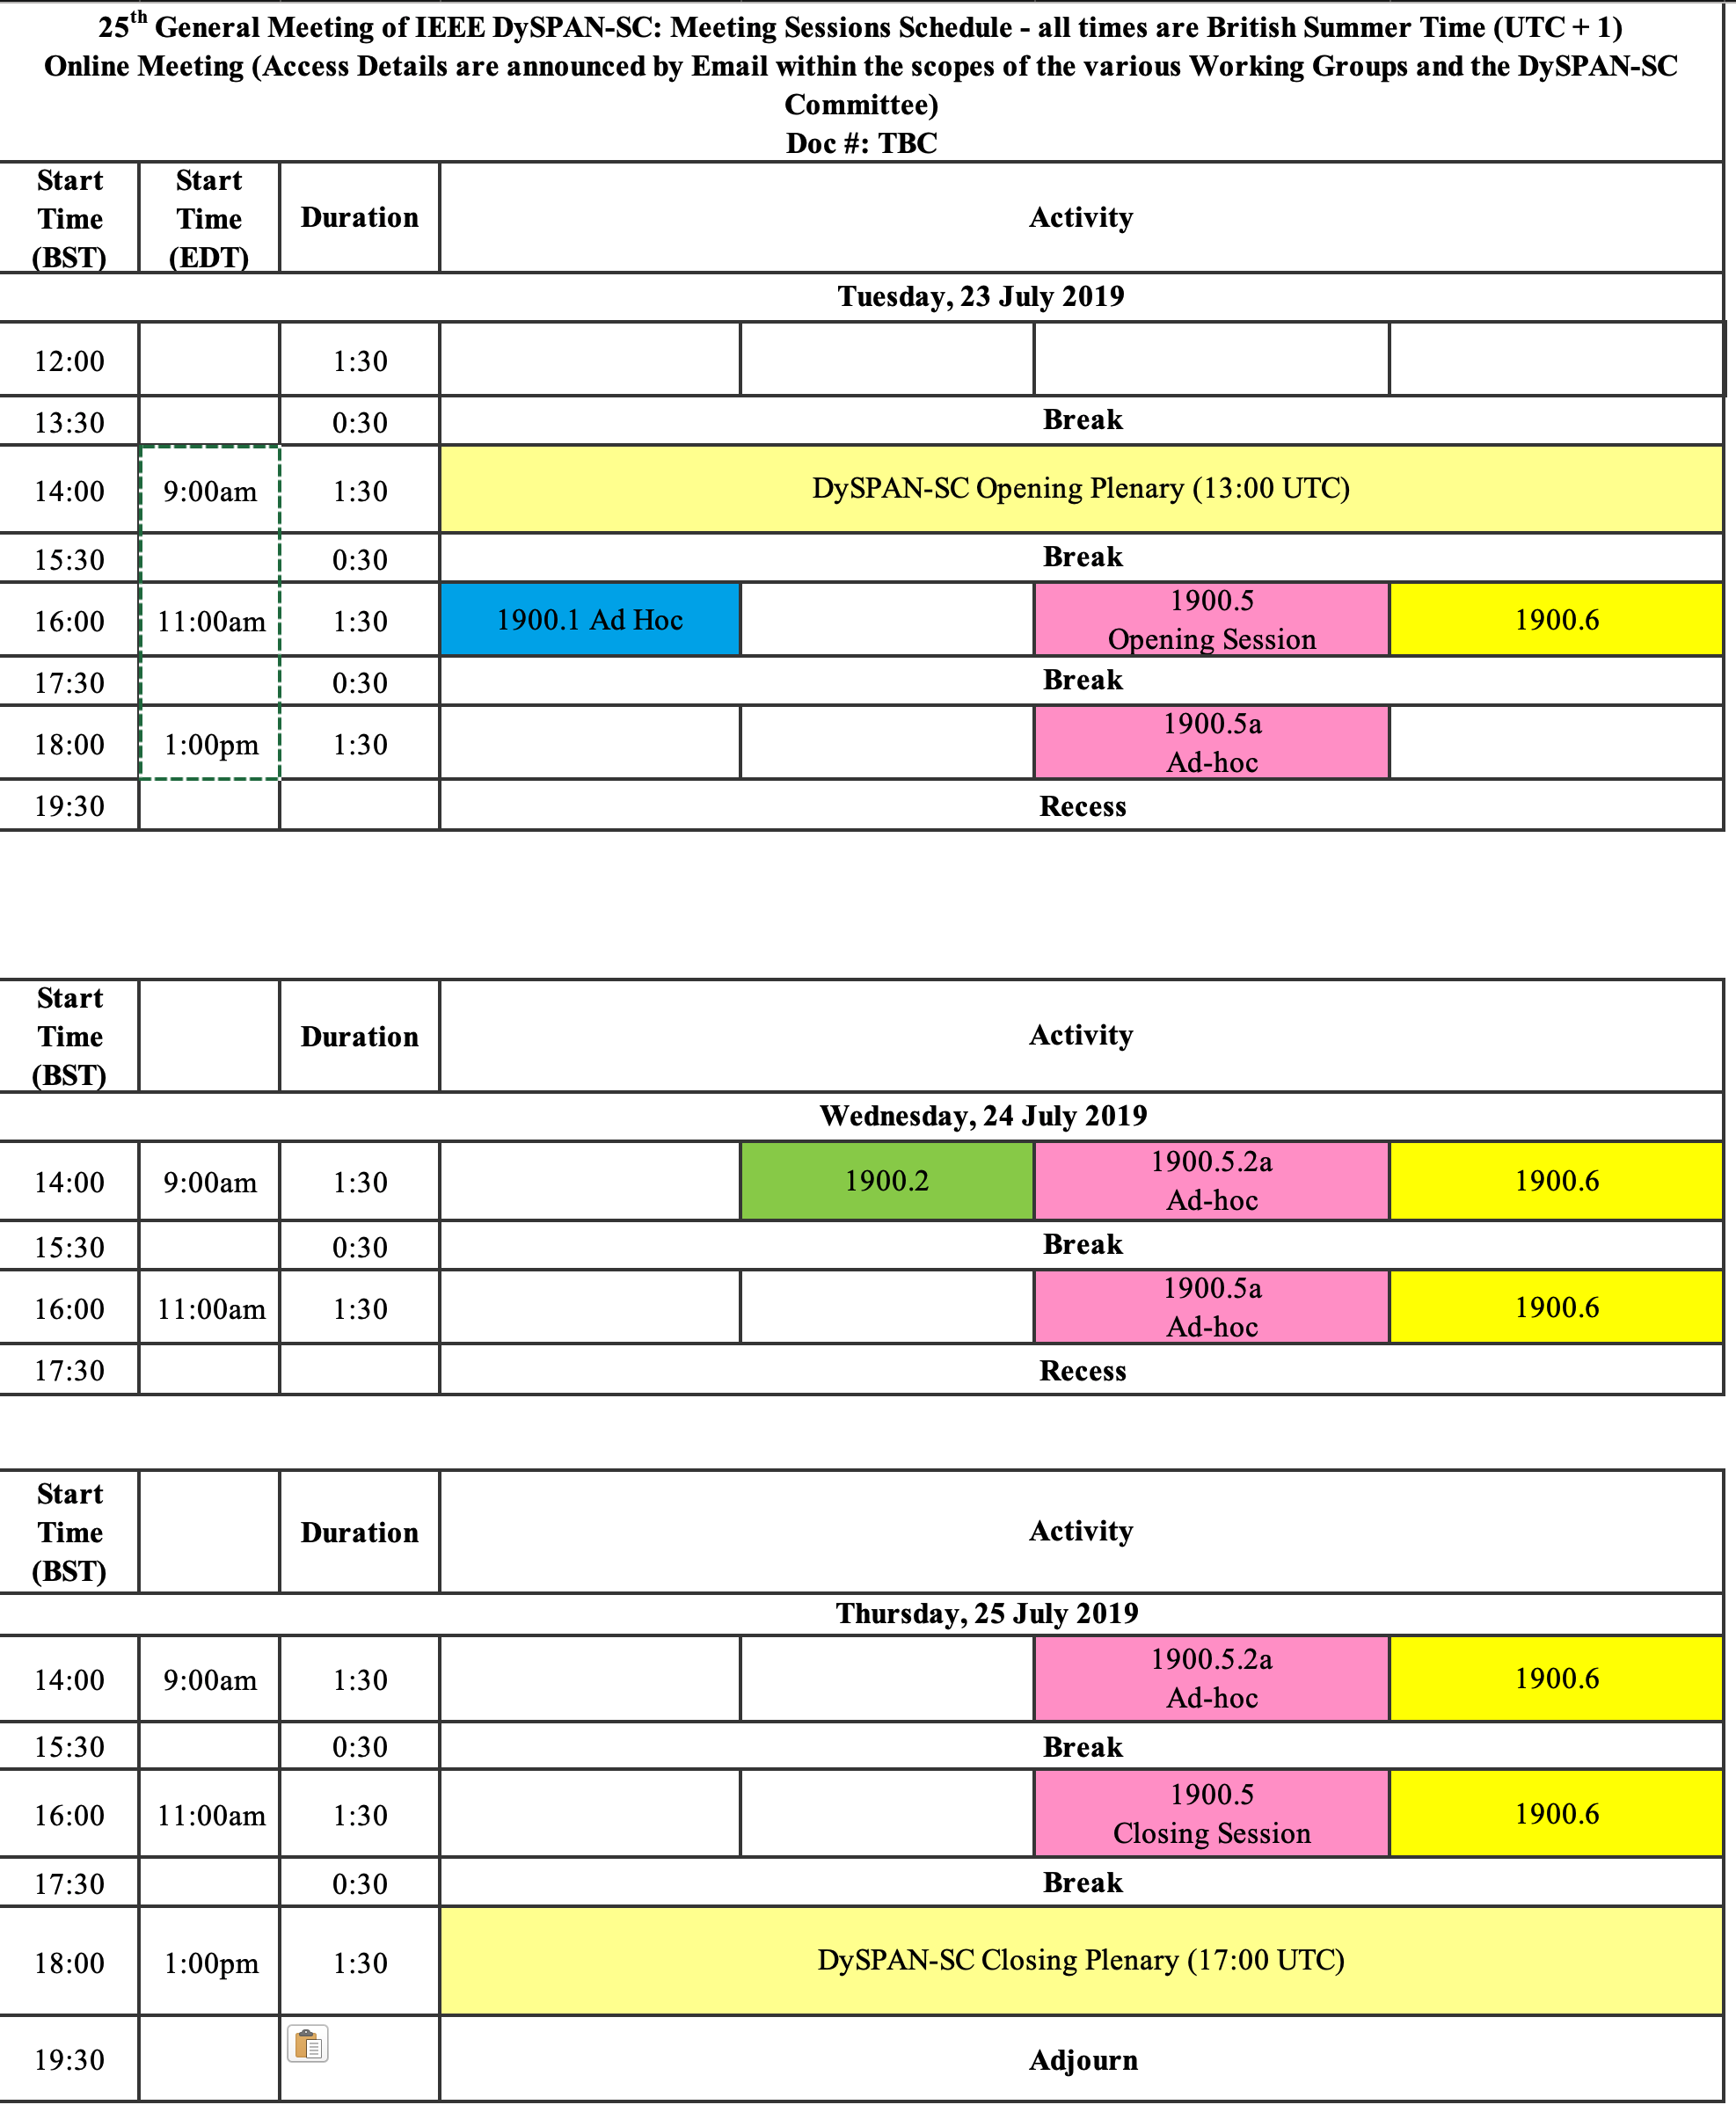
7/23-25/19 Meeting Schedule

Slide 4
7/23/19 Items

Slide 5
Rules
IEEE DySPAN-SC rules
  http://standards.ieee.org/about/sasb/audcom/pnp/DySPAN_SC.pdf
IEEE 1900.5 WG rules
  http://grouper.ieee.org/groups/dyspan/files/individual-WG-PnPs.pdf
Roberts Rules (latest edition) as needed…
Note – Rules changed approved effective 1/1/19
  https://mentor.ieee.org/1900.5/dcn/18/5-18-0037-00-polp-draft-policies-and-procedures-for-ieee-dyspan-sc-working-groups.doc

Slide 6
Current Membership
7/23/19 | WG Status | First Name | Last Name | Affiliation
 | 17 | Total
 | Member | Thor | Berglie | SSC
x | Member | Carlos | Caicedo | Syracuse University (Secretary)
x | Member | David | Chester | L3Harris
x | Member | Lynn | Grande | Southern Cloud Solutions
 | Member | Colby | Harper | Pathfinder Wireless Corp
 | Member | Mitch | Kokar | VIStology & Northeastern University
 | Member | Alex | Lackpour | Drexel University
 | Member | Li | Li | Communications Research Centre Canada
 | Member | Jakub | Moskal | Vistology
 | Member | V | Prasad | Wireless and Mobile Communication, TU Delft
x | Member | Tony | Rennier | Foundry Inc (Chair)
x | Member | Reinhard | Schrage | SchrageConsult
 | Member | Mat | Sherman | BAE Systems (Former Chair)
x | Member | Kael | Stilp | MITRE
 | Member | John | Stine | MITRE
 | Member | Darcy | Swain-Walsh | MITRE (Vice Chair)
 | Member | Julia | Andrusenko | JHU/APL
Quorum?
No
Quorum > ½ membership (9 members)
2 meetings to get in, 2 meetings to get out

Slide 7
Draft Agenda
7/23/19 11:00-12:30 EDT
Administrivia
  Roll Call / Quorum Check
  Approve Agenda
  Patent slides / Notes on status
  Approval of recent minutes
Status on 1900.5.1
Status on 1900.5.2a
Status on 1900.5 Revision
Review of other 1900 activities (1900.1, Leadership meeting etc.)
1900.5 marketing inputs
1900.5 meeting planning and review
AoB
Adjourn
1900.5 Revision Ad Hoc session
Any modifications?
Notes:
September 22, 2008
7

Slide 8
Instructions for the WG Chair
The IEEE-SA strongly recommends that at each WG meeting the chair or a designee:
  Show slides #1 through #4 of this presentation
  Advise the WG attendees that:
    IEEE’s patent policy is described in Clause 6 of the IEEE-SA Standards Board Bylaws;
    Early identification of patent claims which may be essential for the use of standards under development is strongly encouraged;
    There may be Essential Patent Claims of which IEEE is not aware. Additionally, neither IEEE, the WG, nor the WG Chair can ensure the accuracy or completeness of any assurance or whether any such assurance is, in fact, of a Patent Claim that is essential for the use of the standard under development.
  Instruct the WG Secretary to record in the minutes of the relevant WG meeting:
    That the foregoing information was provided and that slides 1 through 4 (and this slide 0, if applicable) were shown;
    That the chair or designee provided an opportunity for participants to identify patent claim(s)/patent application claim(s) and/or the holder of patent claim(s)/patent application claim(s) of which the participant is personally aware and that may be essential for the use of that standard
    Any responses that were given, specifically the patent claim(s)/patent application claim(s) and/or the holder of the patent claim(s)/patent application claim(s) that were identified (if any) and by whom.
  The WG Chair shall ensure that a request is made to any identified holders of potential essential patent claim(s) to complete and submit a Letter of Assurance.
  It is recommended that the WG Chair review the guidance in IEEE-SA Standards Board Operations Manual 6.3.5 and in FAQs 14 and 15 on inclusion of potential Essential Patent Claims by incorporation or by reference.
  Note: WG includes Working Groups, Task Groups, and other standards-developing committees with a PAR approved by the IEEE-SA Standards Board.
(Optional to be shown)

Slide 9
Participants have a duty to inform the IEEE
  Participants shall inform the IEEE (or cause the IEEE to be informed) of the identity of each holder of any potential Essential Patent Claims of which they are personally aware if the claims are owned or controlled by the participant or the entity the participant is from, employed by, or otherwise represents
  Participants should inform the IEEE (or cause the IEEE to be informed) of the identity of any other holders of potential Essential Patent Claims
  Early identification of holders of potential Essential Patent Claims is encouraged
Slide #1

Slide 10
Ways to inform IEEE
Cause an LOA to be submitted to the IEEE-SA (patcom@ieee.org); or
Provide the chair of this group with the identity of the holder(s) of any and all such claims as soon as possible; or
Speak up now and respond to this Call for Potentially Essential Patents
If anyone in this meeting is personally aware of the holder of any patent claims that are potentially essential to implementation of the proposed standard(s) under consideration by this group and that are not already the subject of an Accepted Letter of Assurance, please respond at this time by providing relevant information to the WG Chair
Slide #2

Slide 11
Other guidelines for IEEE WG meetings
All IEEE-SA standards meetings shall be conducted in compliance with all applicable laws, including antitrust and competition laws.
  Don’t discuss the interpretation, validity, or essentiality of patents/patent claims.
  Don’t discuss specific license rates, terms, or conditions.
    Relative costs of different technical approaches that include relative costs of patent licensing terms may be discussed in standards development meetings.
      Technical considerations remain the primary focus
  Don’t discuss or engage in the fixing of product prices, allocation of customers, or division of sales markets.
  Don’t discuss the status or substance of ongoing or threatened litigation.
  Don’t be silent if inappropriate topics are discussed … do formally object.
---------------------------------------------------------------
For more details, see IEEE-SA Standards Board Operations Manual, clause 5.3.10 and
Antitrust and Competition Policy: What You Need to Know at http://standards.ieee.org/develop/policies/antitrust.pdf
Slide #3

Slide 12
Patent-related information
  The patent policy and the procedures used to execute that policy are documented in the:
    IEEE-SA Standards Board Bylaws (http://standards.ieee.org/develop/policies/bylaws/sect6-7.html#6)
    IEEE-SA Standards Board Operations Manual (http://standards.ieee.org/develop/policies/opman/sect6.html#6.3)
  Material about the patent policy is available at
  http://standards.ieee.org/about/sasb/patcom/materials.html
  If you have questions, contact the IEEE-SA Standards Board Patent Committee Administrator at patcom@ieee.org
Slide #4

Slide 13
Approval of Agenda
Motion to approve Agenda contained in Doc #:5-19-0029-00-agen
Mover:
Second:
Vote:

Slide 14
Minutes for approval
Motion to approve 6/7/19 WG minutes contained in Doc #: 5-19-0030-00-mins
Mover: John
Second: Jakub
Vote: UC

Slide 15
Current Status for 1900.5.1
5/3/19
  Addressing comments made in the F2F
    Making progress
  Working on boilerplate for using the policy language
    Started on a geo policy
    Reinhard to post material for review in ad-hoc
  Spent time discussing RDL with RIF Core because of problems
    RIF core abandoned but Oxford presentation on OWL 2 EL showed fatal flaw
    Developed a filter to disallow the combination that leads to failure
    Lynn to review standards procedure to find out how to address
6/7/19
  No issues
  Will provide ad-hoc
  Recirculating planned for 7/31/19
7/23/19
  PAR Extension approved by email vote (10 members voted to approve)
  PAR Extension submitted to DySPAN approved (NesCom status pending)
  Recirculating planned for 8/5/19
  Lynn checking on the latitude for changes
  Use email coordination on how to properly move forward

Slide 16
Working Schedule for 1900.5.1
Full review of drafting 3/17 √
First WG Ballot 2/19 √
WG Recirc 8/19
Sponsor Ballot 10/19
Sponsor Recirc 1/20
Sponsor Recirc 2 4/19
Submit to REVCOM 8/20
Proposed Update
Requires PAR Extension

Slide 17
Current Status for 1900.5.2a
6/7/19
  Still working on schema setup
    Carlos - making more improvement for the next month
    Kael - Working on XSLT to match the schema
    Still working on conceptual rules
7/23/19
  PAR Request submitted to DySPAN (status pending)
  John coordinated with Carlos and we agreed that I should be making a push to update the spec with all changes that have an effect on the schema.
  Intent is, by Wednesday morning before our ad hoc, to add to mentor the update of the standard and then to use the ad hoc on Wednesday to go over everything we proposed changing and how those changes were put into the standard. There are quite a few changes.
  We could then use the Thursday ad hoc for further discussion about those changes and to map out work we should do to clean up what still needs to be done or to back out what I proposed.
  It would be good to schedule a 1900.5.2a ad hoc in August.

Slide 18
Current Status for 1900.5 Revision
6/7/19
  Held ad-hoc last Friday
  Dave has made a significant contribution
  Encourage everyone to read and comment
7/23/19
  Ad-hoc held 6/28/19

Slide 19
Other DySPAN-SC Activities
Leadership meetings
  7/23/19
Spectrum Sharing Standards
  5/3/19
    Proposal to create Dynamic spectrum sharing collaborating language
      Email into John Chapin who is sharing with DARPA
    AWS-3 R&D work awaiting sponsor approval
  6/7
    DSO on hold for SA
  7/23
    Panel for DySPAN conference (11/14/19 – workshop, Newark NJ) (Carlos and Alex planning)
      Looking for 1900.5 panel participation
      Can we use inputs for spectrum sharing (planning and coordination) language development coming out of the DARPA competition?
    DSO on hold SA

Slide 20
1900.5 Marketing Inputs
5/3/19
  Mark Norton briefed standards relate to 5G at recent NSC event
    Didn’t mention 1900 only 802, need to establish 1900.5 as part of 5G
    Mark is aware but we need to make the case
      We need to come to consensus before we engage Mark or
  Carlos still working on .1 paper for DySPAN
    Will discuss with Reinhard within 2 weeks
  Carlos DySPAN workshop organizer Newark NJ in Nov – paper call 5/31
    Spectrum collaboration
    MM wave comms
  Dave still working on paper
6/7/19
  DySPAN papers extended to 6/25 Carlos and Reinhard working on a paper – looking good
  Spectrum Collaboration challenge Workshop paper deadline the middle of September
  Dave’s paper on 1900.5a is the start
7/23/19
  .1 Paper submitted
  International Future Networks (5G and Beyond) conference in Silicon Valley
    Reinhard received interest in the .1 Policy language will follow up

Slide 21
1900.5 Meeting Planning and Review
WG electronic only meeting (TBR)
  2:30 PM EDT on 8/2/2019
WG electronic only meeting (TBR)
  8:00 AM EDT on 9/6/2019
Tentative 1900.5 F2F October/November???
  Review 1900.5.1 update?
  Deep dive on 1900.5 Rev?
  Deep dive on 1900.5.2a?

Slide 22
AoB
  7/23/19
    ??

Slide 23
Ad Hoc Sessions
1900.5 Rev

Slide 24
7/24/19 Items

Slide 25
Ad Hoc Sessions
1900.5.2a
1900.5 Rev

Slide 26
7/25/19 Items

Slide 27
Ad Hoc Sessions
1900.5.2a

Slide 28
Rules
IEEE DySPAN-SC rules
  http://standards.ieee.org/about/sasb/audcom/pnp/DySPAN_SC.pdf
IEEE 1900.5 WG rules
  http://grouper.ieee.org/groups/dyspan/files/individual-WG-PnPs.pdf
Roberts Rules (latest edition) as needed…
Note – Rules changed approved effective 1/1/19
  https://mentor.ieee.org/1900.5/dcn/18/5-18-0037-00-polp-draft-policies-and-procedures-for-ieee-dyspan-sc-working-groups.doc

Slide 29
Current Membership
7/25/19 | WG Status | First Name | Last Name | Affiliation
 | 17 | Total
 | Member | Thor | Berglie | SSC
x | Member | Carlos | Caicedo | Syracuse University (Secretary)
x | Member | David | Chester | Harris
x | Member | Lynn | Grande | Self
 | Member | Colby | Harper | Pathfinder Wireless Corp
 | Member | Mitch | Kokar | VIStology & Northeastern University
 | Member | Alex | Lackpour | Drexel University
x | Member | Li | Li | Communications Research Centre Canada
x | Member | Jakub | Moskal | Vistology
 | Member | V | Prasad | Wireless and Mobile Communication, TU Delft
x | Member | Tony | Rennier | Foundry Inc (Chair)
x | Member | Reinhard | Schrage | SchrageConsult
 | Member | Mat | Sherman | BAE Systems (Former Chair)
x | Member | Kael | Stilp | MITRE
x | Member | John | Stine | MITRE
 | Member | Darcy | Swain-Walsh | MITRE (Vice Chair)
 | Member | Julia | Andrusenko | JHU/APL
Quorum?
YES!
Quorum > ½ membership (9 members)
2 meetings to get in, 2 meetings to get out

Slide 30
Draft Agenda
7/25/19 11:00-12:30 EDT
Administrivia
  Roll Call / Quorum Check
  Approve Agenda
  Patent slides / Notes on status
  Approval of recent minutes
1900.5 meeting planning and review
AoB
Adjourn
Any modifications?
Notes:
September 22, 2008
30

Slide 31
Approval of Agenda
Motion to approve Agenda contained in Doc #:5-19-0029-00-agen
Mover: John
Second: Lynn
Vote: UC

Slide 32
Minutes for approval
Motion to approve 6/7/19 WG minutes contained in Doc #: 5-19-0030-00-mins
Mover: John
Second: Jakub
Vote: UC

Slide 33
Instructions for the WG Chair
The IEEE-SA strongly recommends that at each WG meeting the chair or a designee:
  Show slides #1 through #4 of this presentation
  Advise the WG attendees that:
    IEEE’s patent policy is described in Clause 6 of the IEEE-SA Standards Board Bylaws;
    Early identification of patent claims which may be essential for the use of standards under development is strongly encouraged;
    There may be Essential Patent Claims of which IEEE is not aware. Additionally, neither IEEE, the WG, nor the WG Chair can ensure the accuracy or completeness of any assurance or whether any such assurance is, in fact, of a Patent Claim that is essential for the use of the standard under development.
  Instruct the WG Secretary to record in the minutes of the relevant WG meeting:
    That the foregoing information was provided and that slides 1 through 4 (and this slide 0, if applicable) were shown;
    That the chair or designee provided an opportunity for participants to identify patent claim(s)/patent application claim(s) and/or the holder of patent claim(s)/patent application claim(s) of which the participant is personally aware and that may be essential for the use of that standard
    Any responses that were given, specifically the patent claim(s)/patent application claim(s) and/or the holder of the patent claim(s)/patent application claim(s) that were identified (if any) and by whom.
  The WG Chair shall ensure that a request is made to any identified holders of potential essential patent claim(s) to complete and submit a Letter of Assurance.
  It is recommended that the WG Chair review the guidance in IEEE-SA Standards Board Operations Manual 6.3.5 and in FAQs 14 and 15 on inclusion of potential Essential Patent Claims by incorporation or by reference.
  Note: WG includes Working Groups, Task Groups, and other standards-developing committees with a PAR approved by the IEEE-SA Standards Board.
(Optional to be shown)

Slide 34
Participants have a duty to inform the IEEE
  Participants shall inform the IEEE (or cause the IEEE to be informed) of the identity of each holder of any potential Essential Patent Claims of which they are personally aware if the claims are owned or controlled by the participant or the entity the participant is from, employed by, or otherwise represents
  Participants should inform the IEEE (or cause the IEEE to be informed) of the identity of any other holders of potential Essential Patent Claims
  Early identification of holders of potential Essential Patent Claims is encouraged
Slide #1

Slide 35
Ways to inform IEEE
Cause an LOA to be submitted to the IEEE-SA (patcom@ieee.org); or
Provide the chair of this group with the identity of the holder(s) of any and all such claims as soon as possible; or
Speak up now and respond to this Call for Potentially Essential Patents
If anyone in this meeting is personally aware of the holder of any patent claims that are potentially essential to implementation of the proposed standard(s) under consideration by this group and that are not already the subject of an Accepted Letter of Assurance, please respond at this time by providing relevant information to the WG Chair
Slide #2

Slide 36
Other guidelines for IEEE WG meetings
All IEEE-SA standards meetings shall be conducted in compliance with all applicable laws, including antitrust and competition laws.
  Don’t discuss the interpretation, validity, or essentiality of patents/patent claims.
  Don’t discuss specific license rates, terms, or conditions.
    Relative costs of different technical approaches that include relative costs of patent licensing terms may be discussed in standards development meetings.
      Technical considerations remain the primary focus
  Don’t discuss or engage in the fixing of product prices, allocation of customers, or division of sales markets.
  Don’t discuss the status or substance of ongoing or threatened litigation.
  Don’t be silent if inappropriate topics are discussed … do formally object.
---------------------------------------------------------------
For more details, see IEEE-SA Standards Board Operations Manual, clause 5.3.10 and
Antitrust and Competition Policy: What You Need to Know at http://standards.ieee.org/develop/policies/antitrust.pdf
Slide #3

Slide 37
Patent-related information
  The patent policy and the procedures used to execute that policy are documented in the:
    IEEE-SA Standards Board Bylaws (http://standards.ieee.org/develop/policies/bylaws/sect6-7.html#6)
    IEEE-SA Standards Board Operations Manual (http://standards.ieee.org/develop/policies/opman/sect6.html#6.3)
  Material about the patent policy is available at
  http://standards.ieee.org/about/sasb/patcom/materials.html
  If you have questions, contact the IEEE-SA Standards Board Patent Committee Administrator at patcom@ieee.org
Slide #4

Slide 38
1900.5 Meeting Planning and Review
WG electronic only meeting (TBR)
  2:30 PM EDT on 8/2/2019
WG electronic only meeting (TBR)
  8:00 AM EDT on 9/6/2019
Tentative 1900.5 F2F Septish???
  Review 1900.5.1 update?
  Deep dive on 1900.5 Rev?
  Deep dive on 1900.5.2a?

Slide 39
AoB
  7/23/19
    ??

