Slide 1
IEEE 1900.5 Contribution
Author’s Name | Affiliation | Address | Phone | email
Matthew Sherman | BAE Systems | Wayne, NJ | 973-229-9520 | matthew.sherman@baesystems.com
Document Title: Agenda, Admin and chair’s notes for IEEE 1900.5 WG Meeting on 06 November 2018
Document Date: 04\6 November 2018
Document No: 5-18-0039-01-agen
Notice: This document has been prepared to assist IEEE DySPAN-SC and its Working Groups. It is offered as a basis for discussion and is not binding on the contributing individual(s) or organization(s). The material in this document is subject to change in form and content after further study. The contributor(s) reserve(s) the right to add, amend or withdraw material contained herein.
Release: The contributor grants a free, irrevocable license to the IEEE to incorporate material contained in this contribution, and any modifications thereof, in the creation of an IEEE Standards publication; to copyright in the IEEE’s name any IEEE Standards publication even though it may include portions of this contribution; and at the IEEE’s sole discretion to permit others to reproduce in whole or in part the resulting IEEE Standards publication. The contributor also acknowledges and accepts that this contribution may be made public by IEEE DySPAN-SC.
Patent Policy and Procedures: The contributor is familiar with the IEEE Patent Policy and Procedures including the statement "IEEE standards may include the known use of patent(s), including patent applications, provided the IEEE receives assurance from the patent holder or applicant with respect to patents essential for compliance with both mandatory and optional portions of the standard." Early disclosure to IEEE DySPAN-SC and its Working Groups of patent information that might be relevant to the standard is essential to reduce the possibility for delays in the development process and increase the likelihood thatthe draft publication will be approved for publication. Please notify the Chair <matthew.sherman@baesystems.com> as early as possible, in written or electronic form, if patented technology (or technology under patent application) might be incorporated into a draft standard being developed within the IEEE DySPAN-SC Committee. If you have questions, contact the IEEE Patent Committee Administrator at < patcom@ieee.org >.

Slide 2
Monthly WG Meeting Electronic Meeting Details
WebEx:
Join WebEx meeting Meeting number (access code): 909 315 836 Meeting password: pPGdAhiZ Join from a video system or application Dial 909315836@baefed.webex.com Join by phone 1-844-800-2712 Call-in toll-free number (US/Canada) 1-669-234-1181 Call-in toll number (US/Canada) Global call-in numbers | Toll-free calling restrictions Can't join the meeting?
Notes:
September 22, 2008
2

Slide 3
Rules
IEEE DySPAN-SC rules
http://standards.ieee.org/about/sasb/audcom/pnp/DySPAN_SC.pdf
IEEE 1900.5 WG rules
http://grouper.ieee.org/groups/dyspan/files/individual-WG-PnPs.pdf
Roberts Rules (latest edition) as needed…
Note – Rules being updated…
https://mentor.ieee.org/1900.5/dcn/18/5-18-0037-00-polp-draft-policies-and-procedures-for-ieee-dyspan-sc-working-groups.doc

Slide 4
Current Membership
11/6/18 | WG Status | First Name | Last Name | Affiliation
 | 16 | Total
x | Member | Thor | Berglie | SSC
x | Member | Carlos | Caicedo | Syracuse University (Secretary)
x | Member | David | Chester | Harris
x | Member | Lynn | Grande | Self
 | Member | Colby | Harper | Pathfinder Wireless Corp
 | Member | Nilesh | Khamberkar | Univ. of Buffalo
 | Member | Mitch | Kokar | VIStology & Northeastern University
 | Member | Alex | Lackpour | Drexel / NOAA?
 | Member | Li | Li | Communications Research Centre Canada
 | Member | V | Prasad | Wireless and Mobile Communication, TU Delft
x | Member | Mat | Sherman | BAE Systems (Chair)
x | Member | John | Stine | Mitre
x | Member | Darcy | Swain-Walsh | Mitre (Vice Chair)
x | Member | Tony | Rennier | Foundry Inc
x | Member | Reinhard | Schrage | SchrageConsult
x | Member | Shawn | Kern | SRI International
 | Participant | Mark | McHenry | Shared Spectrum Company
 | Participant | Yuriy | Posherstnik | US Army RDECOM CERDEC
 | Participant | Paul | Falvell | CGI Group Inc.
 | Participant | Nicholas | Sherman | BAE Systems
 | Participant | Saeedeh | Parsaeefard | ITRC
 | Participant | Joe | Messner | BAE Systems
 | Participant | Roghayeh
Quorum?
Quorum > ½ membership (9 members)
2 meetings to get in, 2 meetings to get out

Slide 5
Draft Agenda
Administrivia
Roll Call / Quorum Check
Approve Agenda
Patent slides / Notes on status
Approval of recent minutes
Status on 1900.5.1
Status on 1900.5.2a
Contributions?
Status on Architecture / 1900.5 PAR
Contributions?
Review of other 1900 activities (1900.1, Leadership meeting etc.)
1900.5 marketing inputs
National Spectrum Consortium
Comms Standard Magazine
Others?
1900.5 meeting planning and review
AoB
Adjourn
In Ad Hoc, Review 1900.5.1
Any modifications?
Notes:
September 22, 2008
5

Slide 6
Approval of Agenda
Motion to approve Agenda contained in 5-18-0039-01
Mover: Tony
Second: Lynn
Vote: UC

Slide 7
Instructions for the WG Chair
The IEEE-SA strongly recommends that at each WG meeting the chair or a designee:
Show slides #1 through #4 of this presentation
Advise the WG attendees that:
IEEE’s patent policy is described in Clause 6 of the IEEE-SA Standards Board Bylaws;
Early identification of patent claims which may be essential for the use of standards under development is strongly encouraged;
There may be Essential Patent Claims of which IEEE is not aware. Additionally, neither IEEE, the WG, nor the WG Chair can ensure the accuracy or completeness of any assurance or whether any such assurance is, in fact, of a Patent Claim that is essential for the use of the standard under development.
Instruct the WG Secretary to record in the minutes of the relevant WG meeting:
That the foregoing information was provided and that slides 1 through 4 (and this slide 0, if applicable) were shown;
That the chair or designee provided an opportunity for participants to identify patent claim(s)/patent application claim(s) and/or the holder of patent claim(s)/patent application claim(s) of which the participant is personally aware and that may be essential for the use of that standard
Any responses that were given, specifically the patent claim(s)/patent application claim(s) and/or the holder of the patent claim(s)/patent application claim(s) that were identified (if any) and by whom.
The WG Chair shall ensure that a request is made to any identified holders of potential essential patent claim(s) to complete and submit a Letter of Assurance.
It is recommended that the WG Chair review the guidance in IEEE-SA Standards Board Operations Manual 6.3.5 and in FAQs 14 and 15 on inclusion of potential Essential Patent Claims by incorporation or by reference.
Note: WG includes Working Groups, Task Groups, and other standards-developing committees with a PAR approved by the IEEE-SA Standards Board.
(Optional to be shown)

Slide 8
Participants have a duty to inform the IEEE
Participants shall inform the IEEE (or cause the IEEE to be informed) of the identity of each holder of any potential Essential Patent Claims of which they are personally aware if the claims are owned or controlled by the participant or the entity the participant is from, employed by, or otherwise represents
Participants should inform the IEEE (or cause the IEEE to be informed) of the identity of any other holders of potential Essential Patent Claims
Early identification of holders of potential Essential Patent Claims is encouraged
Slide #1

Slide 9
Ways to inform IEEE
Cause an LOA to be submitted to the IEEE-SA (patcom@ieee.org); or
Provide the chair of this group with the identity of the holder(s) of any and all such claims as soon as possible; or
Speak up now and respond to this Call for Potentially Essential Patents
If anyone in this meeting is personally aware of the holder of any patent claims that are potentially essential to implementation of the proposed standard(s) under consideration by this group and that are not already the subject of an Accepted Letter of Assurance, please respond at this time by providing relevant information to the WG Chair
Slide #2

Slide 10
Other guidelines for IEEE WG meetings
All IEEE-SA standards meetings shall be conducted in compliance with all applicable laws, including antitrust and competition laws.
Don’t discuss the interpretation, validity, or essentiality of patents/patent claims.
Don’t discuss specific license rates, terms, or conditions.
Relative costs of different technical approaches that include relative costs of patent licensing terms may be discussed in standards development meetings.
Technical considerations remain the primary focus
Don’t discuss or engage in the fixing of product prices, allocation of customers, or division of sales markets.
Don’t discuss the status or substance of ongoing or threatened litigation.
Don’t be silent if inappropriate topics are discussed … do formally object.
---------------------------------------------------------------
For more details, see IEEE-SA Standards Board Operations Manual, clause 5.3.10 and Antitrust and Competition Policy: What You Need to Know at http://standards.ieee.org/develop/policies/antitrust.pdf
Slide #3

Slide 11
Patent-related information
The patent policy and the procedures used to execute that policy are documented in the:
IEEE-SA Standards Board Bylaws (http://standards.ieee.org/develop/policies/bylaws/sect6-7.html#6)
IEEE-SA Standards Board Operations Manual (http://standards.ieee.org/develop/policies/opman/sect6.html#6.3)
Material about the patent policy is available at
http://standards.ieee.org/about/sasb/patcom/materials.html
If you have questions, contact the IEEE-SA Standards Board Patent Committee Administrator at patcom@ieee.org
Slide #4

Slide 12
Minutes for approval
Motion to approve WG minutes contained in 5-18-0036-00 & 5-10-0040-01
.
Mover: Reinhard
Second: Tony
Vote: UC

Slide 13
Status on 1900.5.1
Draft Status
Tentative ad hoc today
Aligning draft with 1900.5-2011 standard
Should be ready for vote in December…

Slide 14
Working Schedule for 1900.5.1
Complete Draft for Clause 4 7/30√
Complete Draft for Clause 5 (Needs Work) 10/15 1/17?
Complete Draft for Clause 6 (More examples) 1/16 8/16 √
Complete Draft for Clause 7 (put xml file in annex?) 3/16 7/4 √
Complete Draft for Clause 8 (Minor additions needed) 4/16 9/16 √
Full review of drafting 3/17 √
First WG Ballot 5/17 2/18
WG Recirc 8/17 4/18
Sponsor Ballot 10/17 6/18
Sponsor Recirc 4/18 9/18
Sponsor Recirc 2 8/18 12/18
Submit to REVCOM 11/17 3/19!!
Need updated schedule
Won’t update till first ballot

Slide 15
Current Status for 1900.5.2a
PAR Approved
Editor: Carlos
Contributions?
Call for Contributions?
Same status as 2 months ago
Double checking that standard matches schema
MITRE working XML and JSON versions

Slide 16
Current Architecture Status
Proposed 1900.5 Revision PAR approved by WG
Should conduct some comment resolution
Motion to adopt changes suggested by comments in EB2018-01?
Not forwarding to DySPAN-SC till resolution on language
Other architecture discussions or contributions?

Slide 17
Electronic Ballot on Architecture PAR EB2018-01
Motion: For the 1900.5 WG Chair to make any editorial changes as required and forward the draft PAR in document 5-18-0027-00 to the DySPAN-SC Sponsor for approval to submit the PAR for consideration by IEEE SASB.
Mover: Lynn Grande
Second: Darcy Swain Walsh
Vote: Approve: 11 Disapprove: 1 Abstain 1 DNV: 3
MOTION PASSES…
Comments: “Unfortunately I have to vote disapprove because given the PAR wording focuses on the antiquated concepts of cognitive radio, software defined radio, and dynamic spectrum allocation as the singular objective. I believe that the wording should replace cognitive radio with cognitive wireless networks, software defined radio with self-configuring wireless networks and call out dynamic spectrum allocation as a required but not singularly sufficient enabling technology for cognitive wireless networks.”

Slide 18
Other DySPAN-SC Activities
Leadership meetings
October meeting deferred…
Primary focus on updates to WG P&P
Planning virtual “far east” plenary Nov 27-29
Sync with time in China / Japan
When will 1900.5 F2F be?
Architecture / API Study Group
Update?
Machine Learning Study Group
Update?

Slide 19
Marketing Inputs
Working on “Get DySPAN-SC” Program: Probably not…
NSC – Status (Several projects targeting 1900.5 compliance)
Working towards release of project list
Standards paper in process – No update…
Communications Magazine
1900.5.1 tutorial in works
1900.5.2 paper accepted (Publication date December?)
Paper on 1900.5.2 over VITA 49 Accepted but stalled
New review to be answered and pushed to next issue (working responses)
General set of DySPAN-SC papers for Pub
Issue in communications standards magazine
Spectrum related standards
Issues stalled – ????
AI Mat – Ask about this at DySPAN-SC meeting….

Slide 20
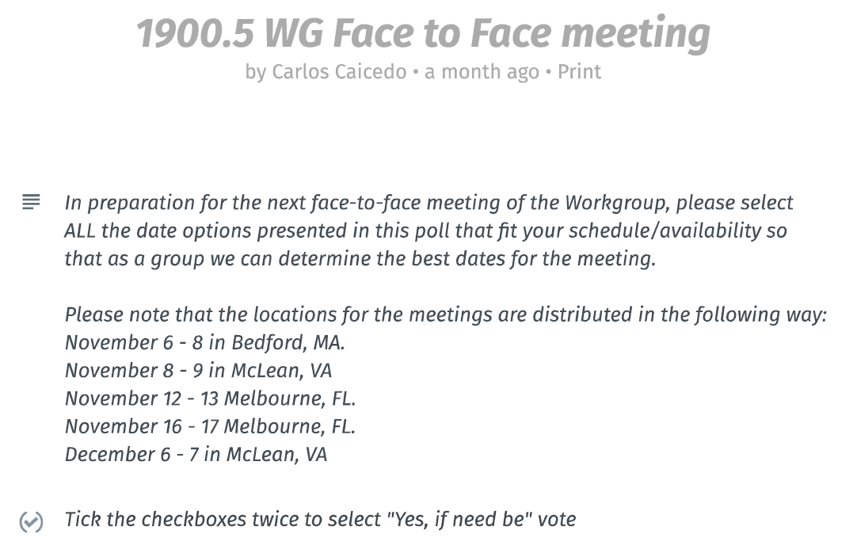
Doodle Poll

Slide 21
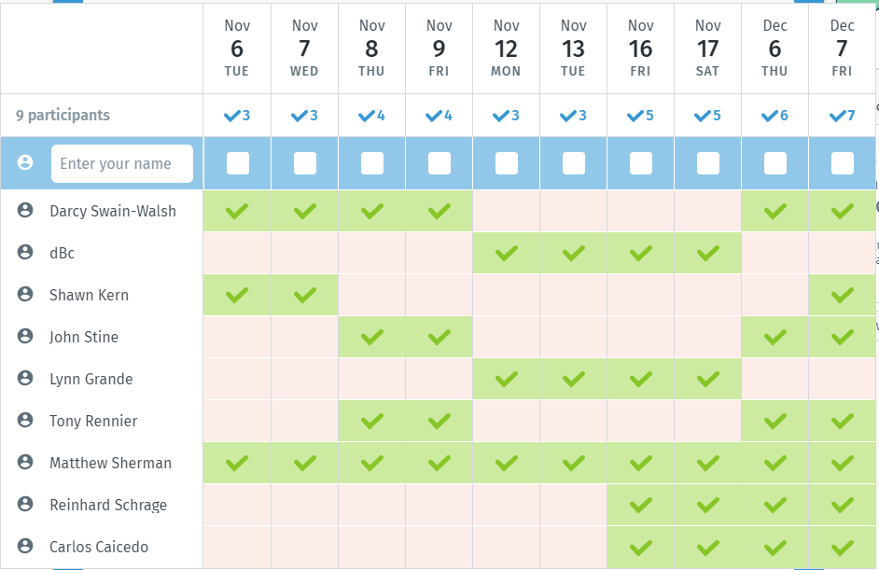
Updated Doodle Results on F2F
Dec 6-7 seems to be best dates…

Slide 22
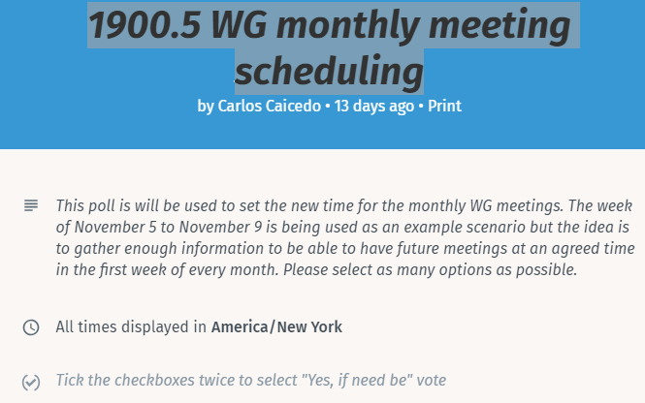
2nd Doodle Poll

Slide 23
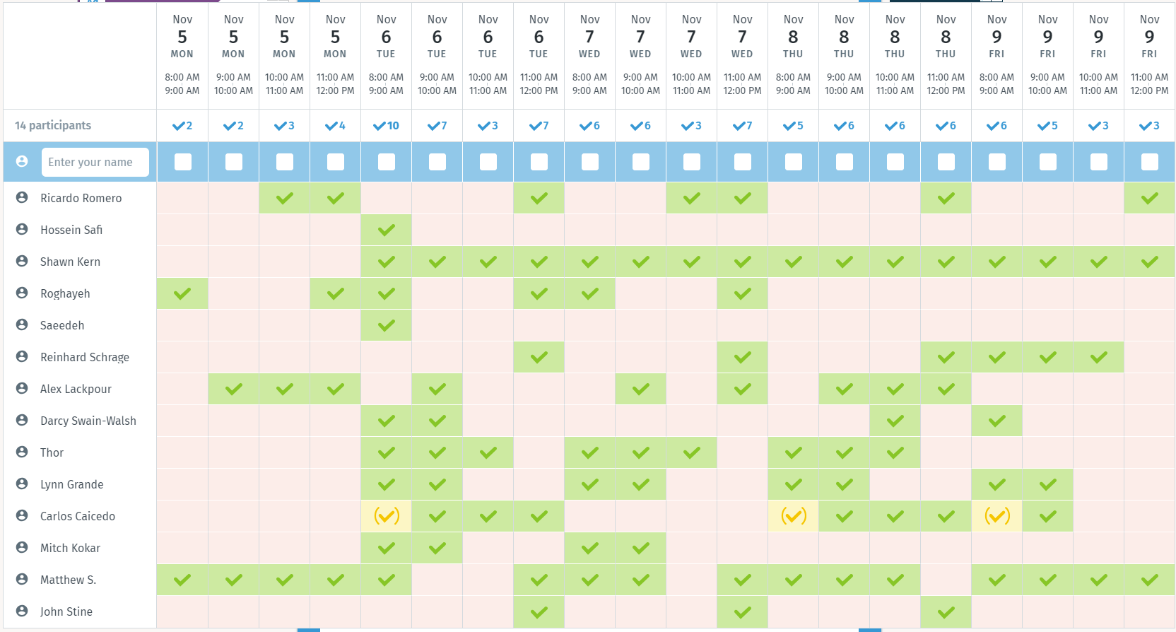
Doodle Results on Meeting Times
Results require some consideration

Slide 24
Meetings
Next WG meeting tentatively 2:30 PM EST (UTC-5) on Tuesday 04 December 2018 (If no F2F)
Doodle Poll on time change suggests 8 AM Tuesday
But some key people may be unavailable
Skip for December….
Other possibilities
Rotating schedule between two times
Produce minutes earlier to allow non attendees easier engagement
Tentative: Mat will flip schedules between 2:30 PM and 8 AM each month
Face to Face for December? (1900.5 only)
Planning virtual “far east” plenary Nov 27-29
Mat will schedule one teleconference week of Nov 27-29
Call for candidates for elections….
Dec. 6-7 Mclean VA (John Stine)
Strawpoll: Can attend at least one day: 7+2
Face to Face in March for DySPAN-SC
FL , Cape Canaveral

Slide 25
AoB
FCC released next version of proceeding 3.7-4 GHz…
Favorable comments on our comments

Slide 26
IEEE 1900.5 Meeting 10/2/18 @2:30 PM US EDT (UTC-4)
PLEASE STANDBY

Slide 27
Ad Hoc?
Review of 1900.5.1

