Slide 1
Cloud Sensing Model for Coexistence of Wi-Fi and Cellular Wireless Networks
Saeedeh Parsaeefard
Roghayeh Joda
Hossein Safi

Slide 2
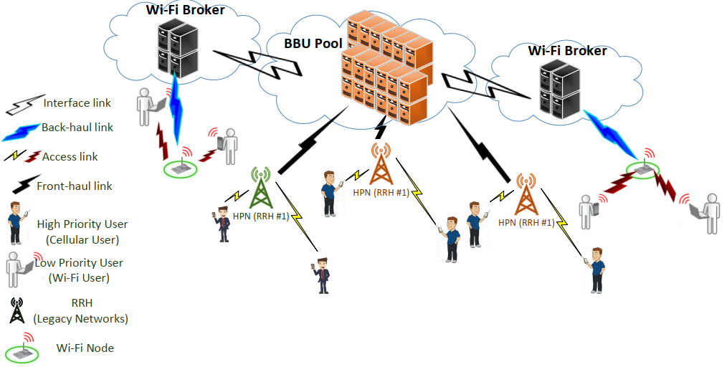
Proposed Model (Cloud Sensing)

Slide 3
System Model (Cloud Sensing)
Regional coverage for Low-priority users (LPUs) is provided by a C-RAN structure.
By employing spectrum sensing, Wi-Fi and C-RAN are be enabled to share idle or temporary underutilized cellular spectrum bands.
LPUs have to manage their transmit powers both to mitigate interference with high priority users (HPUs) and attain high throughput.
Cooperative spectrum sensing will be facilitated by using C-RAN architecture (BBU center) and their interaction with WiFi brokers

Slide 4
System Model (Cloud Sensing) Cont.
RRHs are connected to a set of BBUs B = {1; ·· · ; B}
Spectrum band is cooperatively sensed by Wi-Fi nodes to find idle channels.
The spectrum band of HPUs is divided into a set of sub-carriers K = {1; · · · ; K}

Slide 5
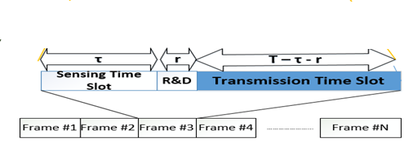
Frame Structure (Cloud Sensing)
Transmission time is divided into slots with a fixed length T
In each transmission time, there exist three phases
Sensing phase,
Reporting and decision phase,
Transmission phase.
Duration of sensing phase for each sub-carrier and each Node is denoted by $τ_{n,k}$
$τ_{n,k}$ should be optimized
To reach LPUs throughput maximization as well as HPUs protection.
In the reporting and decision phase each Wi-Fi node sends its measurement to Wi-Fi broker located in C-RAN

Slide 6
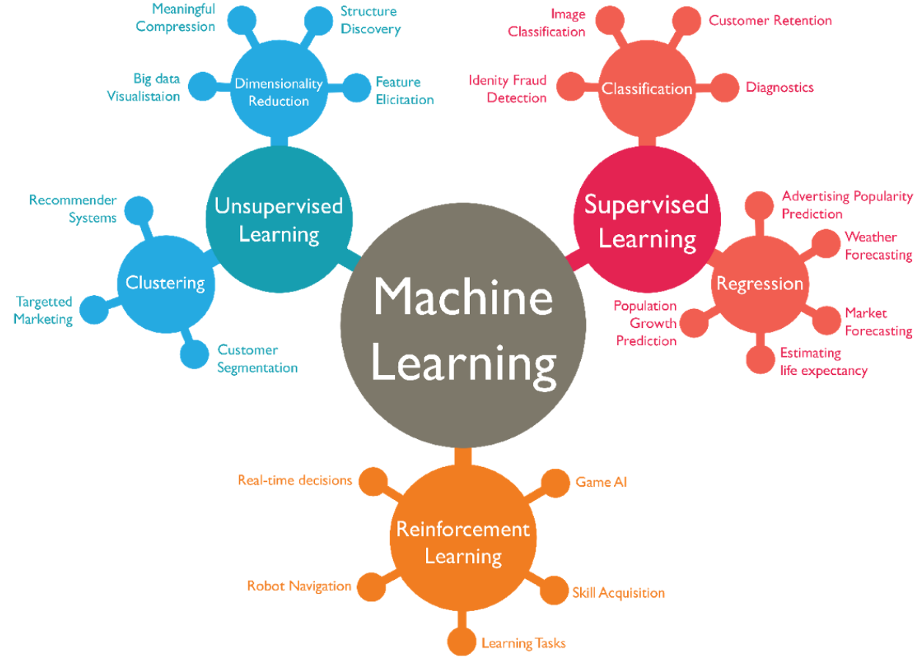
Why Machine Learning?
Machine learning is required for our setup due to the decentralized and mixed structure of unknown parameters in this network
Machine Learning: The most promising artificial intelligence tools
Source: www.medium.com

Slide 7
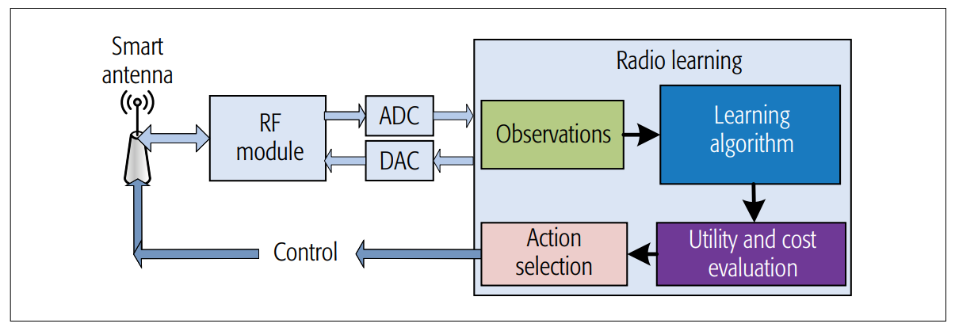
Machine Learning (Review) for Spectrum Sensing
Intelligent radio learning paradigm
Future smart 5G mobile terminals are expected to
Autonomously access the most meritorious spectral bands
Using the aid of sophisticated spectral efficiency learning and inference
Control the transmission power (while relying )
Simultaneously adjust the transmission protocols (QoS learning)
Jiang, Chunxiao, et al. "Machine learning paradigms for next-generation wireless networks." IEEE Wireless Communications 24.2 (2017): 98-105.

Slide 8
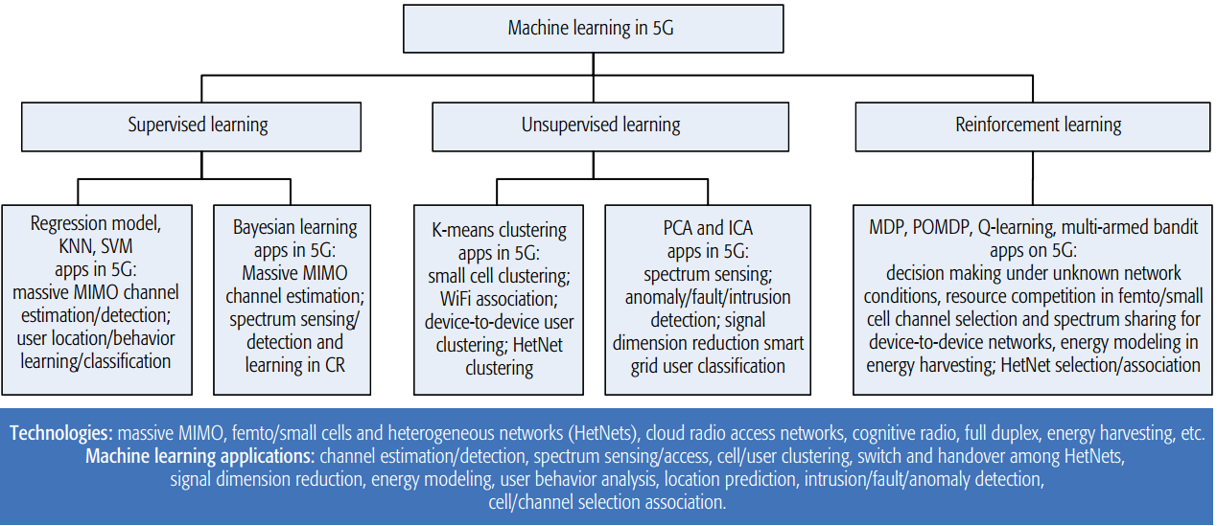
High Level View of Machine Learning Approaches
The family-tree of machine learning techniques and their potential applications in 5G.
Jiang, Chunxiao, et al. "Machine learning paradigms for next-generation wireless networks." IEEE Wireless Communications 24.2 (2017): 98-105.

Slide 9
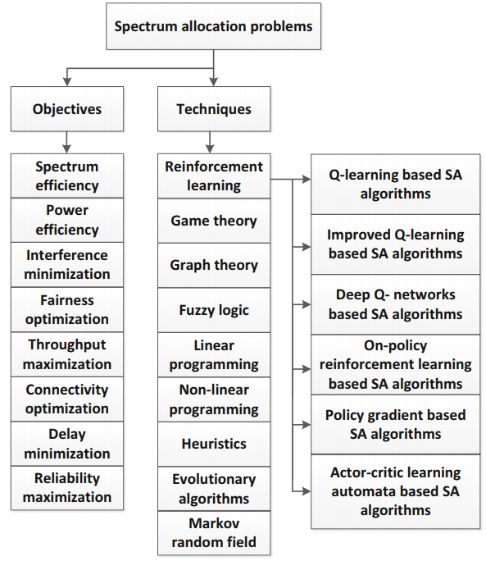
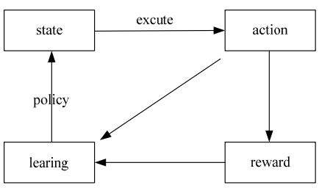
Spectrum Management via Machine Learning
How to properly configure the transmission parameters?
Wang, Yonghua, et al. "A survey of dynamic spectrum allocation based on reinforcement learning algorithms in cognitive radio networks." Artificial Intelligence Review (2018): 1-14.

Slide 10
Thank You

