Slide 1
IEEE 1900.5 Contribution
Author’s Name | Affiliation | Address | Phone | email
Matthew Sherman | BAE Systems | Wayne, NJ | 973-229-9520 | matthew.sherman@baesystems.com
Document Title: Agenda, Admin and chair’s notes for IEEE 1900.5 WG Meeting on 06 March 2018
Document Date: 25 February 2018
Document No: 5-18-0007-00-agen
Notice: This document has been prepared to assist IEEE DySPAN-SC and its Working Groups. It is offered as a basis for discussion and is not binding on the contributing individual(s) or organization(s). The material in this document is subject to change in form and content after further study. The contributor(s) reserve(s) the right to add, amend or withdraw material contained herein.
Release: The contributor grants a free, irrevocable license to the IEEE to incorporate material contained in this contribution, and any modifications thereof, in the creation of an IEEE Standards publication; to copyright in the IEEE’s name any IEEE Standards publication even though it may include portions of this contribution; and at the IEEE’s sole discretion to permit others to reproduce in whole or in part the resulting IEEE Standards publication. The contributor also acknowledges and accepts that this contribution may be made public by IEEE DySPAN-SC.
Patent Policy and Procedures: The contributor is familiar with the IEEE Patent Policy and Procedures including the statement "IEEE standards may include the known use of patent(s), including patent applications, provided the IEEE receives assurance from the patent holder or applicant with respect to patents essential for compliance with both mandatory and optional portions of the standard." Early disclosure to IEEE DySPAN-SC and its Working Groups of patent information that might be relevant to the standard is essential to reduce the possibility for delays in the development process and increase the likelihood thatthe draft publication will be approved for publication. Please notify the Chair <matthew.sherman@baesystems.com> as early as possible, in written or electronic form, if patented technology (or technology under patent application) might be incorporated into a draft standard being developed within the IEEE DySPAN-SC Committee. If you have questions, contact the IEEE Patent Committee Administrator at < patcom@ieee.org >.

Slide 2
Monthly WG Meeting
Electronic Meeting Details
WebEx:
https://baesystems.webex.com/baesystems/j.php?MTID=mc0092d6c3c64e9b40002c3997313c0a7
Meeting Number: 967 452 805
Meeting Password: mZyJ3QxK
Provide your phone number when you join the meeting to receive a call back. Alternatively, you can call:
Call-in toll-free number (ATT Audio Conference): 1-888-3316674 (US)
Call-in number (ATT Audio Conference): 1-312-7771452 (US)
Show global numbers: https://www.teleconference.att.com/servlet/glbAccess?process=1&accessNumber=888-3316674&accessCode=6336344&accessNumber2=312-7771452
Attendee access code: 633 634 4
Notes:
September 22, 2008
2

Slide 3
Rules
IEEE DySPAN-SC rules
  http://standards.ieee.org/about/sasb/audcom/pnp/DySPAN_SC.pdf
IEEE 1900.5 WG rules
  http://grouper.ieee.org/groups/dyspan/files/individual-WG-PnPs.pdf
Roberts Rules (latest edition) as needed…

Slide 4
Current Membership
 | 3/6/18 | WG Status | First Name | Last Name | Affiliation
 |  | 14 | Total
 |  | Member | Carlos | Caicedo | Syracuse University (Secretary)
 |  | Member | David | Chester | Harris
 |  | Member | Colby | Harper | Pathfinder Wireless Corp
 |  | Member | Nilesh | Khamberkar | Univ. of Buffalo
 |  | Member | Mitch | Kokar | VIStology & Northeastern University
 |  | Member | Alex | Lackpour | Drexel / NOAA?
 |  | Member | Li | Li | Communications Research Centre Canada
 |  | Member | V | Prasad | Wireless and Mobile Communication, TU Delft
 |  | Member | Mat | Sherman | BAE Systems (Chair)
 |  | Member | John | Stine | Mitre
 |  | Member | Darcy | Swain-Walsh | Mitre (Vice Chair)
 |  | Member | Tony | Rennier | Foundry Inc
 |  | Member | Reinhard | Schrage | SchrageConsult
 |  | Member | Shawn | Kern | SRI International
 |  | Participant | Mark | McHenry | Shared Spectrum Company
 |  | Participant | Yuriy | Posherstnik | US Army RDECOM CERDEC
Quorum?
Quorum > ½ membership (8 members)
2 meetings to get in, 2 meetings to get out

Slide 5
Draft Agenda
Administrivia
  Roll Call / Quorum Check
  Approve Agenda
  Patent slides / Notes on status
  Approval of recent minutes
Status on 1900.5.1
Status on 1900.5.2
Status on Architecture
Review of other 1900 activities (1900.1, Leadership meeting etc.)
1900.5 marketing inputs
  National Spectrum Consortium
  Comms Standard Magazine
  Others?
1900.5 meeting planning and review
AoB
Adjourn
In Ad Hoc, Review 1900.5.1 or 1900.5 Architecture
Any modifications?
Notes:
September 22, 2008
5

Slide 6
Approval of Agenda
Motion to approve Agenda contained in 5-18-0007-00
Mover:
Second:
Vote:

Slide 7
Participants, Patents, and Duty to Inform
All participants in this meeting have certain obligations under the IEEE-SA Patent Policy.
  Participants [Note: Quoted text excerpted from IEEE-SA Standards Board Bylaws subclause 6.2]:
    “Shall inform the IEEE (or cause the IEEE to be informed)” of the identity of each “holder of any potential Essential Patent Claims of which they are personally aware” if the claims are owned or controlled by the participant or the entity the participant is from, employed by, or otherwise represents
    “Should inform the IEEE (or cause the IEEE to be informed)” of the identity of “any other holders of potential Essential Patent Claims” (that is, third parties that are not affiliated with the participant, with the participant’s employer, or with anyone else that the participant is from or otherwise represents)
  The above does not apply if the patent claim is already the subject of an Accepted Letter of Assurance that applies to the proposed standard(s) under consideration by this group
  Early identification of holders of potential Essential Patent Claims is strongly encouraged
  No duty to perform a patent search
Slide #1

Slide 8
Patent Related Links
  All participants should be familiar with their obligations under the IEEE-SA Policies & Procedures for standards development.
  Patent Policy is stated in these sources:
  IEEE-SA Standards Boards Bylaws
  http://standards.ieee.org/develop/policies/bylaws/sect6-7.html#6
  IEEE-SA Standards Board Operations Manual
  http://standards.ieee.org/develop/policies/opman/sect6.html#6.3
  Material about the patent policy is available at
  http://standards.ieee.org/about/sasb/patcom/materials.html
If you have questions, contact the IEEE-SA Standards Board Patent Committee Administrator at patcom@ieee.org or visit http://standards.ieee.org/about/sasb/patcom/index.html
This slide set is available at https://development.standards.ieee.org/myproject/Public/mytools/mob/slideset.ppt
Slide #2

Slide 9
Call for Potentially Essential Patents
If anyone in this meeting is personally aware of the holder of any patent claims that are potentially essential to implementation of the proposed standard(s) under consideration by this group and that are not already the subject of an Accepted Letter of Assurance:
  Either speak up now or
  Provide the chair of this group with the identity of the holder(s) of any and all such claims as soon as possible or
  Cause an LOA to be submitted
Slide #3

Slide 10
Other Guidelines for IEEE WG Meetings
All IEEE-SA standards meetings shall be conducted in compliance with all applicable laws, including antitrust and competition laws.
  Don’t discuss the interpretation, validity, or essentiality of patents/patent claims.
  Don’t discuss specific license rates, terms, or conditions.
    Relative costs, including licensing costs of essential patent claims, of different technical approaches may be discussed in standards development meetings.
      Technical considerations remain primary focus
  Don’t discuss or engage in the fixing of product prices, allocation of customers, or division of sales markets.
  Don’t discuss the status or substance of ongoing or threatened litigation.
  Don’t be silent if inappropriate topics are discussed … do formally object.
---------------------------------------------------------------
See IEEE-SA Standards Board Operations Manual, clause 5.3.10 and “Promoting Competition and Innovation: What You Need to Know about the IEEE Standards Association's Antitrust and Competition Policy” for more details.
Slide #4

Slide 11
Minutes for approval
Motion to approve WG minutes contained in
5-18-0005-00.
Mover:
Second:
Vote:

Slide 12
Status on 1900.5.1
Draft Status

Slide 13
Working Schedule for 1900.5.1
Complete Draft for Clause 4 7/30√
Complete Draft for Clause 5 (Needs Work) 10/15 1/17?
Complete Draft for Clause 6 (More examples) 1/16 8/16 √
Complete Draft for Clause 7 (put xml file in annex?) 3/16 7/4 √
Complete Draft for Clause 8 (Minor additions needed) 4/16 9/16 √
Full review of drafting 3/17 √
First WG Ballot 5/17 2/18
WG Recirc 8/17 4/18
Sponsor Ballot 10/17 6/18
Sponsor Recirc 4/18 9/18
Sponsor Recirc 2 8/18 12/18
Submit to REVCOM 11/17 3/19!!

Slide 14
Current Status for 1900.5.2
Base Standard complete and with IEEE staff for editing
  Issue date – 3/18?
DRAFT 1900.5.2a PAR posted
  https://mentor.ieee.org/1900.5/dcn/18/5-18-0003-00-par0-draft-1900-5-2a-amendment-adding-spectrum-consumption-model-schema.pdf
Submitted to DySPAN-SC for consideration

Slide 15
Current Architecture Status
Focus on 1900.5.1 and 1900.5.2a PAR
Conducting additional architecture activities while not interfering with 1900.5.1/2
  Goal is PAR to update based stadard in next couple of months

Slide 16
Other DySPAN-SC Activities
Leadership meetings
  Report on 2/28/18 meeting
“Virtual” F2F planned 3/26-29/18
  Hosted by Mat Sherman
  Need to plan meetings
Delay in appointing chair has impacted progress of 1900.5.2a PAR
  Can now proceed ahead

Slide 17
Marketing Inputs
NSC - Status
Standards paper in process
  Communications Magazine
    2 papers – 1900.5.1 and 1900.5.2
    1900.5.2 paper accepted
  Paper on 1900.5.2 over VITA 49 Accepted
Need to update website
  Mat Sherman action but on back burner

Slide 18
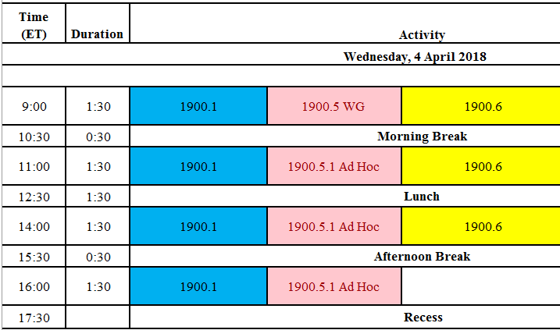
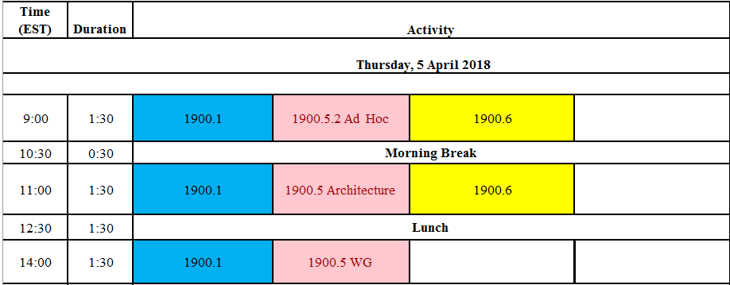
Meeting Planning
03 April 2018 is next scheduled monthly electronic meeting
  Recommend deferring to meetings on 4-5 April

Slide 19
Ad Hoc?
Review of 1900.5.1 or 1900.5 architecture

Slide 20
IEEE 1900.5 Meeting
3/6/18 @2:30 PM US ET (UTC-5)
PLEASE STANDBY

