Slide 1
IEEE 1900.5 Contribution
Author’s Name | Affiliation | Address | Phone | email
Matthew Sherman | BAE Systems | Wayne, NJ | 973-229-9520 | matthew.sherman@baesystems.com
Document Title: Agenda and Admin for IEEE 1900.5 WG Meeting on 12-14 January 2016
Document Date: 14 January 2016
Document No: 5-15-0080-03-agen
Notice: This document has been prepared to assist IEEE DySPAN-SC and its Working Groups. It is offered as a basis for discussion and is not binding on the contributing individual(s) or organization(s). The material in this document is subject to change in6 form and content after further study. The contributor(s) reserve(s) the right to add, amend or withdraw material contained herein.
Release: The contributor grants a free, irrevocable license to the IEEE to incorporate material contained in this contribution, and any modifications thereof, in the creation of an IEEE Standards publication; to copyright in the IEEE’s name any IEEE Standards publication even though it may include portions of this contribution; and at the IEEE’s sole discretion to permit others to reproduce in whole or in part the resulting IEEE Standards publication. The contributor also acknowledges and accepts that this contribution may be made public by IEEE DySPAN-SC.
Patent Policy and Procedures: The contributor is familiar with the IEEE Patent Policy and Procedures including the statement "IEEE standards may include the known use of patent(s), including patent applications, provided the IEEE receives assurance from the patent holder or applicant with respect to patents essential for compliance with both mandatory and optional portions of the standard." Early disclosure to IEEE DySPAN-SC and its Working Groups of patent information that might be relevant to the standard is essential to reduce the possibility for delays in the development process and increase the likelihood that the draft publication will be approved for publication. Please notify the Chair <matthew.sherman@baesystems.com> as early as possible, in written or electronic form, if patented technology (or technology under patent application) might be incorporated into a draft standard being developed within the IEEE DySPAN-SC Committee. If you have questions, contact the IEEE Patent Committee Administrator at < patcom@ieee.org >.

Slide 2
Meeting Invite
This IEEE 1900.5 meeting will be a joint meeting with the Wireless Innovation Forum’s Modeling Language for Mobility Work Group (MLM-WG)
MLM-WG members can participate in the agenda topics of mutual interest either in-person or electronically

Slide 3
Electronic Meeting Details
Same for all 3 days
1. Please join my meeting.
https://global.gotomeeting.com/join/679013973
2. Use your microphone and speakers (VoIP) - a headset is recommended. Or, call in using your telephone.
United States: +1 (619) 550-0006
Australia: +61 2 9087 3605
Austria: +43 (0) 7 2088 1403
Belgium: +32 (0) 38 08 1856
Canada: +1 (647) 497-9351
Denmark: +45 (0) 69 91 88 64
Finland: +358 (0) 942 41 5780
France: +33 (0) 170 950 592
Access Code: 679-013-973
Audio PIN: Shown after joining the meeting
Meeting ID: 679-013-973
Germany: +49 (0) 692 5736 7210
Ireland: +353 (0) 14 845 978
Italy: +39 0 553 98 95 67
Netherlands: +31 (0) 208 080 381
New Zealand: +64 (0) 4 974 7214
Norway: +47 21 03 58 98
Spain: +34 955 32 0845
Sweden: +46 (0) 853 527 836
Switzerland: +41 (0) 435 0167 09
United Kingdom: +44 (0) 330 221 0086
Notes:
September 22, 2008
3

Slide 4
Tentative Meeting Times
Tues 1/12: 9 AM – 12 PM, 1 PM – 5 PM
  Breaks as needed
  Please arrive at visitor center at 8:30 to allow time for badging etc.
  Dave Chester is host (dchest04@harris.com)
Wed 1/13: 9 AM – 12 PM, 1 PM – 5 PM
  Breaks as needed
Thu 1/14: 9 AM – 12 PM, 1 PM – 5 PM
  Breaks as needed

Slide 5
Meeting Location and Details
Harris Technology Center (HTC)
  Melbourne FL
  Approx GPS Coordinates (for navigation purposes):
    28 Deg 01’50.63” N, 80 Deg 36’11.25” W
    Specific address not available but see driving directions
Must fill out Visit Request Embedded as a file on this slide to attend in person

Slide 6
General Directions
From Orlando FL Airports
  From the Sanford airport you take the Greenway toll road (417) to 528 east. From the Orlando airport you to take the north exit to the Beeline toll road (528) east. Note that tolls use “EZ-pass” but also work from license plates (ask at auto rental location). You can take 528 all the way to I-95 but it is a bit quicker to take the 520 exit, 520 is a 4 lane divided highway, and take 520 east to I-95. Take I-95 south to the appropriate Melbourne exit (Depending on where you stay)

Slide 7
Detailed Directions
From beachside
  Take the closest causeway east over the Indian River to US 1. Turn left onto US 1 and go south to the traffic light at Robert J Conlan Blvd. That is about 2 miles south of US 192. Follow Conlan Blvd to the traffic light at Palm Bay Rd. Turn Right onto Palm Bay Rd. and go west for about 0.35 miles to the traffic light at Troutman Blvd. Turn left onto Troutman Blvd. and follow it for about 0.2 miles to Franklin Dr. Turn Right onto Franklin Dr. and in about 100 yards there will be a parking lot entrance on the left. Enter the parking lot and park.
From Melbourne:
  Take the closest north/south road (Minton Rd., Hollywood Blvd., Dairy Rd. or Babcock St.) south to Palm Bay Rd. Turn left onto Palm Bay Rd. and go east. The Palm Bay Rd. intersection with Babcock St. is a major intersection and once you go through that intersection and are on Palm Bay Rd. continue for one mile where you will find the second traffic light after the one at Babcock St. At that second traffic light the crossing road is Lipscomb St. to the north and Clearmont St. to the south. Turn right onto Clearmont St. and stay on it for about 0.2 miles. Turn left onto Franklin Drive and in about 90 to 100 yards on the right you will see the entrance to a sizable parking lot. Enter the lot and find a parking place.
From the parking lot:
  On the east side of the parking lot you will see a six story glass building shaped like a script letter pi lying on its side. The top of the pi is on the east side of the building so there is a north leg and a south leg. The lobby is near the middle of the north side of the south leg. Enter the lobby and we will meet there as a group.

Slide 8
Hotels and Tourist Attractions
Hotels: You can stay beachside (on the barrier island) or in Melbourne. The drive from a beachside hotel to the HTC is about half an hour and about 15 minutes from Melbourne. Here are some of my recommendations. Melbourne: Courtyard Melbourne West, Hilton Melbourne Rialto Place (For any Redsox fans this has the Tim Wakefield Conference Center), Extended Stay Deluxe Melbourne – Airport, Residence Inn Melbourne, Suburban Extended Stay Melbourne, Fairfield Inn & Suites Melbourne. Beachside: Radisson Suite Hotel Oceanfront, Crowne Plaza Melbourne Oceanfront, Hilton Melbourne Beach Oceanfront, Quality Suites Oceanside.
Tourist locations: The Kennedy Space Center Visitor Complex is about a 45 minute drive north from Melbourne. If there is a scheduled launch during a meeting day we can take a break, go outside and look up and northeast. Then there is Orlando. If you plan to spend more than a day in Orlando I’d book a hotel in Orlando.

Slide 9
Rules
IEEE DySPAN-SC rules
  http://standards.ieee.org/about/sasb/audcom/pnp/DySPAN_SC.pdf
IEEE 1900.5 WG rules
  http://grouper.ieee.org/groups/dyspan/files/individual-WG-PnPs.pdf
Roberts Rules (latest edition) as needed…

Slide 10
Current Membership
Attendance |  |  | WG Status | First Name | Last Name | Affiliation
Tues 1/12 | Wen 1/13 | Thur 1/14 | 13 | Total
 | x | x | Member | Carlos | Caicedo | Syracuse University (Secretary)
x | x | x | Member | David | Chester | Harris
x |  | x | Member | Colby | Harper | Pathfinder Wireless Corp
 |  | x | Member | Nilesh | Khamberkar | Univ. of Buffalo
x | x | x | Member | Mitch | Kokar | VIStology & Northeastern University
 | x | x | Member | Yuriy | Posherstnik | US Army RDECOM CERDEC
 |  |  | Member | V | Prasad | Wireless and Mobile Communication, TU Delft
 |  |  | Member | Sam | Schmitz | Mitre
x | x | x | Member | Mat | Sherman | BAE Systems (Chair)
x | x | x | Member | John | Stine | Mitre
x |  |  | Member | Darcy | Swain-Walsh | Mitre (Vice Chair)
x |  |  | Member | Tony | Rennier | Foundry Inc
x | x | x | Member | Reinhard | Schrage | SchrageConsult
 |  |  | Participant | Charles | Sheehe | NASA
 |  |  | STAFF | Jonathan | Goldberg | IEEE
Quorum?
Quorum = ½ membership (7 members)
2 meetings to get in, 2 meetings to get out

Slide 11
Draft Agenda
DAY 1 – 1/12/16
Administrivia
    Roll Call / Quorum Check
    Approve Agenda
    Patent slides / Notes on status
    Approval of recent minutes
1900.5.1 Deep Dive
  Review of latest developments with draft
  Inputs on use cases, requirements and direction of draft
DAY 2 – 1/13/16
1900.5.2 Deep Dive
  Review of Current draft with mandatory editorial changes
  Discussions on use cases, requirements, and direction of draft
DAY 3 – 1/14/16
1900.5 marketing deep dive
  Demo of software from Syracuse University
  WInnForum 3.6GHz stakeholders requirements and positioning
  National Spectrum Consortium requirements and positioning
1900.5 meeting planning and review
AoB
Adjourn
Any modifications?
Notes:
September 22, 2008
11

Slide 12
Adjusted Agenda
DAY 1 – 1/12/16
Administrivia
    Roll Call / Quorum Check
    Approve Agenda
    Patent slides / Notes on status
    Approval of recent minutes
1900.5.2 Deep Dive (Afternoon – 1 PM)
  Review of Current draft with mandatory editorial changes
DAY 2 – 1/13/16
1900.5.1 Deep Dive (Morning?)
  Review of latest developments with draft
  Inputs on use cases, requirements and direction of draft
1900.5.2 Deep Dive (Afternoon)
  Discussions on use cases, requirements, and direction of draft
DAY 3 – 1/14/16
1900.5 marketing deep dive
  Demo of software from Syracuse University
  WInnForum 3.6GHz stakeholders requirements and positioning
  National Spectrum Consortium requirements and positioning
1900.5 meeting planning and review
AoB
Adjourn
Adopted UC
Notes:
September 22, 2008
12

Slide 13
Approval of Agenda
Motion to approve Adjusted Agenda contained in 5-15-0080-02
Mover: Darcy
Second: Reinhard
Vote: UC

Slide 14
Participants, Patents, and Duty to Inform
All participants in this meeting have certain obligations under the IEEE-SA Patent Policy.
  Participants [Note: Quoted text excerpted from IEEE-SA Standards Board Bylaws subclause 6.2]:
    “Shall inform the IEEE (or cause the IEEE to be informed)” of the identity of each “holder of any potential Essential Patent Claims of which they are personally aware” if the claims are owned or controlled by the participant or the entity the participant is from, employed by, or otherwise represents
    “Should inform the IEEE (or cause the IEEE to be informed)” of the identity of “any other holders of potential Essential Patent Claims” (that is, third parties that are not affiliated with the participant, with the participant’s employer, or with anyone else that the participant is from or otherwise represents)
  The above does not apply if the patent claim is already the subject of an Accepted Letter of Assurance that applies to the proposed standard(s) under consideration by this group
  Early identification of holders of potential Essential Patent Claims is strongly encouraged
  No duty to perform a patent search
Slide #1

Slide 15
Patent Related Links
  All participants should be familiar with their obligations under the IEEE-SA Policies & Procedures for standards development.
  Patent Policy is stated in these sources:
  IEEE-SA Standards Boards Bylaws
  http://standards.ieee.org/develop/policies/bylaws/sect6-7.html#6
  IEEE-SA Standards Board Operations Manual
  http://standards.ieee.org/develop/policies/opman/sect6.html#6.3
  Material about the patent policy is available at
  http://standards.ieee.org/about/sasb/patcom/materials.html
If you have questions, contact the IEEE-SA Standards Board Patent Committee Administrator at patcom@ieee.org or visit http://standards.ieee.org/about/sasb/patcom/index.html
This slide set is available at https://development.standards.ieee.org/myproject/Public/mytools/mob/slideset.ppt
Slide #2

Slide 16
Call for Potentially Essential Patents
If anyone in this meeting is personally aware of the holder of any patent claims that are potentially essential to implementation of the proposed standard(s) under consideration by this group and that are not already the subject of an Accepted Letter of Assurance:
  Either speak up now or
  Provide the chair of this group with the identity of the holder(s) of any and all such claims as soon as possible or
  Cause an LOA to be submitted
Slide #3

Slide 17
Other Guidelines for IEEE WG Meetings
All IEEE-SA standards meetings shall be conducted in compliance with all applicable laws, including antitrust and competition laws.
  Don’t discuss the interpretation, validity, or essentiality of patents/patent claims.
  Don’t discuss specific license rates, terms, or conditions.
    Relative costs, including licensing costs of essential patent claims, of different technical approaches may be discussed in standards development meetings.
      Technical considerations remain primary focus
  Don’t discuss or engage in the fixing of product prices, allocation of customers, or division of sales markets.
  Don’t discuss the status or substance of ongoing or threatened litigation.
  Don’t be silent if inappropriate topics are discussed … do formally object.
---------------------------------------------------------------
See IEEE-SA Standards Board Operations Manual, clause 5.3.10 and “Promoting Competition and Innovation: What You Need to Know about the IEEE Standards Association's Antitrust and Competition Policy” for more details.
Slide #4

Slide 18
Minutes for approval
Motion to approve WG minutes contained in
TBD
Mover:
Second:
Vote:

Slide 19
1900.5.1 Deep Dive (1/12/16)
Review of latest developments with draft
Inputs on use cases, requirements and direction of draft

Slide 20
Working Schedule for 1900.5.1
Complete Draft for Clause 4 7/30√
Complete Draft for Clause 5 10/15 1/16
Complete Draft for Clause 6 1/16 2/16
Complete Draft for Clause 7 3/16
Annex A 6/16
First WG Ballot 6/16
WG Recirc 8/16
WG Recirc 2 10/16
Sponsor Ballot 1/17
Sponsor Recirc 3/17
Sponsor Recirc 2 5/17
Submit to REVCOM 6/17

Slide 21
1900.5.2 Deep Dive (1/13/16)
Review of Current draft with mandatory editorial changes
Discussions on use cases, requirements, and direction of draft

Slide 22
Working Schedule for 1900.5.2
Form Ballot Pool (Send Ballot Invitation) 6/7/15√
Final Draft and Schema Adjustments 7/30/15√
WG Vote to Sponsor Ballot (need DySPAN-SC approval) 7/30/15 (8/18) √
DySPAN-SC Approval 8/28/15 (9/2) 9/30√
Mandatory Editorial Coordination Completes 9/30/15 12/1 √
Conduct Ballot 1/28/16
Ballot completes 2/28/15
Form Comment Resolution subcommittee 3/15/16
Suggested resolutions available 3/30/16
Vote for Recirculation Ballot 4/5/16
Conduct Recirc Ballot 4/15/16
Ballot completes 4 /30/16
Suggested comment resolutions available 5/15/16
Vote for Recirc Ballot 6/7/16
Conduct Recirc Ballot 6/15/16
Ballot completes 6/30/16
Approved by Standards Board 4/1/16 7/1/16
Reference implementation available 12/15 1/16
Certification available 3/16 9/16
Rebaselined

Slide 23
Marketing Deep Dive (1/14/16)
Demo of 1900.5.2 software from Syracuse University
WInnForum 3.6GHz stakeholders requirements and positioning
National Spectrum Consortium requirements and positioning

Slide 24
Future Meeting Planning
Normal WG meeting
DySPAN-SC F2F March 21-24, 2014
  Mat Sherman will host at IEEE in Piscataway NJ
No Formal Ad Hocs currently planned
  1900.5 for WInnF planning meeting (not formal Ad Hoc) planned for 11:30 EST Tues 1/19
  Contact M. Sherman if interested

Slide 25
Drawings from 1/14 Meeting

Slide 26
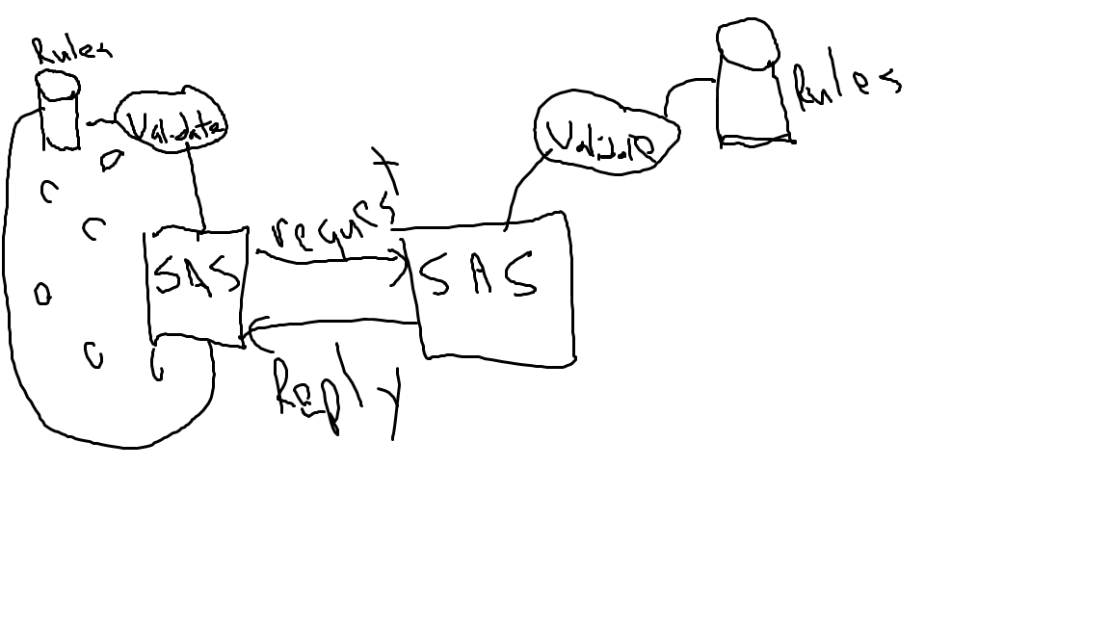

Slide 28
