Slide 1
IEEE 1900.5 Contribution
Author’s Name | Affiliation | Address | Phone | email
Matthew Sherman | BAE Systems | Wayne, NJ | 973-229-9520 | matthew.sherman@baesystems.com
Document Title: Agenda and Admin for IEEE 1900.5 WG Meetings on 27-30 July 2015
Document Date: 25 July 2015
Document No: 5-15-0050-00-agen
Notice: This document has been prepared to assist IEEE DySPAN-SC and its Working Groups. It is offered as a basis for discussion and is not binding on the contributing individual(s) or organization(s). The material in this document is subject to change in6 form and content after further study. The contributor(s) reserve(s) the right to add, amend or withdraw material contained herein.
Release: The contributor grants a free, irrevocable license to the IEEE to incorporate material contained in this contribution, and any modifications thereof, in the creation of an IEEE Standards publication; to copyright in the IEEE’s name any IEEE Standards publication even though it may include portions of this contribution; and at the IEEE’s sole discretion to permit others to reproduce in whole or in part the resulting IEEE Standards publication. The contributor also acknowledges and accepts that this contribution may be made public by IEEE DySPAN-SC.
Patent Policy and Procedures: The contributor is familiar with the IEEE Patent Policy and Procedures including the statement "IEEE standards may include the known use of patent(s), including patent applications, provided the IEEE receives assurance from the patent holder or applicant with respect to patents essential for compliance with both mandatory and optional portions of the standard." Early disclosure to IEEE DySPAN-SC and its Working Groups of patent information that might be relevant to the standard is essential to reduce the possibility for delays in the development process and increase the likelihood that the draft publication will be approved for publication. Please notify the Chair <matthew.sherman@baesystems.com> as early as possible, in written or electronic form, if patented technology (or technology under patent application) might be incorporated into a draft standard being developed within the IEEE DySPAN-SC Committee. If you have questions, contact the IEEE Patent Committee Administrator at < patcom@ieee.org >.

Slide 2
Using Monthly WG Meeting Electronic Meeting Details (All 4 days: 7/27-30/15)
1. Please join my meeting. https://global.gotomeeting.com/join/679013973
2. Use your microphone and speakers (VoIP) - a headset is recommended. Or, call in using your telephone.
United States: +1 (619) 550-0006 Australia: +61 2 9087 3605 Austria: +43 (0) 7 2088 1403 Belgium: +32 (0) 38 08 1856 Canada: +1 (647) 497-9351 Denmark: +45 (0) 69 91 88 64 Finland: +358 (0) 942 41 5780 France: +33 (0) 170 950 592
Access Code: 679-013-973 Audio PIN: Shown after joining the meeting
Meeting ID: 679-013-973
Germany: +49 (0) 692 5736 7210 Ireland: +353 (0) 14 845 978 Italy: +39 0 553 98 95 67 Netherlands: +31 (0) 208 080 381 New Zealand: +64 (0) 4 974 7214 Norway: +47 21 03 58 98 Spain: +34 955 32 0845 Sweden: +46 (0) 853 527 836 Switzerland: +41 (0) 435 0167 09 United Kingdom: +44 (0) 330 221 0086
Notes:
September 22, 2008
2

Slide 3
Rules
IEEE DySPAN-SC rules
http://standards.ieee.org/about/sasb/audcom/pnp/DySPAN_SC.pdf
IEEE 1900.5 WG rules
http://grouper.ieee.org/groups/dyspan/files/individual-WG-PnPs.pdf
Roberts Rules (latest edition) as needed…

Slide 4
Current Membership
Last 2 WG Attend? | Last 2 WG Credit? | WG Status | First Name | Last Name | Affiliation
 |  | 14 | Total
2 | 2 | Member | Carlos | Caicedo | Syracuse University (Act. Secretary)
2 | 2 | Member | David | Chester | Harris
2 | 2 | Member | Mitch | Kokar | VIStology & Northeastern University
2 | 2 | Member | V | Prasad | Wireless and Mobile Communication, TU Delft
1 | 1 | Member | Sam | Schmitz | Mitre
2 | 2 | Member | Mat | Sherman | BAE Systems (Chair)
1 | 1 | Member | John | Stine | Mitre
0 | 0 | Member | Darcy | Swain | Mitre (Vice Chair)
1 | 1 | Member | Tony | Rennier | Foundry Inc
2 | 2 | Member | Reinhard | Schrage | SchrageConsult
1 | 1 | Member | Nilesh | Khamberkar | Univ. of Buffalo
0 | 0 | Member | Harris | Zebrowitz | DISA/DSO - MITRE
1 | 1 | Member | Yuriy | Posherstnik | US Army RDECOM CERDEC
1 | 1 | Member | Colby | Harper | Pathfinder Wireless Corp
0 | 0 | Participant | Jesse | Caufield | Keybridge
0 | 0 | STAFF | Jonathan | Goldberg | IEEE
0 | 0 | Participant | Mark | Johnson | Aerospace Corp.
0 | 0 | Participant | Andy | Lee | Google
0 | 0 | Participant | Andy | Clegg | Google
0 | 0 | Participant | Yang Yi | Chen | Northeastern University
1 | 1 | Participant | Paul | Falvell | CGI Group Inc.
2 | 2 | Participant | Tim | Fulford | Airbus Defence & Space
Quorum?
Quorum = ½ membership (7 members)
2 meetings to get in, 2 meetings to get out

Slide 5
Draft Admin Agenda
Administrivia
Roll Call / Quorum Check (to be performed daily)
Approve Agenda
Patent slides / Notes on status
Approval of recent minutes (TBD)
Status on 1900.5.1
PAR Status / Ad hoc moved to Plenary
Status on 1900.5.2
Prep for Ballot
Review of other 1900 activities (1900.1, Leadership meeting etc)
Discuss contribution to 1900.1
1900.5 marketing inputs
WInnForum 3.6GHz stakeholders
National Spectrum Consortium
Comms Magazine
Others?
Review of 1900.5 meeting schedule for week
Ad Hoc Planning
AoB
See schedule on following Page for further meetings…
Any modifications?
Notes:
September 22, 2008
5

Slide 6
Draft Schedule for General Meetings

Slide 7
Approval of Agenda
Motion to approve Agenda contained in TBD
Mover:
Second:

Slide 8
Participants, Patents, and Duty to Inform
All participants in this meeting have certain obligations under the IEEE-SA Patent Policy.
Participants [Note: Quoted text excerpted from IEEE-SA Standards Board Bylaws subclause 6.2]:
“Shall inform the IEEE (or cause the IEEE to be informed)” of the identity of each “holder of any potential Essential Patent Claims of which they are personally aware” if the claims are owned or controlled by the participant or the entity the participant is from, employed by, or otherwise represents
“Should inform the IEEE (or cause the IEEE to be informed)” of the identity of “any other holders of potential Essential Patent Claims” (that is, third parties that are not affiliated with the participant, with the participant’s employer, or with anyone else that the participant is from or otherwise represents)
The above does not apply if the patent claim is already the subject of an Accepted Letter of Assurance that applies to the proposed standard(s) under consideration by this group
Early identification of holders of potential Essential Patent Claims is strongly encouraged
No duty to perform a patent search
Slide #1

Slide 9
Patent Related Links
All participants should be familiar with their obligations under the IEEE-SA Policies & Procedures for standards development.
Patent Policy is stated in these sources:
IEEE-SA Standards Boards Bylaws
http://standards.ieee.org/develop/policies/bylaws/sect6-7.html#6
IEEE-SA Standards Board Operations Manual
http://standards.ieee.org/develop/policies/opman/sect6.html#6.3
Material about the patent policy is available at
http://standards.ieee.org/about/sasb/patcom/materials.html
If you have questions, contact the IEEE-SA Standards Board Patent Committee Administrator at patcom@ieee.org or visit http://standards.ieee.org/about/sasb/patcom/index.html
This slide set is available at https://development.standards.ieee.org/myproject/Public/mytools/mob/slideset.ppt
Slide #2

Slide 10
Call for Potentially Essential Patents
If anyone in this meeting is personally aware of the holder of any patent claims that are potentially essential to implementation of the proposed standard(s) under consideration by this group and that are not already the subject of an Accepted Letter of Assurance:
Either speak up now or
Provide the chair of this group with the identity of the holder(s) of any and all such claims as soon as possible or
Cause an LOA to be submitted
Slide #3

Slide 11
Other Guidelines for IEEE WG Meetings
All IEEE-SA standards meetings shall be conducted in compliance with all applicable laws, including antitrust and competition laws.
Don’t discuss the interpretation, validity, or essentiality of patents/patent claims.
Don’t discuss specific license rates, terms, or conditions.
Relative costs, including licensing costs of essential patent claims, of different technical approaches may be discussed in standards development meetings.
Technical considerations remain primary focus
Don’t discuss or engage in the fixing of product prices, allocation of customers, or division of sales markets.
Don’t discuss the status or substance of ongoing or threatened litigation.
Don’t be silent if inappropriate topics are discussed … do formally object.
---------------------------------------------------------------
See IEEE-SA Standards Board Operations Manual, clause 5.3.10 and “Promoting Competition and Innovation: What You Need to Know about the IEEE Standards Association's Antitrust and Competition Policy” for more details.
Slide #4

Slide 12
Minutes for approval
Motion to approve WG minutes contained in 5-15-0047-00 & 5-15-0048-00
Mover:
Second:

Slide 13
Current Issues for 1900.5.1
Schedule for 1900.5.1
PAR Extension
Has been submitted on 5/10/15
Is on NESCOM Agenda for September (Tokyo)
Presentations / activities this week?

Slide 14
Working Schedule for 1900.5.1
Complete Draft for Clause 4 7/30
Complete Draft for Clause 5 10/15
Complete Draft for Clause 6 1/16
Complete Draft for Clause 7 3/16
Annex A 6/16
First WG Ballot 6/16
WG Recirc 8/16
WG Recirc 2 10/16
Sponsor Ballot 1/17
Sponsor Recirc 3/17
Sponsor Recirc 2 5/17
Submit to REVCOM 6/17

Slide 15
Current Issues for 1900.5.2
Ballot invitation
93 in pool
Pool looks balanced
Invitation extended to August 14th
Will slip actual ballot of needed to accommodate
Draft Update
Schema Update (Dropped?)
NIEM compatibility (Dropped?)

Slide 16
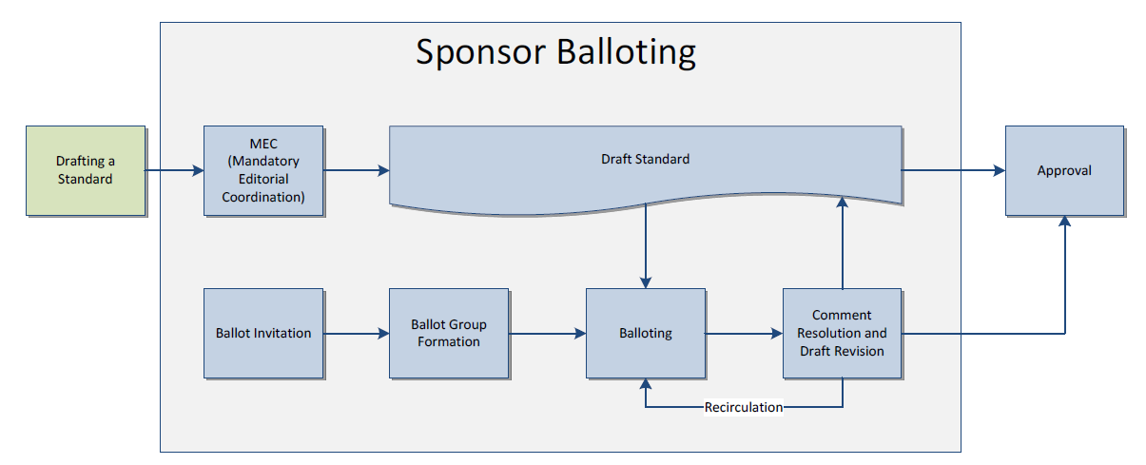
Balloting Process

Slide 17
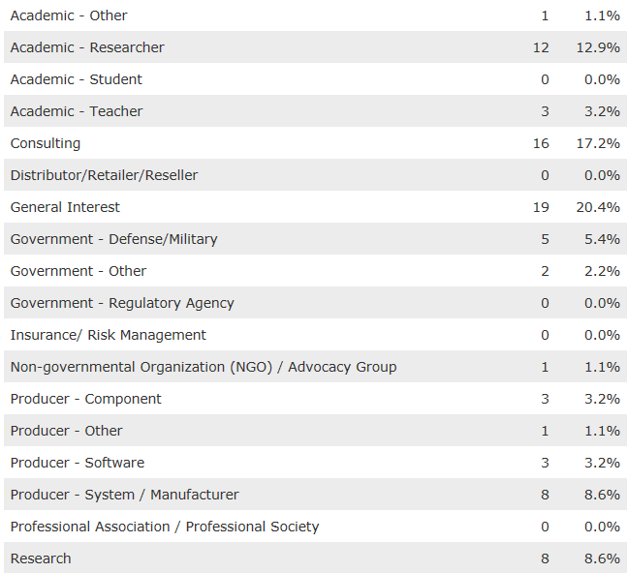
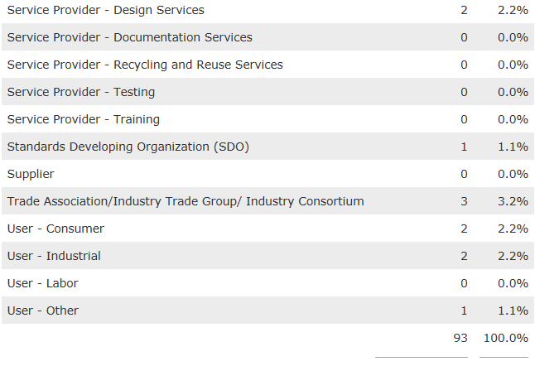
Current Ballot Pool Status

Slide 18
Working Schedule for 1900.5.2
Form Ballot Pool (Send Ballot Invitation) 6/6/2015
Final Draft and Schema Adjustments 7/21/2015
Vote to Sponsor Ballot 7/28/2015
Conduct Ballot 8/11/2015
Ballot completes 9/8/2015
Form Comment Resolution subcom 9/22/2015
Suggested resolutions available 10/20/2015
Vote for Recirculation Ballot 10/27/2015
Conduct Recirc Ballot 11/10/2015
Ballot completes 11/24/2015
Suggested comment resolutions available 12/8/2015
Vote for Recirc Ballot 1/5/2016
Conduct Recirc Ballot 1/19/2016
Ballot completes 2/2/2016
Approved by Standards Board 3/1/2016
Reference implementation available 12/15/2015
Certification available 3/1/2016

Slide 19
Other DySPAN-SC Activities
Leadership meeting
None… Next one ??
Inputs to 1900.1?

Slide 20
Marketing Inputs
WInnForum 3.5 GHz stakeholders
Tutorial on Aug 5
WinnF meeting on Aug 6
NSC
Application of SAS to 1755-1850 MHz spectrum sharing?
DySPAN-SC standards Paper and follow up… Communications Magazine special issue
Others?

Slide 21
Meeting Planning
All WG meetings in morning
Ad Hocs in afternoon?
August WG meeting?

Slide 22
AoB?

