Slide 1
IEEE 1900.5 Contribution
Author’s Name | Affiliation | Address | Phone | email
Nicholas Sherman (intern) and Jesse Caulfield | Key Bridge Global LLC | McLean, VA | 713 414 3500 | jesse.caulfield@keybridgeglobal.com
Document Title: IEEE-1900.5.2 Proposed Document Revisions
Document Date: August 25, 2014
Document No: 5-14-0075-00-subs
Notice: This document has been prepared to assist IEEE DySPAN-SC and its Working Groups. It is offered as a basis for discussion and is not binding on the contributing individual(s) or organization(s). The material in this document is subject to change in6 form and content after further study. The contributor(s) reserve(s) the right to add, amend or withdraw material contained herein.
Release: The contributor grants a free, irrevocable license to the IEEE to incorporate material contained in this contribution, and any modifications thereof, in the creation of an IEEE Standards publication; to copyright in the IEEE’s name any IEEE Standards publication even though it may include portions of this contribution; and at the IEEE’s sole discretion to permit others to reproduce in whole or in part the resulting IEEE Standards publication. The contributor also acknowledges and accepts that this contribution may be made public by IEEE DySPAN-SC.
Patent Policy and Procedures: The contributor is familiar with the IEEE Patent Policy and Procedures including the statement "IEEE standards may include the known use of patent(s), including patent applications, provided the IEEE receives assurance from the patent holder or applicant with respect to patents essential for compliance with both mandatory and optional portions of the standard." Early disclosure to IEEE DySPAN-SC and its Working Groups of patent information that might be relevant to the standard is essential to reduce the possibility for delays in the development process and increase the likelihood that the draft publication will be approved for publication. Please notify the Chair <matthew.sherman@baesystems.com> as early as possible, in written or electronic form, if patented technology (or technology under patent application) might be incorporated into a draft standard being developed within the IEEE DySPAN-SC Committee. If you have questions, contact the IEEE Patent Committee Administrator at < patcom@ieee.org >.

Slide 2
1900.5.2 Specification
Proposed Data Model Revisions for Implementation in Software

Slide 3
3 Goals of this Effort
Focus on implementation
Simplify as must as possible, but no more
Use plain language
Notes:
Implementation-centric approach
First priority is to enable implementation in software
Preserve the theory : work on implementation strategy
Simplify as must as possible, but no more
Establish and enforce a clear model heirarchy
Minimize new object definitions, use abstraction
Use primitives and pre-defined types wherever possible
Use plain language
Mostly editorial style
Focus the text to methods, practices and implementation specific explanations

Slide 4
Summary of our Approach
Start with the XSD
Compile to Java/C++/C#
Fix the code
Decompile to XSD
Fix the XSD
Repeat
This process guarantees XSD compilability and a consistent software implementation for all developers.
Notes:
Our strategy was to compile the proposed XML schema into software. We used Java as our programming language.
After compilation we then updated the software code to implement development best practices and to minimize duplication. The updated Java software code was then decompiled back into a new XML schema.
We then edited and updated the XML schema to improve its own readability and other best practices.
This process was repeated dozens of times until we were happy with both representations of the data model – in software code and in XML, and the process was both repeatable and reversable.
This cyclical process ensures that the schema published with this specification firstly can be used by developers to actually implement the specification in software and secondly that those software implementations are highly likely to be interoperable.

Slide 5
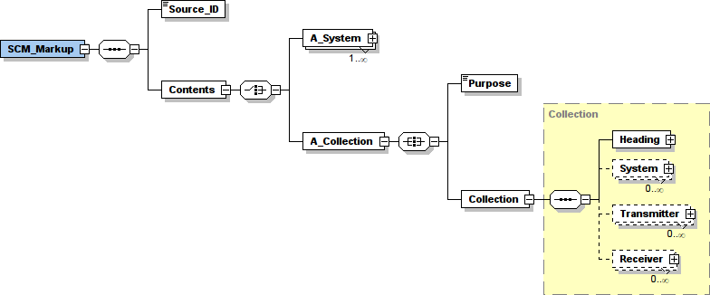
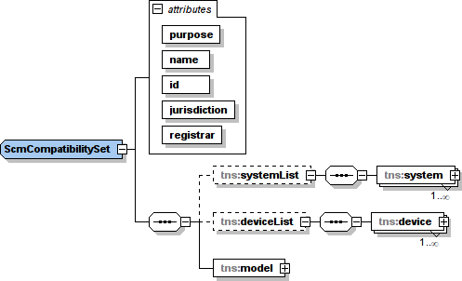
Major Revisions at the Top;
Minor Revisions Throughout
Original
Revised
Notes:
What you see immediately is that the original data structure was very deep; the useful information was buried inside numerous layers of category and organization. We flattened this heirarchy, making it easier to access useful information while trying our best to preserve the intended functionality of each component.
One significant change we have implemented is that we impose a single point of entry into the data object model. This has great benefit for computerized implementations in that the programmer always knows what to expect. This also enables us to reduce some duplication of fields while ensuring that the object heirarcy is always consistently enforced.
You will also notice that we’e applied some global formatting styles to the data model, such as:
All objects and elements are named using CamelCase – this is where the first letter of each word is upper case and names do not contain special characters
We’ve reorganized all data objects so that local parameters are always declared as attributes while objects are always encoded as elements
We’ve wrapped all object liss to improve XML readability
We use abstract List and Key/Value mappings throughout. These standard XML types compile directly to software collection types (e.g. ArrayList, HashMap) and ensure a more consistent implementation by users
We make maximum reuse of W3C schema data types (DateTime, Duration, etc.) to improve interoperability
We impose a standard object naming strategy improves legibility, reduces chance for name-space conflict with other specifications and data models. (“Scm” prefix)
Finally, we split the schema into multiple, individual files to enable a cleaner software packaging and hierarchy strategy. This approach also enables smaller, piecewise updates, improvements and feature-adds in the future.

Slide 6
List of Data Model Revisions
Original |  | Revised
SCM_Markup, Collection | → | ScmCompatabilitySet
System | → | ScmSystem
Transmitter | → | AScmRadioDeviceType : ScmTransmitter
Receiver | → | AScmRadioDeviceType : ScmReceiver
 |  | AScmRadioDeviceType : ScmTransciever
Constructs | → | SpectrumConsumptionModel
Likelihood + Probability | → | AScmConfidenceType
Location + 14 sub-types | → | ScmLocation
Start_Time, End_Time + Duty Cycle Types | → | ScmSchedule
Total_Power | → | ScmPowerLevel
Power_Map | → | ScmPowerGain
Spectrum_Mask | → | ScmSpectrumMask
Underlay_Mask | → | ScmUnderlayMask
Propagation_Map | → | AScmPathLossType
Intermodulation_Mask | → | ScmIntermodulationMask
Protocol_or_Policy | → | AScmPolicyType
NEW
NEW
NEW
NEW
Notes:
We have tried to simplify the original data model through the use of abstract data types and scenario-specific implementations. This is a common software architecture strategy that allows for many diverse implementations, all conforming to a basic inter-operability contract.
Recalling the naming style strategy: All original types were renamed with the “Scm” prefix. This is to avoid name-space clashes and improve current and future interoperability with other specifications and data models
We have consolidated related elements and data fields have into a single type where possible
E.g scheduling information across several different data types was consolidated into a single ScmSchedule type
We have created and used abstract data types where possible to further consolidate and simplify the model
E.g. common transmitter and receiver data fields were consolidated into a single radio device type. The transmitter and receiver types then inherit those common attributes and can declare attributed specific to their own implementation.

Slide 7
We’ve also taken some editorial license
Various sections rewritten using plain language
From
To
The purpose of the spectrum mask construct is to convey the spectral content of RF emissions and their power spectral density. RF signals occupy a band of spectrum and may extend beyond the nominal bounds of their channel or fit well within that channel. The spectrum mask attempts to convey the bounds to the spectral content of the signal. This construct enables SCM to be used to determine when adjacent band interference will occur
A ScmSpectrumMask describes the spectrum and power components of a radio frequency emission, which may extend beyond a modeled transmitter’s channel assignment.
A basic understanding of RF engineering by the reader is assumed. The text has been rewritten to convey the same information in a more terse and direct manner.

Slide 8
Summary
Focused on building software
Simplified the data model
Edited many sections to use plain language
Notes:
Implementation-centric approach
We focused on the data model and software implementation
Tried our best to preserve the theory
Simplified the model as must as possible
Establish and enforce a clear model heirarchy
Minimize new object definitions, use abstraction
Use primitives and pre-defined types wherever possible
Use plain language
Mostly editorial style
Focus the text to methods, practices and implementation specific explanations

Slide 9
Issues
Our data model is structurally different
Initial review with the Author show some deficiencies
Documents need to be harmonized
  Data models to be synchronized
  Compatibility must to be reconfirmed
Notes:
Initial reviews with the Author show some deficiencies
We missed several nuanced modeling strategies
Mostly having to do with 3-dimensional representation of power values
Our data model does not appear to be 100% compatible with existing algorithms
We must either revise the data model or the algorithm. The easiest approach is probably to focus on the data model, but it’s also probably a good idea to study the algorithm.
All compatibility concepts and calculations need to be reconfirmed. This was outside the scope of our work. We tried our best to preserve the fundamental capabilities as we understand them, but again, there are many subtle and nuanced calculation methods in the specification that we either missed or do not completely understand.

Slide 10
Next Steps
We have identified three high-level issues to address. Others will surface upon review of the documents.
Location
  Added support for complex, convex geometries
Path Loss
  Added interpolated strategy for terrestrial broadcast
Power Gain
  Cartesian volumetric versus polar intepolated strategy
Notes:
We had an initial review of our proposed data model revisions with the Author and several issues were immediately discovered. We expect that more issues will surface upon further review of the two documents, and we are prepared to work through them to harmonize the data model with the specification requirements.
Here are initial issues that we might use as starting points for our collaboration:
In our location representation we use standard computer-friendly geometries and rely upon standardized computer algorithms for geometric calculations and manipulation. This simplifies the data model and development process but also can increase the calculation complexity. This is a tradeoff the group should consider.
We added a pre-calculated, interpolated path loss strategy to accommodate terrestrial broadcast services. This implementation does not easily support non-terrestrial (e.g. airborn) receivers, and the group should consider if this is a needed addition or the two existing path loss strategies are sufficient.
In modeling directional gain and 3-dimensional power distribution we missed some subtle aspects of the original “PowerMap” and favored an approach using finite 3D computer models instead of a more precise and compact polar interpolation strategy.
We don’t have an opinion as to which is better or worse. The new approach is more determinative and relies less on client calculation; whereas the former approach is more flexible and compact but also requires the client to implement a calculation strategy in software independent of the data model.

Slide 11
Thank you.
Nicholas Sherman, Intern Summer 2014
Notes:
Thank you and we are happy to answer any questions you might have.

Slide 12
Extra Slides

Slide 13
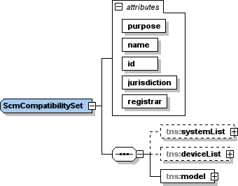
ScmCompatibilitySet
Single point of entry to the model
Identifies a purpose
  Authorization
  Constraint
  Consumption
This is the data structure exchanged between parties
  Requires authority (jurisdiction & registrar) plus tracking attributes (id)
A hierarchical set of abstract radio device elements
  ScmTransmitter
  ScmReceiver
  ScmTransceiver
Radio devices may be organized or grouped for convenience into one or more abstract ScmSystem

Slide 14
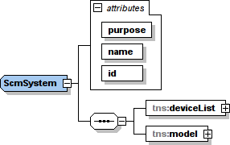
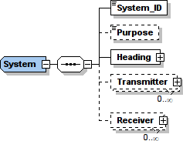
ScmSystem
User-defined grouping of modeled radio devices
Identifies a purpose
  Authorization
  Constraint
  Consumption
This data structure describes a network or system
  Requires a user-provided name and system-generated id for
Contains a single (general) SpectrumConsumptionModel configuration
ScmSytem SCM is further specified by modeled radio devices within the deviceList element
  Each radio device has its own SCM instance providing device-specific configuration
Notes:
Reorganized local fields as attributes
Added a user-defined “name” attribute

Slide 15
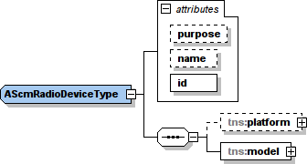


AScmRadioDeviceType
An abstract data element describing a generic radio device.
Not implemented directly
Defines a minimum contract that any real-world implementation must meet.
Extended by three radio device type implementations:
  ScmTransmitter
  ScmReceiver
  ScmTransceiver
Each implemented type may be used wherever an AScmRadioDeviceType is required, according to the modeler requirements
Notes:
Consolidated identical type definitions into a single abstract type
Added a Platform reference
Added a Transciever type – only benefit is terseness – the TX and RX configurations may be combined into a single record

Slide 16
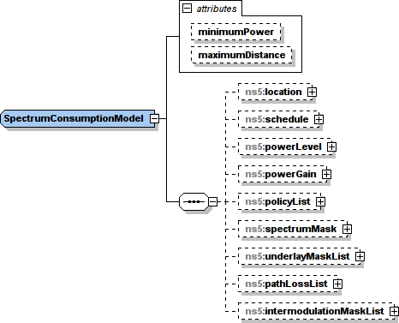
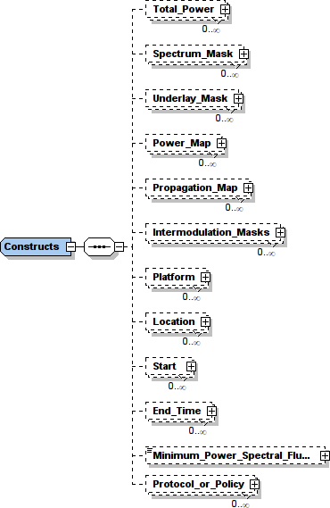
SpectrumConsumptionModel
A flexible container to efficiently communicate a spectrum occupancy, authorization or use request.
Can provide variable amounts of detail or abstraction from actual operating parameters, depending upon the modeller’s requirements
Notes:
No major changes, just renamed and reorganized

Slide 17
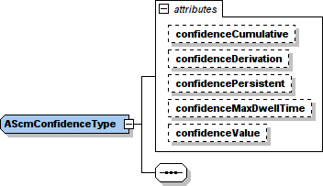
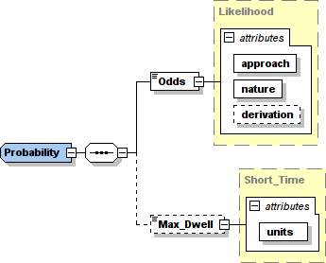
AScmConfidenceType
Abstract data type with a statistical probability.
SCM statistical probabilities are modeled as a set of attributes within an abstract AScmConfidenceType.
Extended by
  ScmPlatform
  ScmLocation
  ScmSchedule
  ScmPowerLevel
  ScmPowerGain
  ScmSpectrumMask
  ScmUnderlayMask
  AscmPathlossType
  ScmIntermodulationMask
Notes:
Consolidates the concepts and capabilities of the Probability and Likelihood data types into a single set of inherited attributes
This is muct easier to configure, manage and handle confidence type values in software

Slide 18
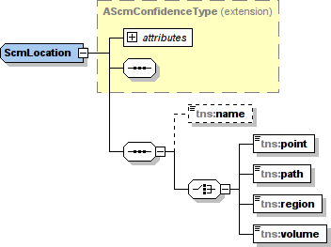
ScmLocation
Conveys where the components of a modeled system may be used.
Specified as one of four types:
  Point
  Path
  Area
  Volume
When a non-point is used the location indicates a position uncertainty of a device or possibly that the device is mobile.
An AScmRadioDevice instance may be positioned anywhere within specified location (e.g. along the path, within the area or volume.)
Notes:
A consolidated, simplified but much more flexible location data type.
Consolidates 14 different location sub-types into 4 geometry definitions
This new structure is easy to implement, manage and process in software
No major impact to message size and complexity
Question: Are Areas and Volumes restricted to convex shapes? If not, it increases computational complexity.
Answer: There are no limits to area and volume geometries. The additional complexity is mediated by well-established geometric calculation strategies and existing libraries. This change increases user flexibility and does not require inventing new software or algorithm technology.
Question: TIN and Grid Surfaces are generally non-convex and would require optimizing over each face of the surface.
Answer: TIN and Grid surfaces are intended to convey ground topology information in the absence of an external digital elevation model.
Generally, the idea is to favor flexibility for the model creator over constraints imposed by a model consumer.
For example, if a model creator wishes to provide a highly detailed model then the consumer can either: simplify the model for speed and receive a more conservative spectrum picture or take additional time to process the model for maximum availability.

Slide 19
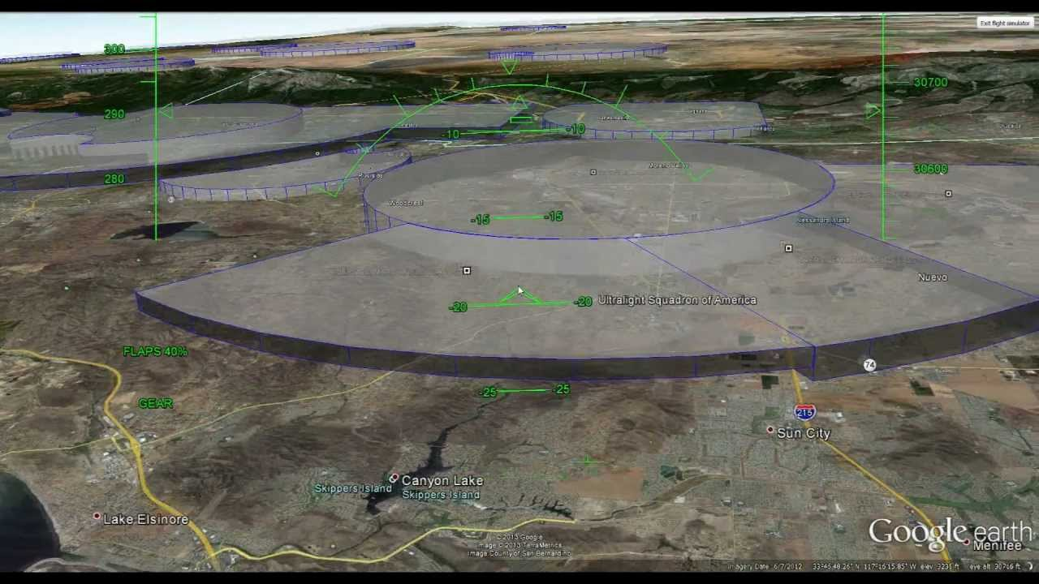
Example ScmLocation : volume

Slide 20
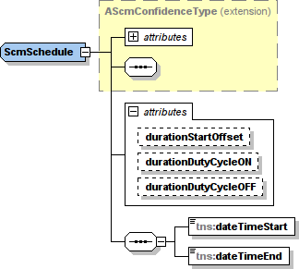
ScmSchedule
Extends the AScmConfidence data type
Describes a DateTime period with optional duty cycle attributes
All DateTime values are recorded in Coordinated Universal Time (the UTC timezone)

Slide 21
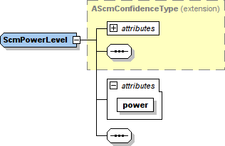
ScmPowerLevel
Contains a reference total power value for a model.
The only data element within a model that has a power reference.
Power values in other model components are relative to this value.

Slide 22
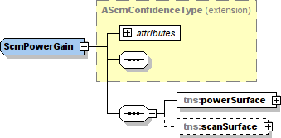
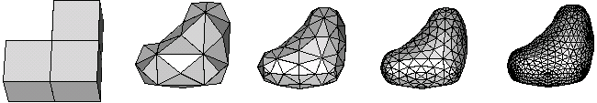
ScmPowerGain
Models the 3-dimensional gain of a directional antenna
Describes the dispersion of electromagnetic energy transmitted from an antenna or the concentration of electromagnetic energy received by an antenna.
Specifies power flux density value by direction that is relative to a ScmPowerLevel
Modeled as a surface in 3-dimensions, centered upon the modeled transmitter or receiver, facing polar north.
The surface must be translated to point in the correct direction.

Slide 23
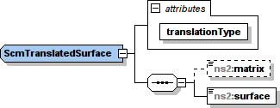
ScmTranslatedSurface
Uses a ScmTranslationMatrix to do one of four things:
  REFLECTION,
  ROTATION,
  SCALE, or
  TRANSLAON.
Can define a point towards which the vertical axis of a ScmPowerGain surface points as it moves

Slide 24
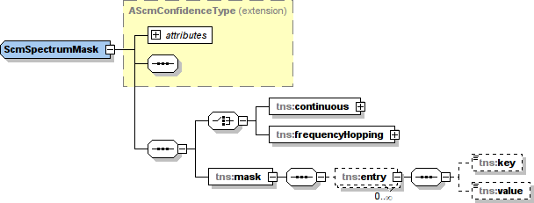
ScmSpectrumMask
Specifies a power-density spectrum (the power per unit bandwidth as a function of frequency) relative to the ScmPowerLevel element
Is a piecewise linear graph
Has an optional time component
Two types, continuous and frequency hopping
The relative power value for frequencies outside the mask is considered to be less than or equal to those at the closest end of the mask

Slide 25
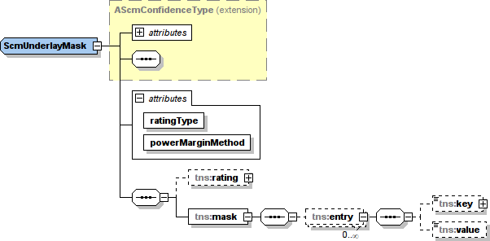
ScmUnderlayMask
Defines tolerable interference
Specifies the power spectral density that a receiver can tolerate from a remote interfering transmitter
Is a piecewise linear graph
Models may use multiple underlay masks
Its main role is to identify the spectral and small scale temporal limits to interference

Slide 26
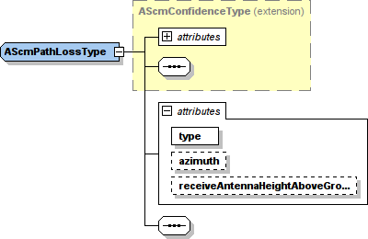
AScmPathLossType
A generic data type to describe the rate of attenuation of a signal by distance
It is extended in three types:
  ScmPathLossLinear
  ScmPathLossPiecewiseLinear
  ScmPathLossInterpolate

Slide 27
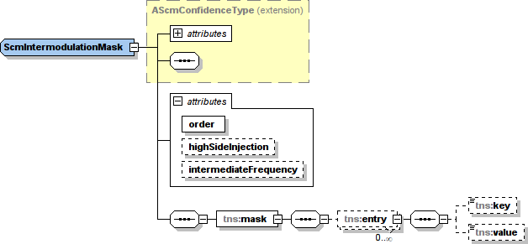
ScmIntermodulationMask
Conveys the susceptibility of AScmRadioDevice models to generate intermodulation (IM) products from externally received signals
Only needed when the modeled radio device is known to generate or be susceptible to harmful IM products

Slide 28
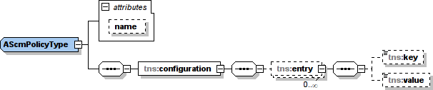
AScmPolicyType
An abstract data element that determines how a system will use spectrum
AScmPolicyType is extended by two implementations:
  ScmPolicyRule
  ScmPolicyProtocol
Provides a means to specify how spectrum sensing may be used to inform spectrum use decisions
It provides a means to exploit reuse opportunities that come from knowing the specific behaviors of incumbents

