Slide 1
Spectrum Consumption Modeling: Algorithms for Assessing Compatibility
Sam Schmitz
Doc #: 5-14-0052-02-subs

Slide 2
Purpose
This document discusses the computations necessary to determine compatibility between Spectrum Consumption Models, as described by John Stine’s draft proposal (DCN 5-13-0043-02-drft)

Slide 3
General Considerations
In order to make Spectrum Consumption Modeling effective, the algorithms used to determine compatibility must have the following properties:
  Protective
    SCMs are intended to protect users, not to predict usage. To the extent simplifying assumptions must be made, err on the side of conservatism.
  Consistency
    Given the same inputs, the algorithm must always return the same result. Algorithms that use randomness to stochastically arrive at a result cannot guarantee this property.
  Efficiency
    To provide full flexibility and range of usage, algorithms should be efficient enough to run on resource-constrained systems (i.e., could a radio compute its own compatibility if it had SCMs of itself and those systems around it?)

Slide 4
Importance
Spectrum Consumption Models (SCMs) define a system’s usage of radio spectrum and tolerance to interference from other models.
Compatibility algorithms are based on this definition.
If we change the constructs used to model spectrum, we must adjust the means of determining compatibility accordingly. Is it still possible to efficiently make this computation?

Slide 5

The SCM Link Budget Equation
For a fixed Tx and Rx pair:
$${TP}_{Tx} +{AG}_{Tx}+ PL\left(d\right) + {AG}_{Rx} + { PM}_{Masks} ≤ {TP}_{Rx}$$
More detail in Support Materials
Transmitter Total Power
+
Transmitter Antenna Gain
+
Pathloss Over Distance
+
Receiver Antenna Gain
+
Power Margin Between Masks
≤
Receiver Total Power
Construct:
Total Power
Power Map
Propagation Map
Power Map
Spectrum Mask & Underlay Mask
Total Power

Slide 6
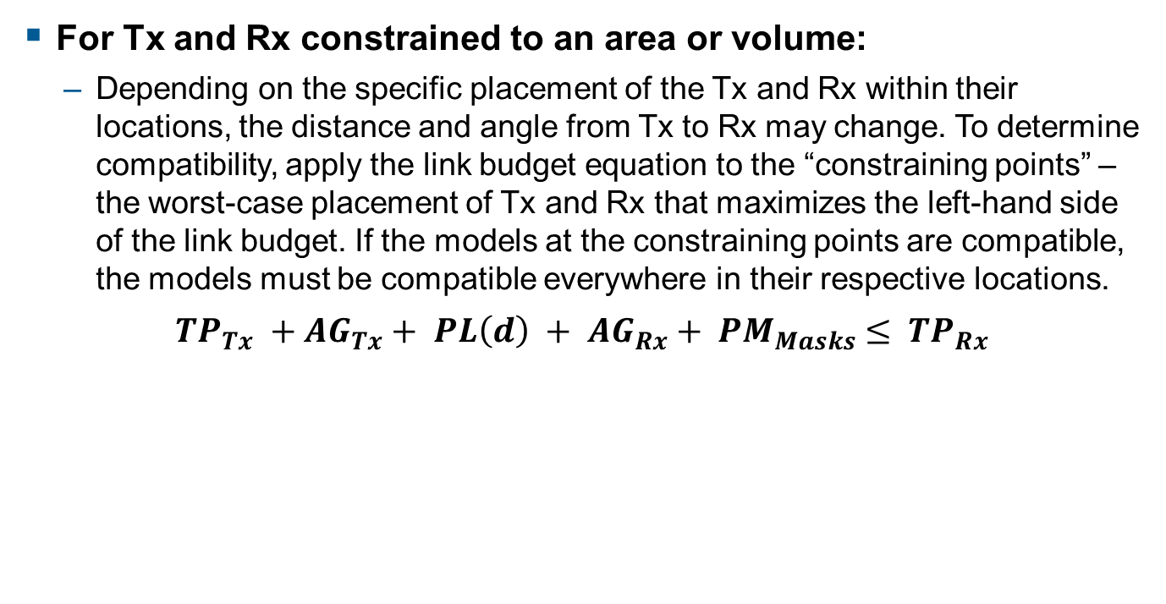
The SCM Link Budget Equation
For Tx and Rx constrained to an area or volume:
  Depending on the specific placement of the Tx and Rx within their locations, the distance and angle from Tx to Rx may change. To determine compatibility, apply the link budget equation to the “constraining points” – the worst-case placement of Tx and Rx that maximizes the left-hand side of the link budget. If the models at the constraining points are compatible, the models must be compatible everywhere in their respective locations.
$${TP}_{Tx} +{AG}_{Tx}+ PL\left(d\right) + {AG}_{Rx} + { PM}_{Masks} ≤ {TP}_{Rx}$$
Transmitter Total Power
+
Transmitter Antenna Gain
+
Pathloss Over Distance
+
Receiver Antenna Gain
+
Power Margin Between Masks
≤
Receiver Total Power
Construct:
Total Power
Power Map
Propagation Map
Power Map
Spectrum Mask & Underlay Mask
Total Power
Only these three terms will change depending on the specific placement of the Tx and Rx. All other terms can be obtained independently.

Slide 7
Power Maps
Recall how a Power Map stores data:
  Values are stored between fixed angle breakpoints
  Between a lower and upper angle of elevation, you can specify any number of azimuthal breakpoints. Between adjacent azimuth breakpoints, a different value is stored.
  Data structure consists of a list of angular breakpoints and the power gains assigned to each sector
Visualization of how Power Map gains are assigned to certain directions.

Slide 8
Propagation Maps
Recall how a Propagation Map stores data:
  Data is stored in a similar structure, assigning propagation models to angular “sectors” bounded by fixed angular breakpoints (both by angle of elevation and azimuth)
  The data being stored in the structure is now either a single pathloss exponent (for a log-linear distance pathloss model), or two exponents and a distance breakpoint (for a piecewise log-linear distance pathloss model)

Slide 9
SCM Properties
Power Map power gains and Propagation Map propagation models only change at fixed angle breakpoints. For all angles between these breakpoints, these parameters are constant.
For a given propagation model, signal strength is strictly decreasing over distance.
Therefore, as long as we are only considering Tx and Rx positions that use the same Map values, closer points are always the most constraining.
An additional feature of SCMs: all location types are convex

Slide 10
Algorithm Strategy
Divide and Conquer:
  Split the problem into a number of subproblems for all possible combination of Map sectors:
    For each subproblem, minimize the distance from Tx to Rx such that:
      The Tx position is bounded by its location construct
      The Rx position is bounded by its location construct
      The angle from the Tx to the Rx is restricted so that only 1 sector of each Map applies
    The solution to this subproblem is called a “candidate solution”
  Apply the link budget equation to each candidate solution. The most restrictive candidate solution represents the constraining points.

Slide 11

Subproblem Nonlinear Programming Formulation
Convex Objective Function
$Minimize {\left(x_{R}−x_{T}\right)}^{2}+{\left(y_{R}−y_{T}\right)}^{2}+{\left(z_{R}−z_{T}\right)}^{2}$
$$subject to:$$
$$\left[\begin{matrix}x_{T} \\ y_{T} \\ z_{T}\end{matrix}\right]∈T$$
$$\left[\begin{matrix}x_{R} \\ y_{R} \\ z_{R}\end{matrix}\right]∈R$$
$$θ_{1}≤\tan^{−1}\left(\frac{y_{R}−y_{T}}{x_{R}−x_{T}}\right)≤θ_{2}$$
$$φ_{1}≤ \cos^{−1}\left(\frac{z_{R}−z_{T}}{\sqrt{{\left(x_{R}−x_{T}\right)}^{2}+{\left(y_{R}−y_{T}\right)}^{2}+{\left(z_{R}−z_{T}\right)}^{2}}}\right)≤ φ_{2}$$
Convex Constraints (because all locations are convex)
Possible to linearize
In general, non-convex

Slide 12
Algorithm Efficiency
Each Nonlinear Program (NLP) is small:
  Only 6 decision variables (or fewer, if one location is a point, or a surface with a fixed z variable)
  Only a handful of constraints:
    4 angular constraints (2 linear + 2 nonlinear)
    Location constraints vary by location construct type:
      Circle → 1 nonlinear constraint
      Cylinder → 1 nonlinear constraint + 2 linear constraints
      Polygon (n sides) → n linear constraints
      Polyhedron (n-sided base) → (n + 2) linear constraints

Slide 13
Algorithm Efficiency
The number of subproblems is small
  While each Map may have an arbitrary number of sectors, in general they typically will only have a few, and will often be isotropic
  While the number of sector combinations is the product of the number of sectors for each Map, in practice many combinations of sectors will be mutually exclusive. In general, the number of subproblems should scale linearly with the complexity of the most detailed Map.
  Certain subproblems may be eliminated as infeasible without attempting to solve the NLP (e.g. the angles allowed by the constraints point away from the Rx location)
  The closest points between two locations can be computed without solving an NLP, and can be used as a lower bound on the constraining points to reduce the number of NLP subproblems that need to be explicitly solved

Slide 14
Impact of Proposed Revisions
This next section will look at some of the Jesse Caulfield’s proposed revisions and discuss the impact these new constructs will have on algorithms to compute compatibility.
Some of the revisions appear to have the potential to make compatibility computations much more expensive.

Slide 15
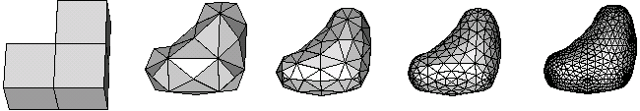
PowerMap / ScmPowerGain
A ScmPowerGain construct was proposed as a replacement for a Power Map to model directional gains (as from a directional antenna)
For a given direction from Tx to Rx, the gain provided by this construct is obtained by finding where a ray extending from the origin along the desired heading intersects the surface of this polyhedron. The distance between this intersection point and the origin is the power gain.

Slide 16
PowerMap / ScmPowerGain
If the heading from Tx to Rx is known and fixed, this calculation is not very expensive.
If we are trying to optimize for the constraining point, however, the gain – instead of being a fixed value over discrete regions – is now a function of the Tx and Rx positional decision variables. This function would have to be added to the new objective function of a potential NLP.
The parameters of this function change depending on which face of the polygon applies. It may, therefore, be necessary to apply a similar “divide & conquer” approach for each face of the polygon.

Slide 17
PropagationMap / ScmPathLossType
A ScmPathLossType was proposed as a replacement for a Propagation Map to model attenuation models by direction.
This assigns different models to different azimuths.
Note that this does not allow different models by angle of elevation. While this change would simplify computation, it is less flexible.
This type allows 3 different types of attenuation models:
  Linear
  Piecewise Linear
  Interpolated
Note that the first 2 types are the same types of models allowed in the Propagation Map construct

Slide 18
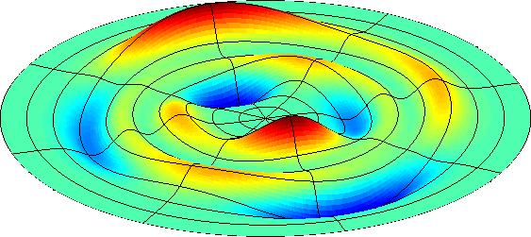
Interpolated Pathloss Model
The 3rd type of model, interpolated, is new
  Pathloss is computed by interpolating over a dataset of distances and losses for each azimuth
  Even if this model is only used for a stationary Tx, it could make constraining point calculations expensive, particularly for an Rx bounded by a volume with a non-isotropic antenna gain. Because power is not required to be strictly non-decreasing, there could be multiple local optima in the solution space.

Slide 19


Locations
The proposed revisions specify altitudes as “above ground level” instead of “above sea level.” Because SCMs must operate without access to a terrain database, it is not possible to determine the relative difference in altitude between two points (unless they happen to have the same latitude and longitude). Relative altitude differences are necessary to determine the appropriate antenna gain (and propagation model, if the original Propagation Map construct is used).
Not all locations specified in the proposed revision are convex, which makes it harder to find constraining points
Other than the altitude issue, the following ScmLocation types closely parallel their original counterparts:
  Point → Point
  Path → Track

Slide 20

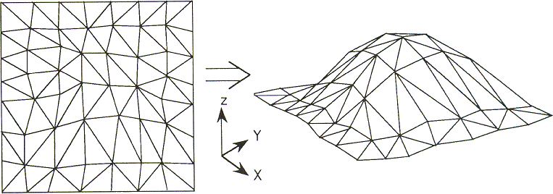
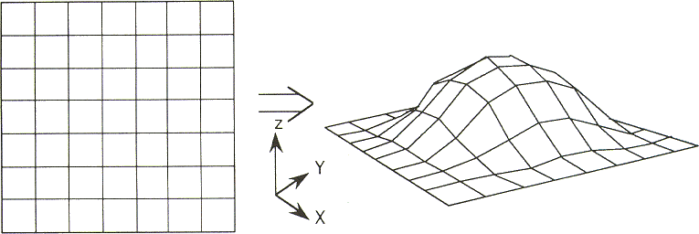
Locations
Other revised locations:
  Polygon
    Similar to a Polygon from before, but is not guaranteed to be convex, and may even have holes.
  Triangular Irregular Network
    Non-convex; would either have to solve for constraining points over each face individually, or separate into convex sections to optimize over separately.
  Gridded Surface
    Non-convex; similar as above.

Slide 21
End

Slide 22
Support Materials

Slide 23
Mask Power Margin

Slide 24
Mask Interaction
Maximum power density method (graphical)
Total power method
  Underlay masks defines a filter
  which operates on the spectrum
  masks to determine the total
  energy that enters a receiver
  Compatible if below a threshold
This spectrum mask violates the boundary of the underlay mask
Compatible
transmission

Slide 25
Underlay Mask – Continued - 3
Total power method of computing power margin uses the underlay mask as an inverted filter that reduces the amount of the interfering signal’s energy that interferes
Energy beneath the underlay mask is subtracted from the energy under the spectrum mask

Slide 26
Determining Power Margin Using the
Total Power Method
Computing the power margin using total power method has four steps
  Determine the allowed interference the underlay permits
  Adjust the shape of the interfering spectrum mask based on the shape of the receiver underlay mask
  Compute the total power in the reshaped spectrum mask
  Find the difference between the total power of the reshaped spectrum mask and the allowed interference specified by the underlay mask

Slide 27
Step 1 Total Power Method
Determine the allowed interference the underlay permits
Defined as the power beneath the lower 3 dB bandwidth

Slide 28
Step 2 – Total Power Method
Adjust the shape of the interfering spectrum mask based on the shape of the receiver underlay mask
Reshaped mask
Underlay mask
Spectrum mask
Mask extends the full bandwidth of the underlay

Slide 29
Step 3 – Total Power Methods
Compute the total power in the reshaped spectrum mask
Given two consecutive inflection points,
and , , the equation for the line is
where and . . The total power under the segment is determined in the linear scale and so within the segment between and ,
is . For segments where
and , ,
where and , ,
and where , .

Slide 30
Step 4 – Total Power Method
Find the difference between the total power of the reshaped spectrum mask and the allowed interference specified by the underlay mask
PM_{Mask}
=
-

Slide 31
Determining Power Margin Using the Maximum Power Spectral Density Method
Criteria for compatibility with underlay mask using the maximum power density method of power margin computation
This spectrum mask violates the boundary of the underlay mask
Compatible
transmission
Maximum power spectral density method of computing power margin
  Determine the adjustment of the spectrum mask to ensure its power levels are beneath the underlay mask

